Slide 1
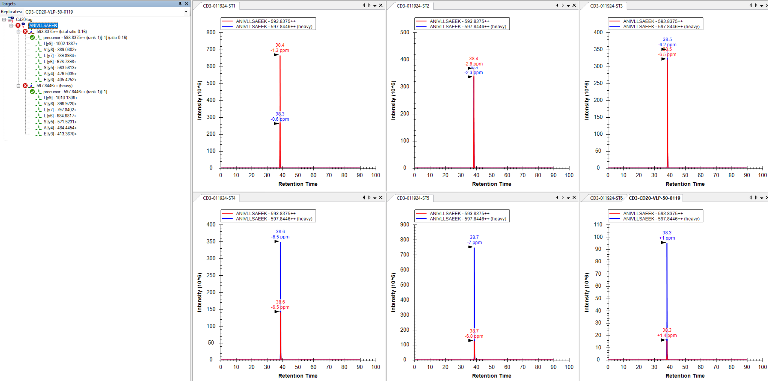
What are the red X mean? How can fix it?

