Slide 1
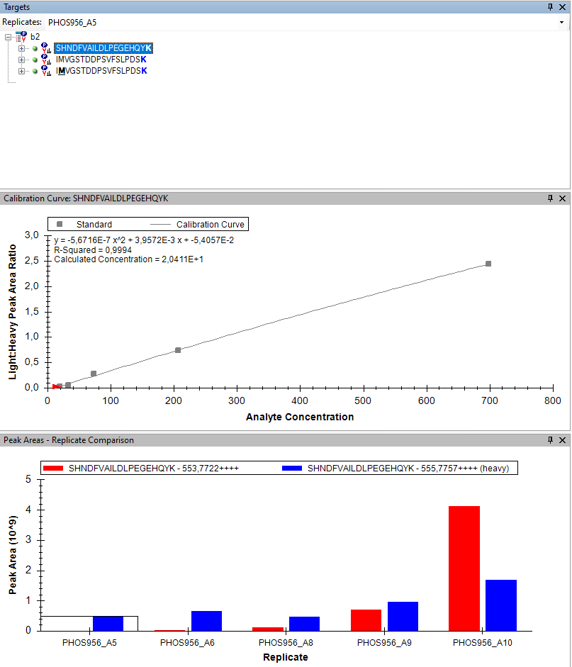
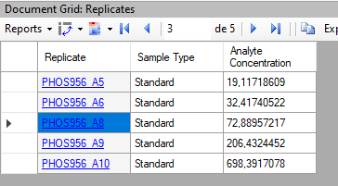
I tried to quantify b2 protein. I have two peptides. One without oxydation and another one with oxydation.
Replicates PHOS956_A5 to A10 are the standard.

Slide 2
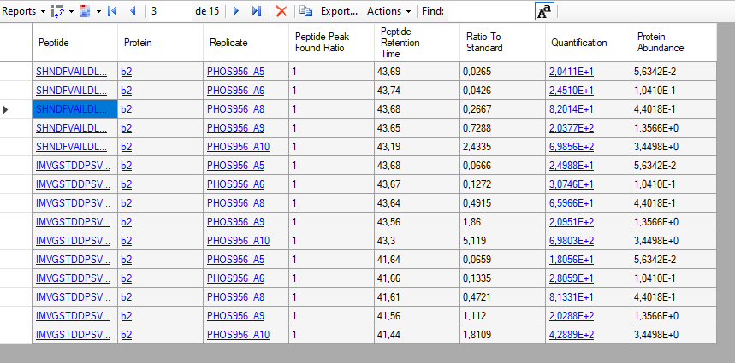
For replicate PHOS956_A10 I have a quantification of ~ 698E2 fmol when I use Quantification and 3,44E0 when I use Protein abundance.

