Slide 1
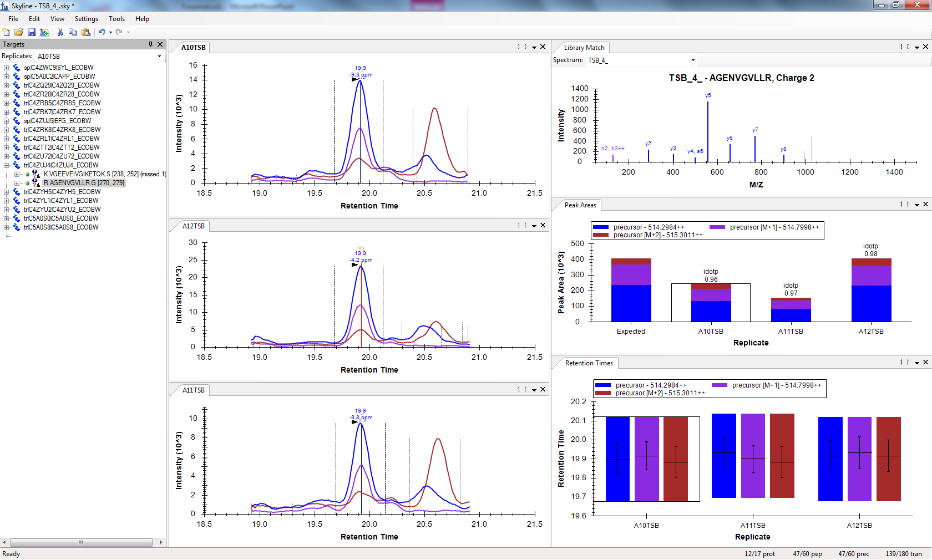
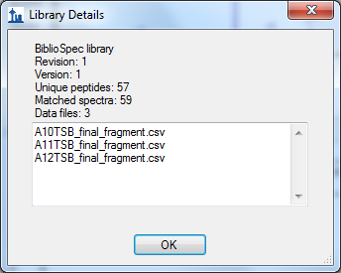
Now I have the ID
(okay somewhere behind the error and RT)
but he still shows final_fragment.csv
Does this matter?

