Slide 1
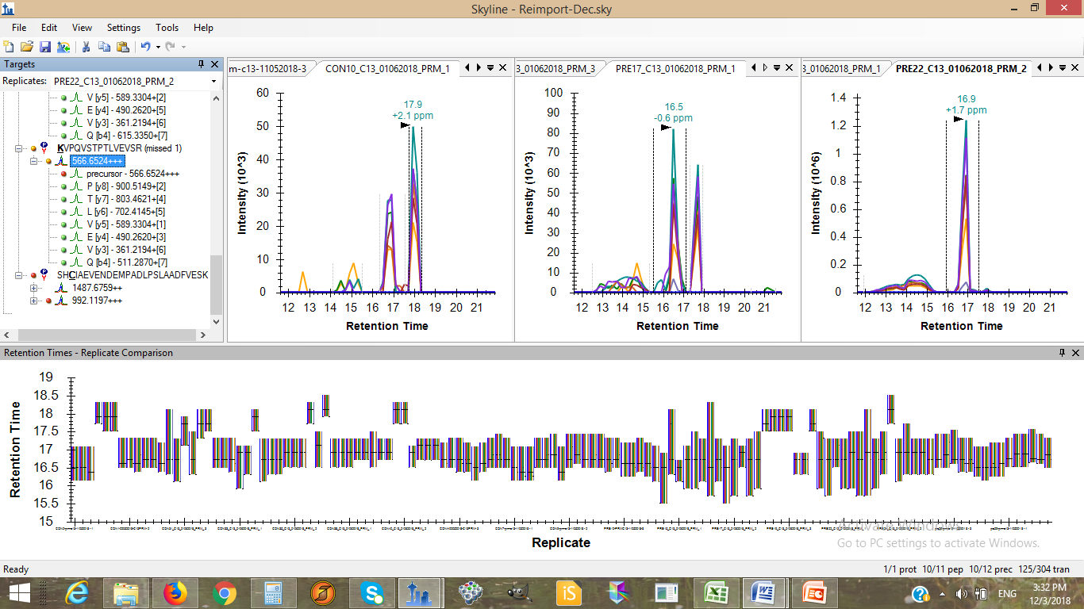
There are two peaks for one peptide and the intensity both peak is similar

Slide 2
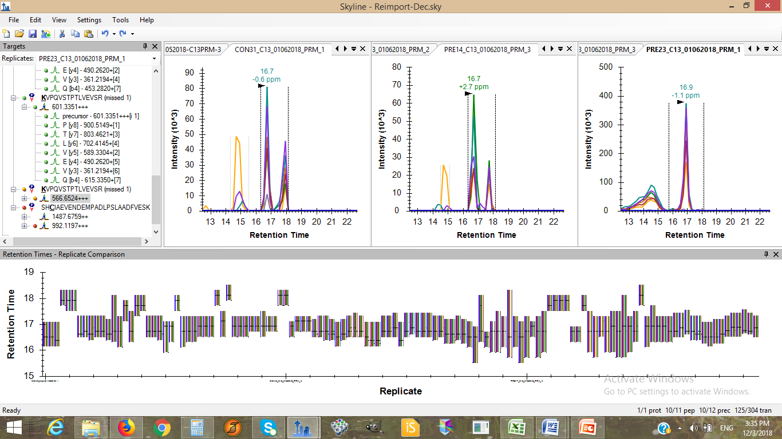
Here also the same case
There are two peaks for one peptide and the intensity both peak is similar

Slide 3
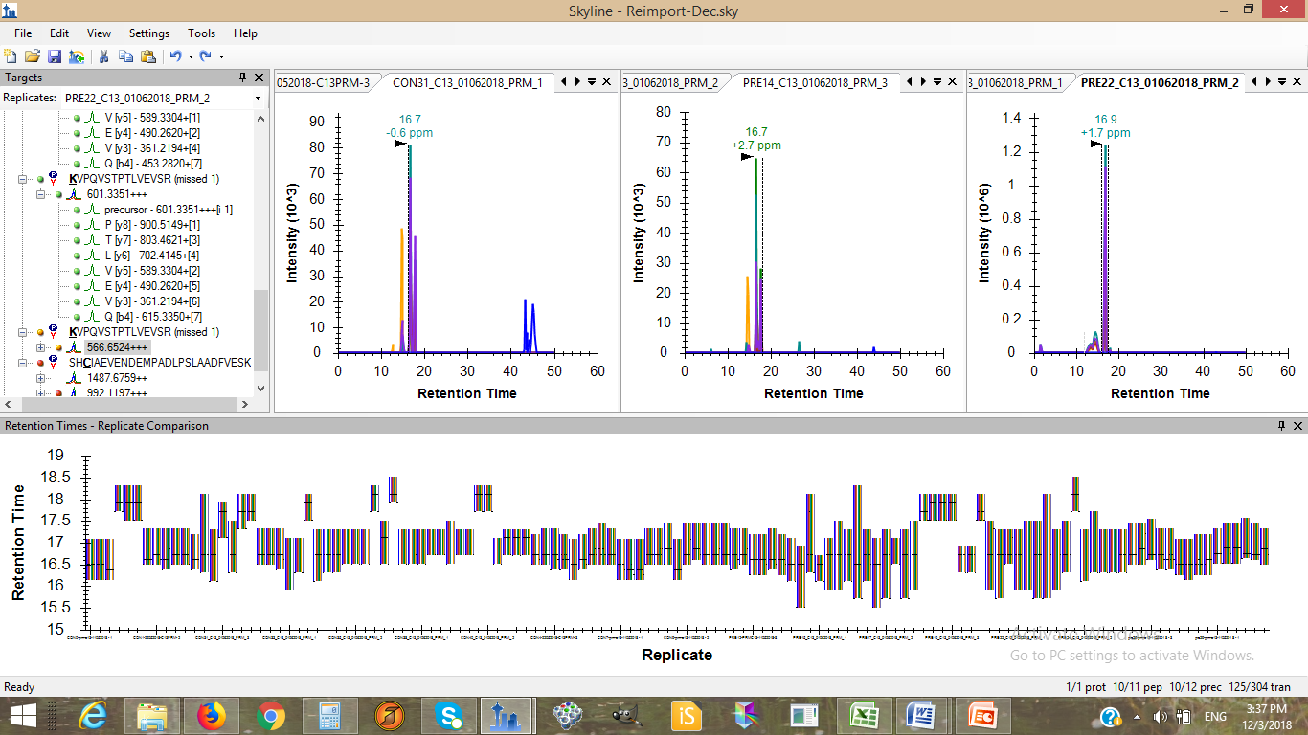
This is unzoomed spectra for the previous one

Slide 4
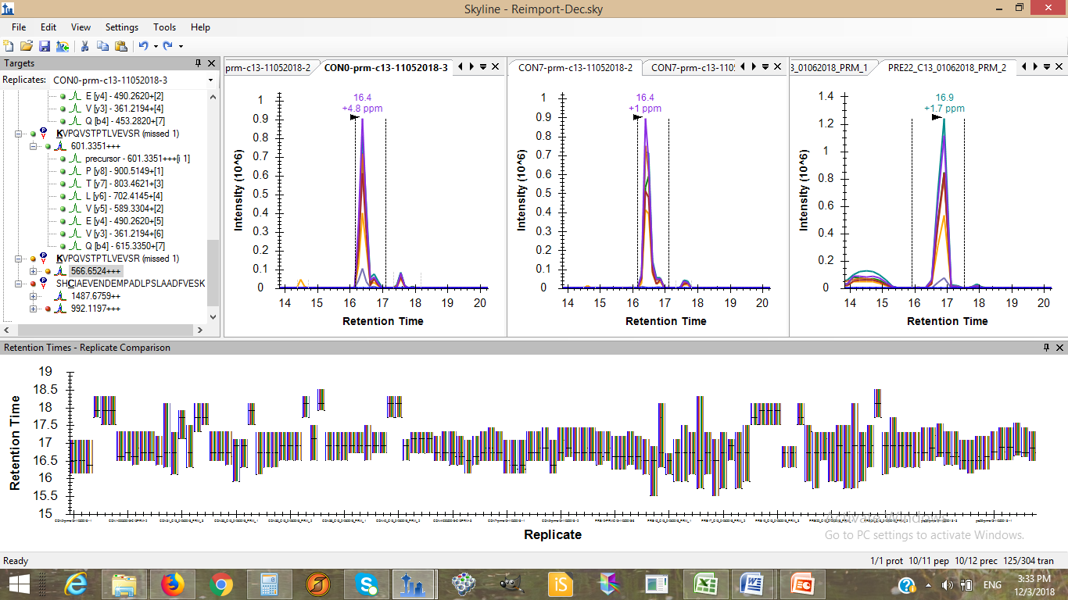
Here also there are two peaks but the intensity of another peak is very less

