Slide 1
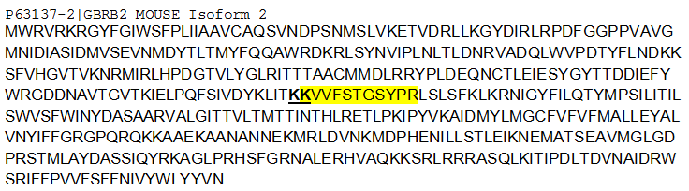
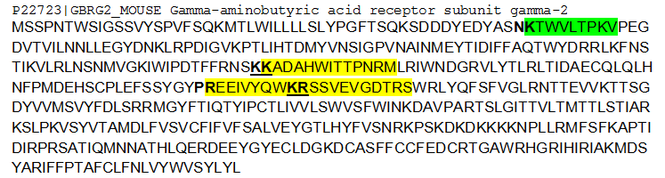
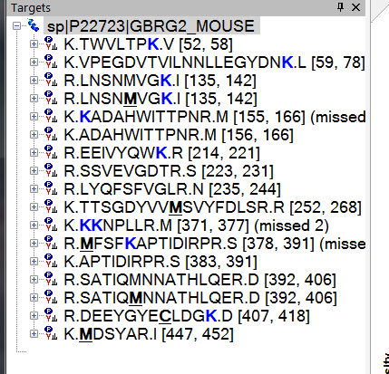
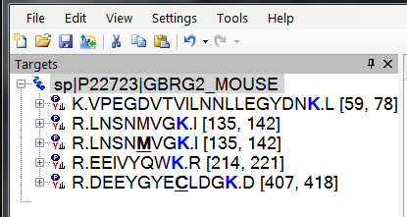
Q1) Ragged ends question
Q1B)What if you just wanted to remove peptides that had failed to cleave after the last K For example: removing peptide 1 below while leaving peptide 2, where the correct cleavage had occurred (maybe this is tricky to do with directionality issues).
1. K.KVVFSTGSYPR.L (missed 1)
2. K.VVFSTGSYPR.L
Q3) Before filter Ending in R
After Filter: Ending in R
Why did the K.TWVLTPK.V peptide disappear?

