Slide 1
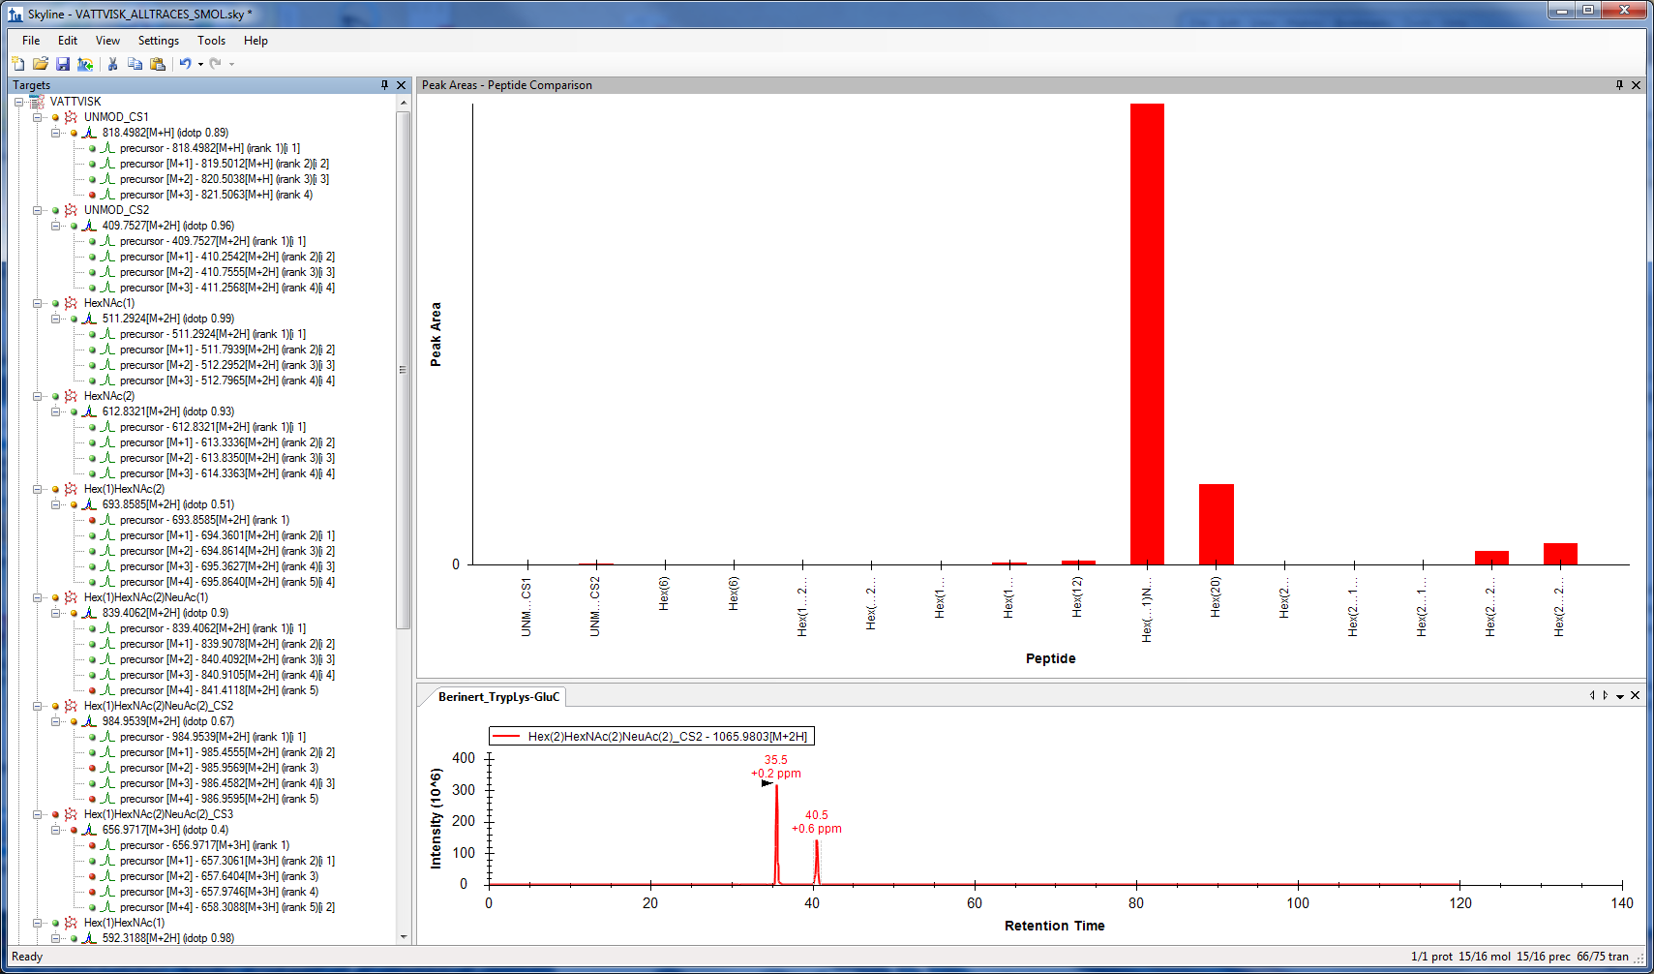
AXIS
For some reason names of the targets are not fully displayed in the graph and
shortened without any clear rules. Is it possible to display them fully ?
Of cause it could be corrected in Excell or PowerPoint but still would be nice to have
Proper naming of objects in X axis, corresponding with names put in Targets

