Slide 1
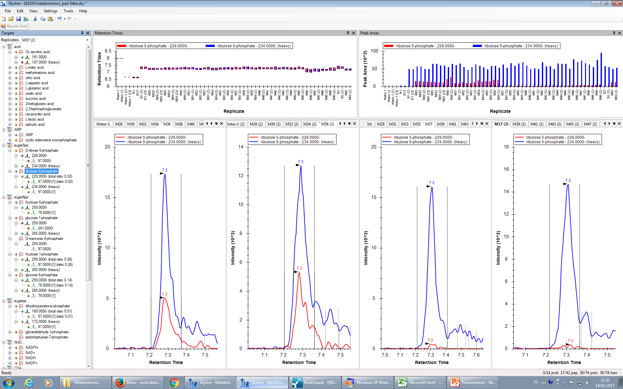
Skyline: ribulose 5-phosphate
RT: 7.3min light: m/z 229/97 heavy: m/z 234/97

Slide 2
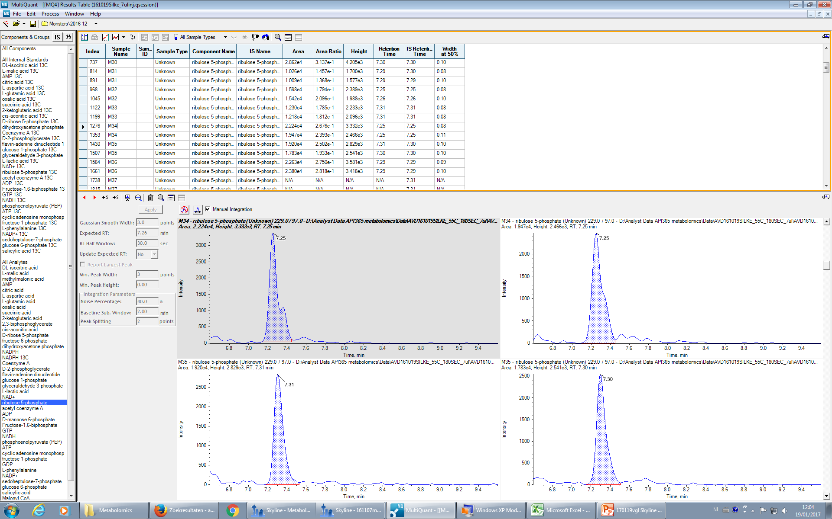
Multiquant: ribulose 5-phosphate
RT: 7.3min light: m/z 229/97 heavy: m/z 234/97

Slide 3
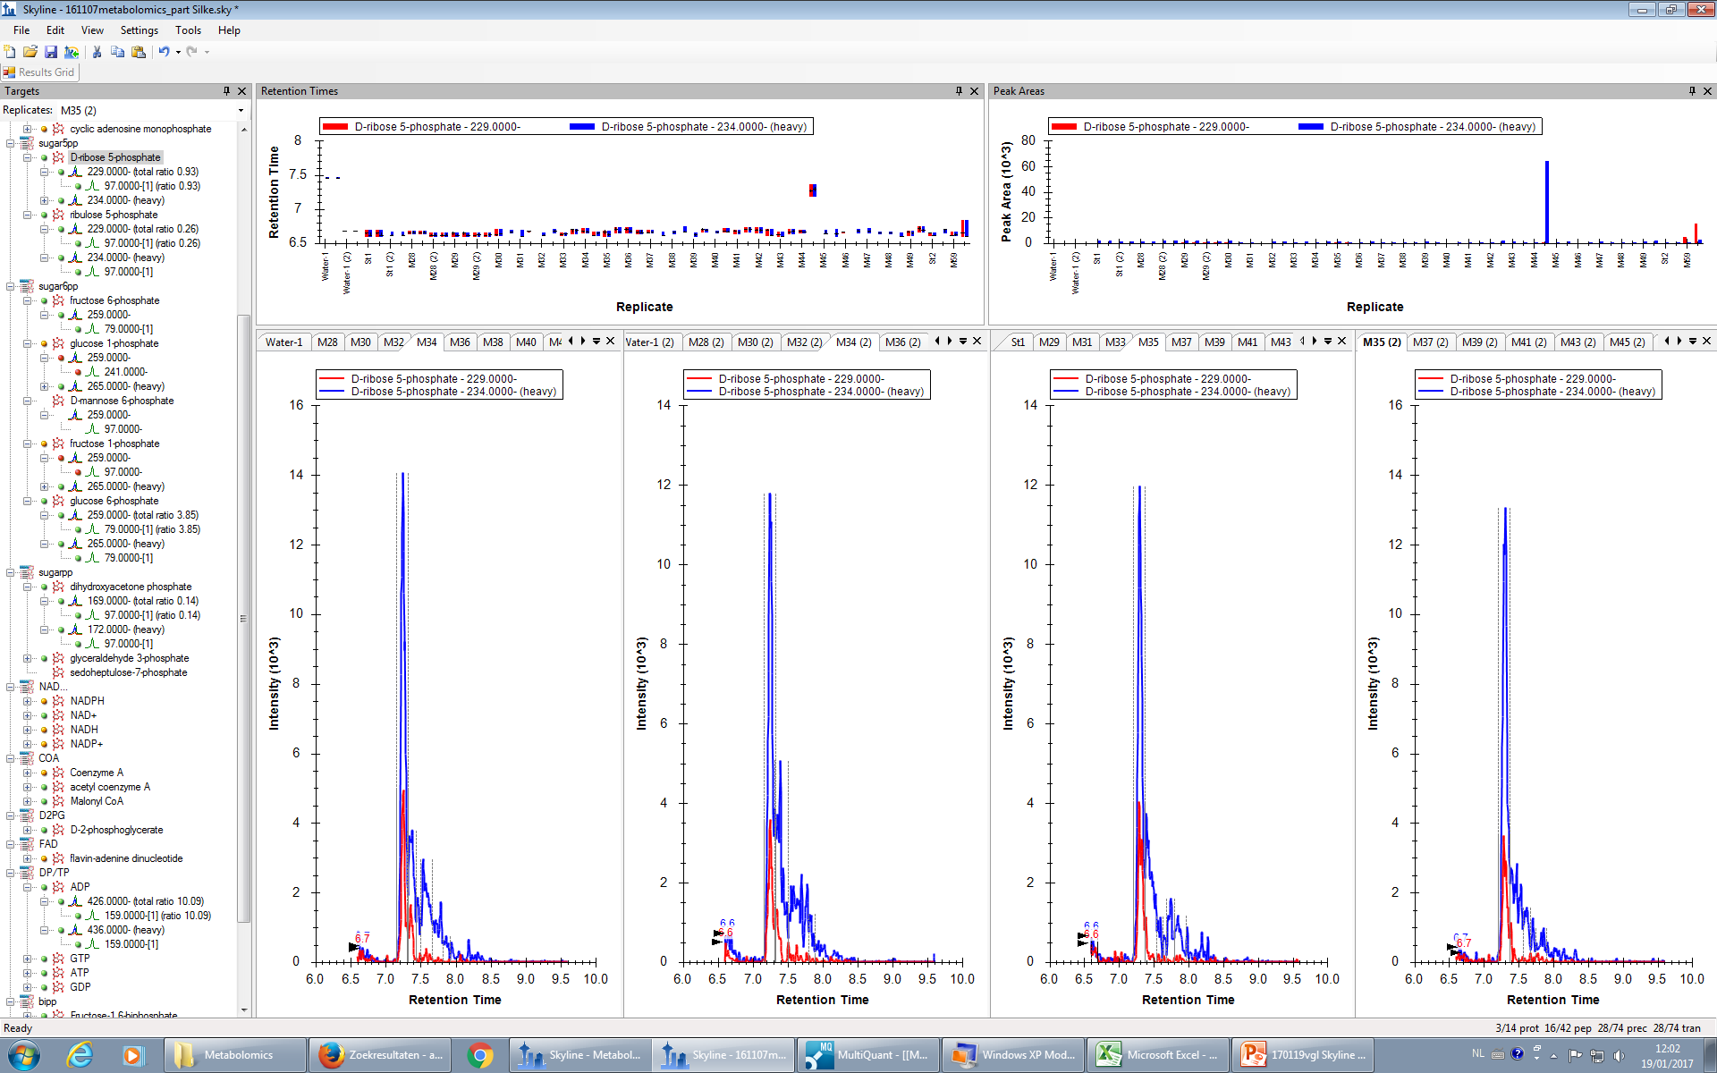
Skyline
D-ribose-5-phosphate
RT: 6.3min light: m/z 229/97 heavy: m/z 234/97

Slide 4
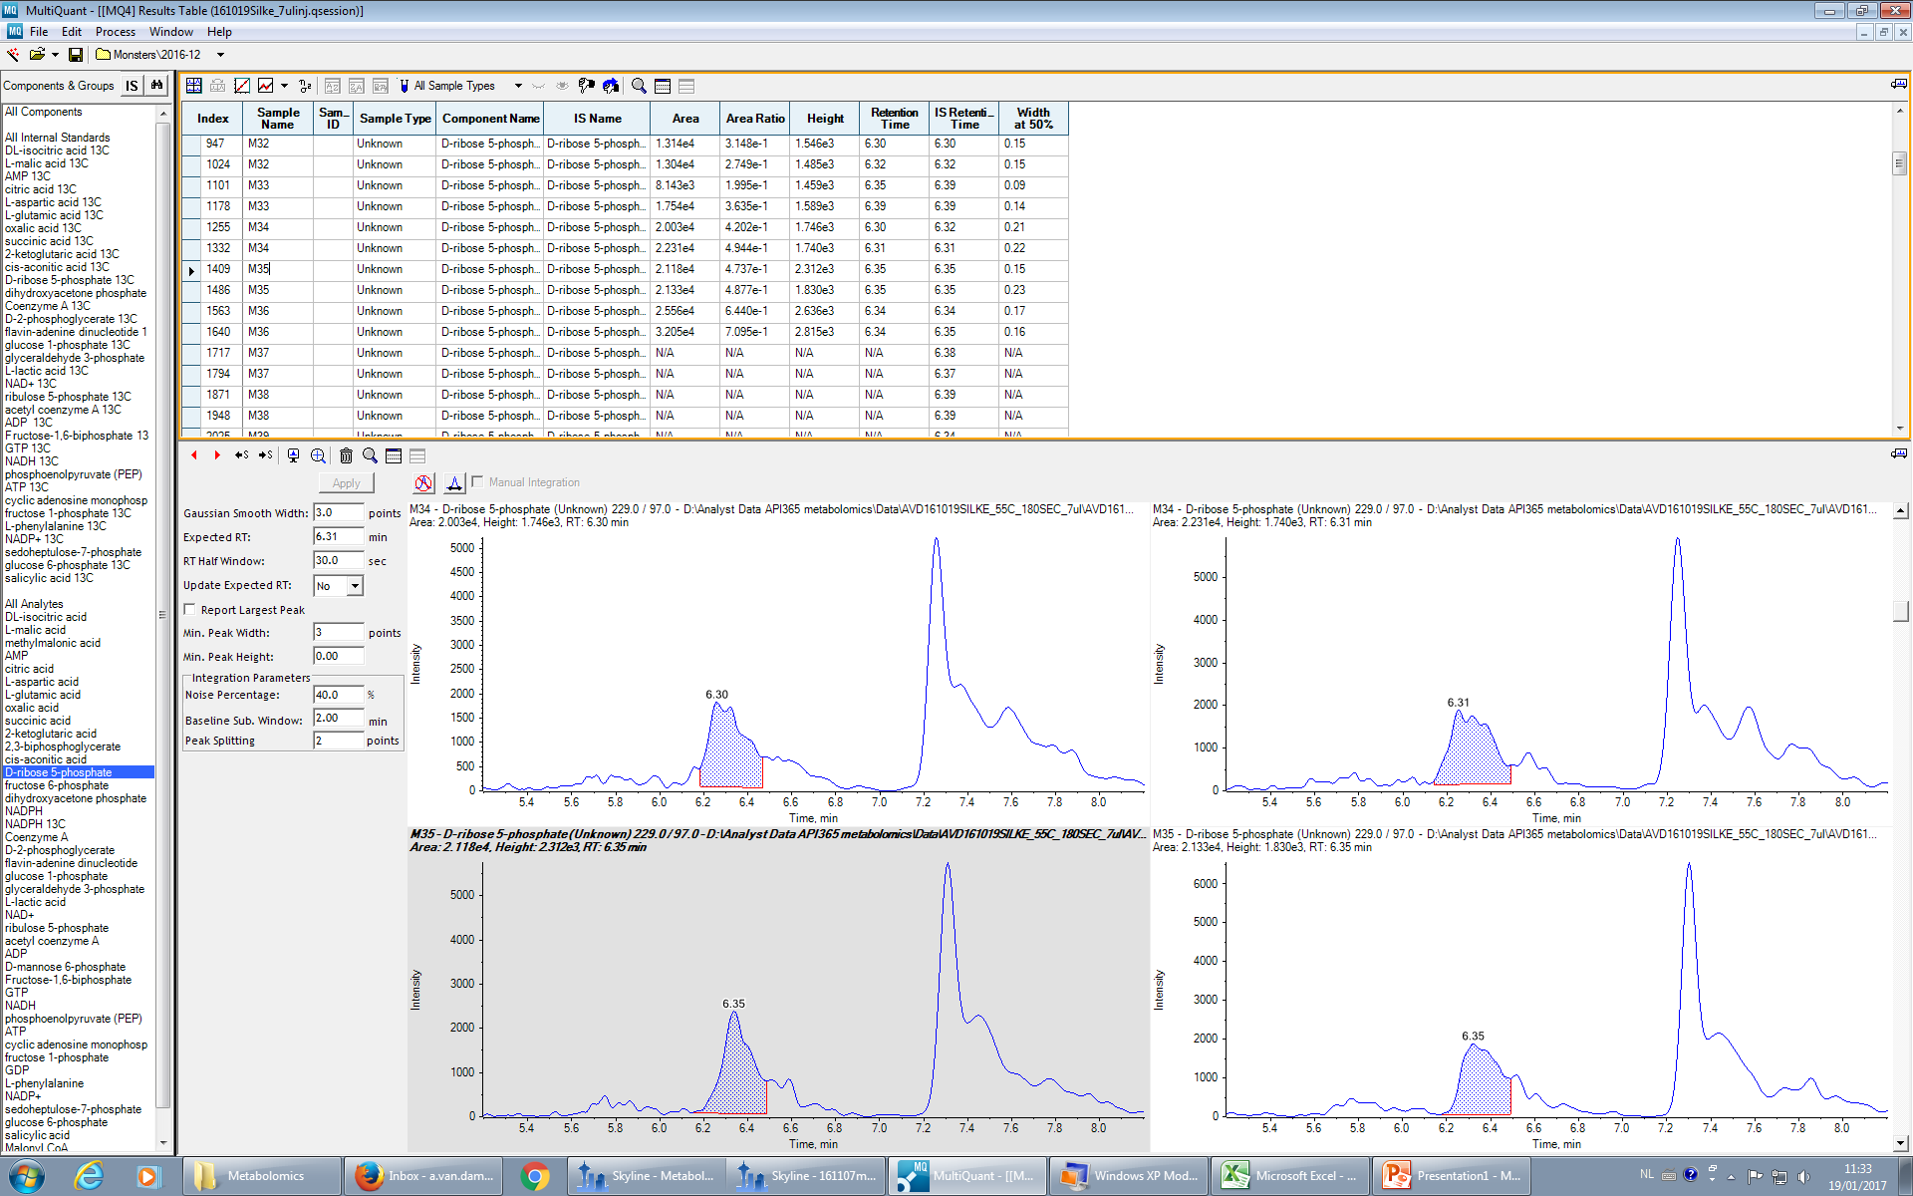
Multiquant:
D-ribose-5-phosphate
RT: 6.3min light: m/z 229/97 heavy: m/z 234/97

