Slide 1
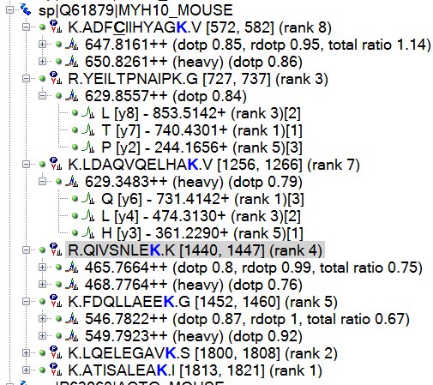
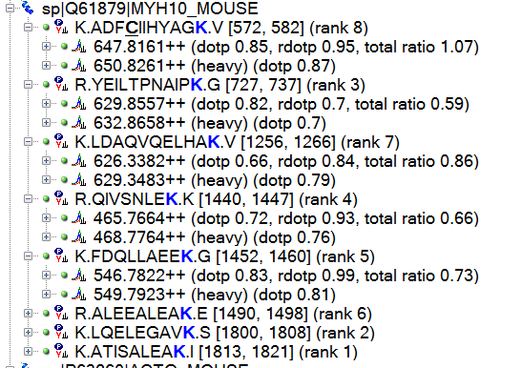
I have data with heavy isotope labeled brain tissue standard and am evaluating SRMS. In the end I want to reduce the SRMs to 3 peptides per protein and 3 transitions per peptide. So far I've used the Refine Results, filter based on target value 0.85 and min dotp of 0.7 (I know in an ideal world these values would be set higher ...).
1) is there a way to filter on rdotp ?
2)I noticed in many cases I lose either the heavy or light. Is there a way to remove peptides where the "complete" heavy & light pair is lost ?
3) I seem to have forgotten how to automatically reduce it to the top 3 ranked peptide also . ☹

Slide 2
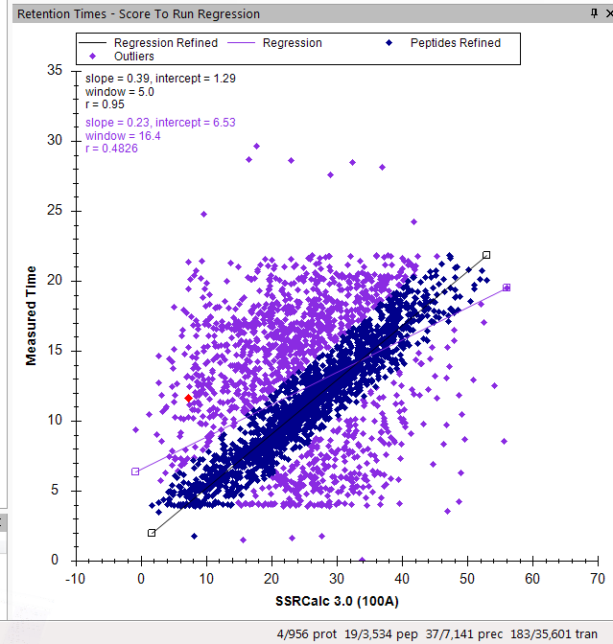
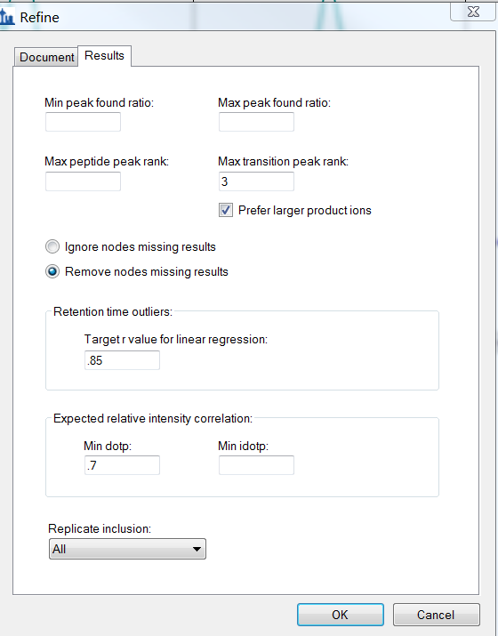
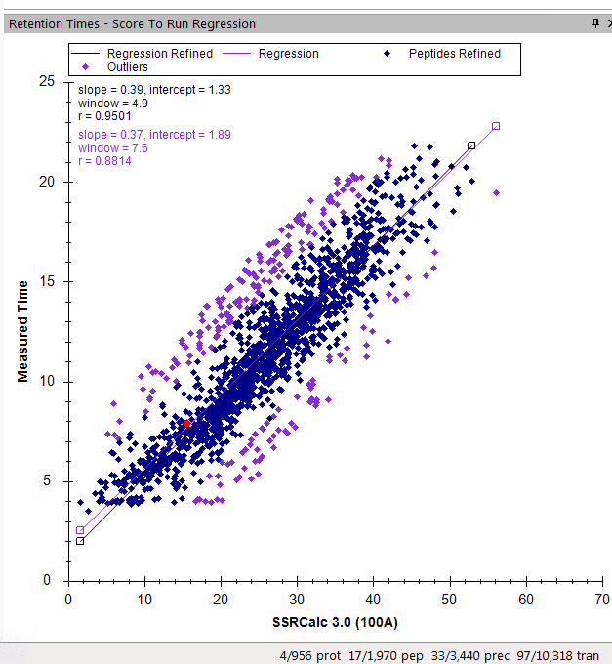
Before Refine
After Refine

