Slide 1
Issue 1: importing results inconsistencies
Summary: Identical raw files imported into skyline documents with identical parameter settings results in drastically different outcomes, described as 3 cases:
File imports, chromatograms viewable/clickable to see spectra, extracted values corresponding to confidently identified peptides (green dots)
Same as A, but precursor/product ion chromatograms not displayed correctly, unable to click to see spectra. Can select peptide to view RT peaks for all precursors. Replicate ratios and peak areas displayed.
Import does not display any precursor/product chromatograms. Extracted values indicate poor identification (red dots). No peak area or ratio data shown.

Slide 2
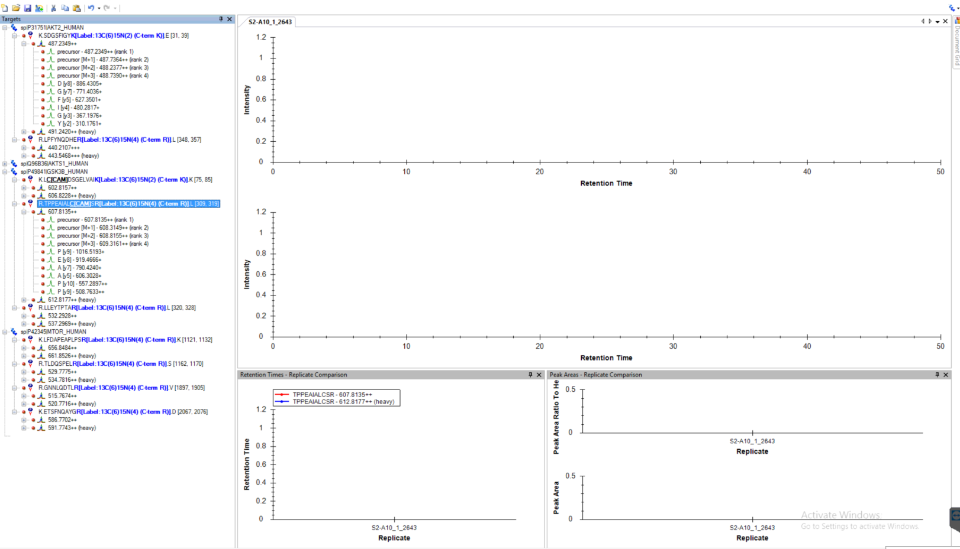
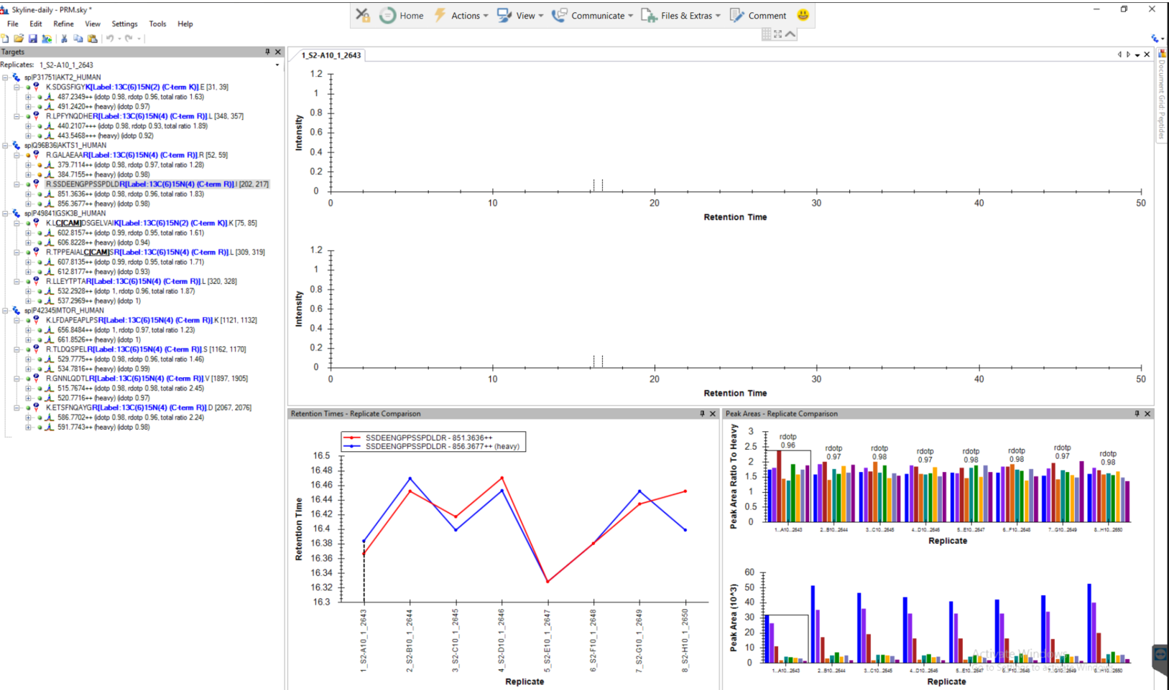
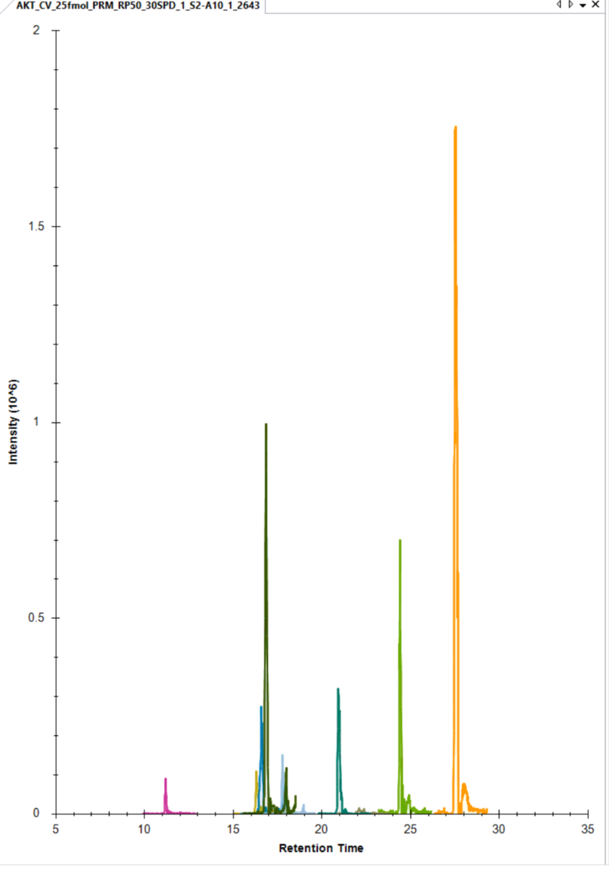
ISSUE B
Same raw file
Same peptide and transition settings (detailed in following slides)
ISSUE C

Slide 3
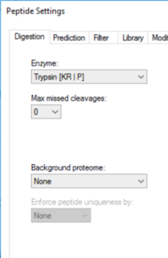
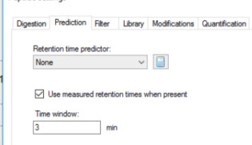
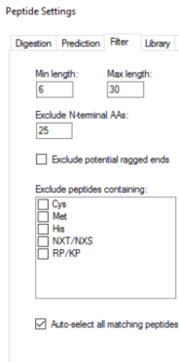
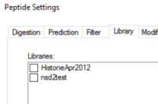
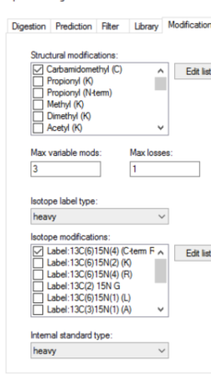
Peptide settings for figures on slide 3

Slide 4
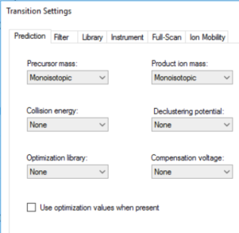
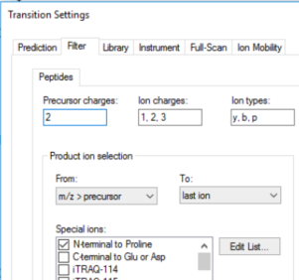
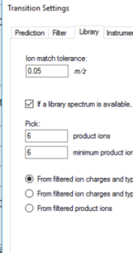
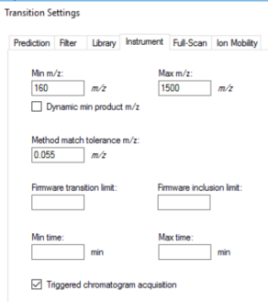
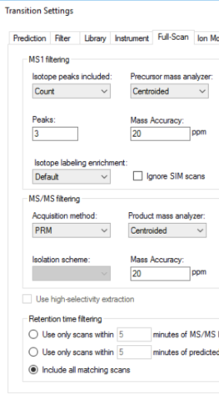
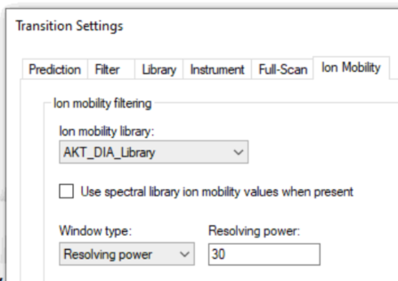
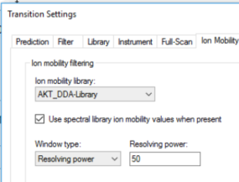
Transition settings for figures on slide 3

Slide 5
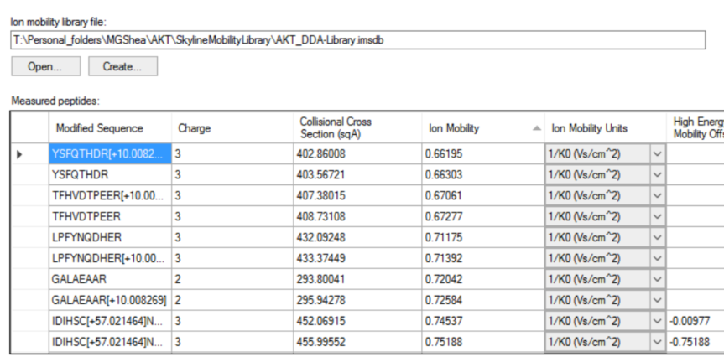
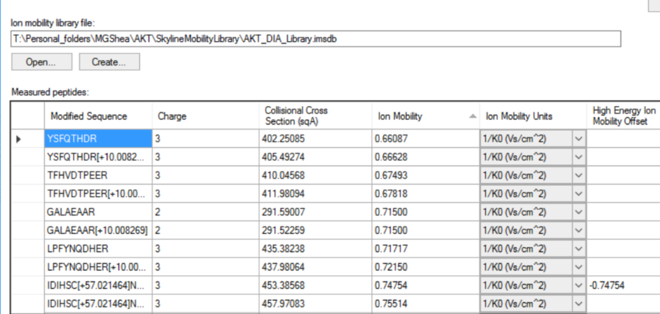
Sample of ion mobility libraries generated from DIA or DDA survey runs

Slide 6
Issue 2: Ion mobility filtering and prm-pasef method development
Summary: a couple of clarifying questions about what skyline does with mobility values and instances of misaligned filtering based on intensity profile of ion
How does skyline incorporate the values from creating a library using survey data (DIA or DDA) to an exported Bruker TimsTOF method? How does the TimsTOF use this library?
After collecting PRM-PASEF data from a method including a mobility library from an exported skyline method – does one still implement the same library for processing the data in skyline? Or should one reapply ‘Use Data’ to filter the data post-acquisition?
Skyline mobility filtering is frequently offset from the observed maximum (see next 2 slides). How can this be mediated?

Slide 7
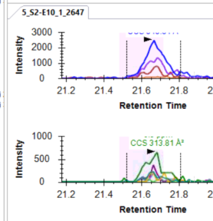
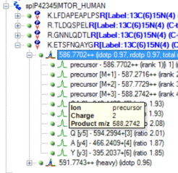
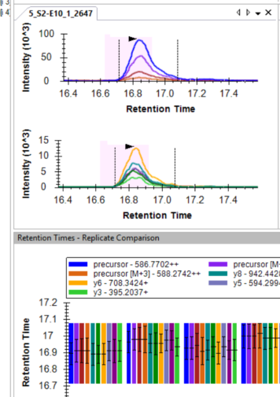
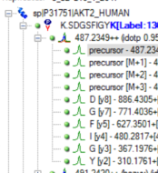
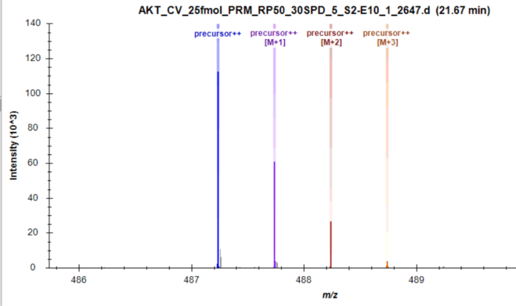
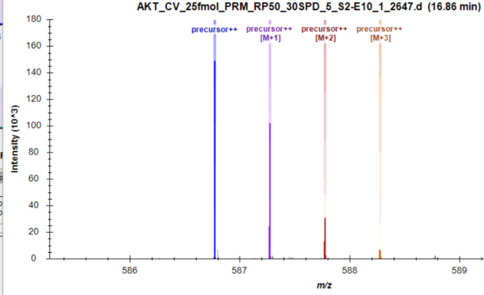
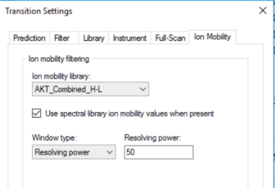
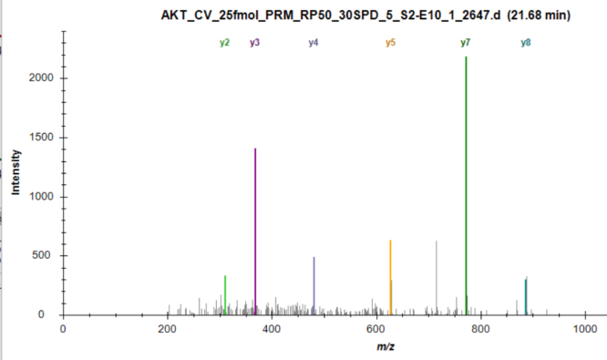
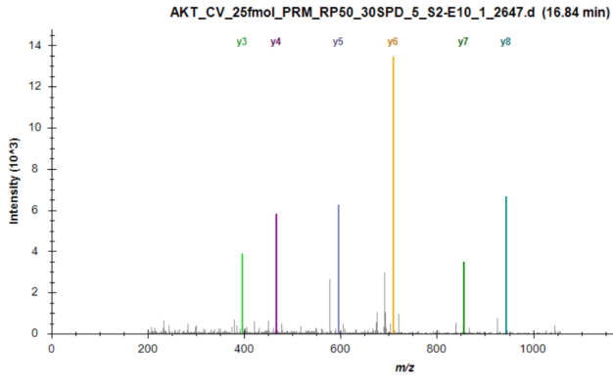
Chromatography much better for peptide at 16.85 minutes (Right), but how does that impact the mobility filtering?
Confident ID of precursors and fragments
Ion mobility filtering settings

Slide 8
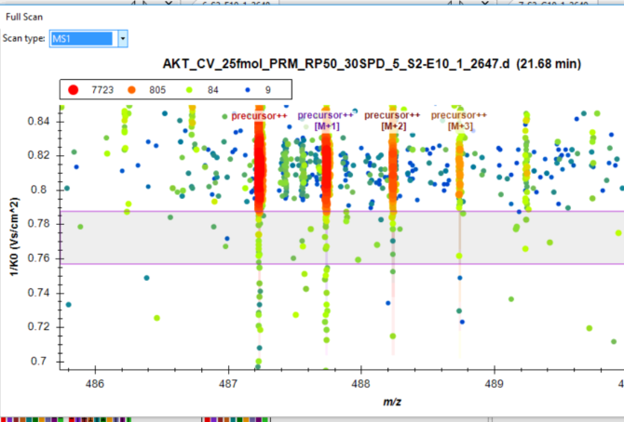
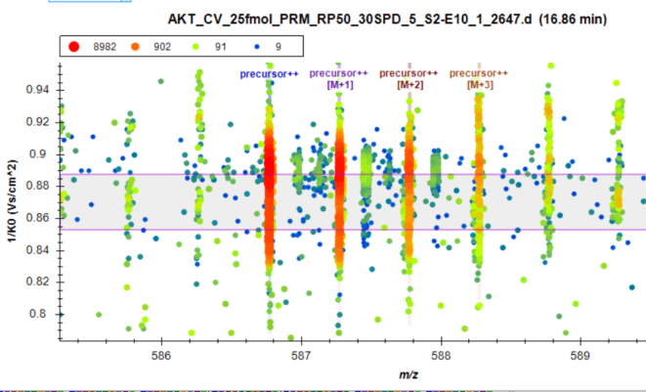
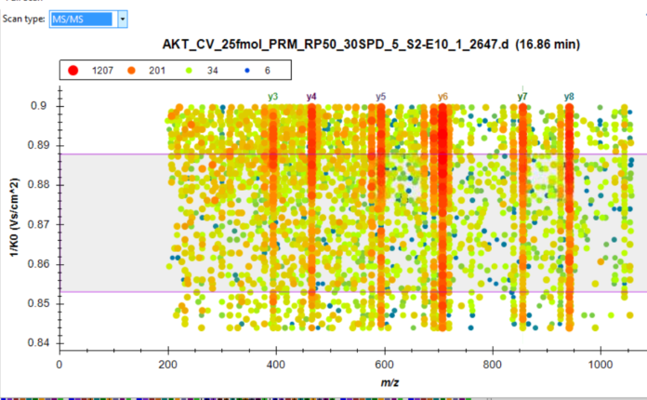
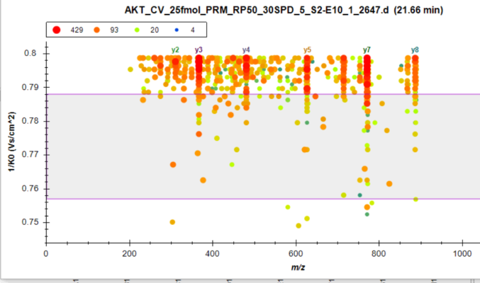
The max peak intensity is apparent – why is skyline missing it?

