Slide 1
Bruker timsTOF Pro PRM Issues
Import as PRM – no chromatograms
Import as DDA – Few product ion traces, despite spectra in library
Import as DIA – Product ions observed in DDA run, few products in PRM run
Following slides are screenshots from DIA import

Slide 2
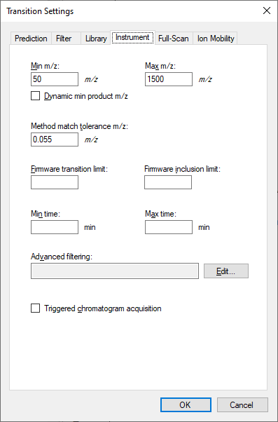
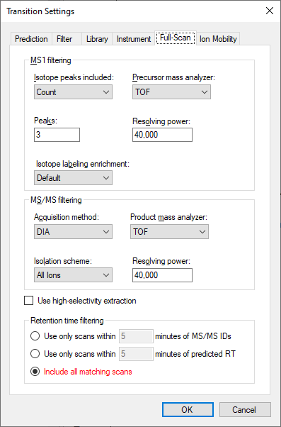
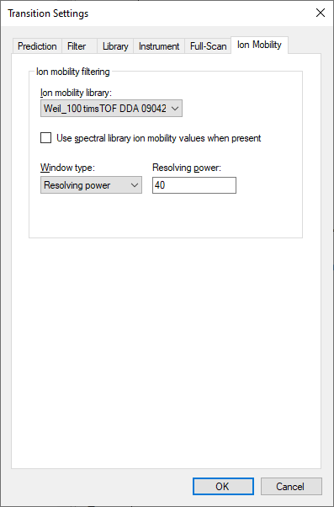
Skyline Transition Settings

Slide 3
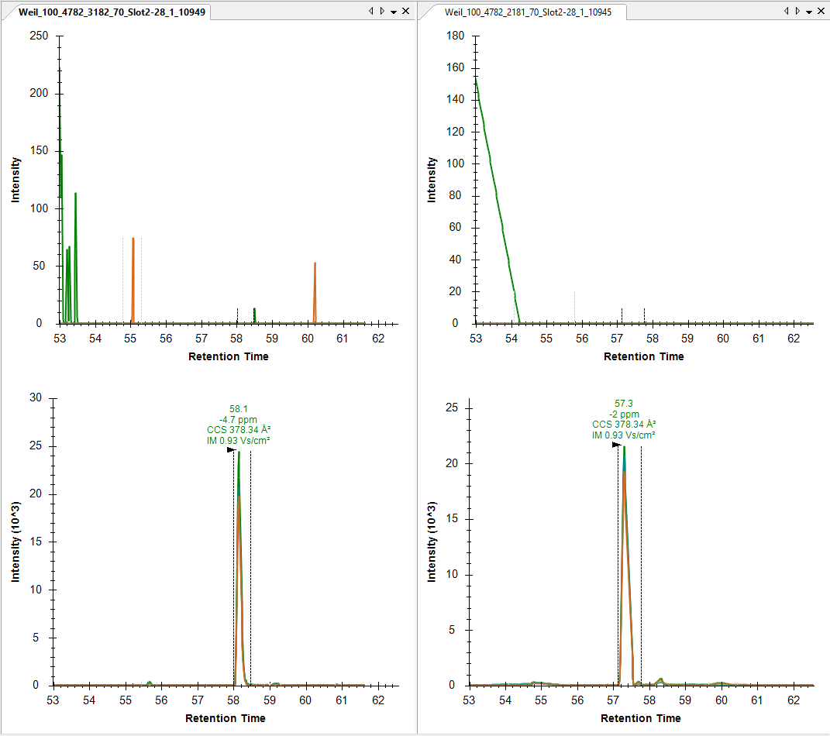
HSLVNDLPVGR
z=+2
m/z=603.331
DDA
PASEF PRM
Light
Heavy

Slide 4
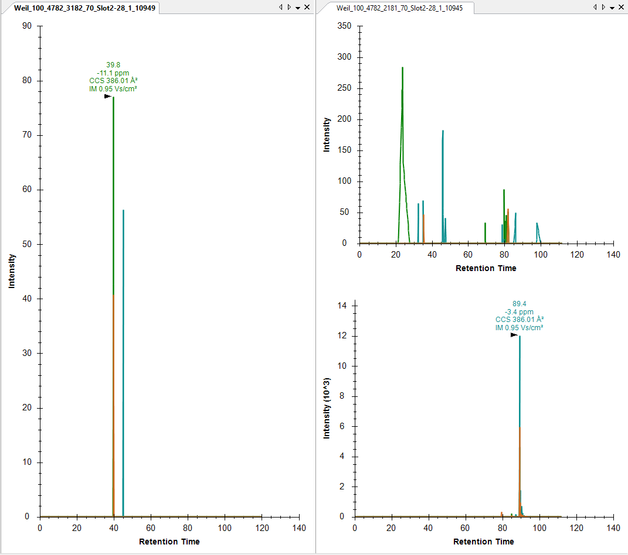
DILSAYDVVLK
z=+2
m/z=618.3477
PASEF PRM
DDA
Heavy (no trace for light)
Light
Heavy

Slide 5
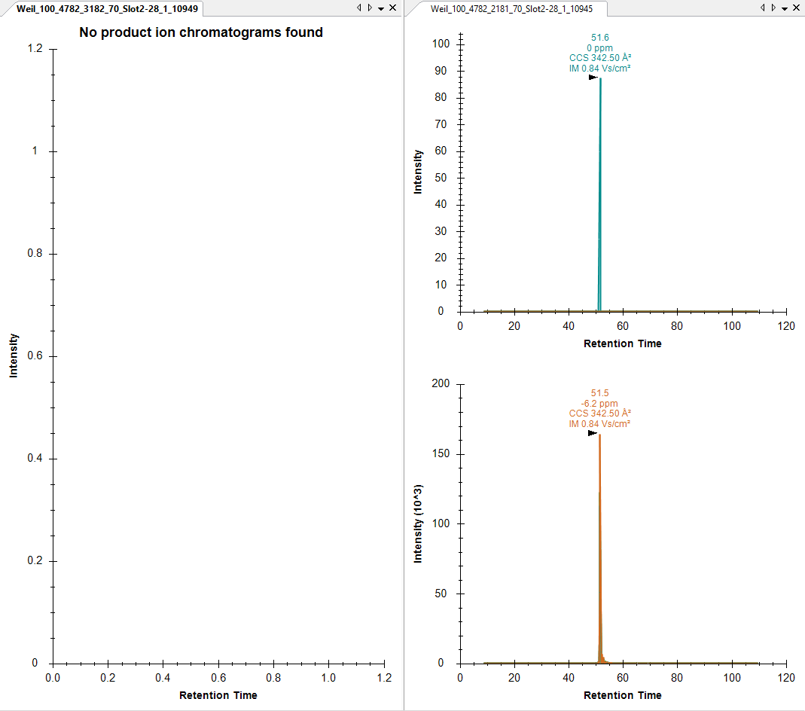
IVVLGSGGVGK
z=+2
m/z=493.3057
PASEF PRM
DDA
No trace
Light
Heavy

Slide 6
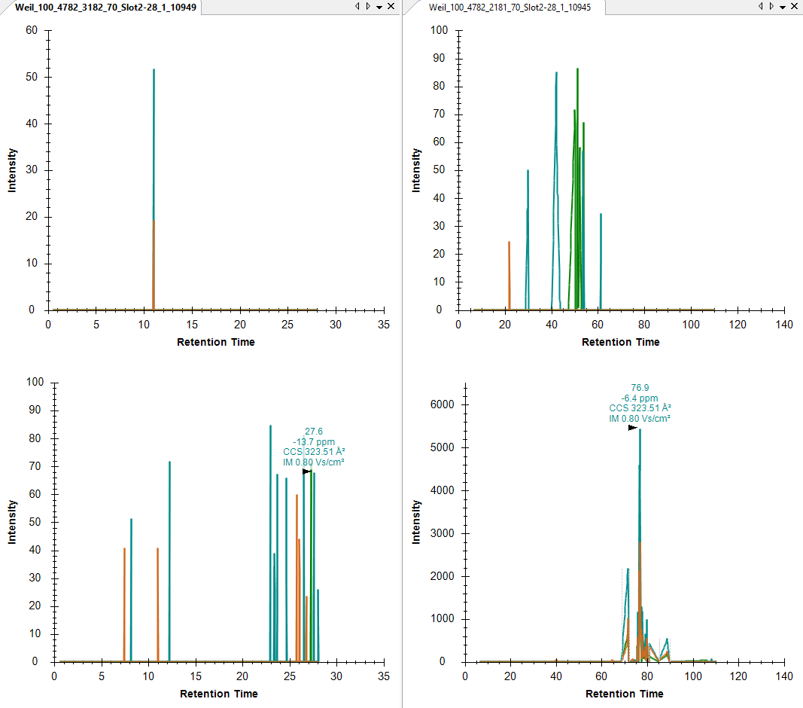
ILDFGLAR
z=+2
m/z=452.7662
DDA
PASEF PRM
Light
Heavy

