Slide 1
Introducing:
Area CV Histograms

Slide 2
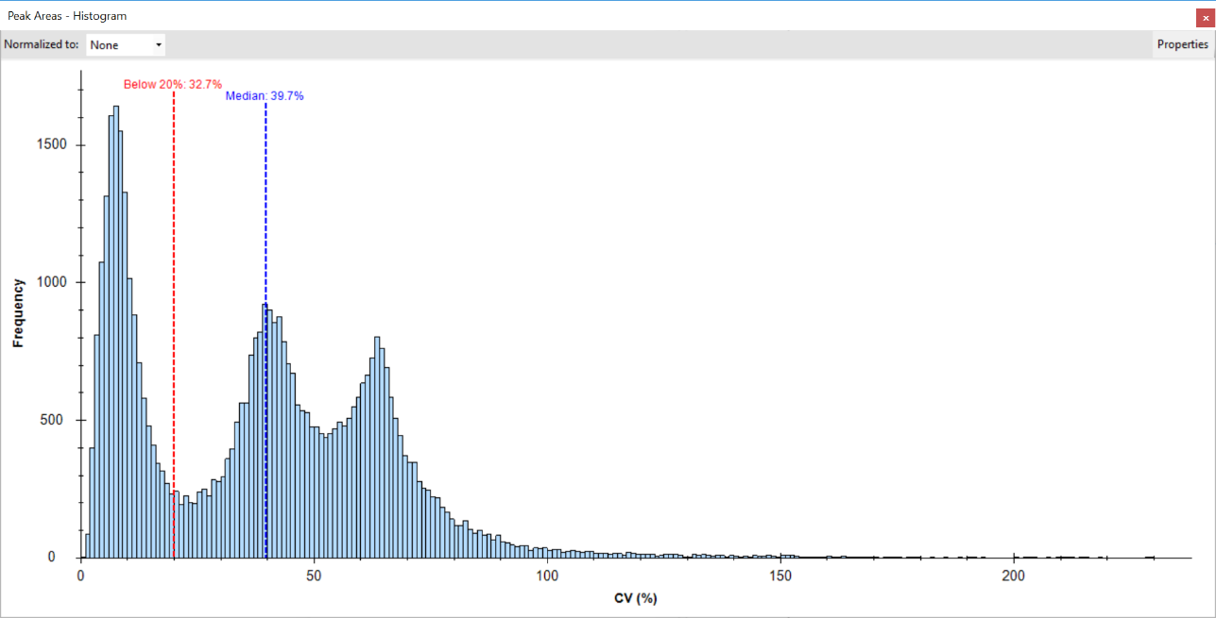
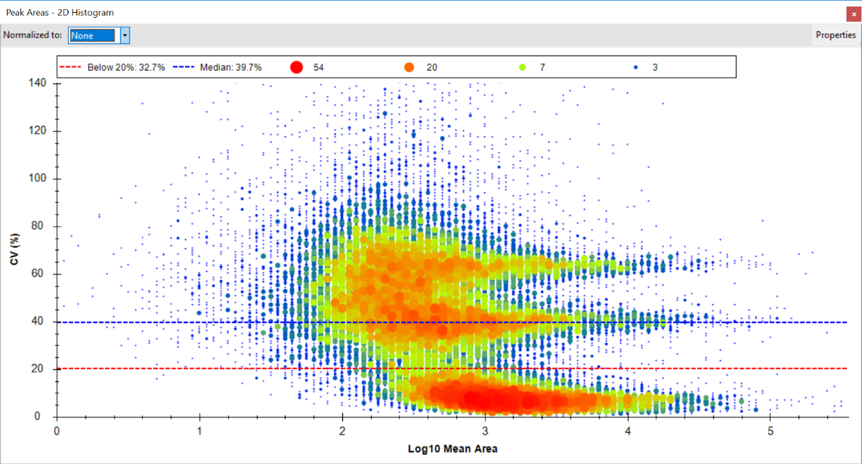
Overview
With the most recent release of Skyline-daily two new Peak area graph types have been added: CV Histogram and CV Histogram 2D (Heat map). These graphs allow you to look at how the Peak areas vary across replicates and groups.
Data from 3 organism mix in Navarro, Nature Biotech. 2016

Slide 3
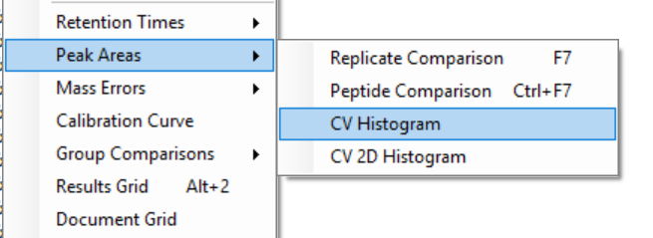
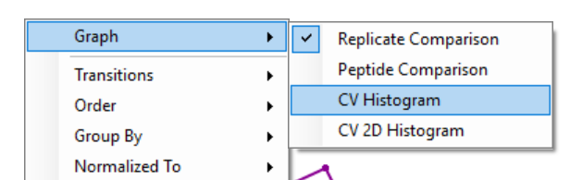
Opening the graphs
The CV Histogram graphs can be accessed via the View menu and by right clicking on any of the Peak Area graphs

Slide 4
Right Click Menu
In the right click menu of both graphs you can change a number of things:
Group by (All replicates or any of the groups that target replicates)
Points (Targets or Decoys)
Bin width (0.5%, 1.0%, 1.5%, 2.0%)
Normalized To (Medians, Global Standards (if available), heavy modifications (if available))
Selection: Highlight CV’s that area affected by the selected peptides (not possible for 2D histograms)

Slide 5
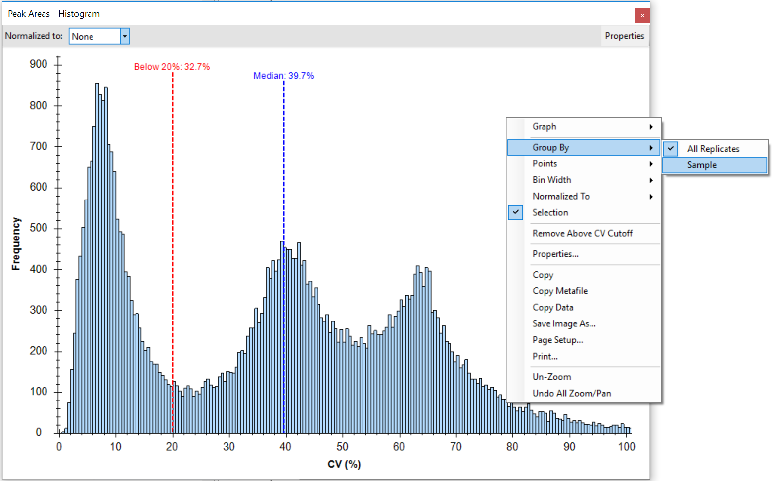
Group By
Just like most other graphs, the CV Histogram graphs allow you to group by an annotation. If no group is selected, the CVs are simply calculated across all replicates. If an annotation is selected the CVs are calculated across all annotation values.

Slide 6
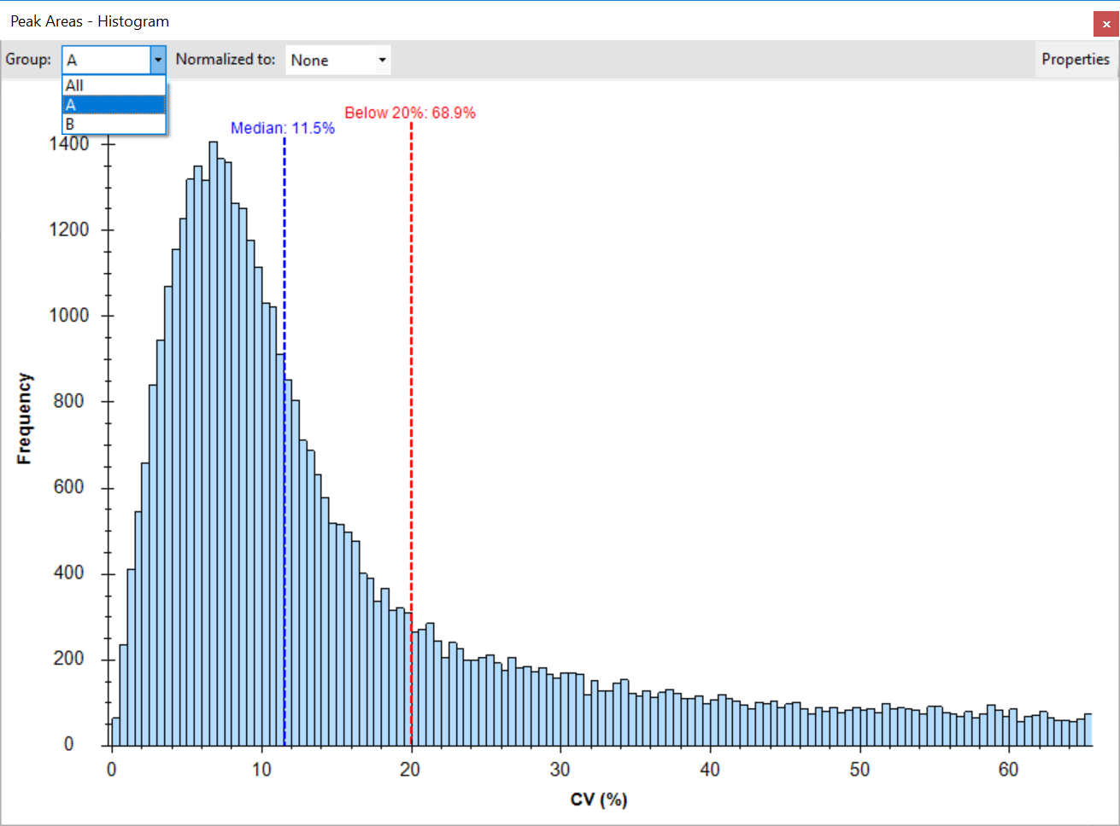
Group By an Annotation Value
As soon as an annotation is selected, the toolbar will display all possible annotation values, with the default being “All”. If you select an annotation, the CV’s will be calculated based on the replicates that have that specific annotation value.

Slide 7
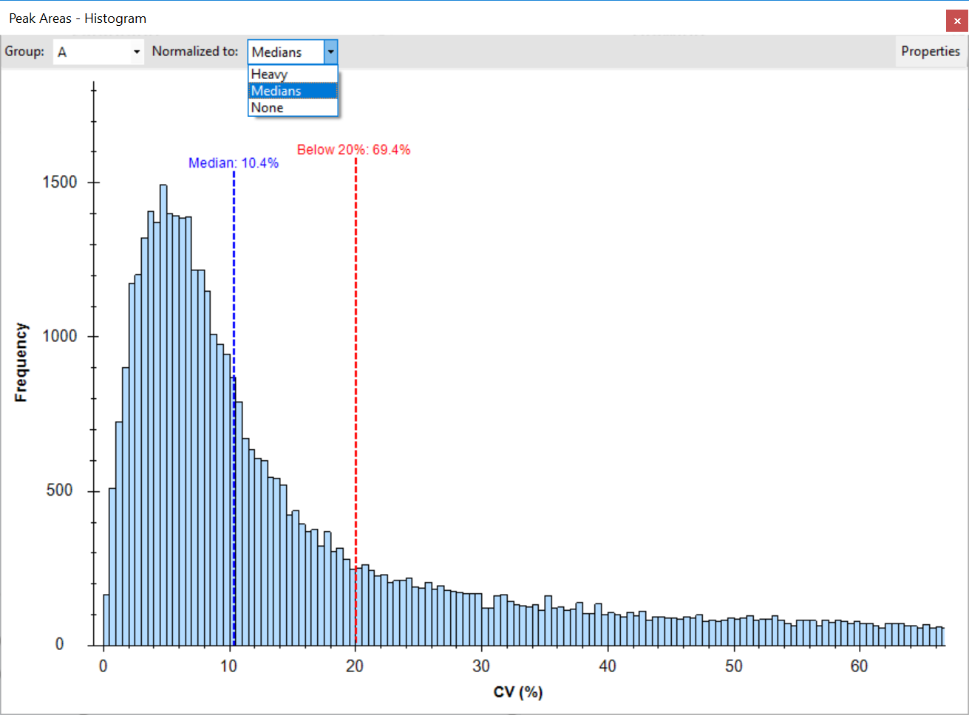
Normalization
In both the right click menu and the toolbar, you can switch between normalization methods to easily compare their effectiveness.

Slide 8
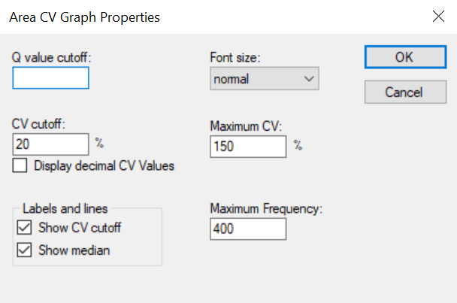
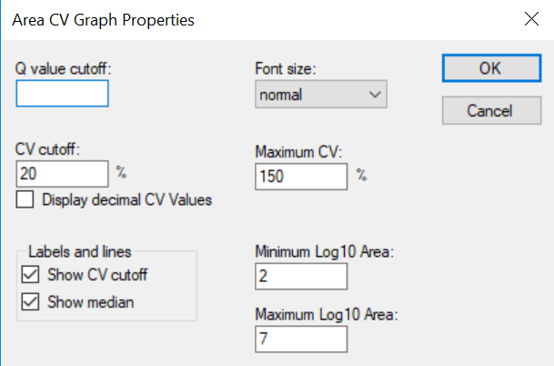
Properties
The properties are accessible from both the toolbar and the right click menu. In the properties you can set a qvalue cutoff, set a CV cutoff that will be displayed on the graph, enable decimal CV values, Show/Hide the CV cutoff/Median labels and change the font size. Both the histogram and the 2d histogram graphs also allow you to set maximum values for both axes.

Slide 9
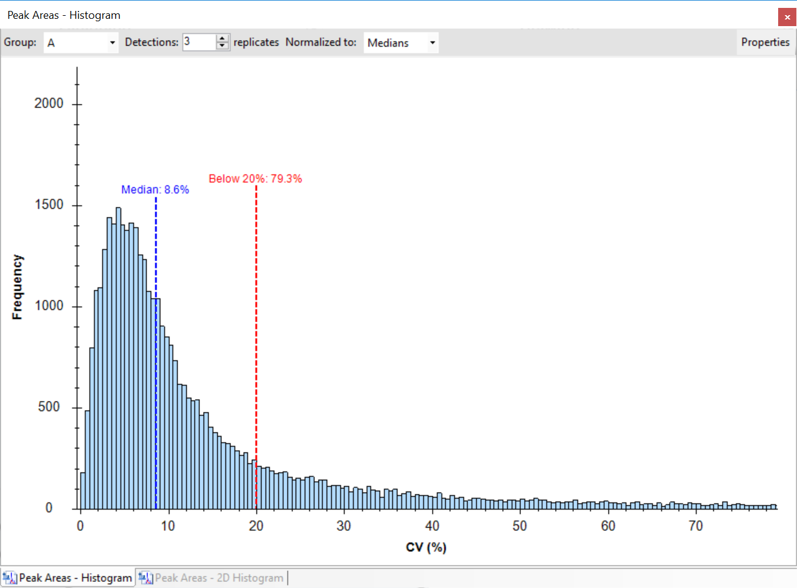
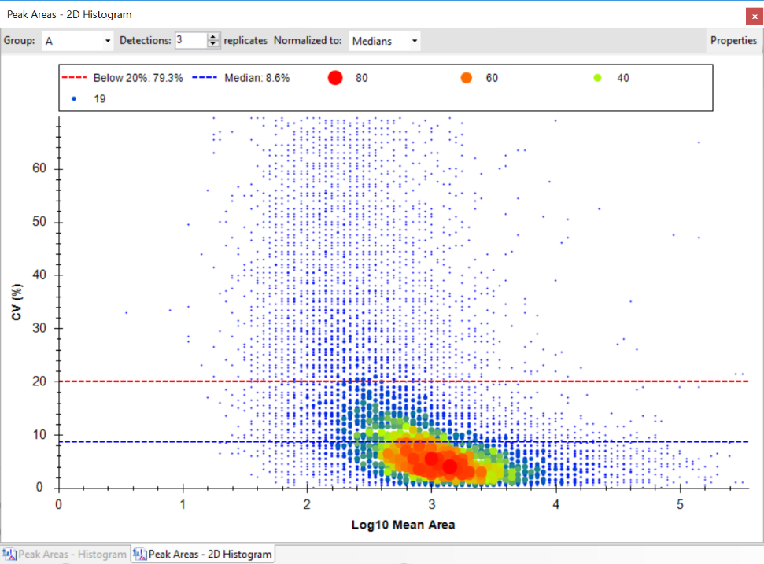
Q Value cutoff
When a qvalue cutoff is entered in the properties and the document has qvalues, a Detections numeric up-down will appear in the toolbar, allowing you to change the minimum number of replicates that have to be below the qvalue cutoff in order for the CV to be included in the histogram.

Slide 10
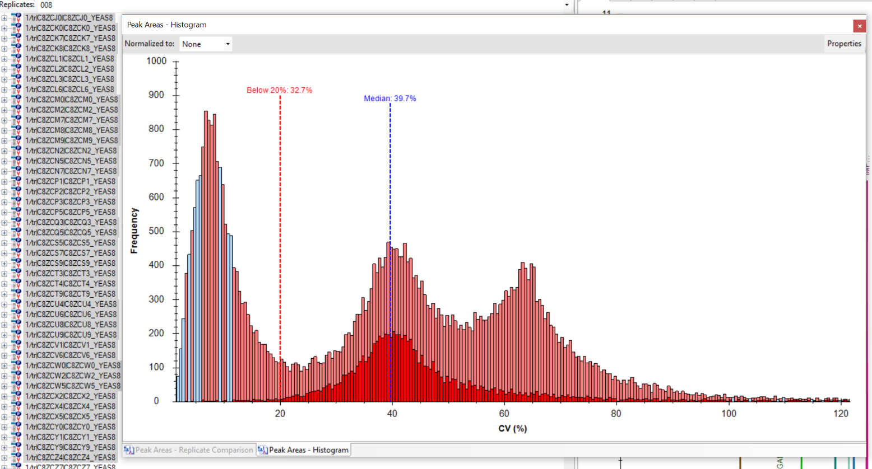
Selection
When the Selection option is enabled, all CV’s that are affected by the selected peptides/proteins are highlighted.

Slide 11
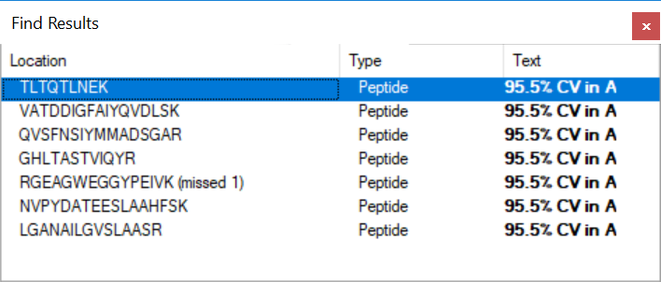
Selecting a bar or a point
When clicking on a bar or a point, the find results window will display all peptides that contributed to the selected CV.

