Slide 1
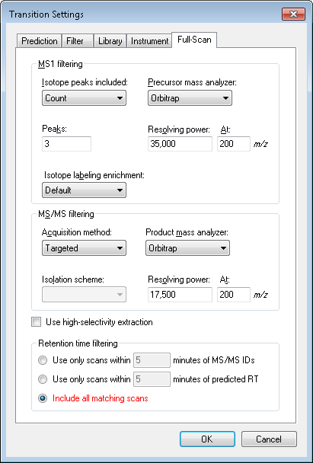
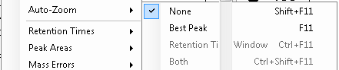
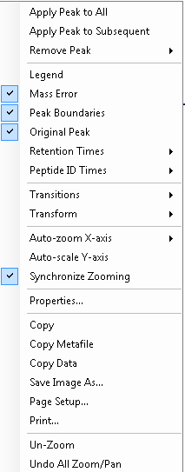
Auto-zoom “None” selected to display entire chromatogram.
Synchronize Zooming selected to display same retention time region for heavy/light traces.
Include all matching scans selected.

Slide 2
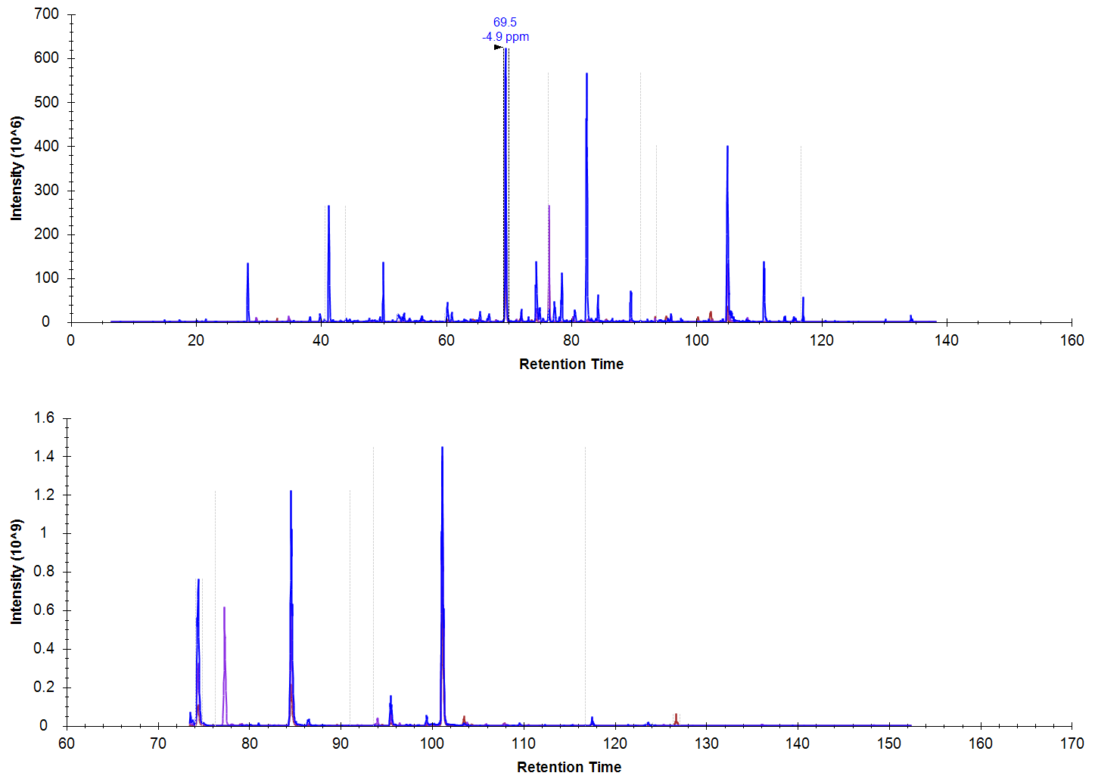
MS1 trace from DDA experiment.
Light peptide
Heavy peptide
Data from different time ranges imported for heavy/light peptides.
Precursor of interest missing in bottom trace.

Slide 3
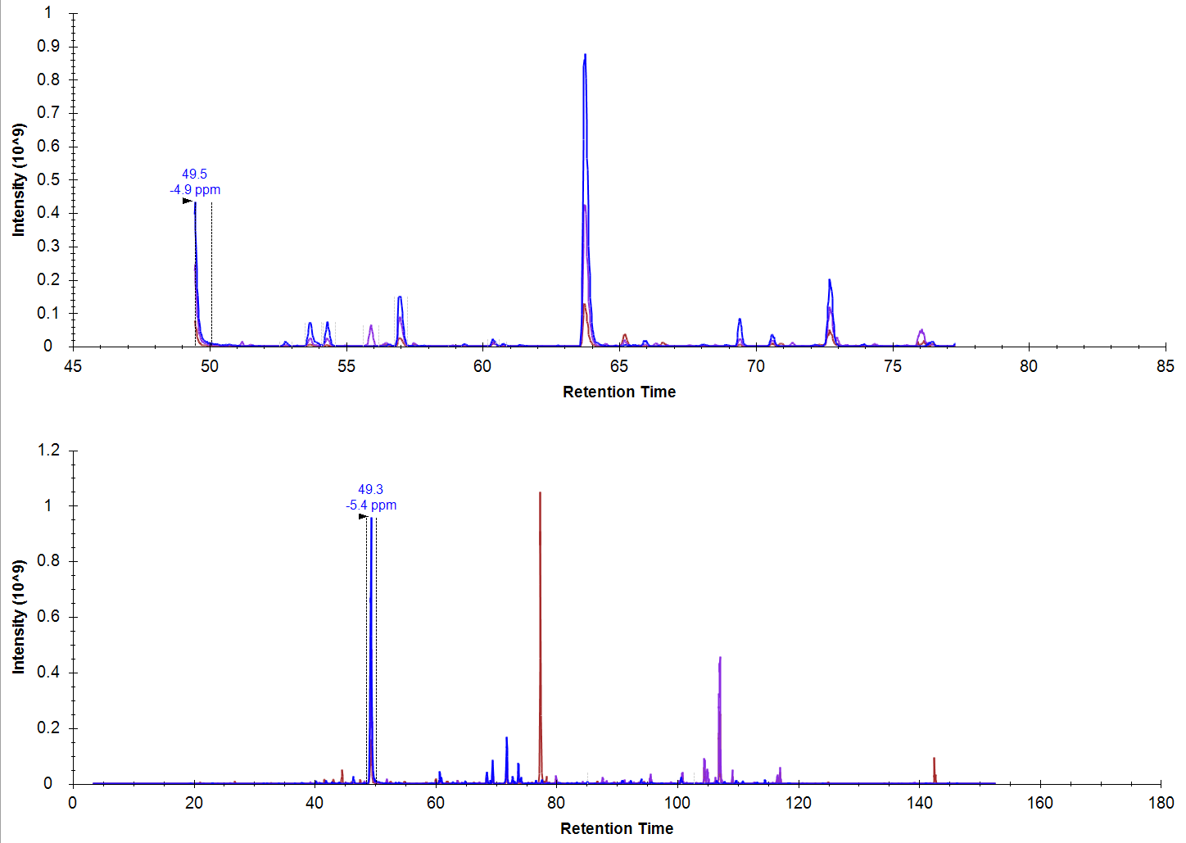
MS1 trace from DDA experiment.
Light peptide
Heavy peptide
Data from different time ranges imported for heavy/light peptides.
Precursor of interest truncated in top trace.

Slide 4
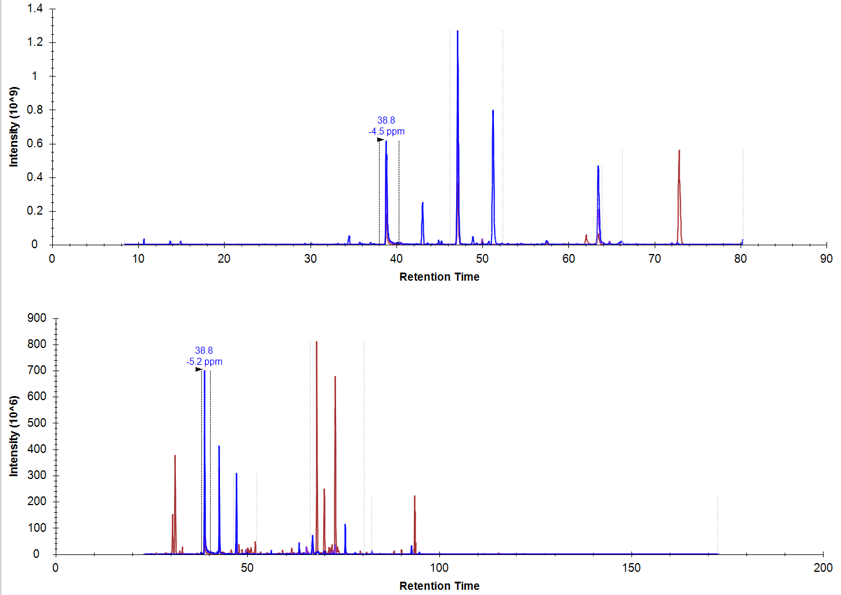
MS1 trace from DDA experiment.
Light peptide
Heavy peptide
Data from different time ranges imported for heavy/light peptides.
Precursor of interest observed in both traces.

