Slide 1
Regression weighing: None
Linear through Zero
Linear

Slide 2
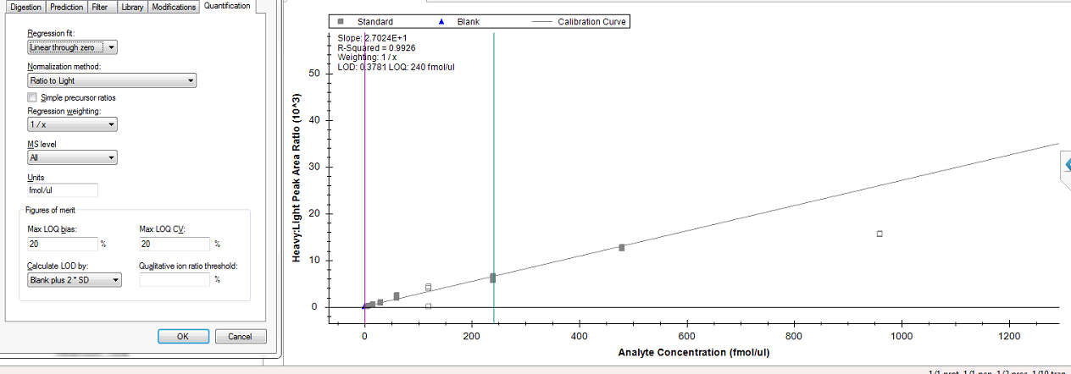
Regression weighing: 1/x
Linear through Zero
Linear

Slide 3
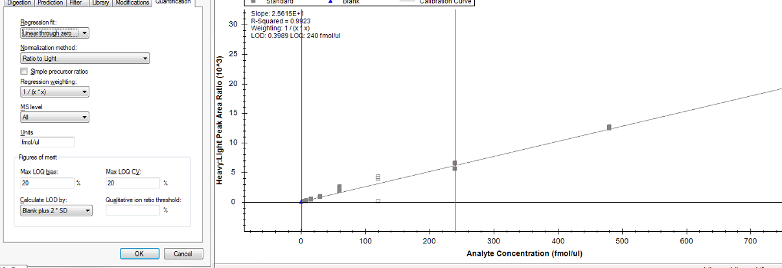
Regression weighing: 1/x*x
Linear through Zero
Linear

