Slide 1
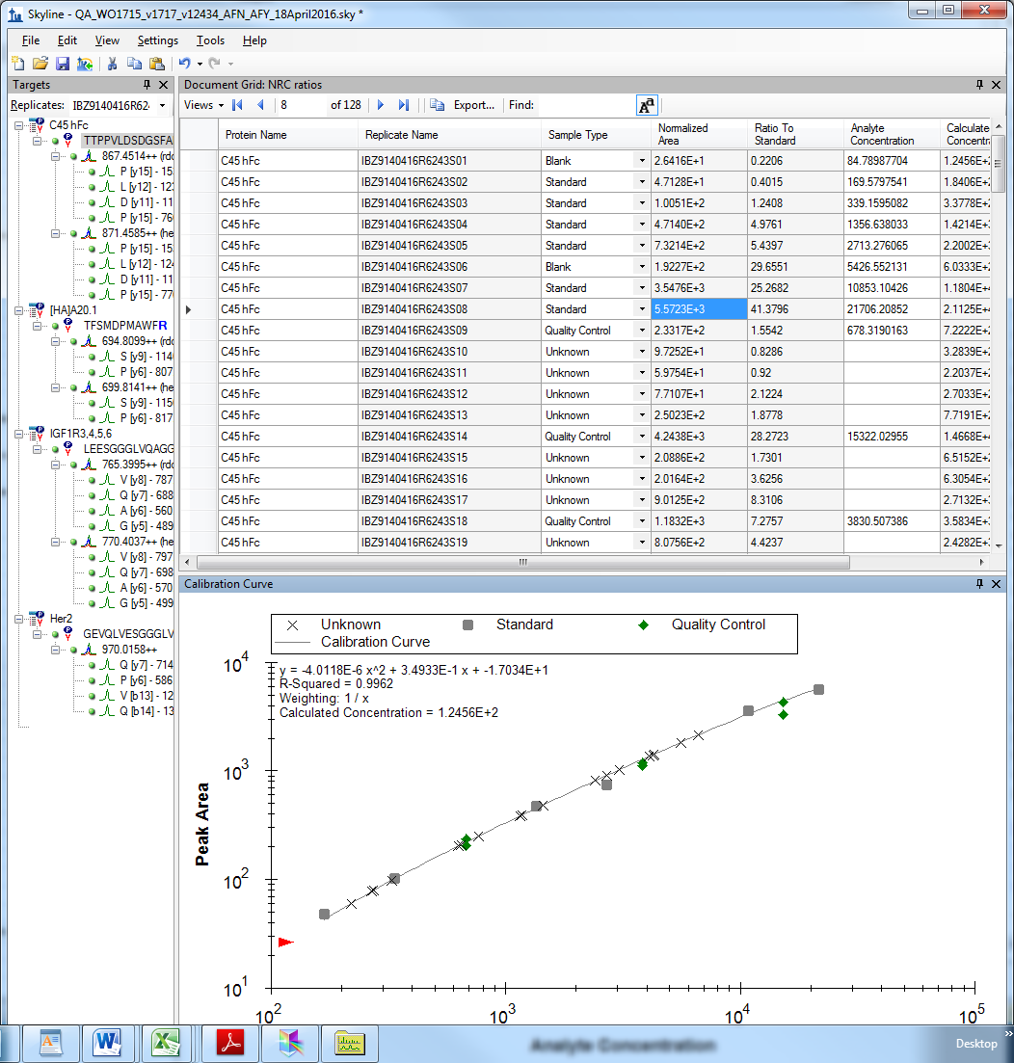
Definition of normalized area for SRM data?

