Slide 1
Theresa’s Document
Why no modifications?

Slide 2
Seeing Protein Peptides in Skyline
Click here
Mouse over protein name
Filter off
Auto-select is off

Slide 3
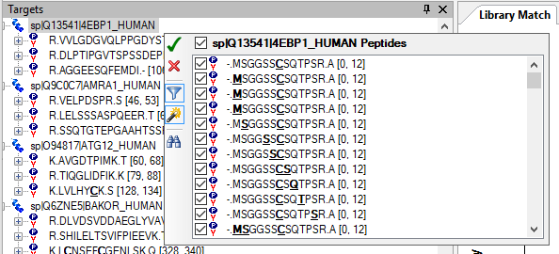
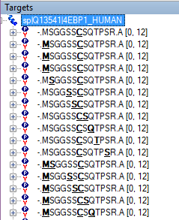
Trying Manual Correction on One Protein
Filter on
Auto-select is on

Slide 4
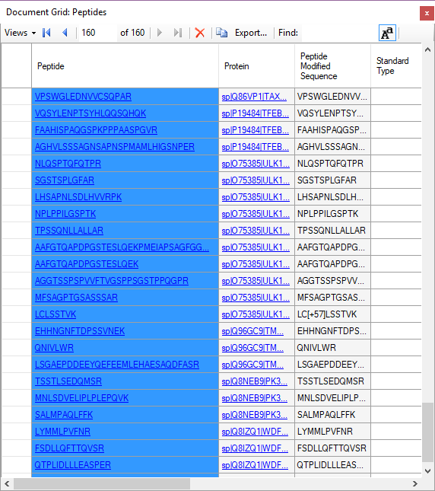
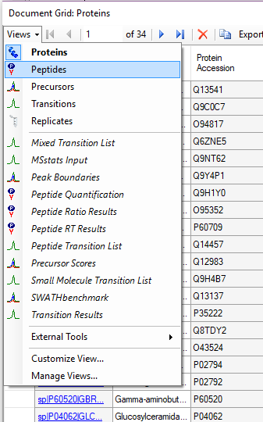
Getting the Original List of Peptides
Undo and use Document Grid
Select All Peptides
Ctrl-C to copy
Paste into text editor
For use with Accept Peptides
Peptides view

Slide 5
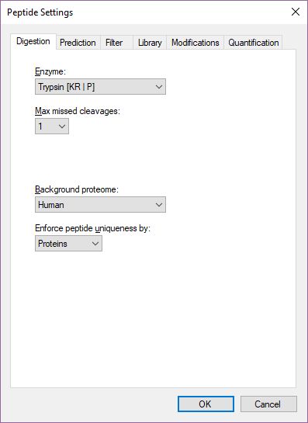
Turn Off Protein Uniqueness

Slide 6
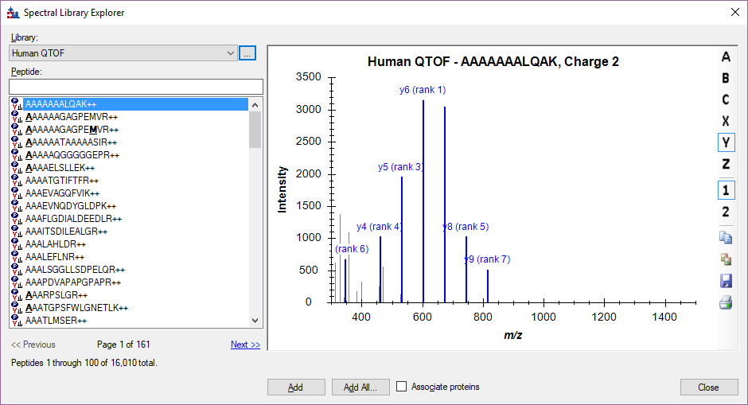
Looking at the Spectral Library

Slide 7
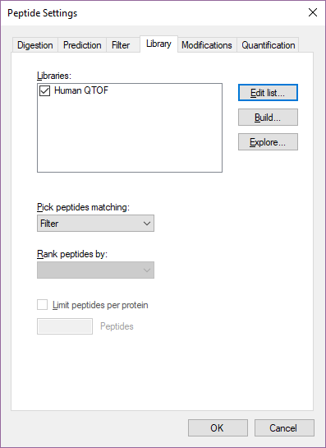
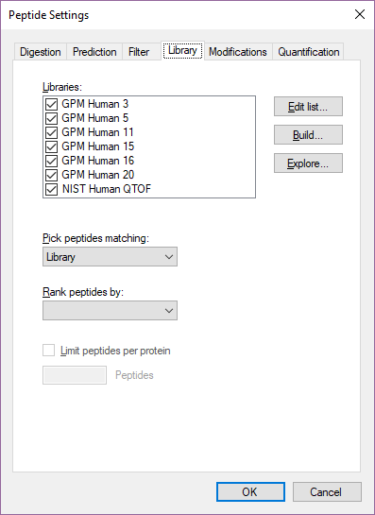
Peptide Settings - Libraries
Change to Library

Slide 8
Only Peptides in Libraries

Slide 9
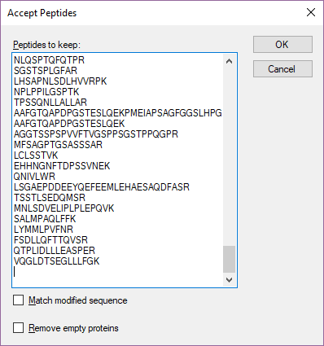
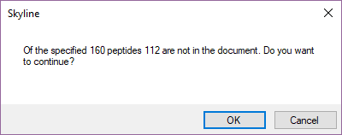
Accept Only Desired Peptides

Slide 10
Final – Now Try with Full Human Libraries

