Slide 1
ISSUES with pepXML in TPP

Slide 2
Double click TPP (installed in desktop icon as shortcut) – This tab is opened in the google chrome browser

Slide 3
Clicked on “Analyze Peptides”

Slide 4
This window opens
The whole webpage is in the next screen shots- where all the parameters are available

Slide 7
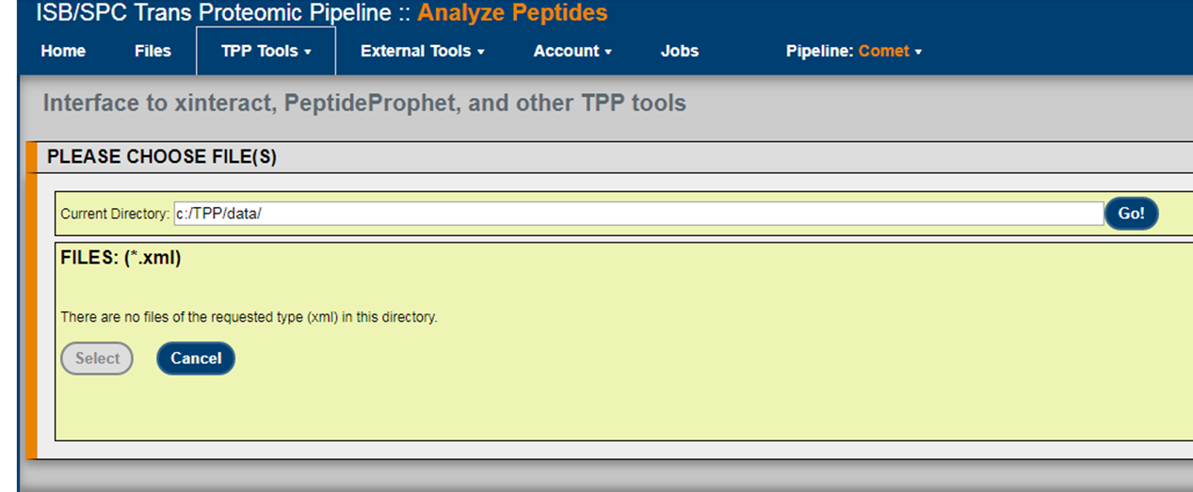
Then I click on “Add files”

Slide 8
Then I keep the data with renaming it in the same directory “c:/TPP/data/”
FILE renamed “.pep.xml”
Then I write the name of the file here and hit “Go”

Slide 9
THE FILE NOT LOADING IN TPP TO RUN PEPTIDE-PROPHET
This is what I see after clicking on “Go” to load the file

Slide 10
However, I can upload the data in the “File” tab

