Slide 1
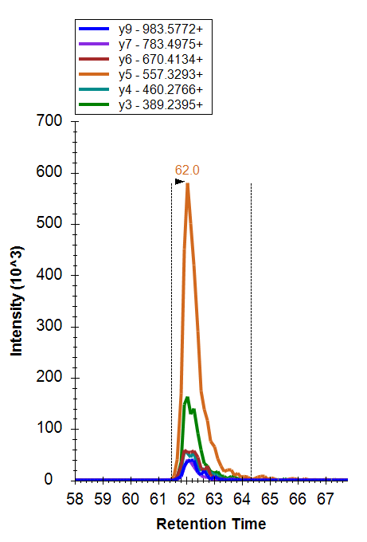
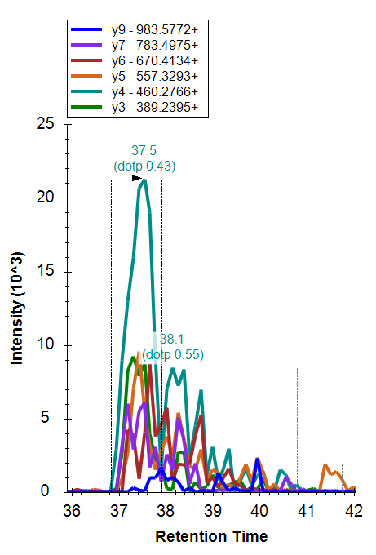
Co-elution count in Mprophet Feature report = 4
y9 – 62.16 mins
y7 – 62.04
y6 – 61.92
y5 - 62.04
y4 – 61.92
y3 – 62.04
ΔRT = Highest is 0.24 mins
Co-elution count = (4)(6)/6 = 4
Co-elution count in Mprophet Feature report = 3.33
y9 – 37.67 mins
y7 – 37.55
y6 – 37.67
y5 - 37.43
y4 – 37.55
y3 – 37.31
ΔRT = Highest is 0.36 mins
Co-elution count = (4)(5)/6 = 3.33
which 5 are considered as “co-eluting”?

