Slide 1
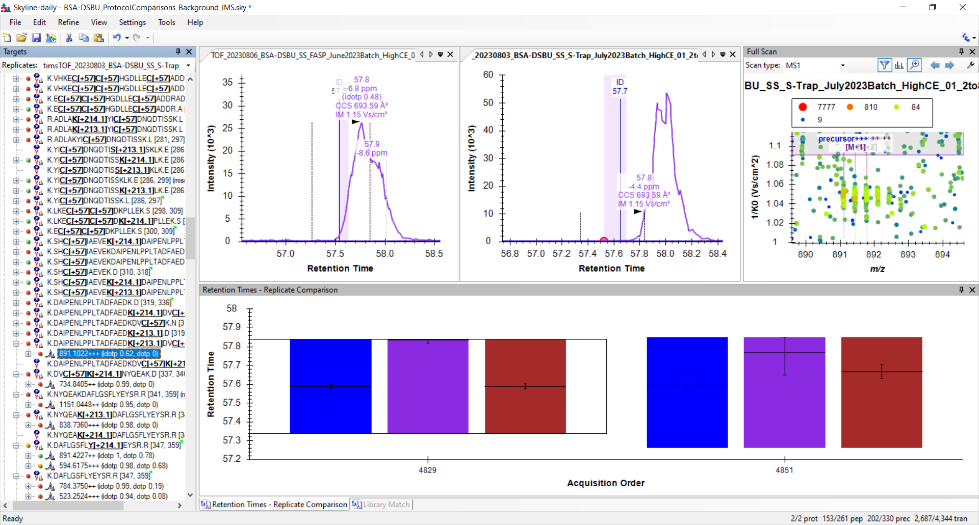
Correct ion envelope

Slide 2
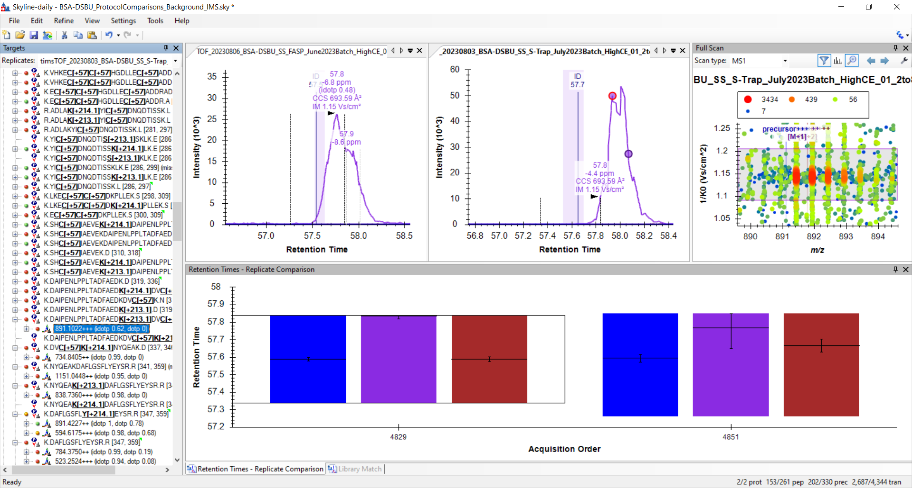
Wrong ion envelope

