Slide 1
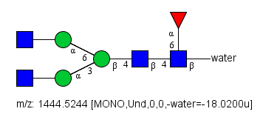
Fragmentation I want to monitor
Ms2 fragments this bond….
Resulting in….
These are the masses I monitor for every glycopeptide (where the peptide is the same and the glycan is what differs).
Y1 ion
m/z = 1392
Y1+F ion
m/z = 1538

Slide 2
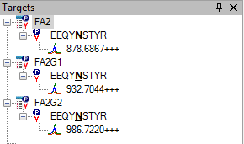
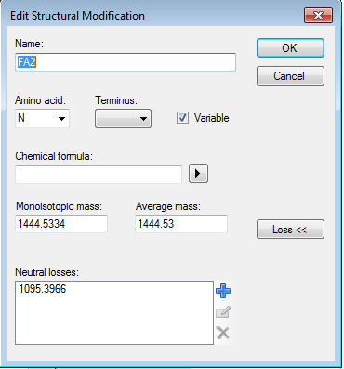
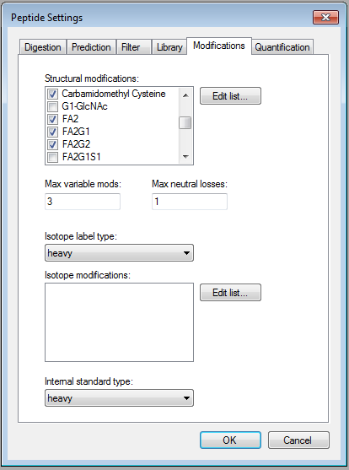
Ms2 fragments this bond….
Resulting in….
Y1 ion
m/z = 1392
Y1+F ion
m/z = 1538
This is the mass that needs to be lost from FA2 to generate either the Y1 ion or the Y1+Fuc ion.

Slide 3
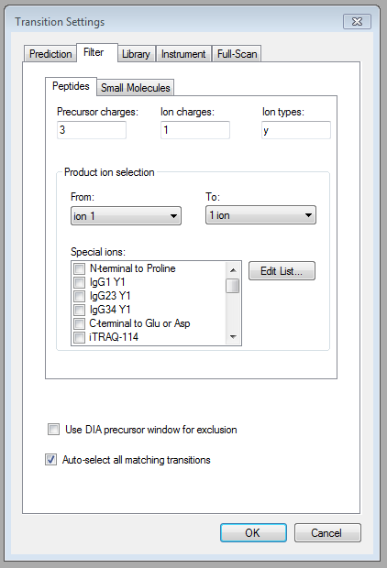
Transition settings

