Slide 1
Deleting peptides with low ratio dot products
Nicholas Shulman
20190624

Slide 2
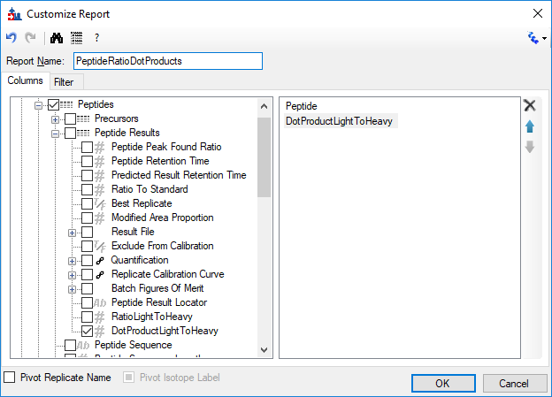
Create a report with “Peptide” and “DotProductLightToHeavy”

Slide 3
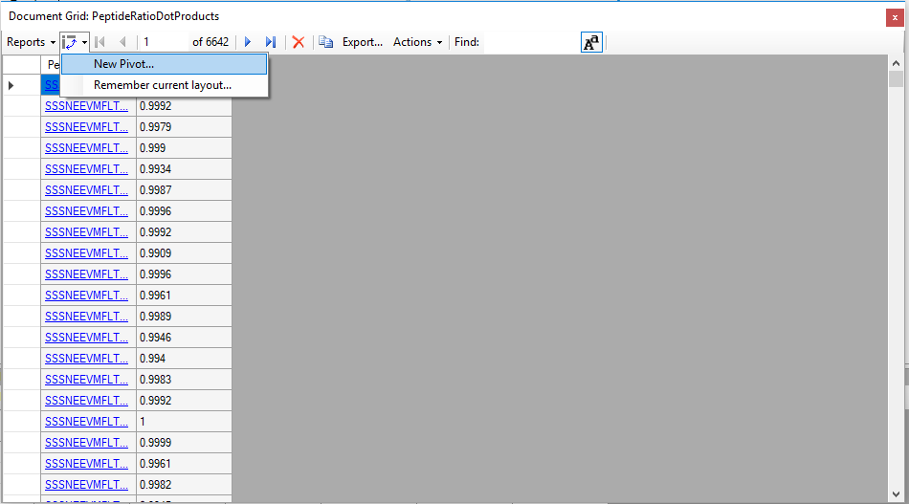
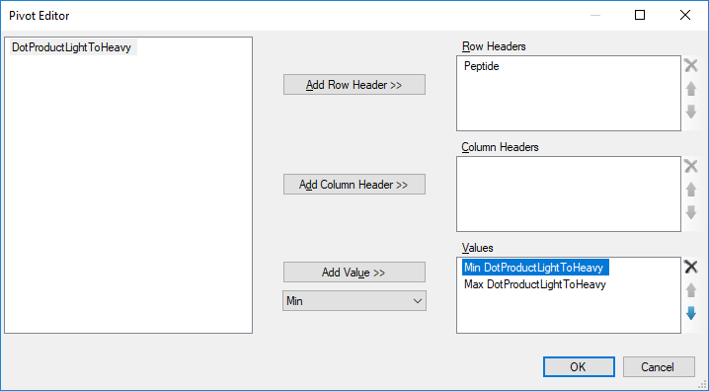
Use the Pivot Editor to find the max and min dot product for each peptide

Slide 4
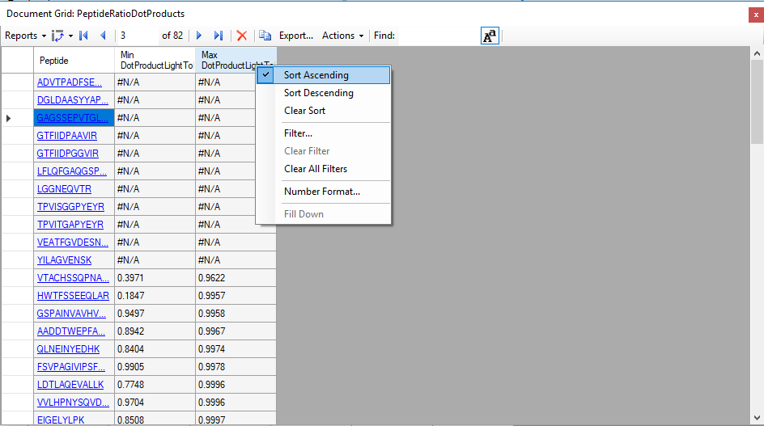
Sort the “Max DotProductLightToHeavy” column

Slide 5
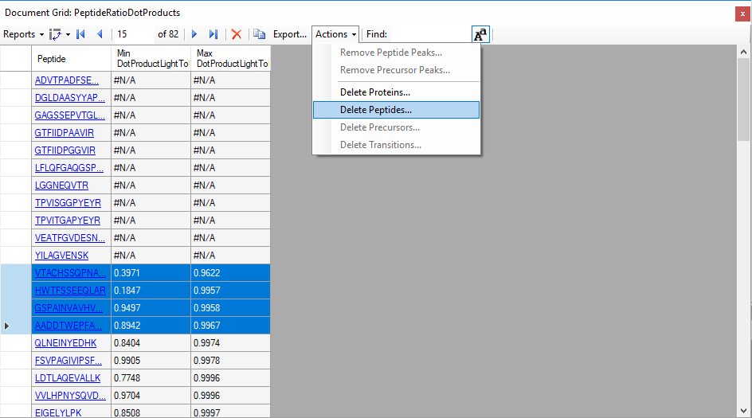
Select the rows with the peptides you want to delete and use the Actions dropdown.

