Slide 1
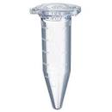
Constructing samples for REVERSE calibration curve
BAL sample X
or pool of BAL samples
This remains constant
same volume
Light (endogenous) peptide levels (should) remain constant
Amount of
of heavy in sample
8000 fmol
Amount
of heavy in 4000 fmol
Amount
of heavy 2000 fmol
Amount
of heavy 400 fmol
Amount
of heavy 200 fmol
Amount
of heavy 40 fmol
Amount
of heavy 20 fmol
Amount
of heavy 4 fmol
Amount
of heavy 0 fmol
H/L
Final Concentration of Heavy spiked in (fmol/uL)
Notes:
BAL sample X
or pool of BAL samples
This remains constant
Same volume
Light peptide levels (should) remain constant
Final concentration of heavy 20 fmol/uL
H/L
Final Concentration of Heavy spiked in (fmol/uL)

Slide 2
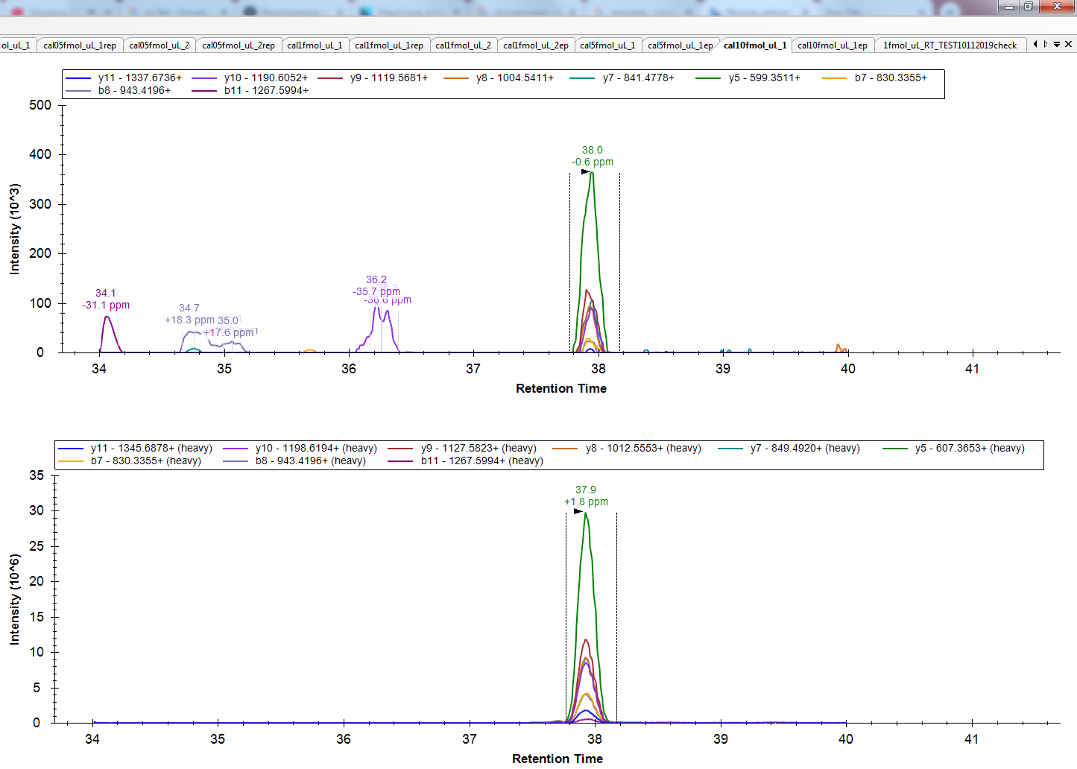
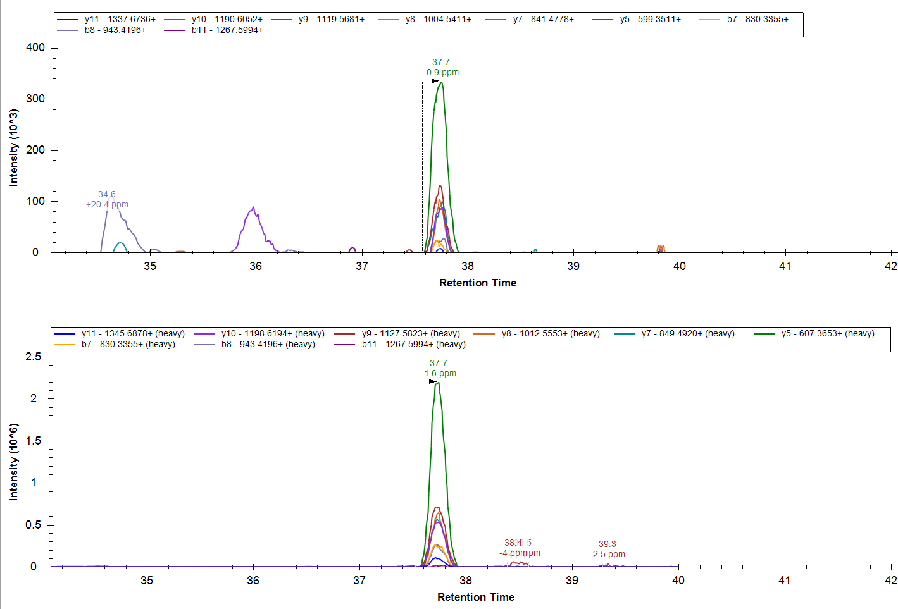
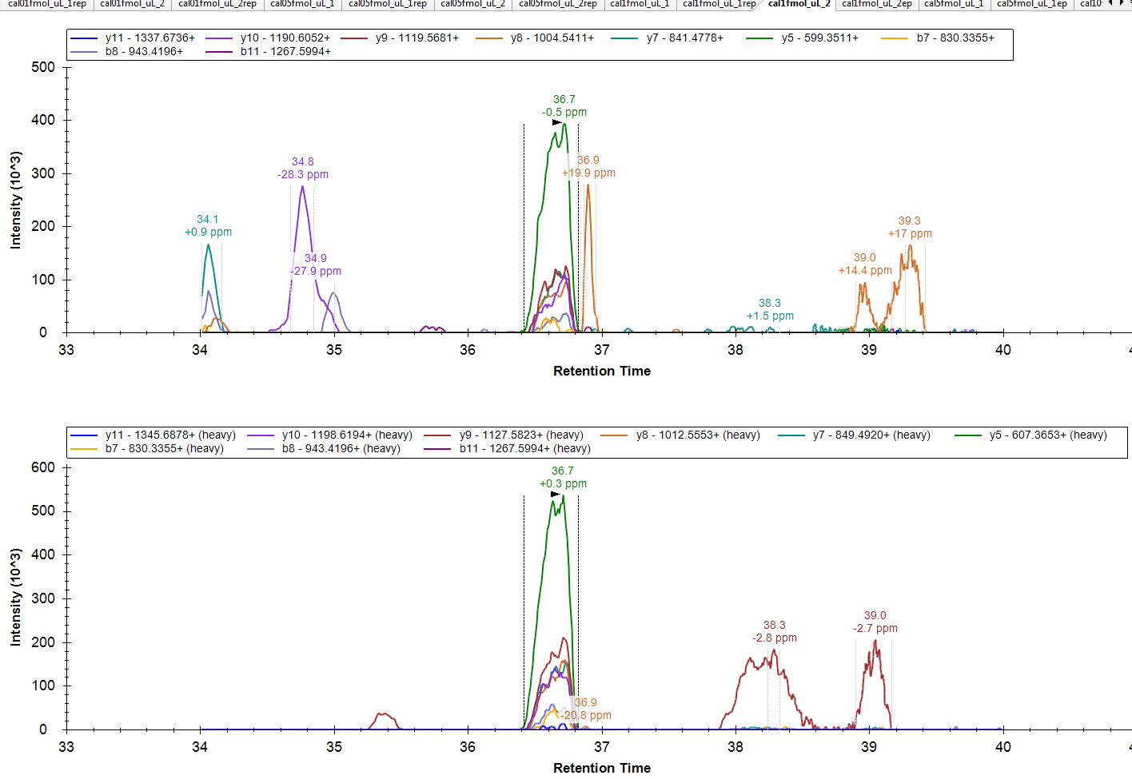
Light; it’s been keep constant
Light; it’s been keep constant
Ratio (L/H): 0.01
Ratio (L/H): 0.13
Heavy in sample 4000 fmol
Heavy in sample 2000 fmol
Light; it’s been keep constant
More dilutions; same BAL sample where
the amount of heavy gets decreased
Ratio (L/H): 0.6
Heavy in sample 400 fmol
Notes:
Heavy
Light
Ratio: 0.01
More dilutions
(……………)

Slide 3
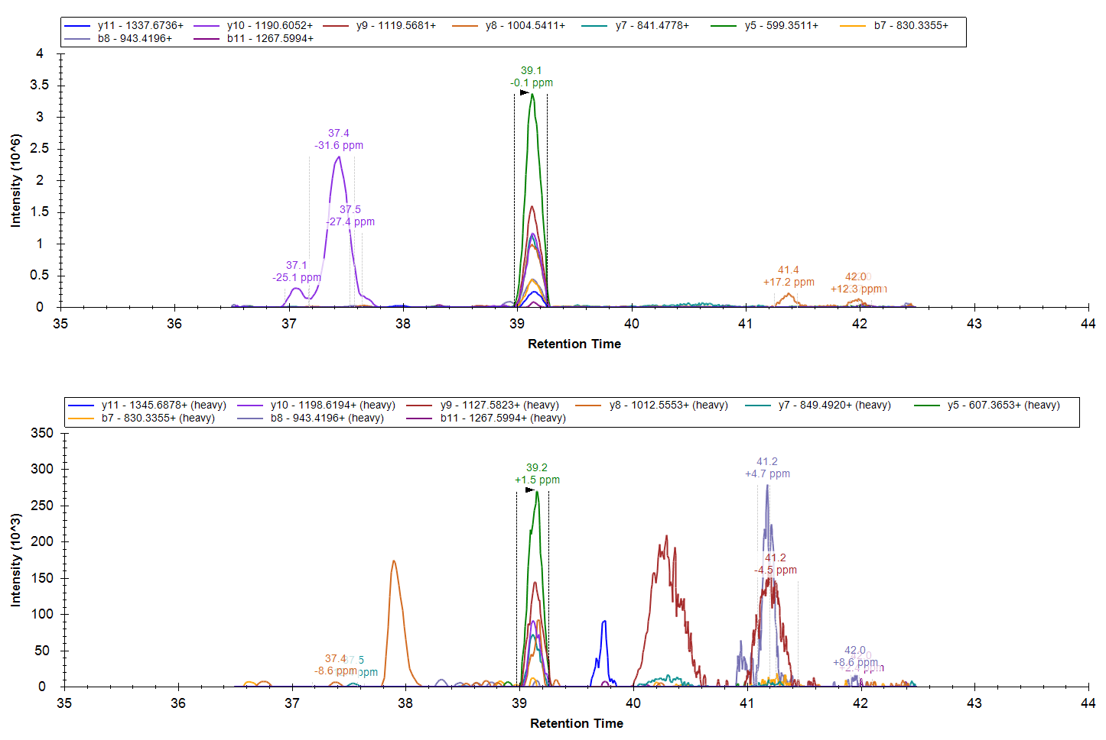
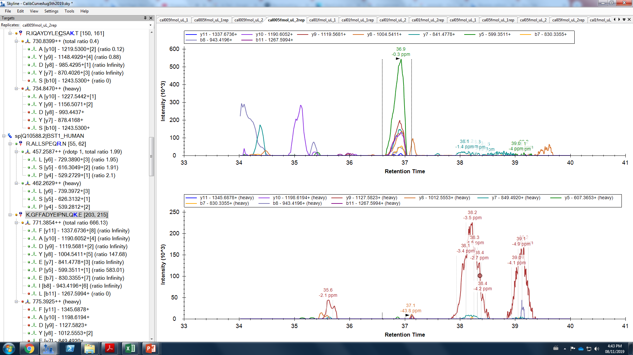
Light; it’s been keep constant
Light; it’s been keep constant
Ratio (L/H): 16
Heavy in sample 20 fmol/uL
When the amount of my heavy in the sample is 4 fmol I don’t see it anymore

Slide 4
For this peptide the Cal curve looked like this
The lowest amount of heavy in the sample which I see is 20 fmol
When the amount of heavy is 4 fmol I don’t
“see” it…
Light; it’s been keep constant
Ratio (L/H): 16
H/L
Heavy in sample 20 fmol
Fmol of heavy
Light
Notes:
The lowest concentration of heavy in the sample which I see is 0.05 fmol/uL

Slide 5
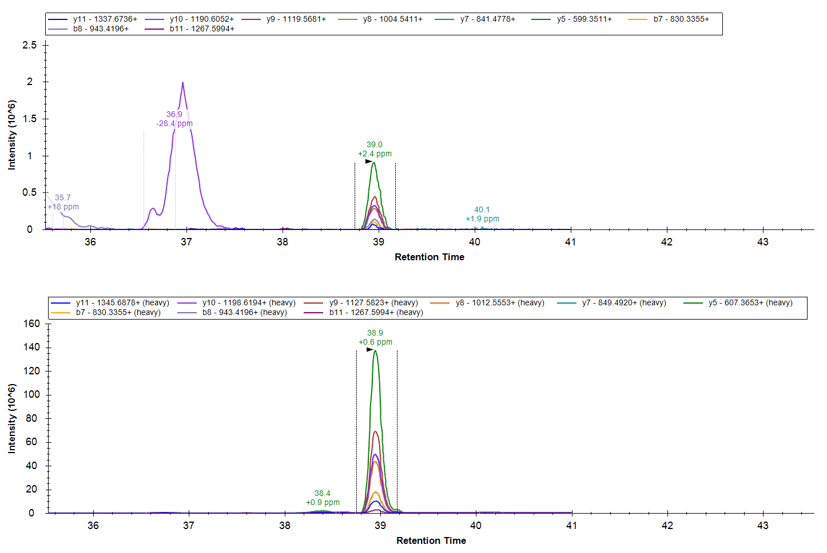
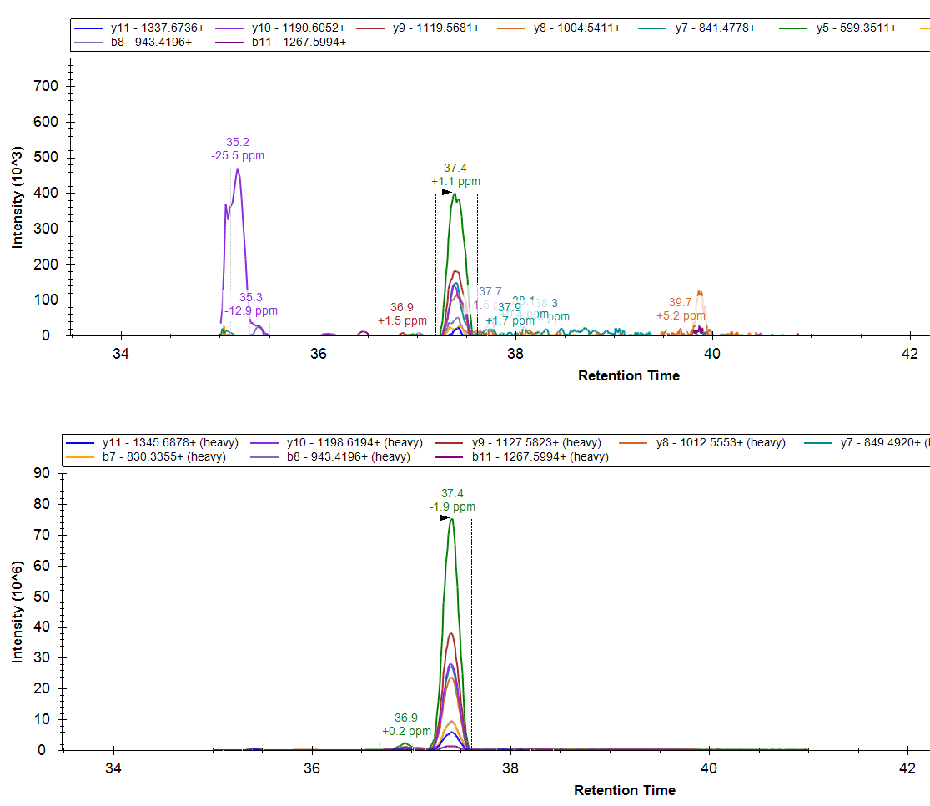
Then I applied PRM for this peptide (and others) to samples
Sample 1
The amount of heavy I have spiked in is 2200 fmol approximately
If I use the formula L/H=[L]/[H] to find the concentration of the light peptide :
For sample 1 I find : 0.006*2200 fmol= 13 fmol
This below the 20 fmol which was the last point which I could see (previous slide)
Ratio L/H= 0.01
Light
Heavy
Ratio L/H= 0.006
The amount of heavy I have spiked in is 2200 fmol approximately
If I use the formula L/H=[L]/[H] to find the concentration of the light peptide :
For sample 1 I find : 0.005*2200 fmol= 11 fmol
This below the 20 fmol which was the last point which I could see (previous slide)
Light
Heavy
Ratio L/H= 0.005
Notes:
6887
Ratio L/H= 0.01
The final concentration of my heavy in both cases is 5 fmol/uL
Light
Heavy

Slide 6
In case you ask me why I didn’t use the equation that the curve gives me to do the calculations is because even when I tried this, things didn’t make more sense.
If I use this equation y=0.0165x to calculate the amount of my light peptide…
From the previous example
Y=L/H=0.006
X= amount of light I want to calculate (fmol)
y=0.0165x
y/0.0165=x
0.006/0.0165=0.364 fmol
This is an amount which I shouldn’t be able to “see”..
H/L
Fmol of heavy

