Slide 1
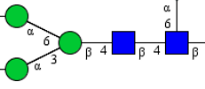
Glycan Oxford nomenclature cheat sheet
Read the glycan from backbone to reducing end
FA2G2S1
Fucose (F)
Galactose (G)
Glucose
Mannose (M)
N-acetyl galactosamine (GN)
N-acetyl glucosamine aka GlcNAc (A)
Sialic acid (S)
1 core fucose
1 sialic acid
2 galactose
2 antenna
starting with GlcNAc
This is the “trimannosyl core.” It is assumed, not denoted, as it is common to all N-glycans
Note:

Slide 2
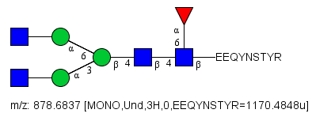
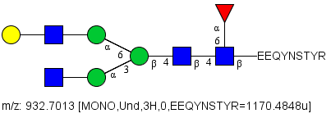
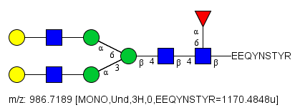
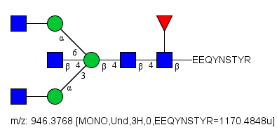
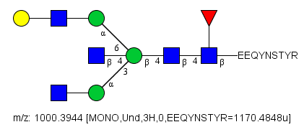
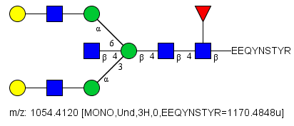
Structures and masses by Glyco Workbench. Oxford nomenclature used to denote glycans.
I am monitoring these 13 glycans.
Here they are shown on IgG1: EEQYNSTYR. These are 13 precursor masses I monitor.
They can also be on IgG2, 3, and 4.
IgG2/3 can share a sequence: EEQFNSTFR. Some IgG3 also has a sequence of EEQYNSTFR. IgG4 has a sequence of EEQFNSTYR, which has the same mass as some IgG3. To answer my particular questions, I don’t care or need to do the fragmentation to distinguish these, so I monitor 3 “buckets”: IgG1, IgG2/3, IgG3/4. For my current experiment’s samples, I know IgG4 is very low, and so is the IgG4-like type of IgG3, so I really just monitor IgG1 and IgG2/3.
Using the special ions approach, I only need to create 4 special ions, because no matter what the glycan is, they all contain the Y1, and the fucosylated ones all contain the Y1+F as well as the Y1. So the 4 special ions are:
-Y1 and the Y1+F for IgG1 peptide backbone
-Y1 and the Y1+F for IgG2/3 peptide backbone
FA2
A2
FA2G1
A2G1
FA2G2
A2G2
FA2G1S1
A2G1S1
FA2G2S1
A2G2S1
Y1 for IgG1
m/z = 1392, +1
Y1 for IgG2/3
m/z = 1360, +1
Y1+F for IgG1
m/z = 1538, +1
Y1+F for IgG2/3
m/z = 1538, +1
FA2Bi (as in bisecting)
FA2BiG1
FA2BiG2

Slide 3
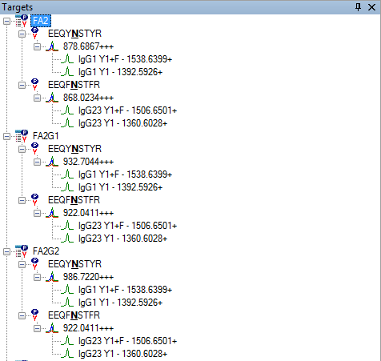
Skyline document—showing only FA2, FA2G1, and FA2G2 for now.
FA2 can be on IgG1: EEQYNSTYR (to generate the Y1 and the Y1+F specific to IgG1)
FA2 can be on IgG2/3: EEQFNSTFR (to generate the Y1 and the Y1+F specific to IgG2/3).
Those same special ions are detected when different glycans (like FA2G1 or FA2G2) are present on the peptides, because the Y1 and Y1+F ions are the same no matter what the glycan is. Only the peptide backbone would change the mass, and I’m only monitoring 2 different peptide backbones.

