Slide 1
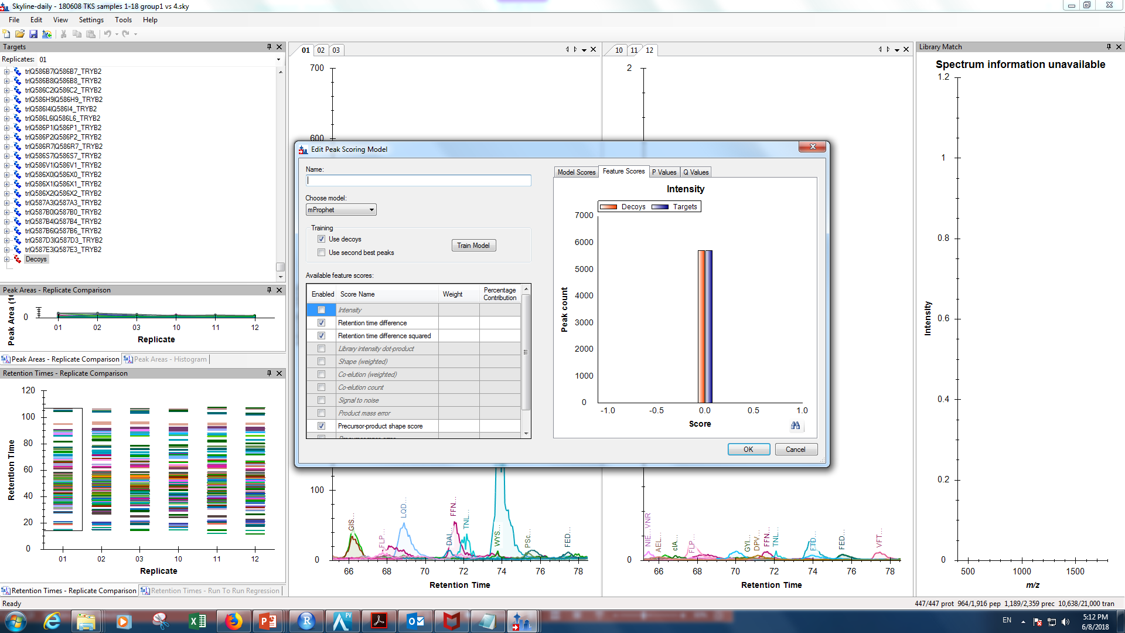
Peak scoring model on default and not mprophet

Slide 2
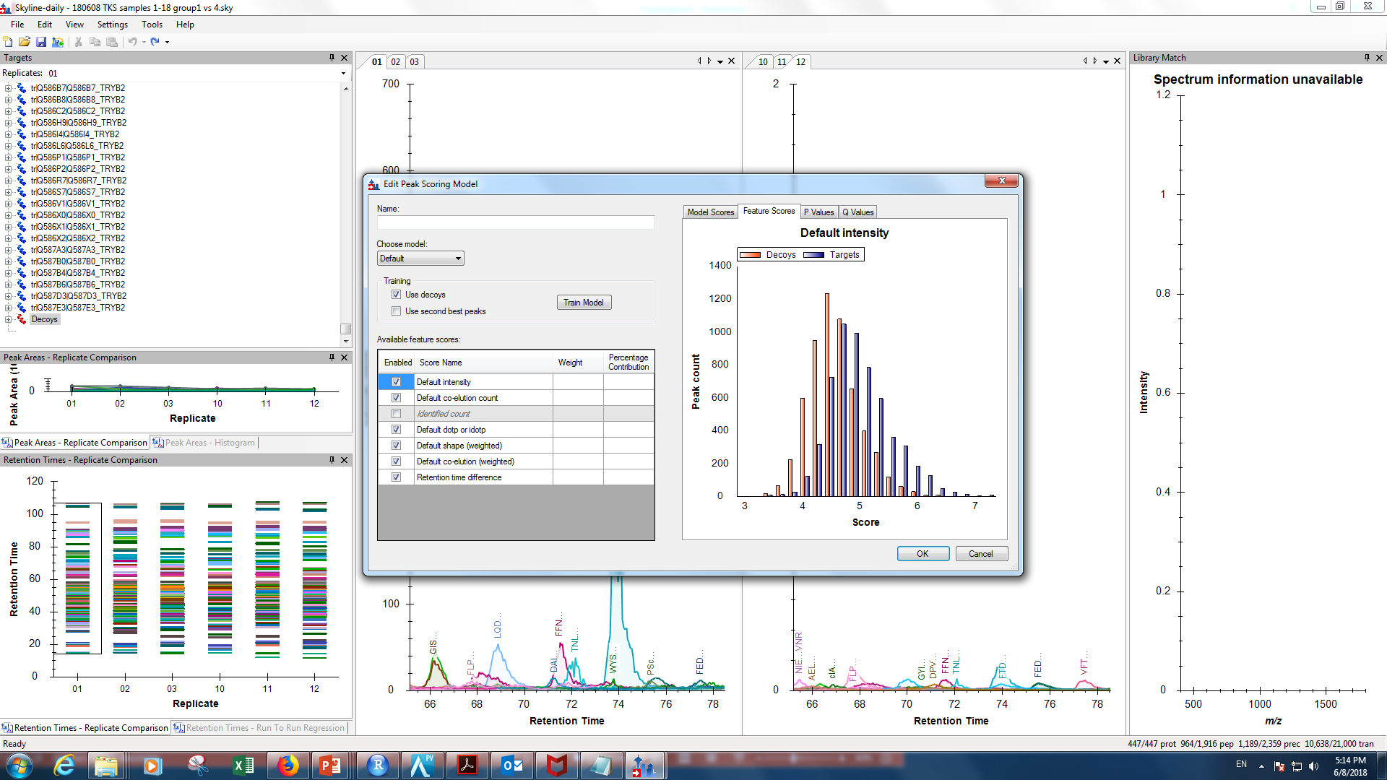
Peak scoring model on default and not mprophet

