Slide 1
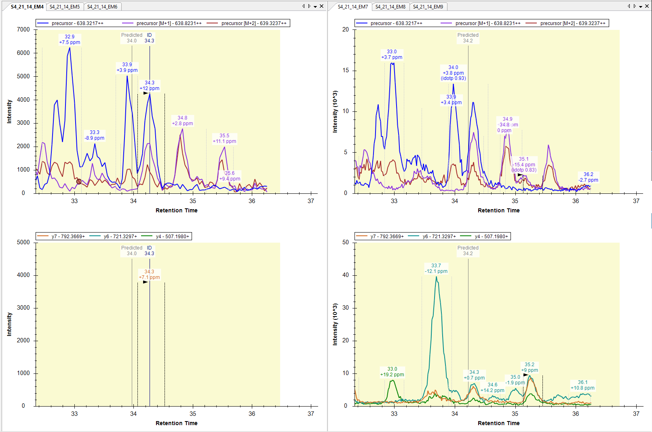
T.EQILALTGC[+57]DR.L [229, 239]
638.3217++ (idotp 0.94, dotp 0.98)
DDA File; ignore
R.TEQILALTGC[+57]DR.L [228, 239]

Slide 2
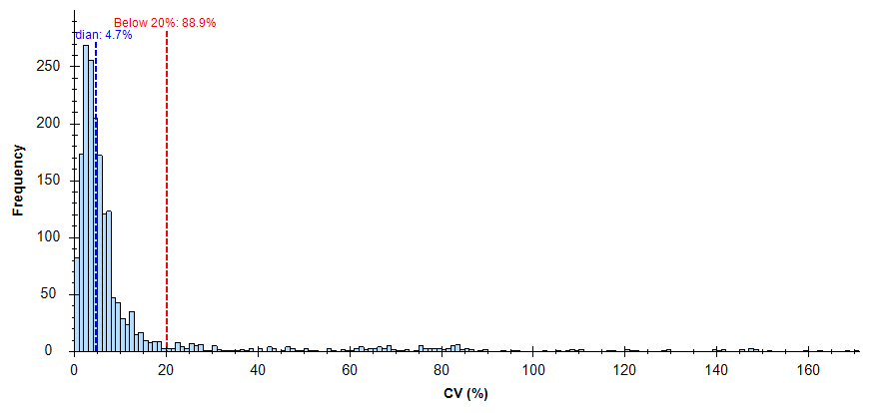
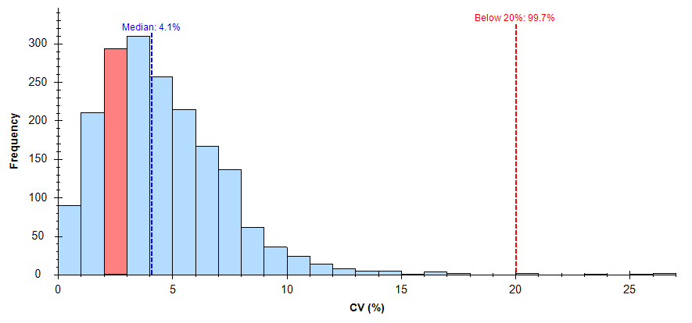
Fig 1. No chromatographic peak correction; „raw“ import
Fig 2. After chromatographic peak correction

Slide 3
