Slide 1
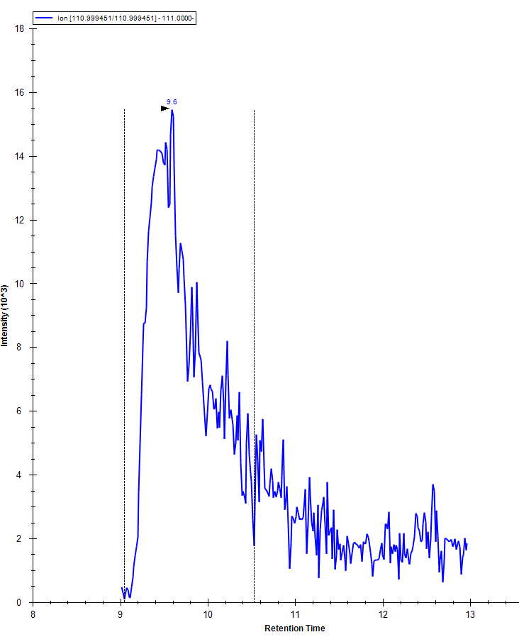
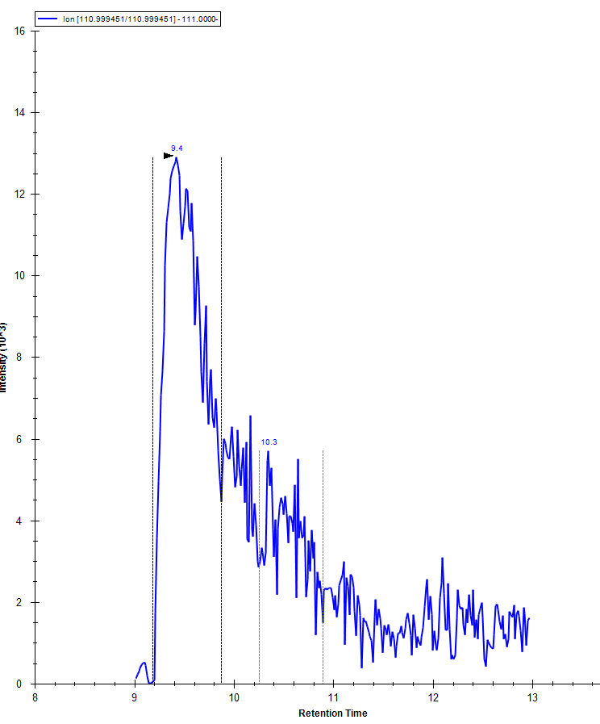
Default integration of citrate by Skyline
Integration for compounds like citrate is not consistent sample to sample
Sample 1
Sample 2

