Slide 1
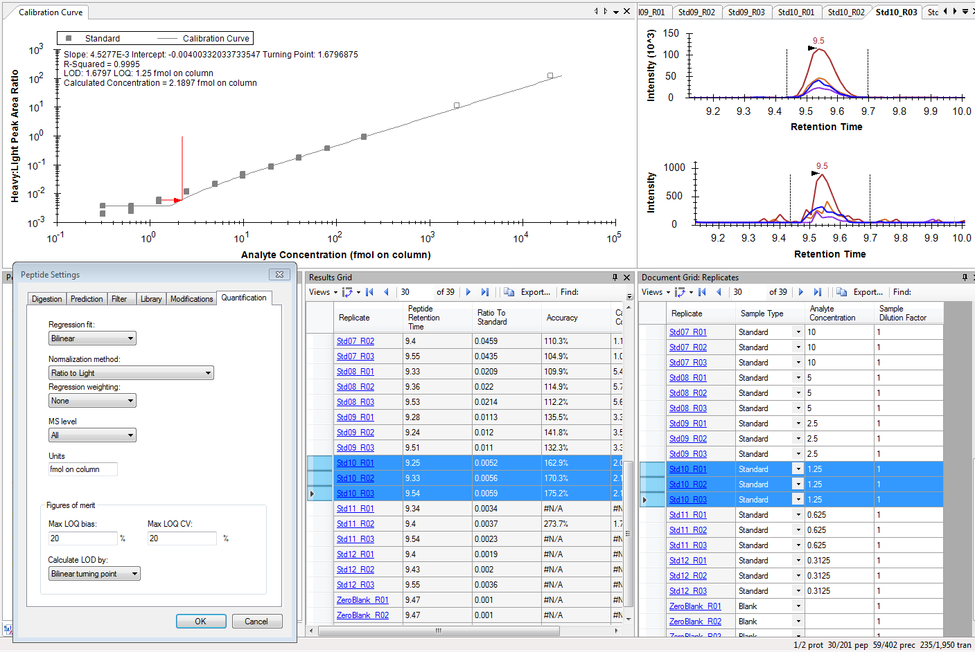
Example: LOQ is calcualted to be 1.25fmol (Standard 10). However the accuracies for all 3 replicates of Standard 10 are >120%, even though Max LOQ bias is set to 20%

