Slide 1
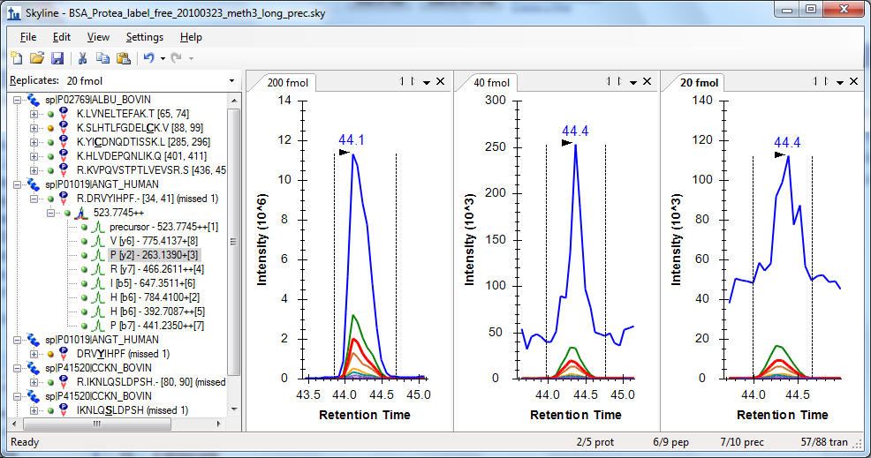
When Selectivity Becomes Sensitivity
Decreasing noise increases signal-to-noise

Slide 2
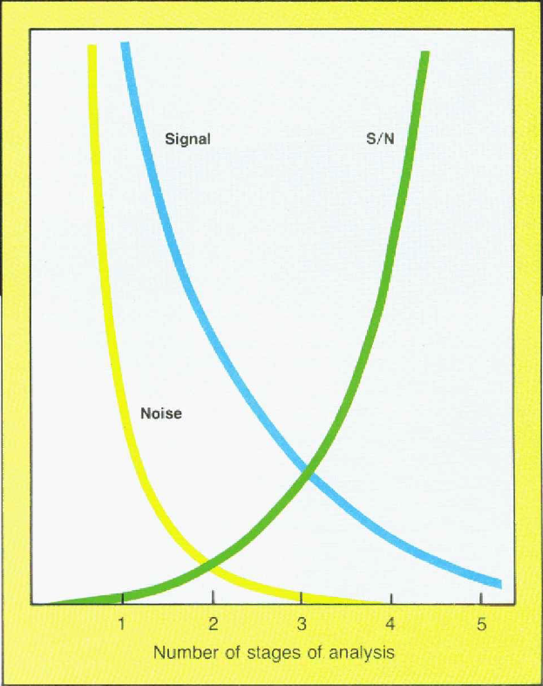
Balancing Signal vs. Noise
Selectivity
Complexity

Slide 3
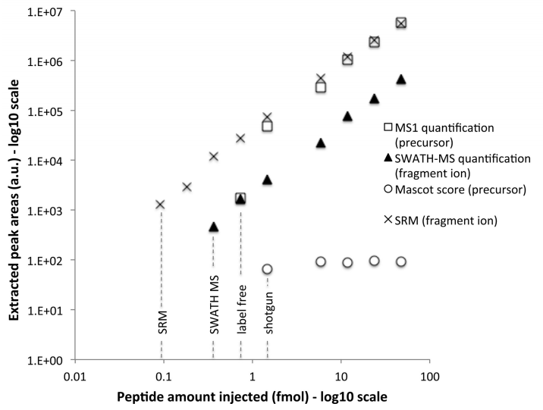
Ordering Acquisition by Selectivity
PRM?
MS1
Gillet, et. al, MCP 2012

Slide 4
Relative Selectivity
PRM (2 m/z isolation and >17,000 resolving power)
SRM (0.7 m/z isolation, and 0.7 m/z fragment filter)
DIA (10-25 m/a isolation, and >17,000 rp)
All Ions with IMS? (IMS separation, and >17,000 rp)
MS1 Filtering (no isolation, precursors >17,000 rp)
All Ions without IMS (no isolation, and >17,000 rp)

