Slide 1
Open Skyline_2peptides.tsv

Slide 2
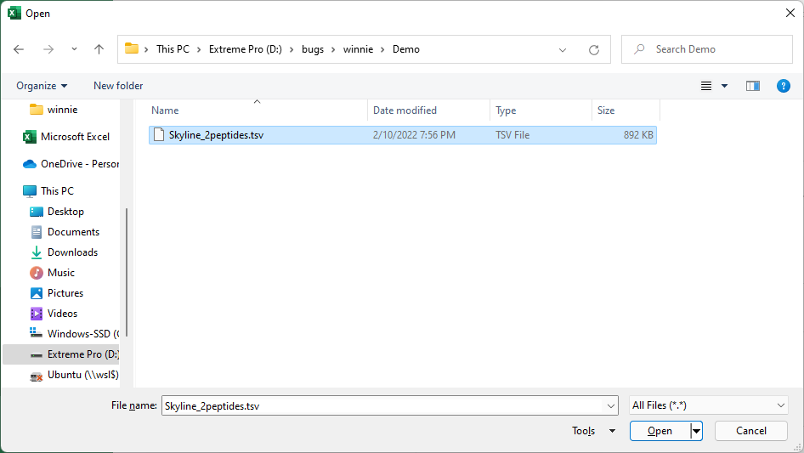
Open File

Slide 3
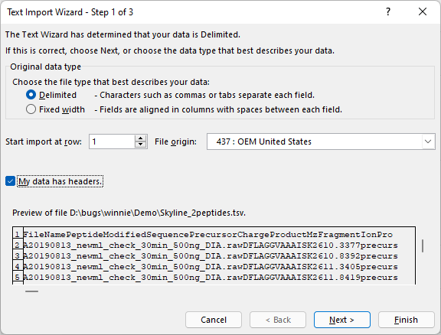
Click “My data has headers” and then press “Next”

Slide 4
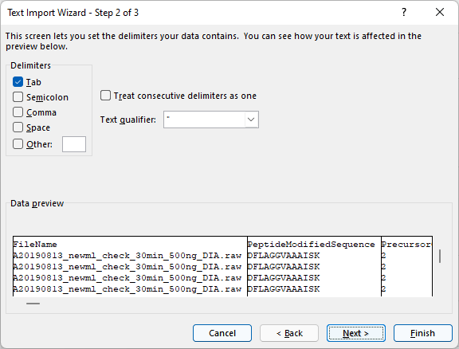
Push “Next”

Slide 5
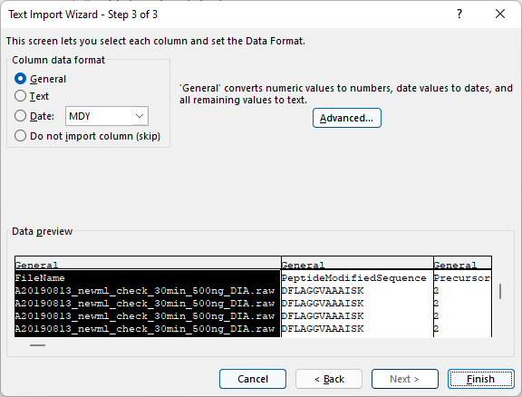
Push “Finish”

Slide 6
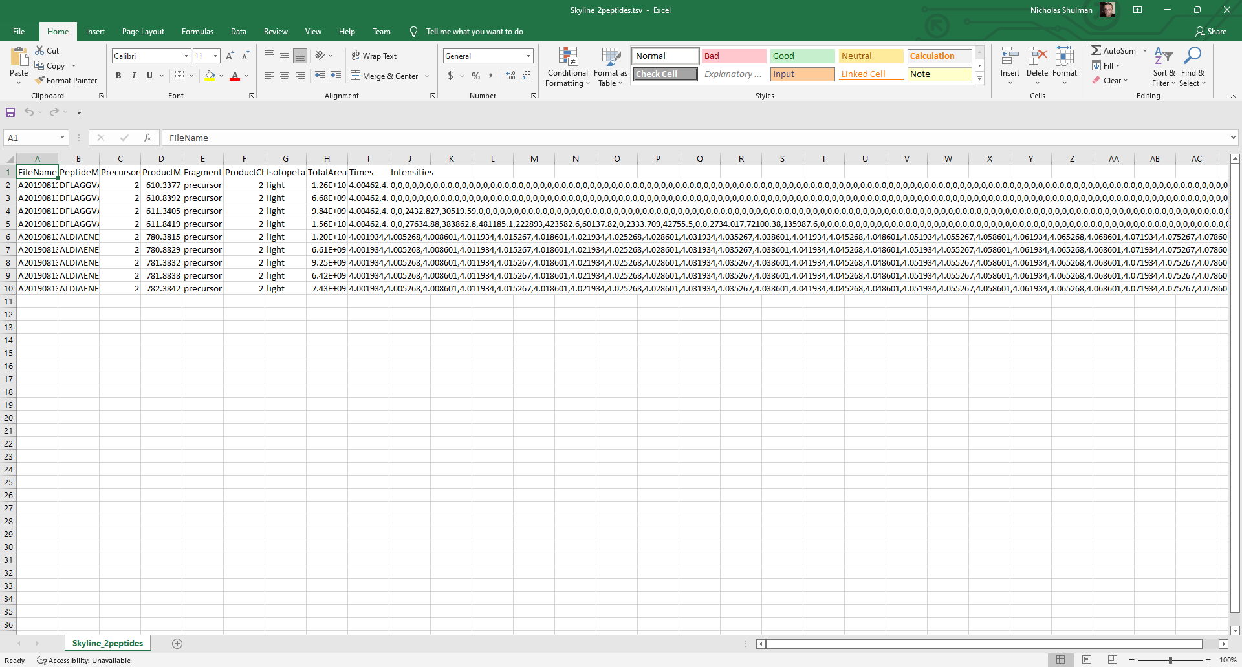
Looks fine to me

Slide 7
Excel version information

