Slide 1
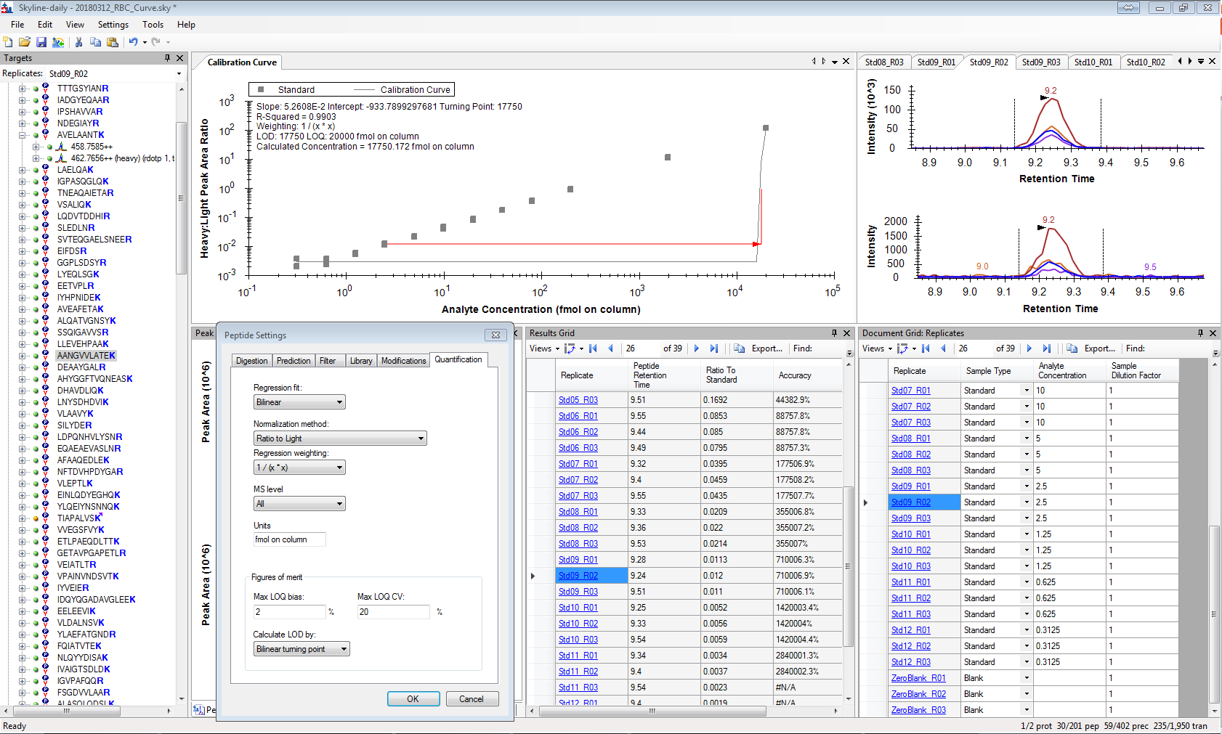
Example: LOQ calculated as the highest concentration standard when bilinear regression + weighting is used. If the highest standard is excluded, the next highest standard becomes the LOQ.

Slide 2
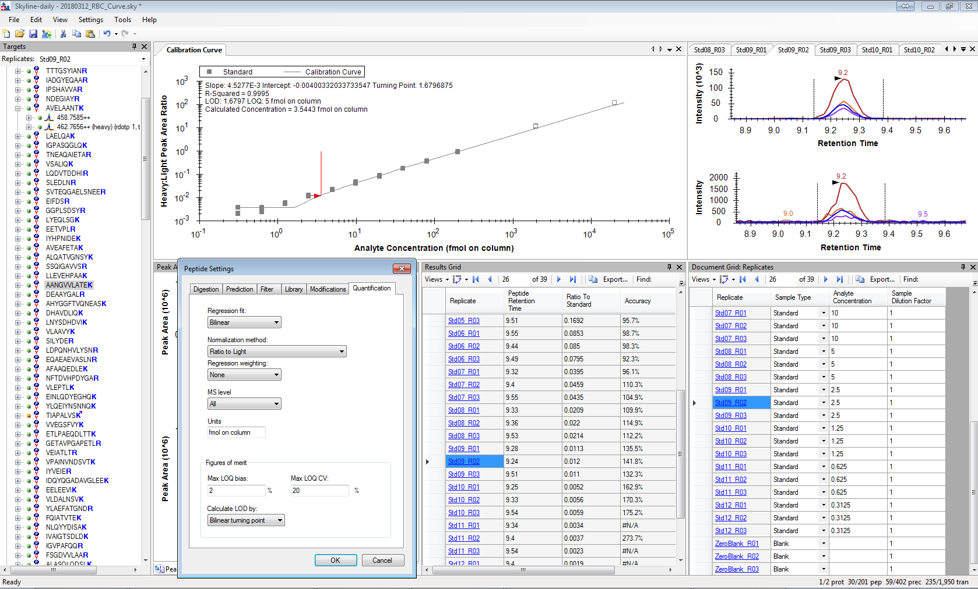
Example: LOQ is lower when bilinear regression + no weighting is used. Excluding standards from the curve decreases the LOQ.

Slide 3
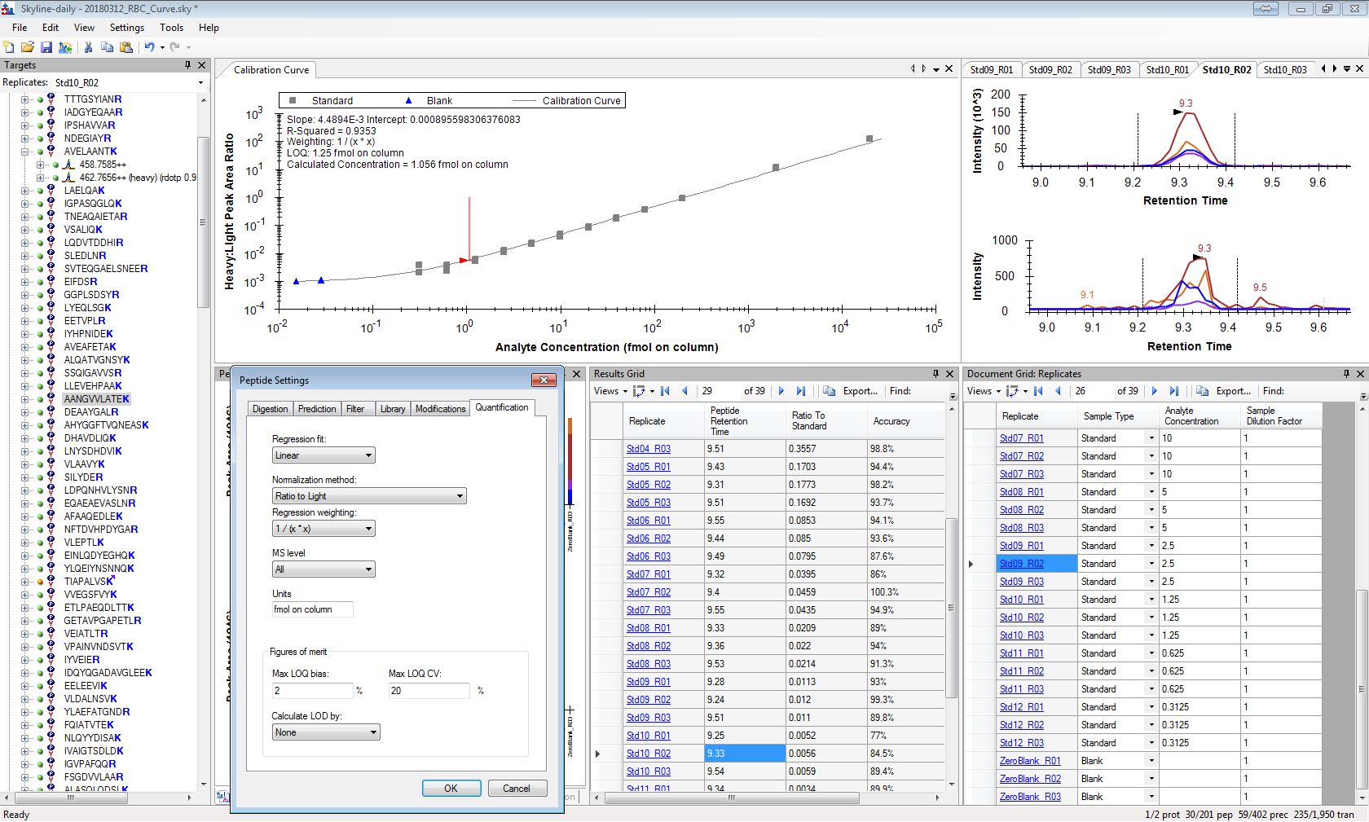
Example: LOQ is lowest using linear regression + weighting.

