Slide 1
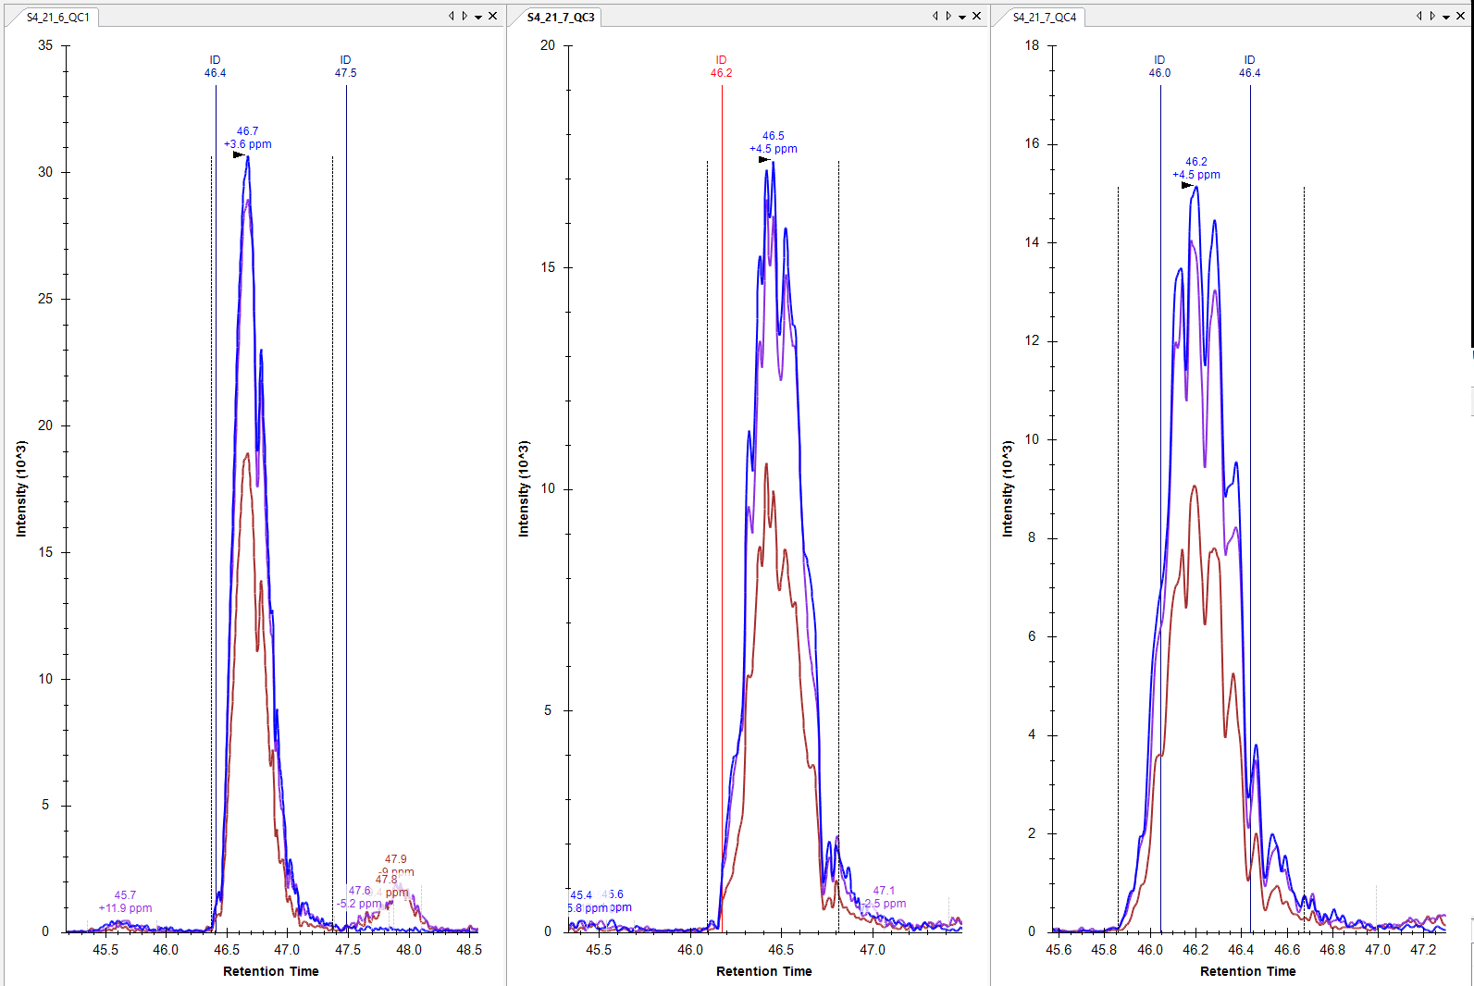
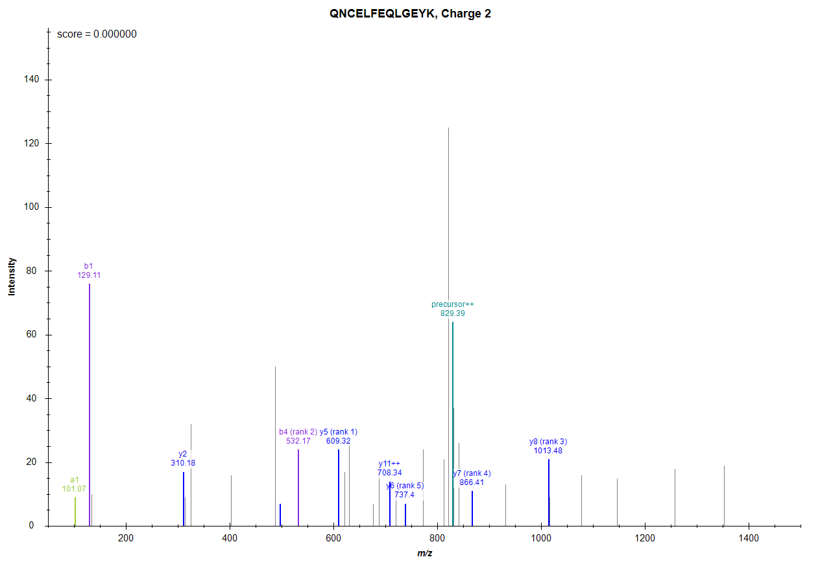
K.QNC[+57]ELFEQLGEYK.F [413, 425]
829.3800++ (idotp 0.99, dotp 0.88)

Slide 2
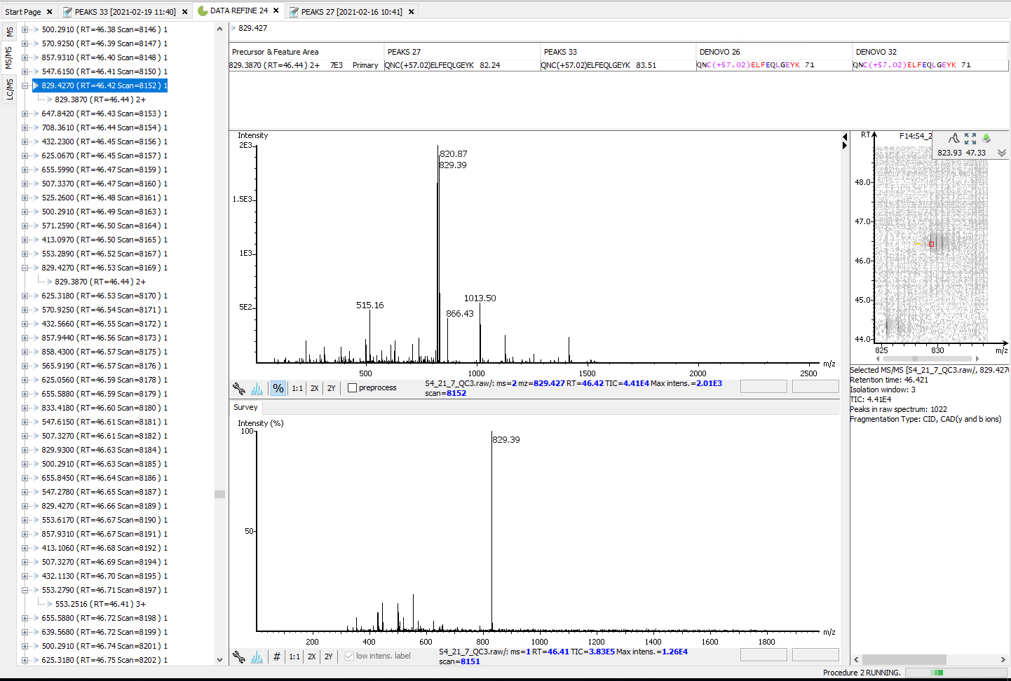
RT: 46.44 min

Slide 3
RT: 46.44 min

