Slide 1
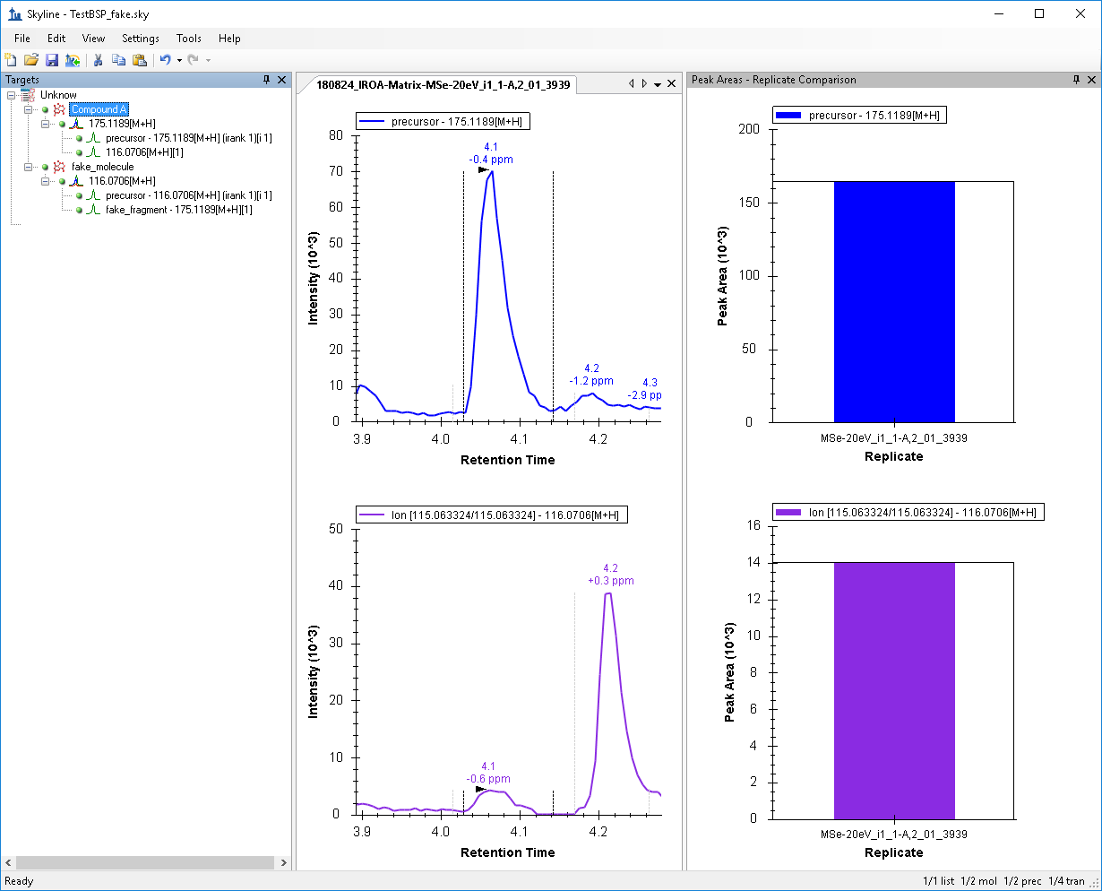
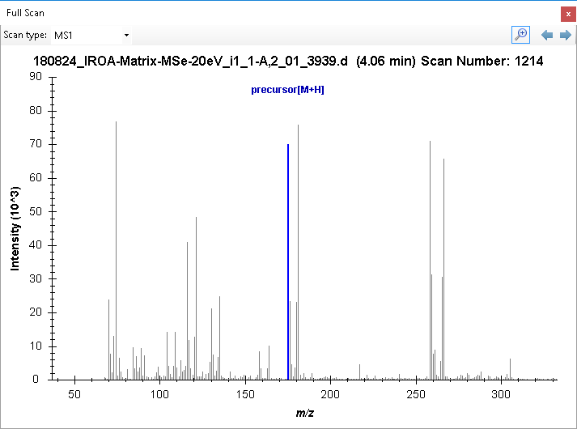
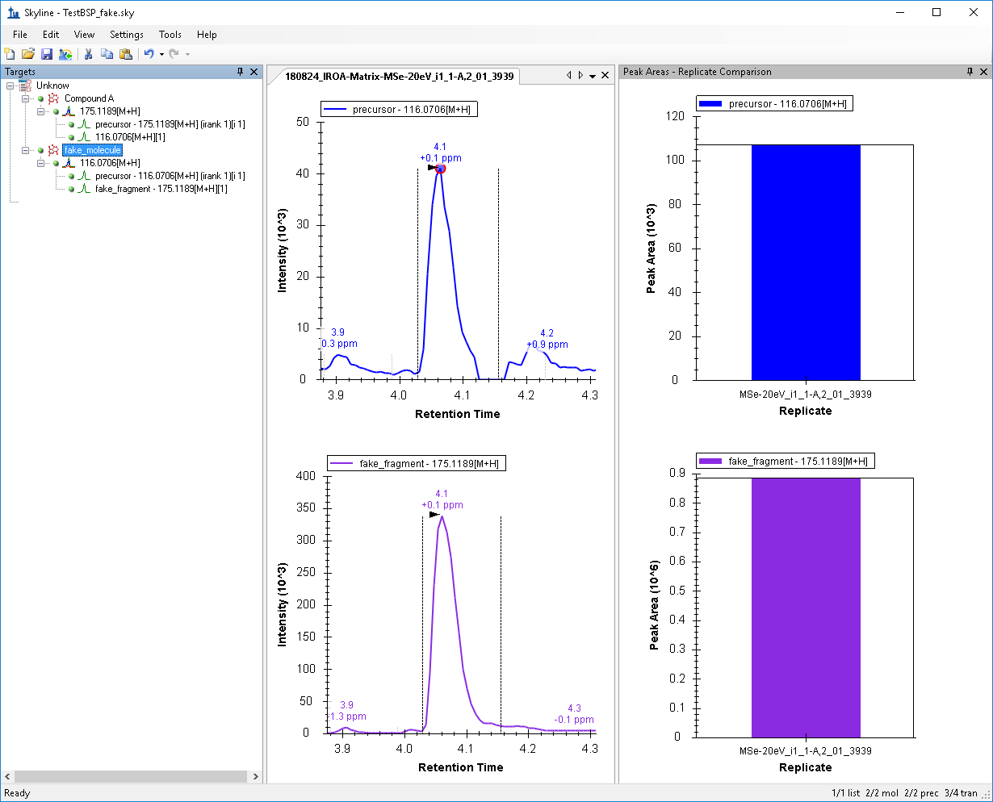
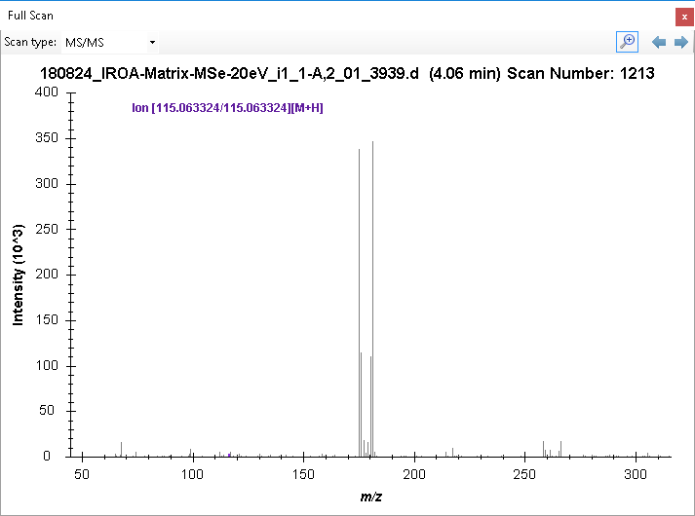
Compound A: 175.1189 -> 116.0706
We expect: 175.1189 precursors ions intensity higher in MS1 vs MS/MS spectra -> not the case, flipped around
116.0706 products ions intensity higher in MS/MS vs MS1 spectra -> not the case, flipped around
Precursor
Product
Precursors
Product

Slide 2
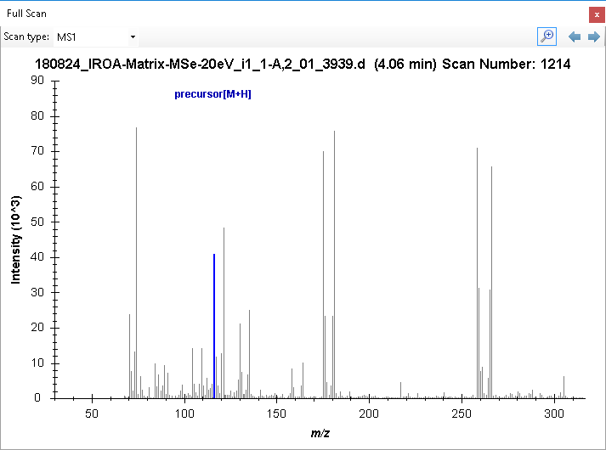
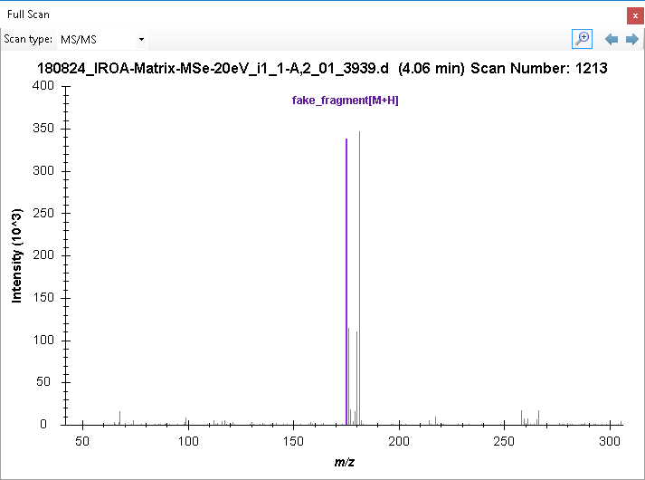
fake_molecule: 116.0706 -> 175.1189
We expect if Low CE/High CE are inverted : 116.0706 precursors ions intensity higher in MS1 vs MS/MS spectra -> correct
175.1189 products ions intensity higher in MS/MS vs MS1 spectra -> correct
Product
Precursor
Product
Precursor

Slide 3
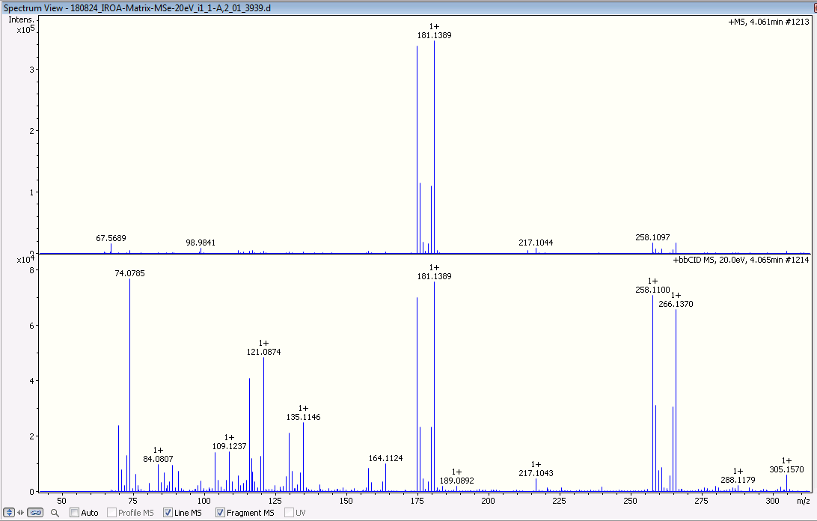
From Skyline
From Bruker Compass DataAnalysis
Precursor
Odd Scan Number = Low CE
Precursor
Product
Even Scan Number = High CE
Product
Precursor
Product

Slide 4
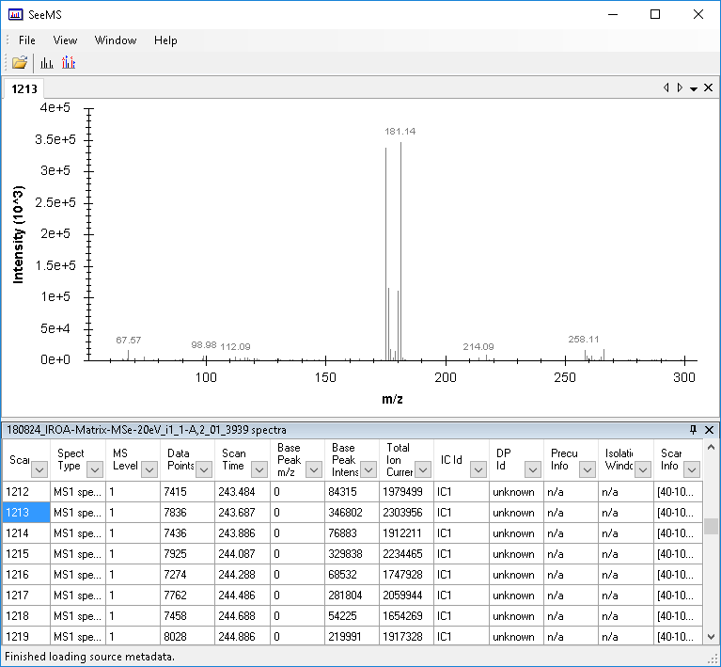
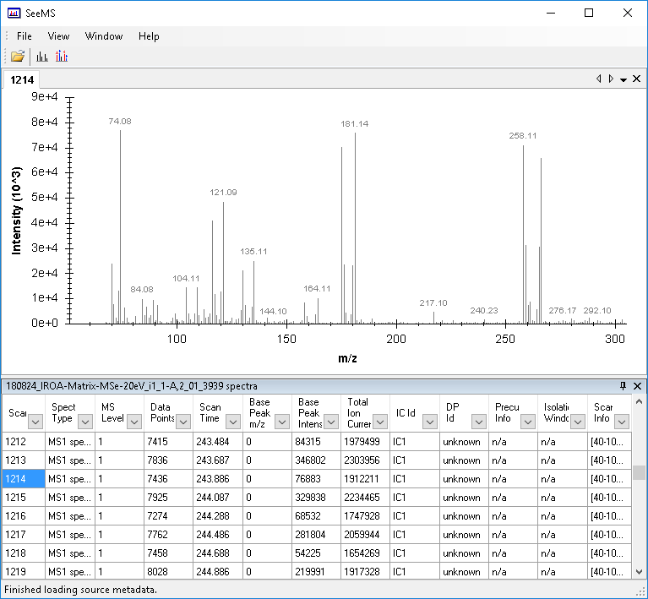
From Proteowizard SeeMS
Scan 1213, supposedly Low CE
Scan 1214 , supposedly High CE
Precursors 175.1189
Product 116.0706

