Slide 1
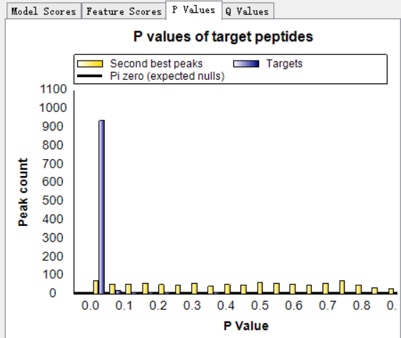
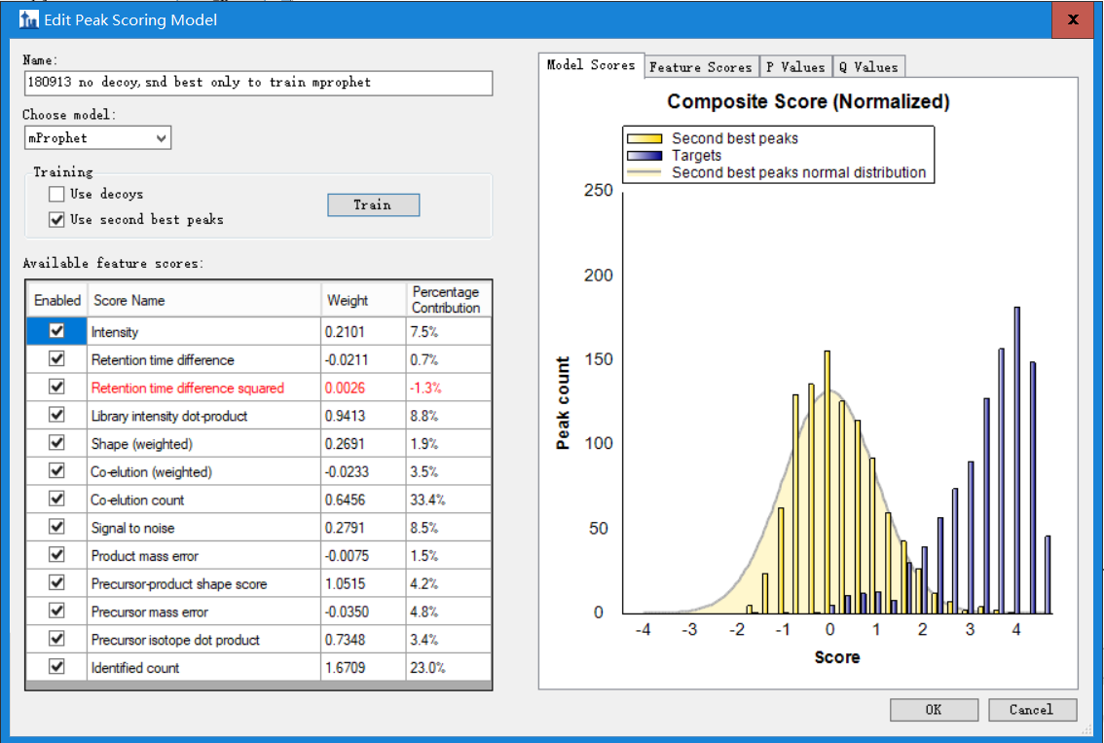
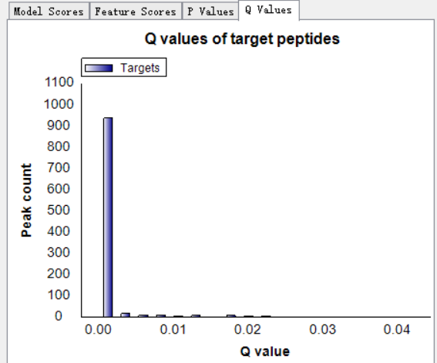
No decoy, only second best

Slide 2
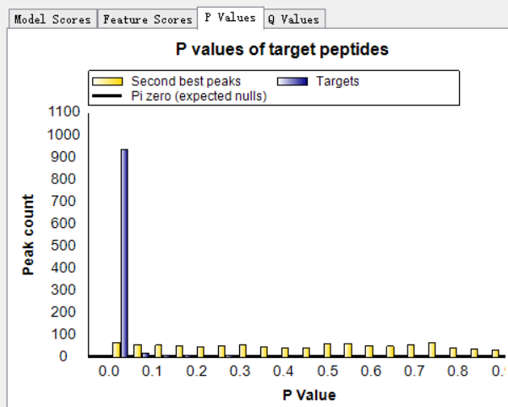
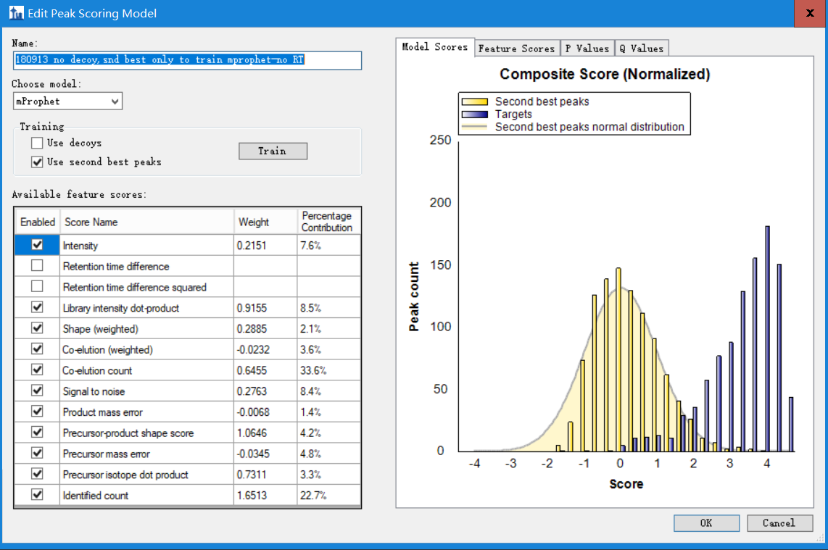
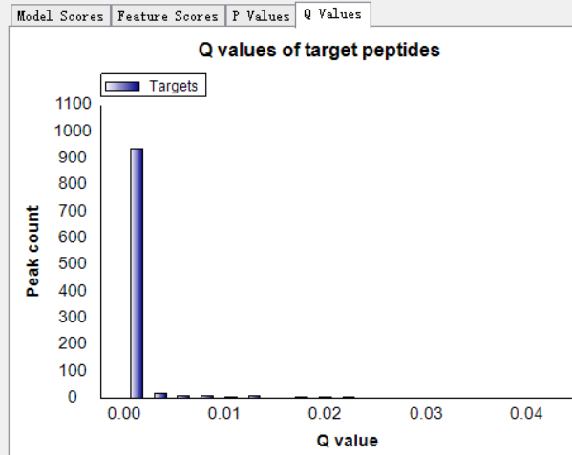
No decoy, only second best
+unchecked 2 RT subscores!
Notes:
Brendan: One thing we maybe should be enforcing is that I don't really think it is valid to use retention time scores when you are using second-best peaks, because these scores are not independent between your targets and decoys. The fact that you expect your targets to show up close to the predicted retention times means that the second best peaks have less available time at which to be close to predicted RT themselves. This is just a feeling I have never tested myself, but the scores really should be independent.

