Slide 1
SkyLine question
Krista Longnecker
15 June 2022

Slide 2
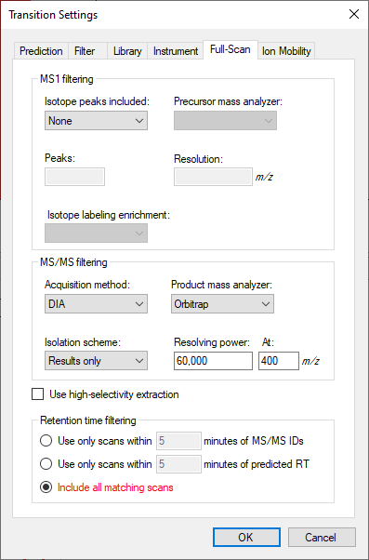
Settings
Also note: explicit retention time is blanked out when the transitions are imported

Slide 3
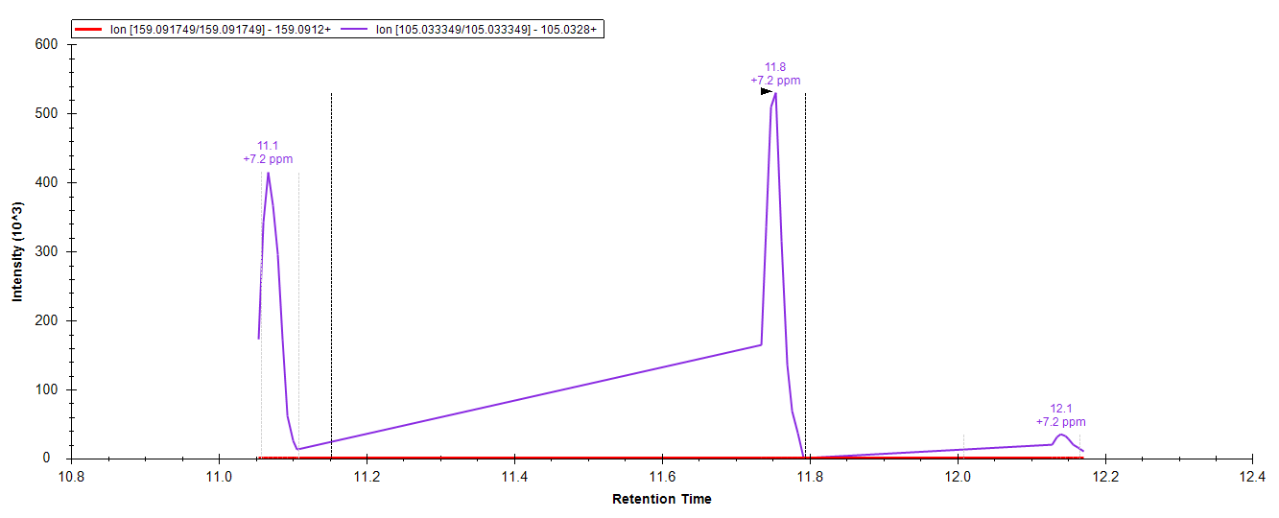
Tryptophan: MS2 in SkyLine

Slide 4
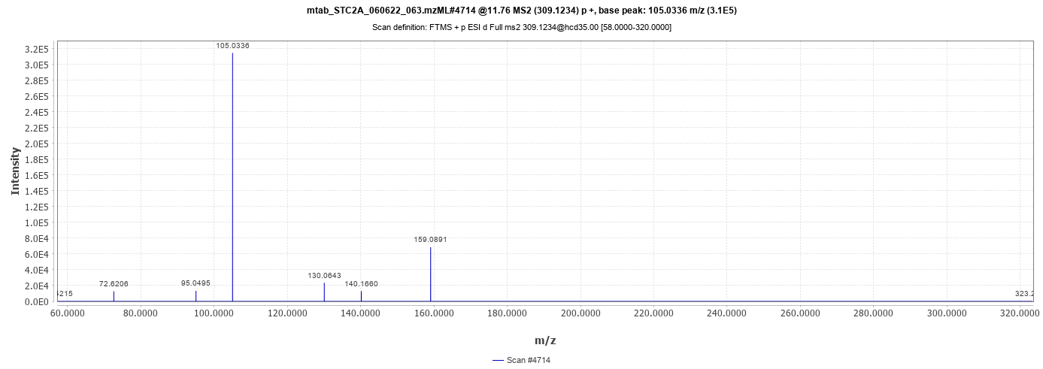
Tryptophan: MS2 in MZmine
The arrow points to the transition 309.1234 → 159.0912 that is missing from SkyLine. It has a peak intensity of e4, and is present in more than six MS2 scans (in this sample).

Slide 5
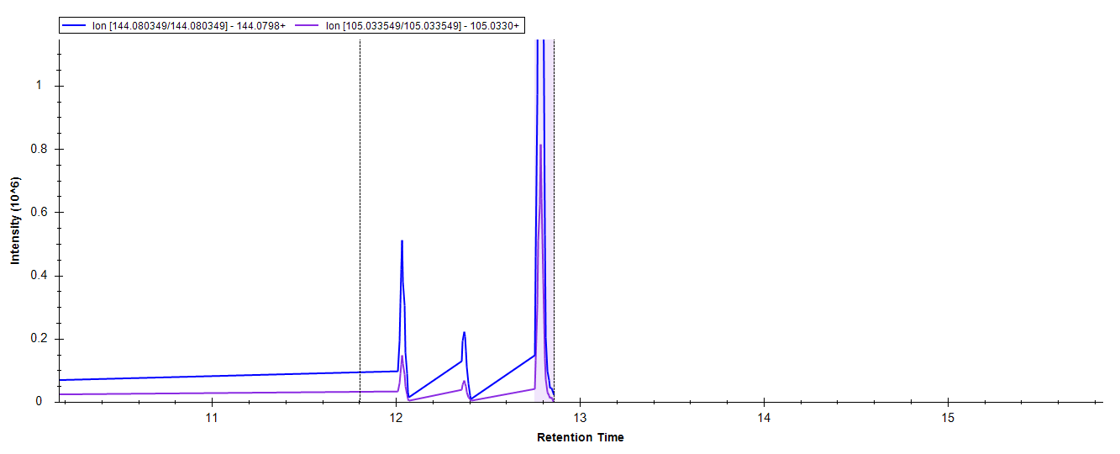
Tryptamine: MS2 in SkyLine

Slide 6
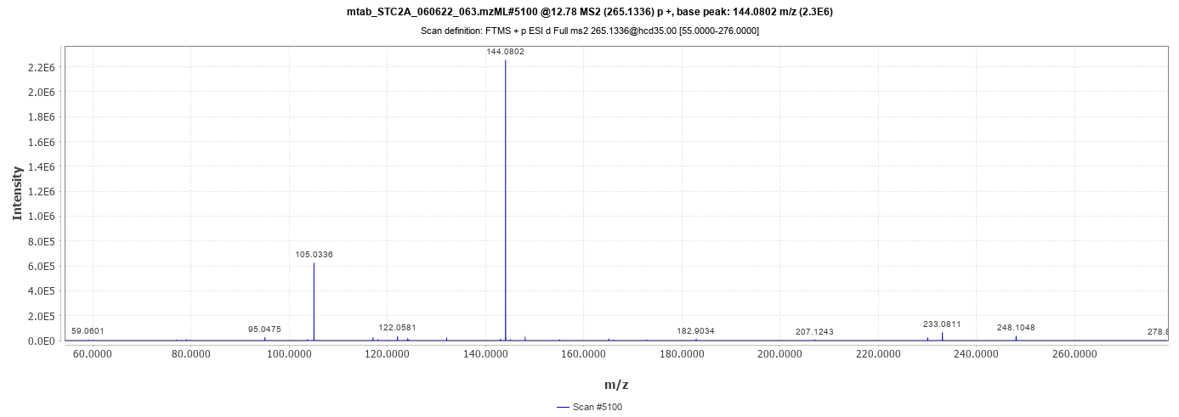
Tryptamine: MS2 in MZmine
The fragments for tryptamine have higher intensities (>e5), and the arrows points to two transitions that are both found by SkyLine

