Slide 1
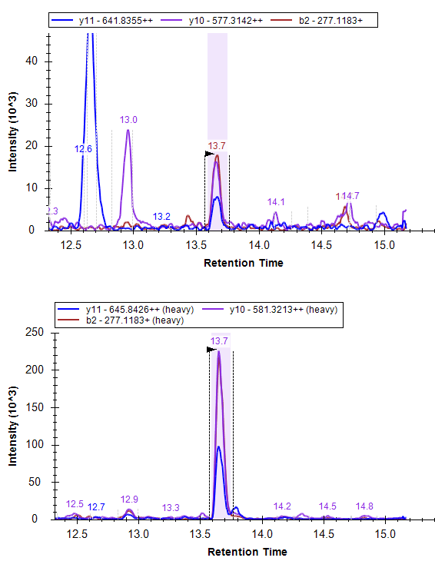
UniProtKB - Q15165 (PON2_HUMAN) is quantified by two signature peptide
Peptide1. FEEAENSLLHLK
Peptide2. LFVYDPNNPPSSEVLR
Peptide1. FEEAENSLLHLK
We have selected two signature peptide for a human
Protein (PON2) and each peptide is monitored by
three fragment – method is validated
Case 1: Peptide 1 – chromatograms at the left
If the correlation between each fragment is good –
As shown here, it indicates
All the fragments belongs to peptide
Integration is good for all the samples
No interference (matrix effect) is observed for a
particular fragment
This is a quality check for the data
This correlation can be bad if one of the fragment
suffer matrix effect or somewhat not integrated
Properly – see peptide 2 (next slide)

Slide 2
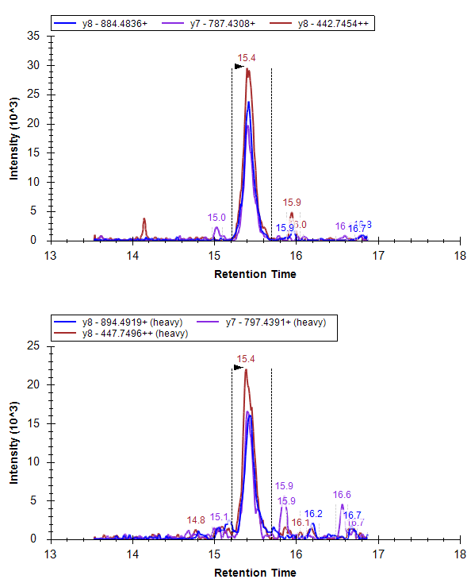
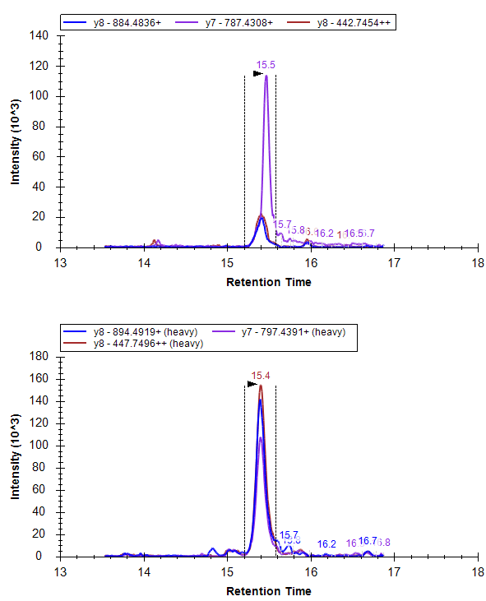
Peptide2. LFVYDPNNPPSSEVLR
A - QC
B - unknown
Case II: In the above example peptide 2 is also validated and shows a good chromatogram in QC sample. But in unknown sample, due to some interference eluting at the same retention time, one of the fragment shows high and variable peak area (high ionization) and many of the time its retention time is also exactly the same.
Here correlation between the fragment helps to detect the wrong fragment or pick the sample where interference is affecting the peak area. In the above case fragment 2 is bad or affected by interference, hence correlation with fragment 2 is bad.
This function should be added into the skyline to check correlation between two fragment or two peptides of the same protein.

