Slide 1
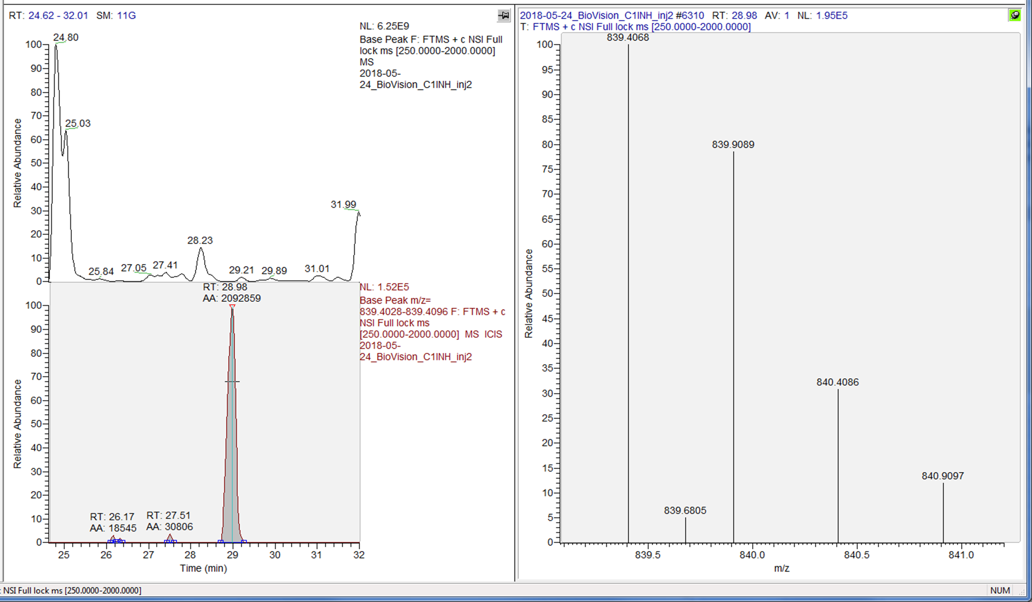
MS
XIC-MS

Slide 2
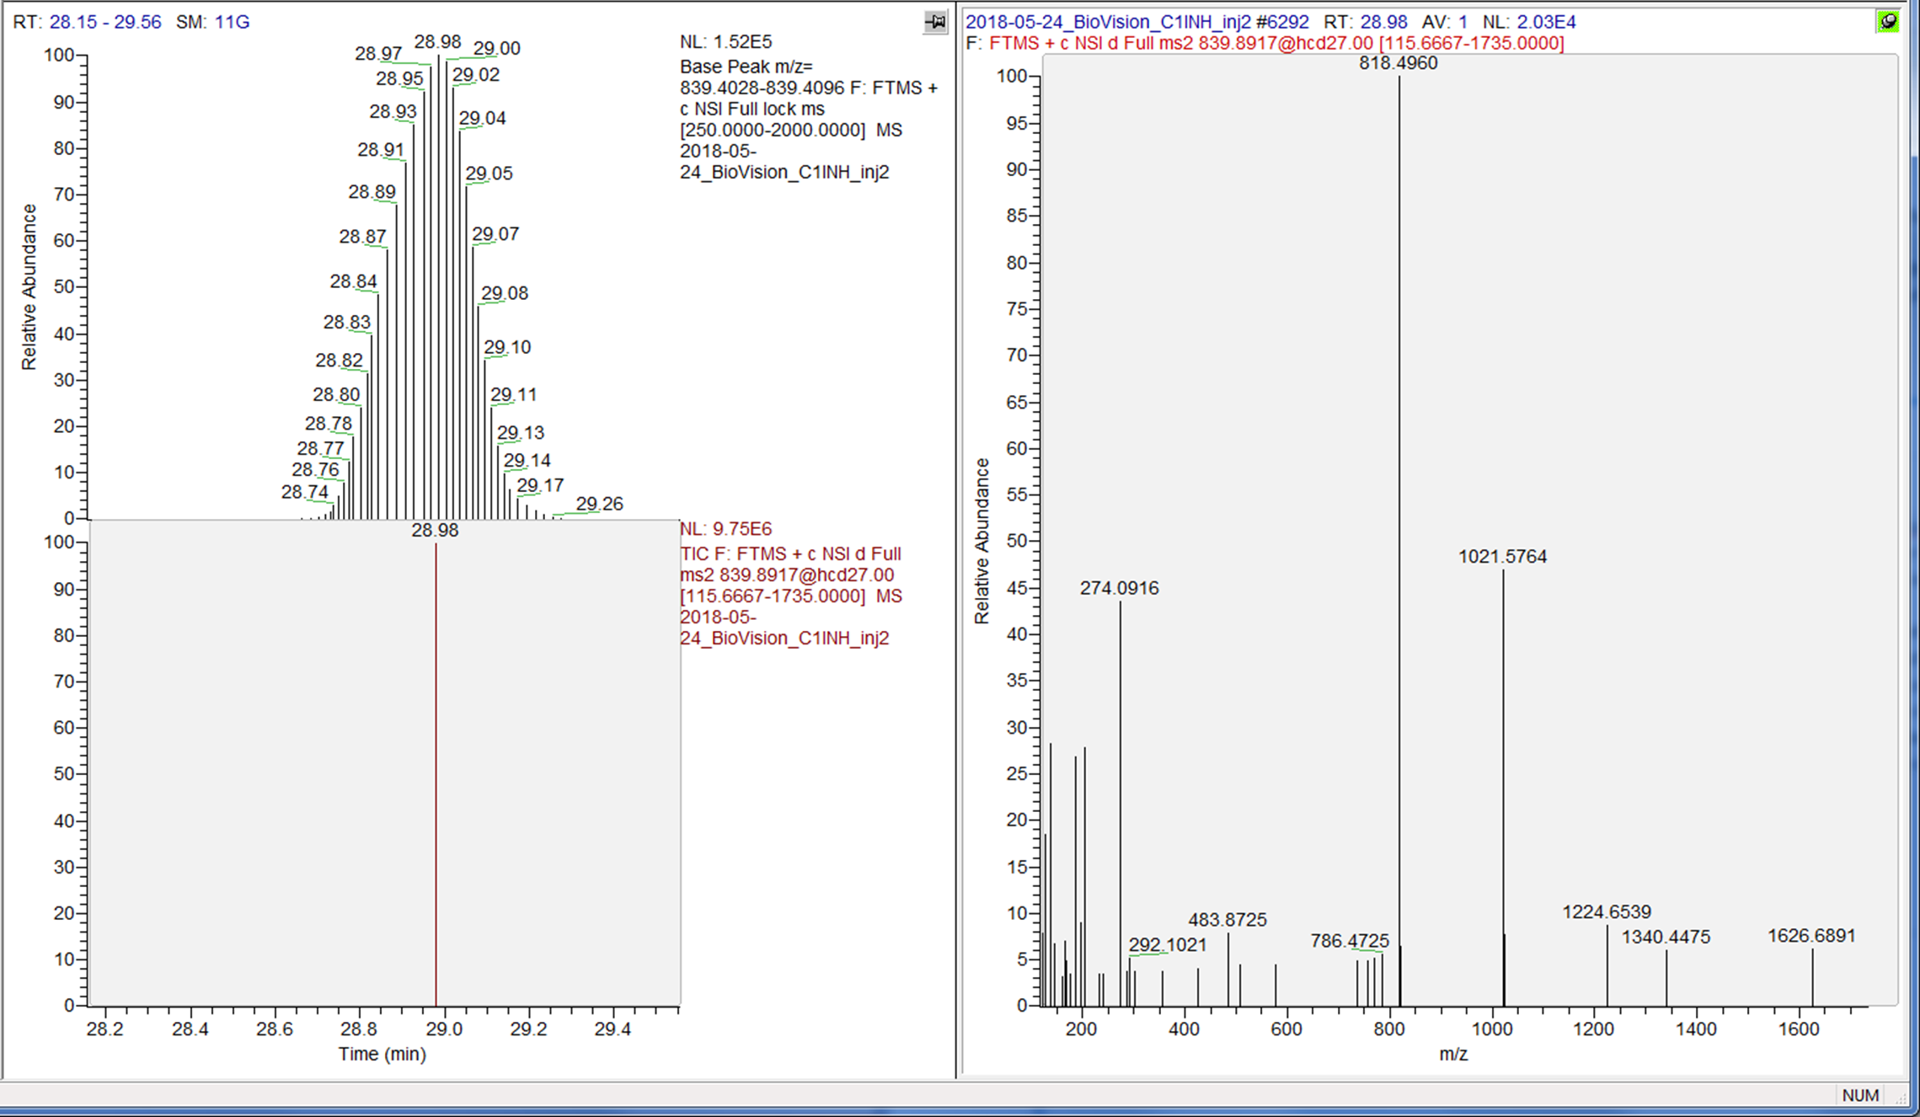
XIC-MS
1.5E5
y8
MSMS
NeuAc-H2O
XIC-MSMS
9.7E6 ?
Hmm..Go figure this 64 fold increase in intensity

Slide 3
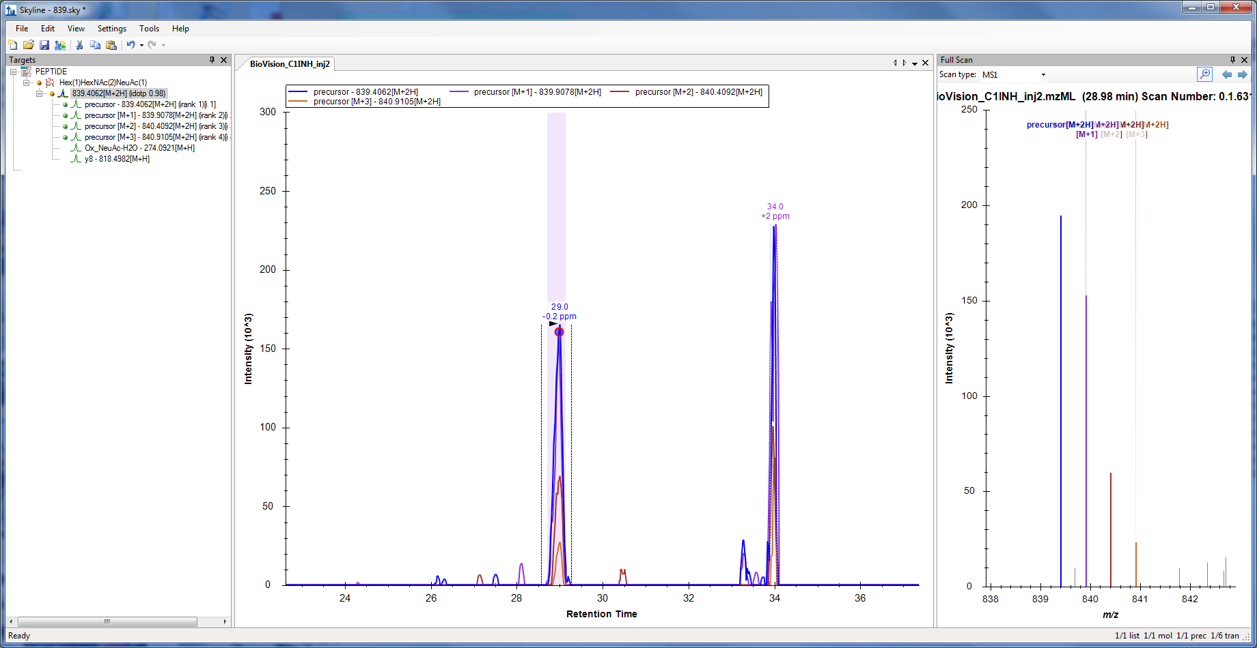
mzML IMPORT
Please note fragments not picked

Slide 4
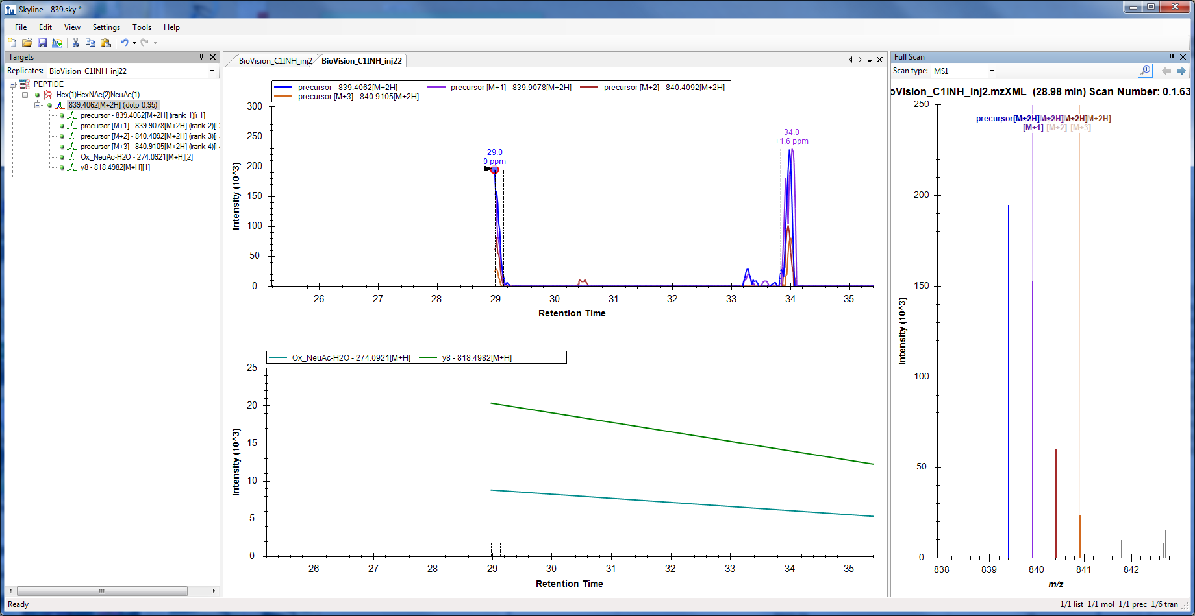
mzXML IMPORT
Peak Cut in half
Please note fragments ARE picked

Slide 5
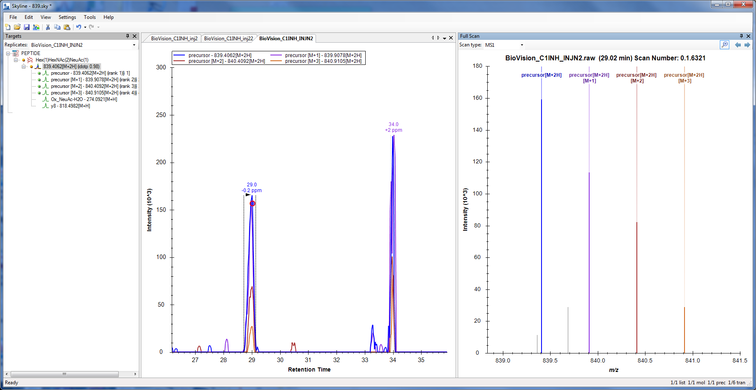
RAW IMPORT
Please note fragments not picked

Slide 6
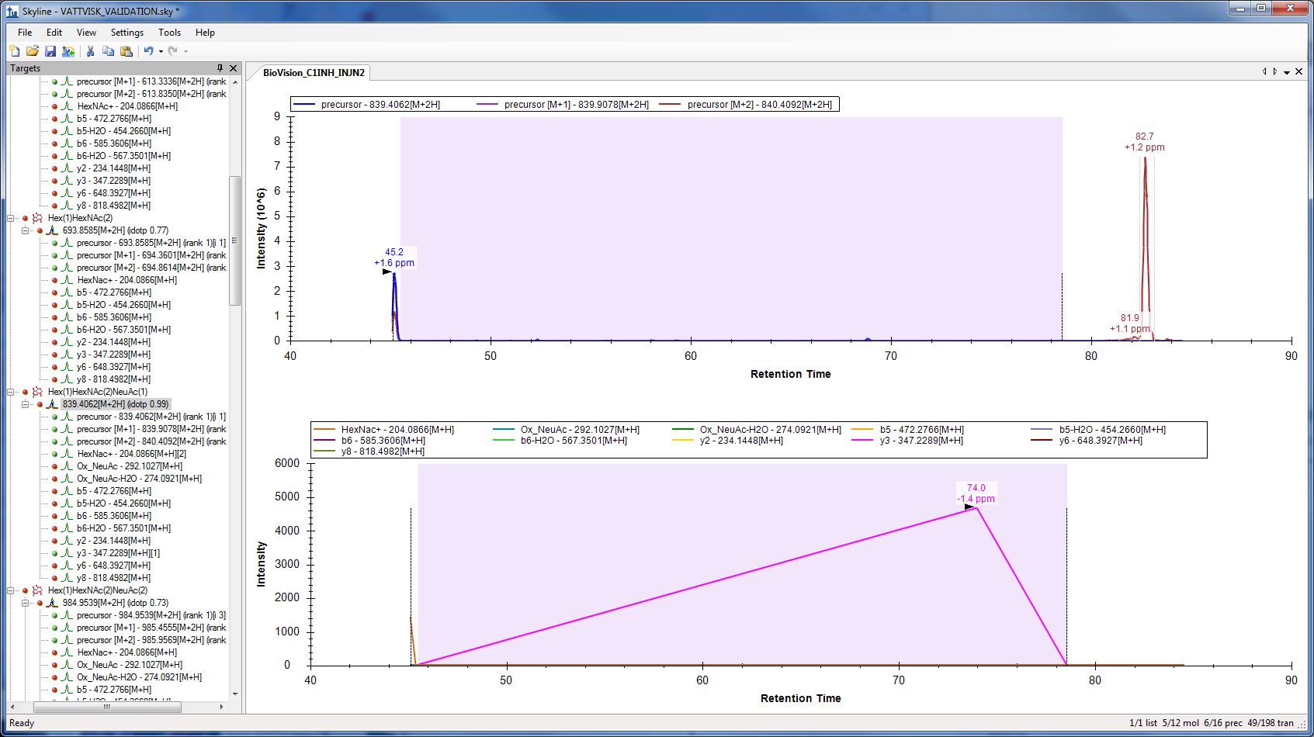
RAW IMPORT ( Multi-targets)

Slide 7
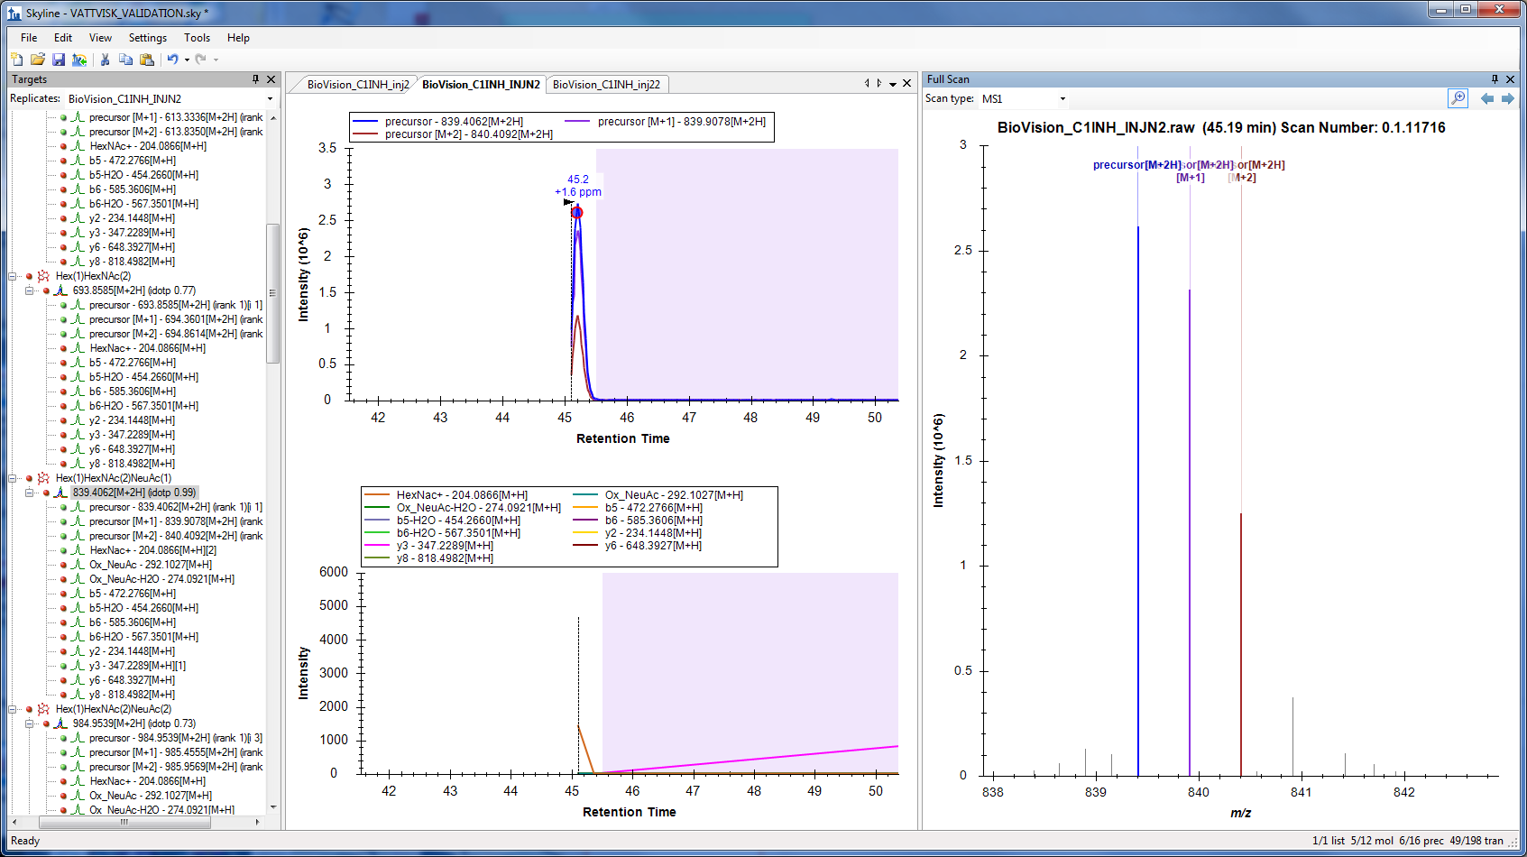
mzML IMPORT ( Multi-targets)
Missing lower RT
Peaks,
This peak cut
Missed
Fragments

Slide 8
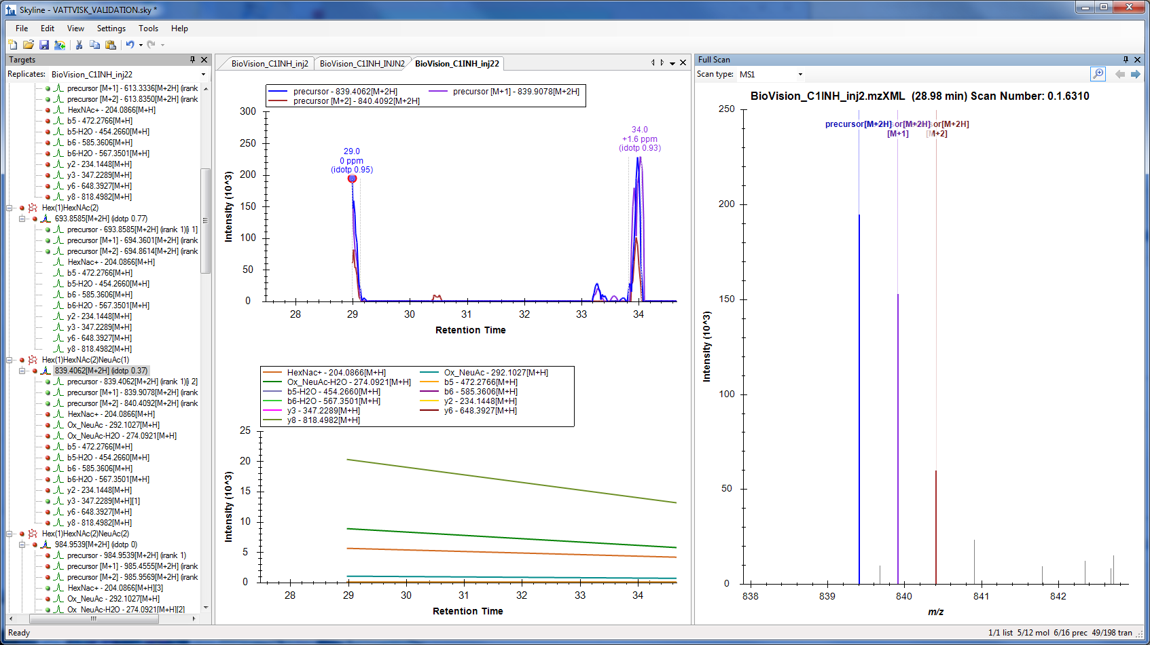
mzXML IMPORT ( Multi-targets)
Peak cut in half
Present fragments not picked

