Slide 1
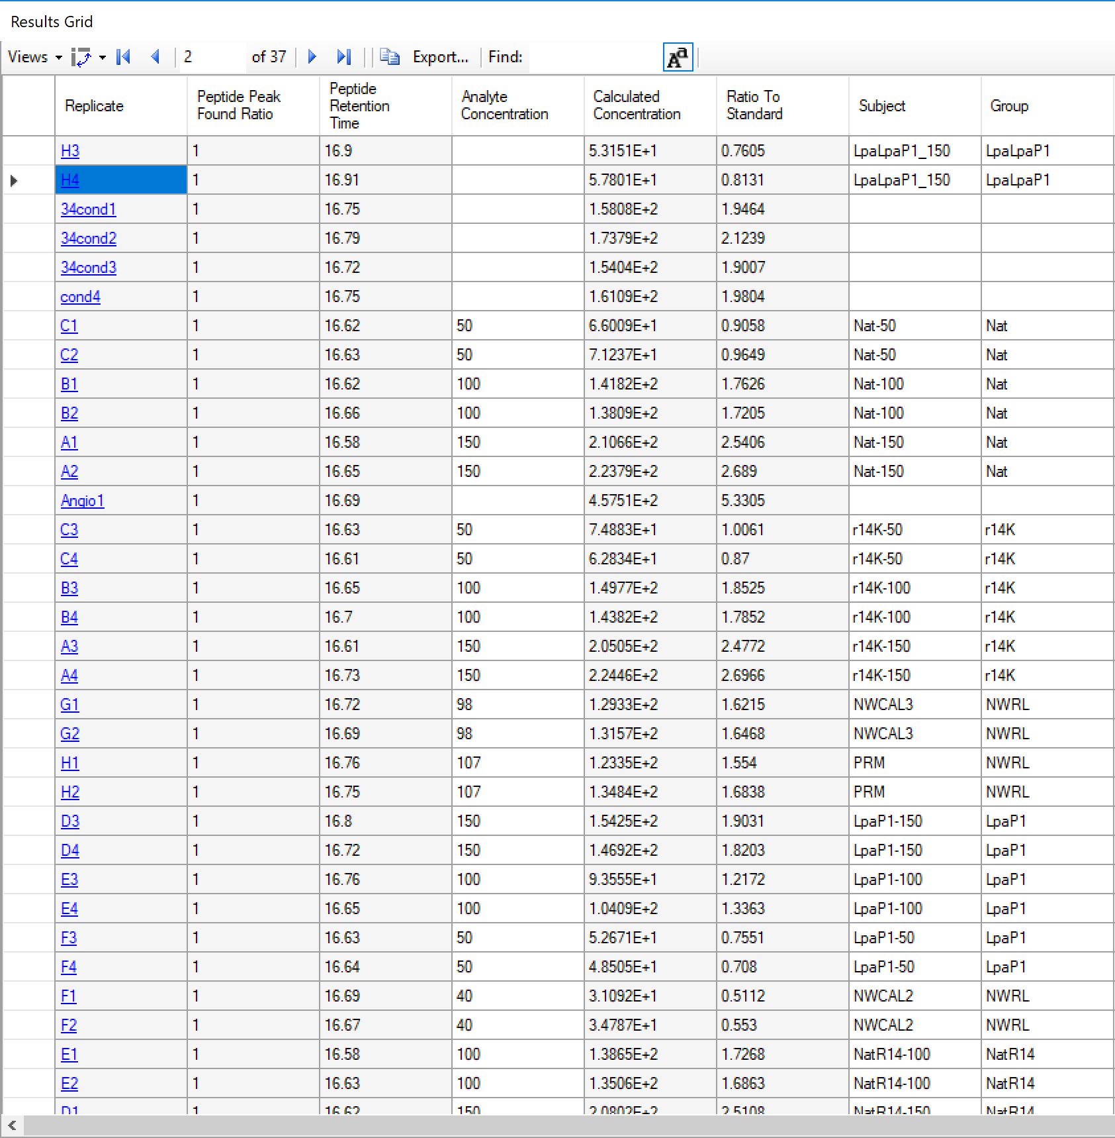
I would like to have here these (in addition to the Calculated values)
Total Area
Total Standard Area

