Slide 1
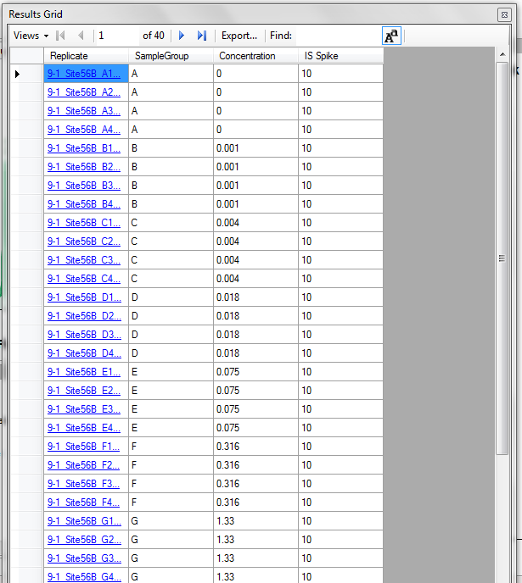
Quasar Errors
[1] Processing arguments ...
Error in preprocess.datafile(skylineFile, skyline.export = TRUE, light.label = light.label, :
Missing required columns in dataset:
SampleGroup,Concentration,IS.Spike
Calls: tryCatch ... tryCatchList -> parse.cmdline -> preprocess.datafile
Execution halted
Finished!

Slide 2
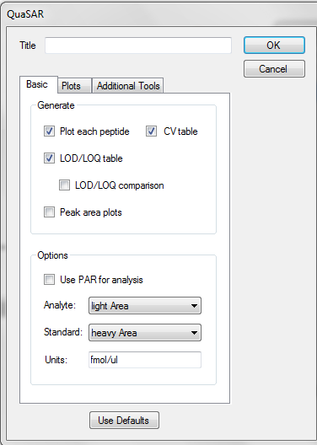
Quasar window differs from tutorial
Missing “Standard Present” selection box

Slide 3
No response curves generated
[1] $Id: QuaSAR-GP.R 107 2012-06-25 18:37:49Z rahmad $
[1] $Id: QuaSAR.R 124 2013-10-09 14:27:44Z manidr $
Loading required package: plyr
Attaching package: 'reshape'
The following object is masked from 'package:plyr':
rename, round_any
Attaching package: 'boot'
The following object is masked from 'package:lattice':
melanoma
The following object is masked from 'package:gtools':
inv.logit, logit
KernSmooth 2.23 loaded
Copyright M. P. Wand 1997-2009
Attaching package: 'gplots'
The following object is masked from 'package:stats':
lowess
[1] Processing arguments ...
[1] >>> Processing part 1 of 2
[1] Initializing ...
[1] Running AuDIT ...
[1] Calculating LODs ...
[1] Calculating CVs ...
[1] >>> Processing part 2 of 2
[1] Initializing ...
[1] Running AuDIT ...
[1] Calculating LODs ...
[1] Calculating CVs ...
[1] Generating plots ...
'opts' is deprecated. Use 'theme' instead. (Deprecated; last used in version 0.9.1)
'opts' is deprecated. Use 'theme' instead. (Deprecated; last used in version 0.9.1)
theme_text is deprecated. Use 'element_text' instead. (Deprecated; last used in version 0.9.1)
'opts' is deprecated. Use 'theme' instead. (Deprecated; last used in version 0.9.1)
Saving 7 x 7 in image
[1] Generating response curves ...
[1] Peptide: AAYLQETGKPLDETLK
Error in order(tran.quality, decreasing = TRUE)[1:n.transitions] :
only 0's may be mixed with negative subscripts
Calls: tryCatch ... tapply -> lapply -> FUN -> FUN -> plot.calibration.curve
Execution halted
Finished!

