Slide 1

Tutorial Webinar #24
Welcome to the next in the series of tutorial webinars designed to help you get the most out of Skyline mass spectrometry software.
We’ll begin shortly …
Webinar Audio: Make sure you have audio during the webinar.
  Click Audio Settings in the lower left-hand corner of the screen :
  Computer audio (preferred) – through your computer’s speakers or a headset
  Phone call (US and International numbers available) By phone, use conference ID: 961 1680 7175
  **Note: we currently have music playing which you should be able to hear.**
Submit Skyline Questions: the Q&A form in Zoom to submit Skyline questions to the presenters
Have logistic issues? Use the Chat applet in Zoom for report webinar software (Zoom) issues or other problems.

Slide 2

Skyline For Lipidomics
Tutorial Webinar #24
With
Brendan MacLean (Principal Developer, Skyline)
Michele Wölk, PhD (Lipidomics Researcher, TU-Dresden)
Mark Belanger (Project Manager, Skyline)

Slide 3
Agenda
Welcome 427 registered, from the Skyline team!
Skyline For Lipidomics
  Introduction with Brendan MacLean
  Presentation and Tutorial with Michele Wölk

Slide 4
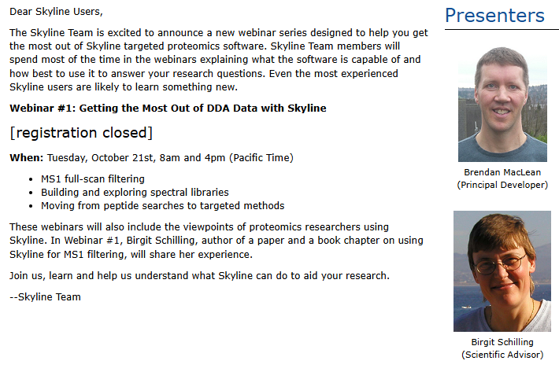
Skyline Tutorial Webinars – 10 years!
Skyline Tutorial Webinar 1 – October 21st, 2014
  Getting the Most Out of DDA Data with Skyline
  Brendan MacLean and
  Birgit Schilling

Slide 5
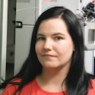
Michele Wölk - Research
HRMS for profiling, identification, and quantification of lipids
PhD at University Leipzig – LC-MS/MS
  Bovine milk proteins (non-enzymatic glycation)
  Lipid-protein adducts
  Lipids
Post-doc at TU-Dresden in Fedorova lab since October 2021
  Lipidome plasticity and lipid quality control
  Targeted and untargeted methods
  Mass spec imaging

Slide 6
Michele Wölk – Teaching Skyline
2023 & 2024 – March – Skyline Course in Dortmund
  New Skyline tutorial for lipidomics presented
2023 – June – Skyline Course at UW
  Birgit Schilling taught Michele’s tutorial
2024 – September – BMSS/BSPR Conference Workshop at Warwick U.
  Michele presented and taught her tutorial

Slide 7
Michele Wölk - Today
Presentation
Tutorial
  Lipid methods with LipidCreator
  Analysis of LC-MS/MS runs for lipids

Slide 8
Questions?
Ask any questions at the Q&A form in Zoom:
Take the post-webinar survey:
https://skyline.ms/survey4webinar.url

Slide 9
Tutorial Webinar #23
This ends this Skyline Tutorial Webinar.
Please give us feedback on the webinar at the following survey:
https://skyline.ms/survey4webinar.url
A recording of today’s meeting will be available shortly at the Skyline website.
We look forward to seeing you at a future Skyline Tutorial Webinar.

