Slide 1


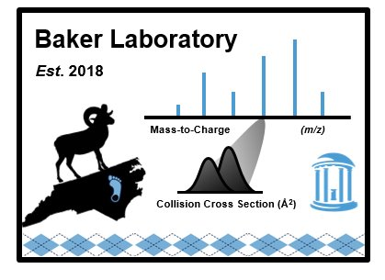
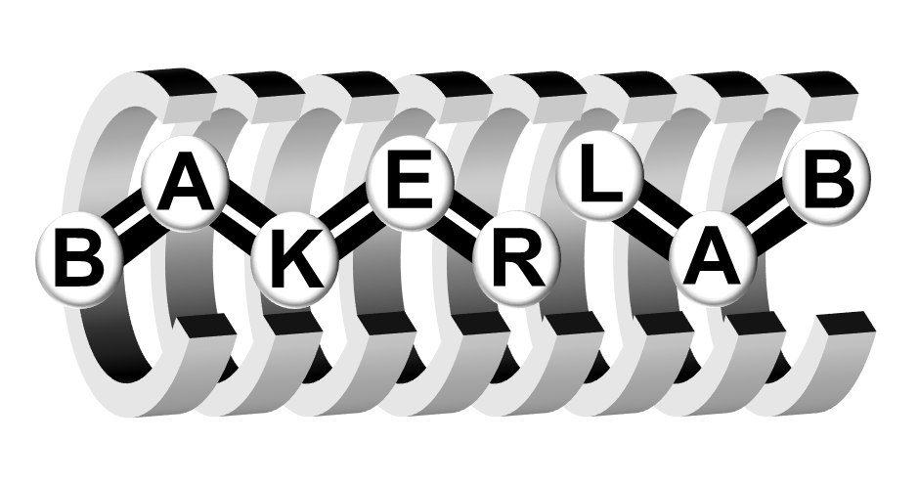
Development and Application of a Multidimensional Lipid Database Containing Liquid Chromatography, Ion Mobility Spectrometry, and Mass Spectrometry Separation Characteristics in Skyline
Amie Solosky
Skyline User Meeting
ASMS 2024

Slide 2
Outline
Lipid Overview
Database Creation
Sea Lion Application

Slide 3
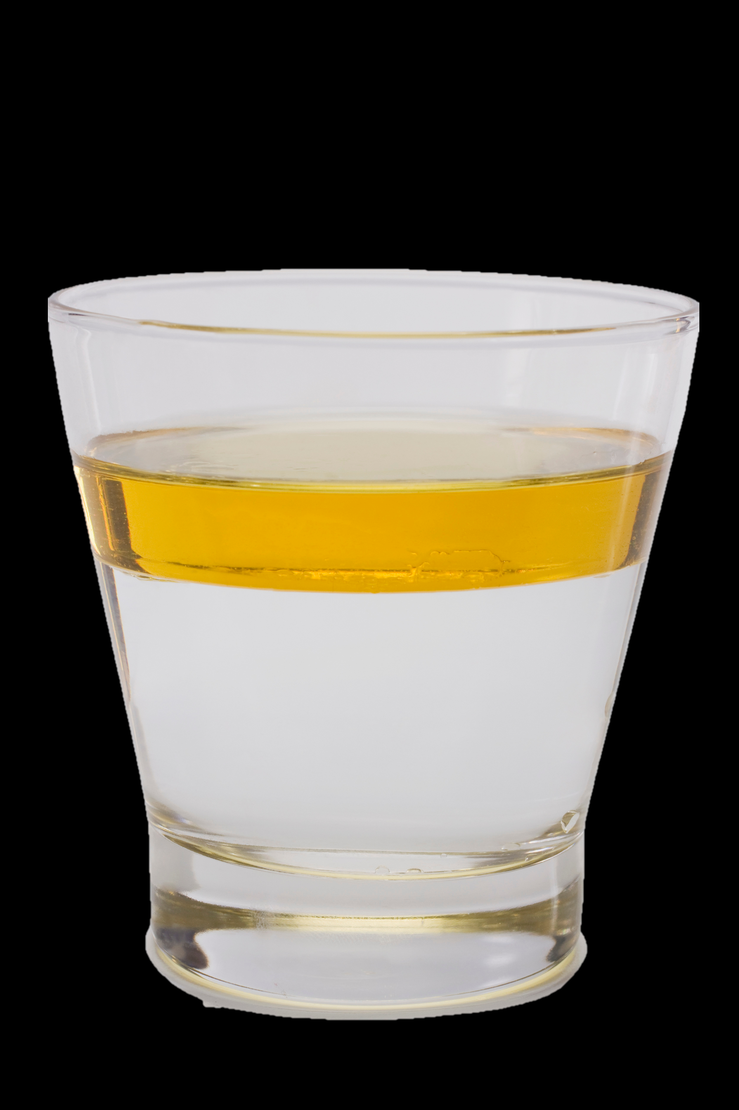
What is a lipid?
Wax monoester (16:0/16:0)
TG(16:0/16:0/18:0)
Common denominator?
Lipid X
Jasmonic acid
Lipids do not dissolve in water!

Slide 4



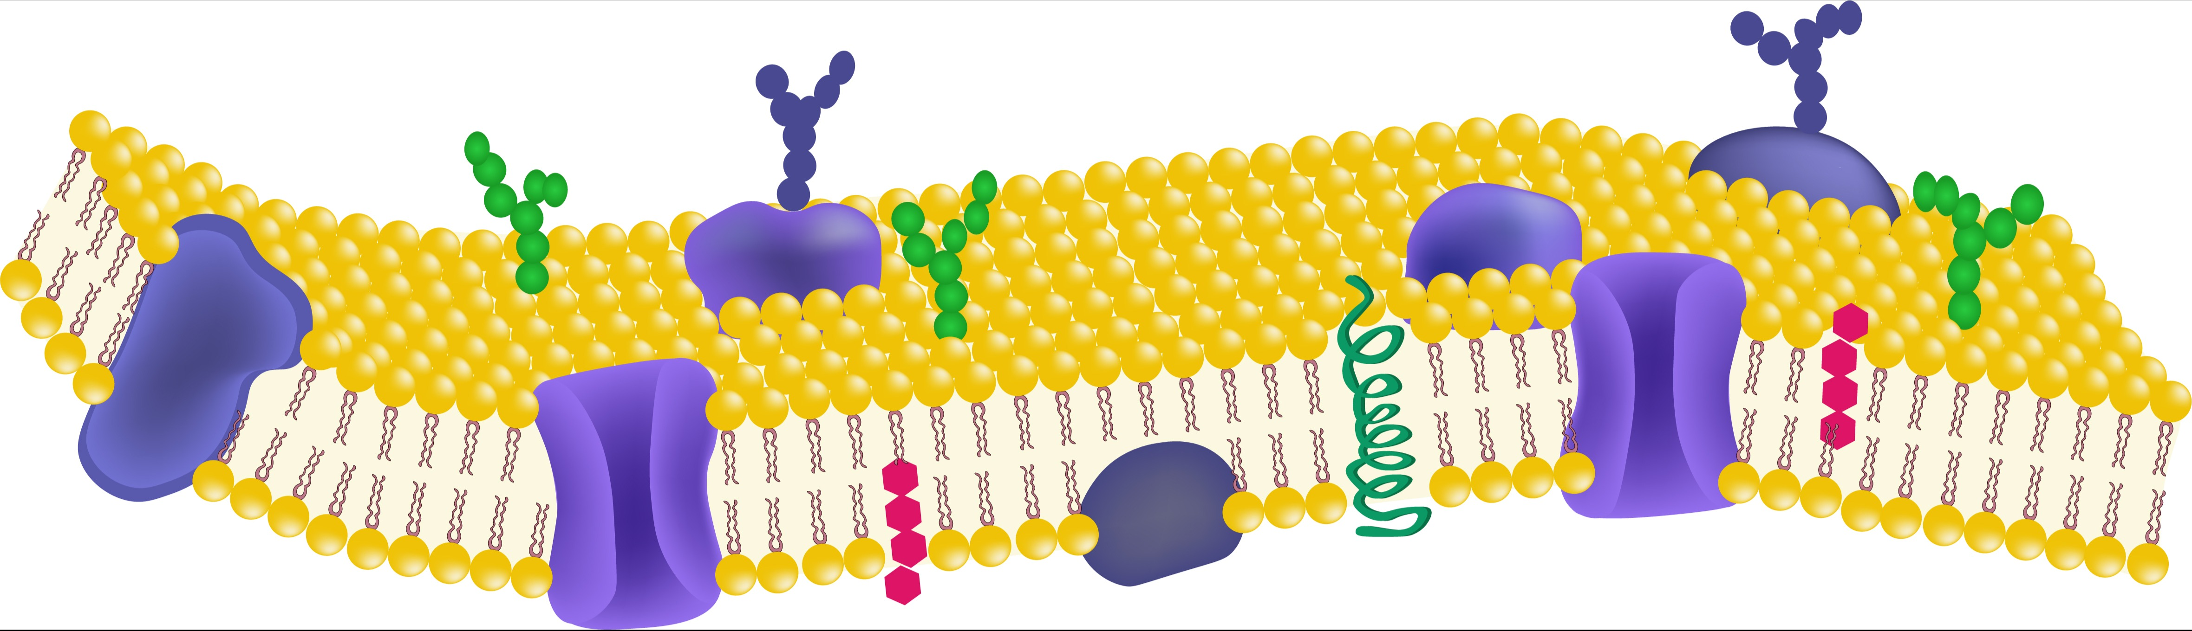
Lipidomics - why are lipids so important?
Cell signaling
Inflammation
Lipid Functions
Energy Storage
Lipid Biosynthesis
Cell Membrane
Fahy, E., et. al. J Lipid Res 2009, 50, S9-14. DOI: 10.1194/jlr.R800095-JLR200

Slide 5
Lipid structure
Sterol Lipids
Glycerolipids
Glycerophospholipids
Lipid Speciation
Category
8
lipid categories
Fatty Acids
Sphingolipids
Saccharolipids
Prenol Lipids
Polyketides
n
Fahy, E., et. al. J Lipid Res 2009, 50, S9-14. DOI: 10.1194/jlr.R800095-JLR200

Slide 6
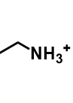
Lipid classes
Lipid Speciation
Glycerophospholipids
Category
X
OH
8
lipid categories
PA
PG
Class
X =
Common lipids vary by head group
PC
PI
PE
PGP
PS
PPA
PIP
CL
Fahy, E., et. al. J Lipid Res 2009, 50, S9-14. doi: 10.1194/jlr.R800095-JLR200

Slide 7
My Passions
Lipid nomenclature
Lipid Speciation
Glycerophospholipids
Category
X
8
lipid categories
PC
Class
Common lipids vary by head group
PC(18:0_18:1)
PC(18:0/18:1)
Head Group (HG)
Lipid
Fatty Acyl (FA)
FAs
18:0
PC
18:1

Slide 8


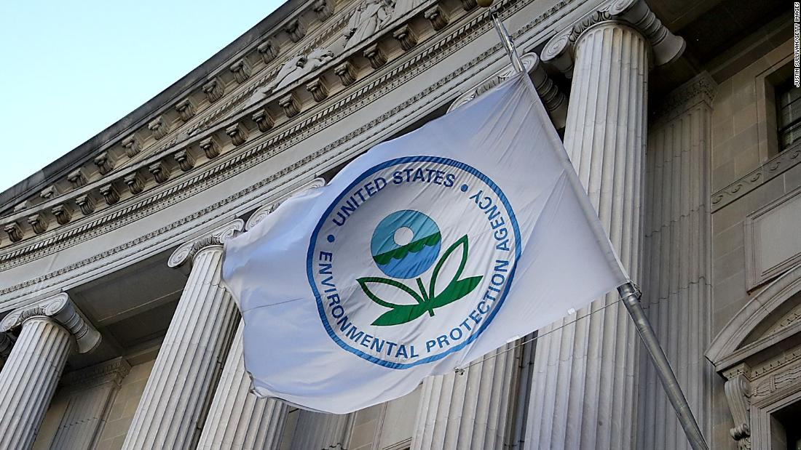

My Passions
Targeted vs. untargeted analysis
Targeted Analysis
Non-targeted Analysis
Pre-determined list of analytes
Only detect known features
Quantitative
Rapid & sensitive
Regulatory methods
Feature finding
Requires high-resolution mass spectrometry
Complex multidimensional data
Time consuming
Qualitative
Exploratory
Baker Lab Analysis
Data Collection
Untargeted
Data
Analysis
Suspect Screening
Unknown unknowns
Discovery
Known unknowns
Suspect Screening
https://www.cnn.com/2020/01/23/politics/trump-epa-repeals-obama-water-regulation/index.html

Slide 9
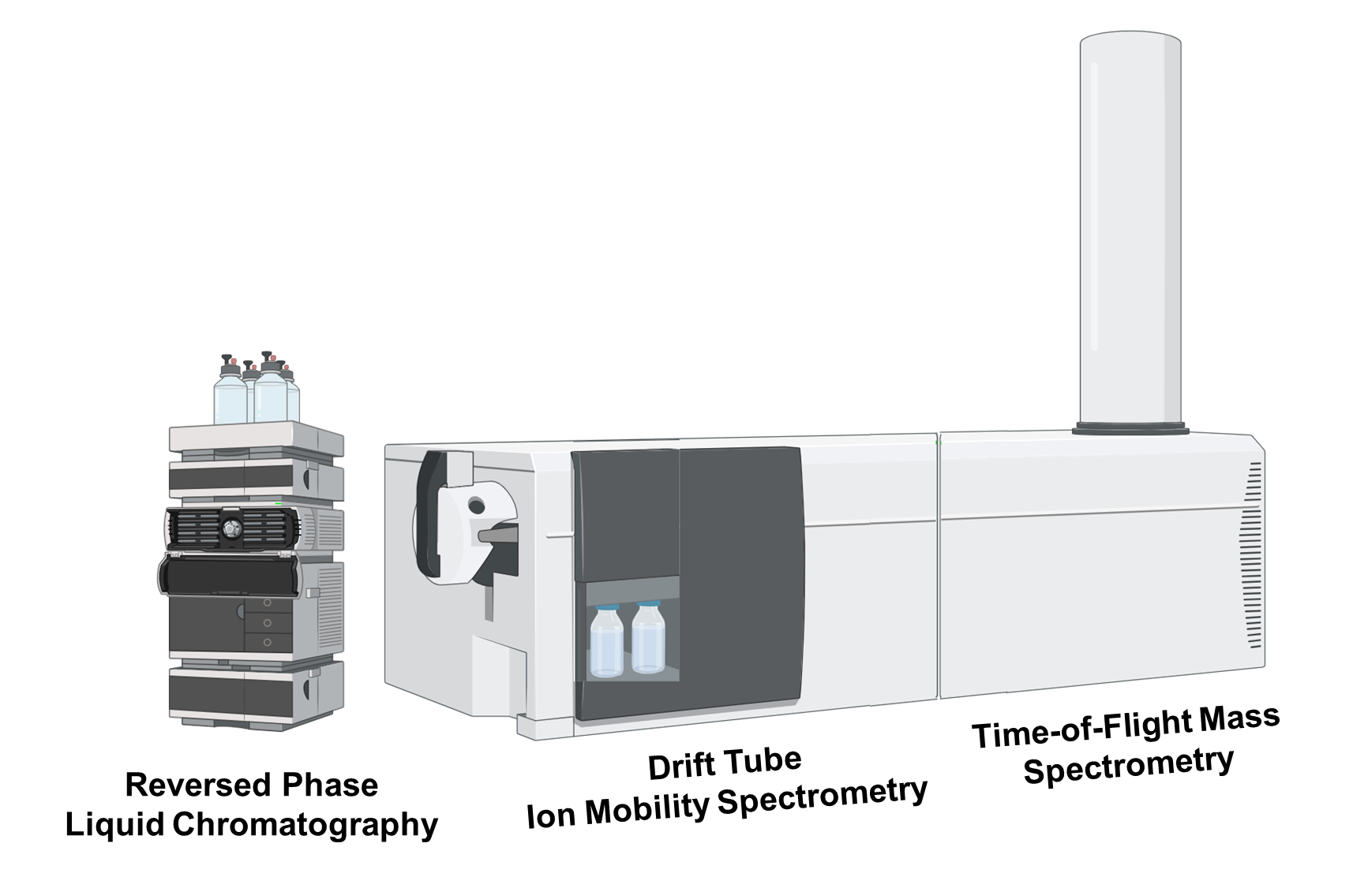

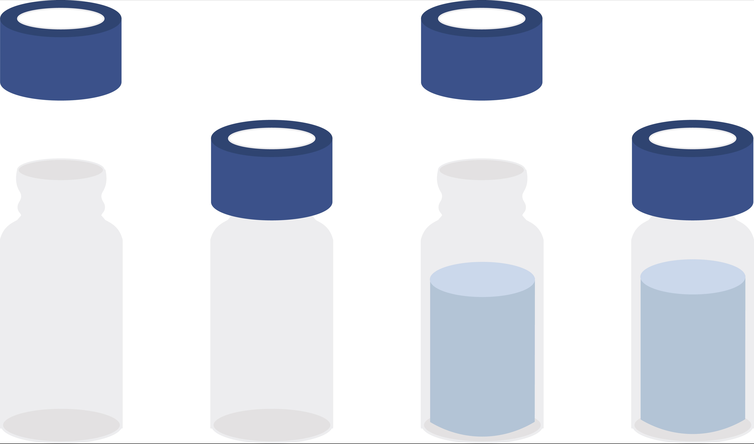
Multidimensional separation technique for lipids
Fragments, m/z
Example Matrices
Size, shape, charge
💩
Data Analysis
Hydrophobicity
🦴
🩸
m/z
Lipid Extraction
Library Creation
Multidimensional separation

Slide 10
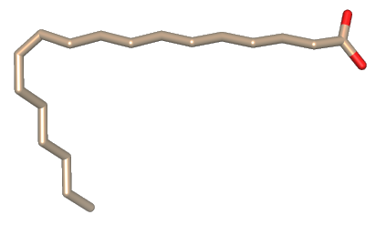
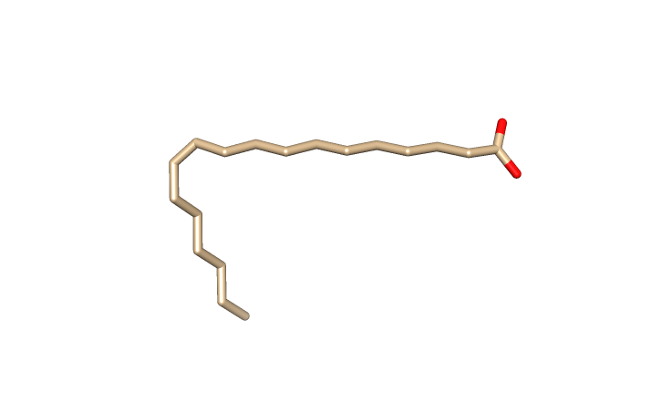
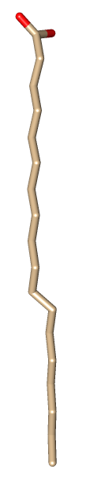
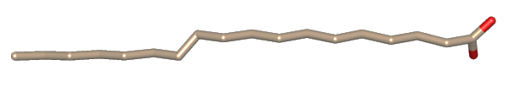
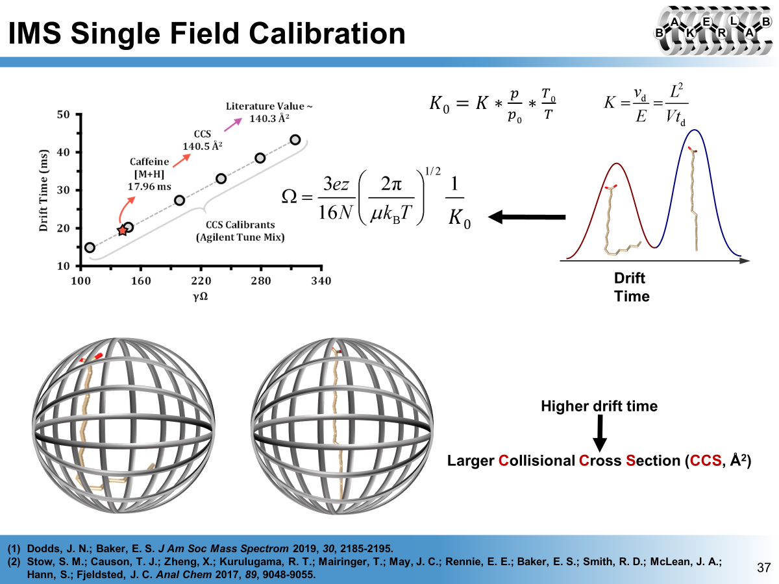
Drift Tube Ion Mobility Spectrometry (DTIMS)
18.2 ms
E
18.0 ms
out
Drift Time
Pulse 2 ions of same m/z but different shape
Isomers separate in time with
peak heights representing amounts
Drift Cell
Higher drift time
=
Larger Collision Cross Section (CCS, Å²)

Slide 11
Fragmentation
DIA All Ions – alternating precursor and fragment scans without precursor isolation
Precursor
Drift Time (ms)
Fragment
m/z
Drift time of fragments = drift time of precursor
Baker et al. J. Am. Soc. Mass Spectrom. 2008, 19(3), 411-419.
Figure created by Jack P. Ryan

Slide 12
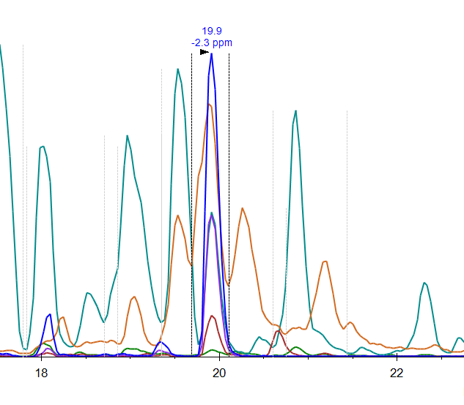
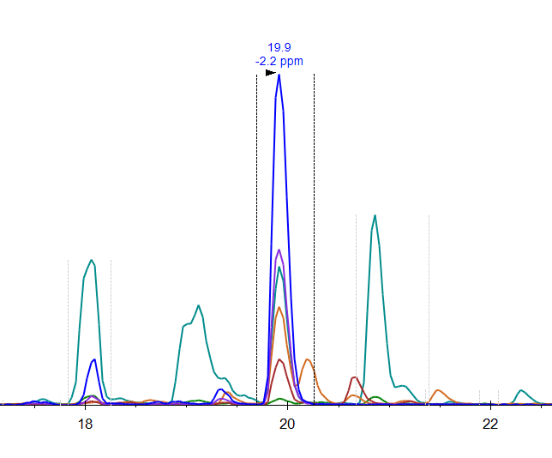
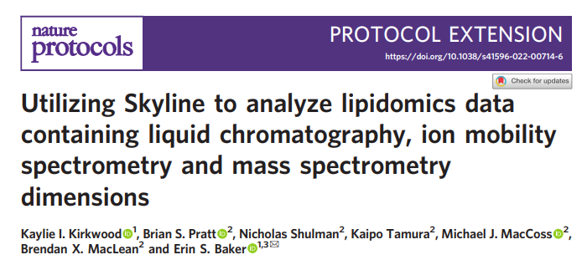
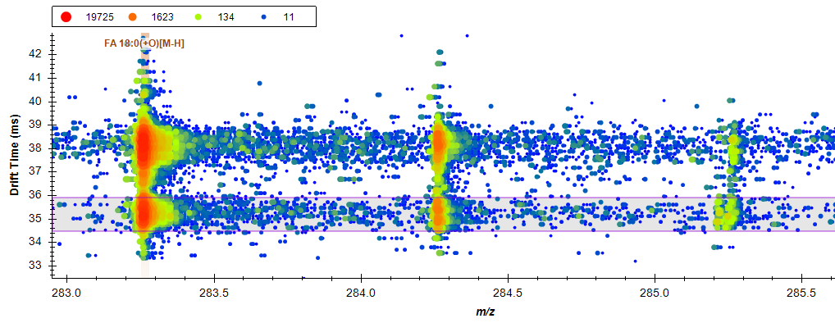
Drift time filtering to increase confidence
Before
19.9
-2.3 ppm
19.9
-2.3 ppm
After
PE(18:0_20:4)
[M-H]
[M+1-H]
[M+2-H]
FA 18:0
Intensity (10³)
FA 20:4
Intensity (10³)
PE Head Group
Retention Time
Retention Time
FA 18:0(+O)[M-H]
Drift Time (ms)
Signal included in chromatogram
m/z
MacLean, B.X., et. al. J Am Soc Mass Spectrom 2018, 29(11): 2182-2188.

Slide 13

Library match
PE(18:0_20:4)
[M-H]
RPLC
IMS
MS/MS Transitions
[M+1-H]
[M+2-H]
19.9
-2.2 ppm
After
FA 18:0
FA 20:4
PE Head Group
Intensity (10³)
RT
CCS
m/z
Library Match
Retention Time
PE(18:0_20:4)
MacLean, B.X., et. al. J Am Soc Mass Spectrom 2018, 29(11): 2182-2188.

Slide 14
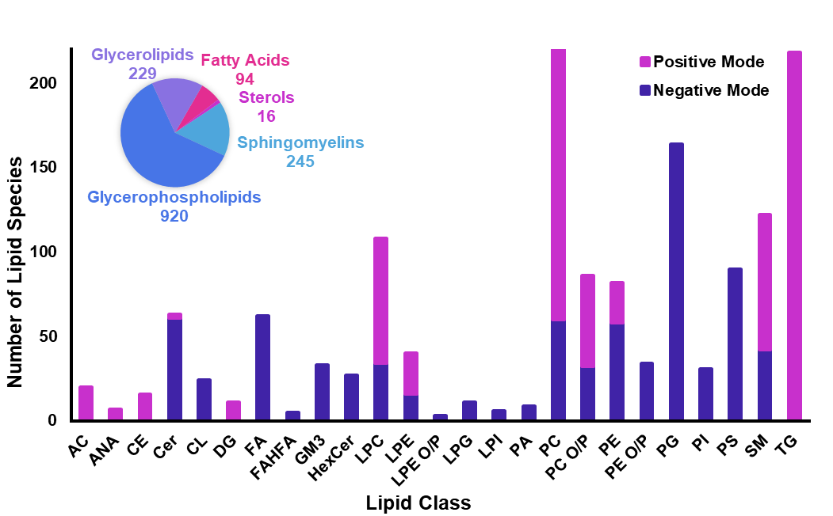
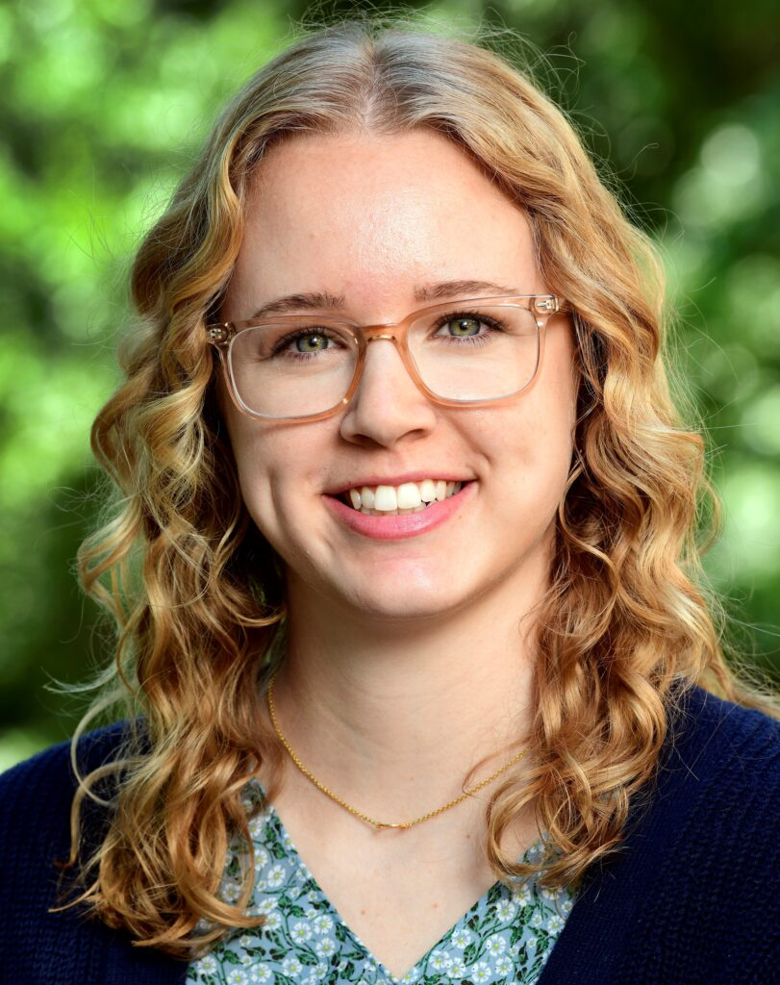
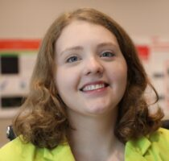
Baker Lab lipid library composition
Lipid Library Magicians🪄
Dr. Kirkwood-Donelson
Number of ion types
Dr. Odenkirk
1504 precursor ion types:
- 877 unique lipids
- 23 stable isotope labeled
Kirkwood, K. I. et al., JPR. 2022, 21(1), 232-242. DOI: 10.1021/acs.jproteome.1c00820.
Kirkwood, K. I. et al. Nature Protocols. 2022, 17, 2415-2430. DOI: 10.1038/s41596-022-00714-6
Solosky, A.M. et al. ABC. 2024. DOI: 10.1007/s00216-024-05351-4

Slide 15
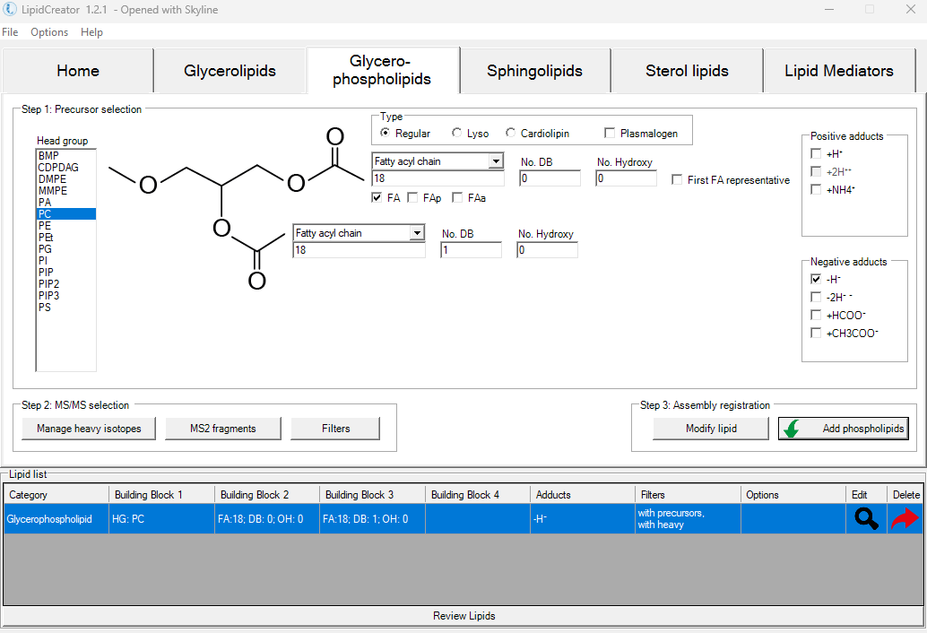

You can do it too!
LipidCreator (in silico)
Transition lists can come from any source: feature finding, online databases, literature, Panorama
Peng et al., Nat Comm. 2020, 11. DOI: 10.1038/s41467-020-15960-z

Slide 16
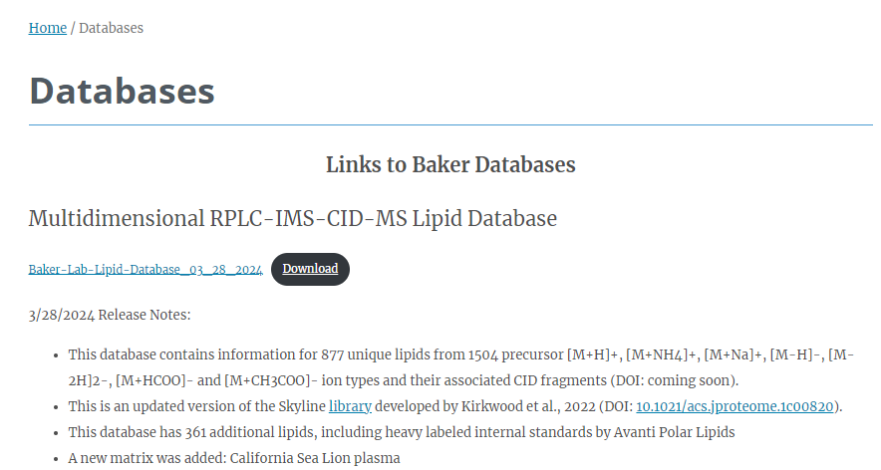
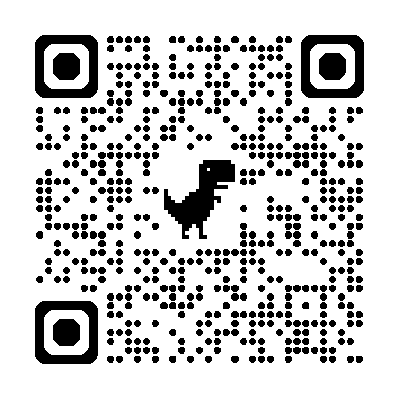
Baker lab database
https://tarheels.live/bakerlab/databases/
Kirkwood, K. I. et al., JPR. 2022, 21(1), 232-242. DOI: 10.1021/acs.jproteome.1c00820.
Kirkwood, K. I. et al. Nature Protocols. 2022, 17, 2415-2430. DOI: 10.1038/s41596-022-00714-6
Solosky, A.M. et al. ABC. 2024. DOI: 10.1007/s00216-024-05351-4

Slide 17
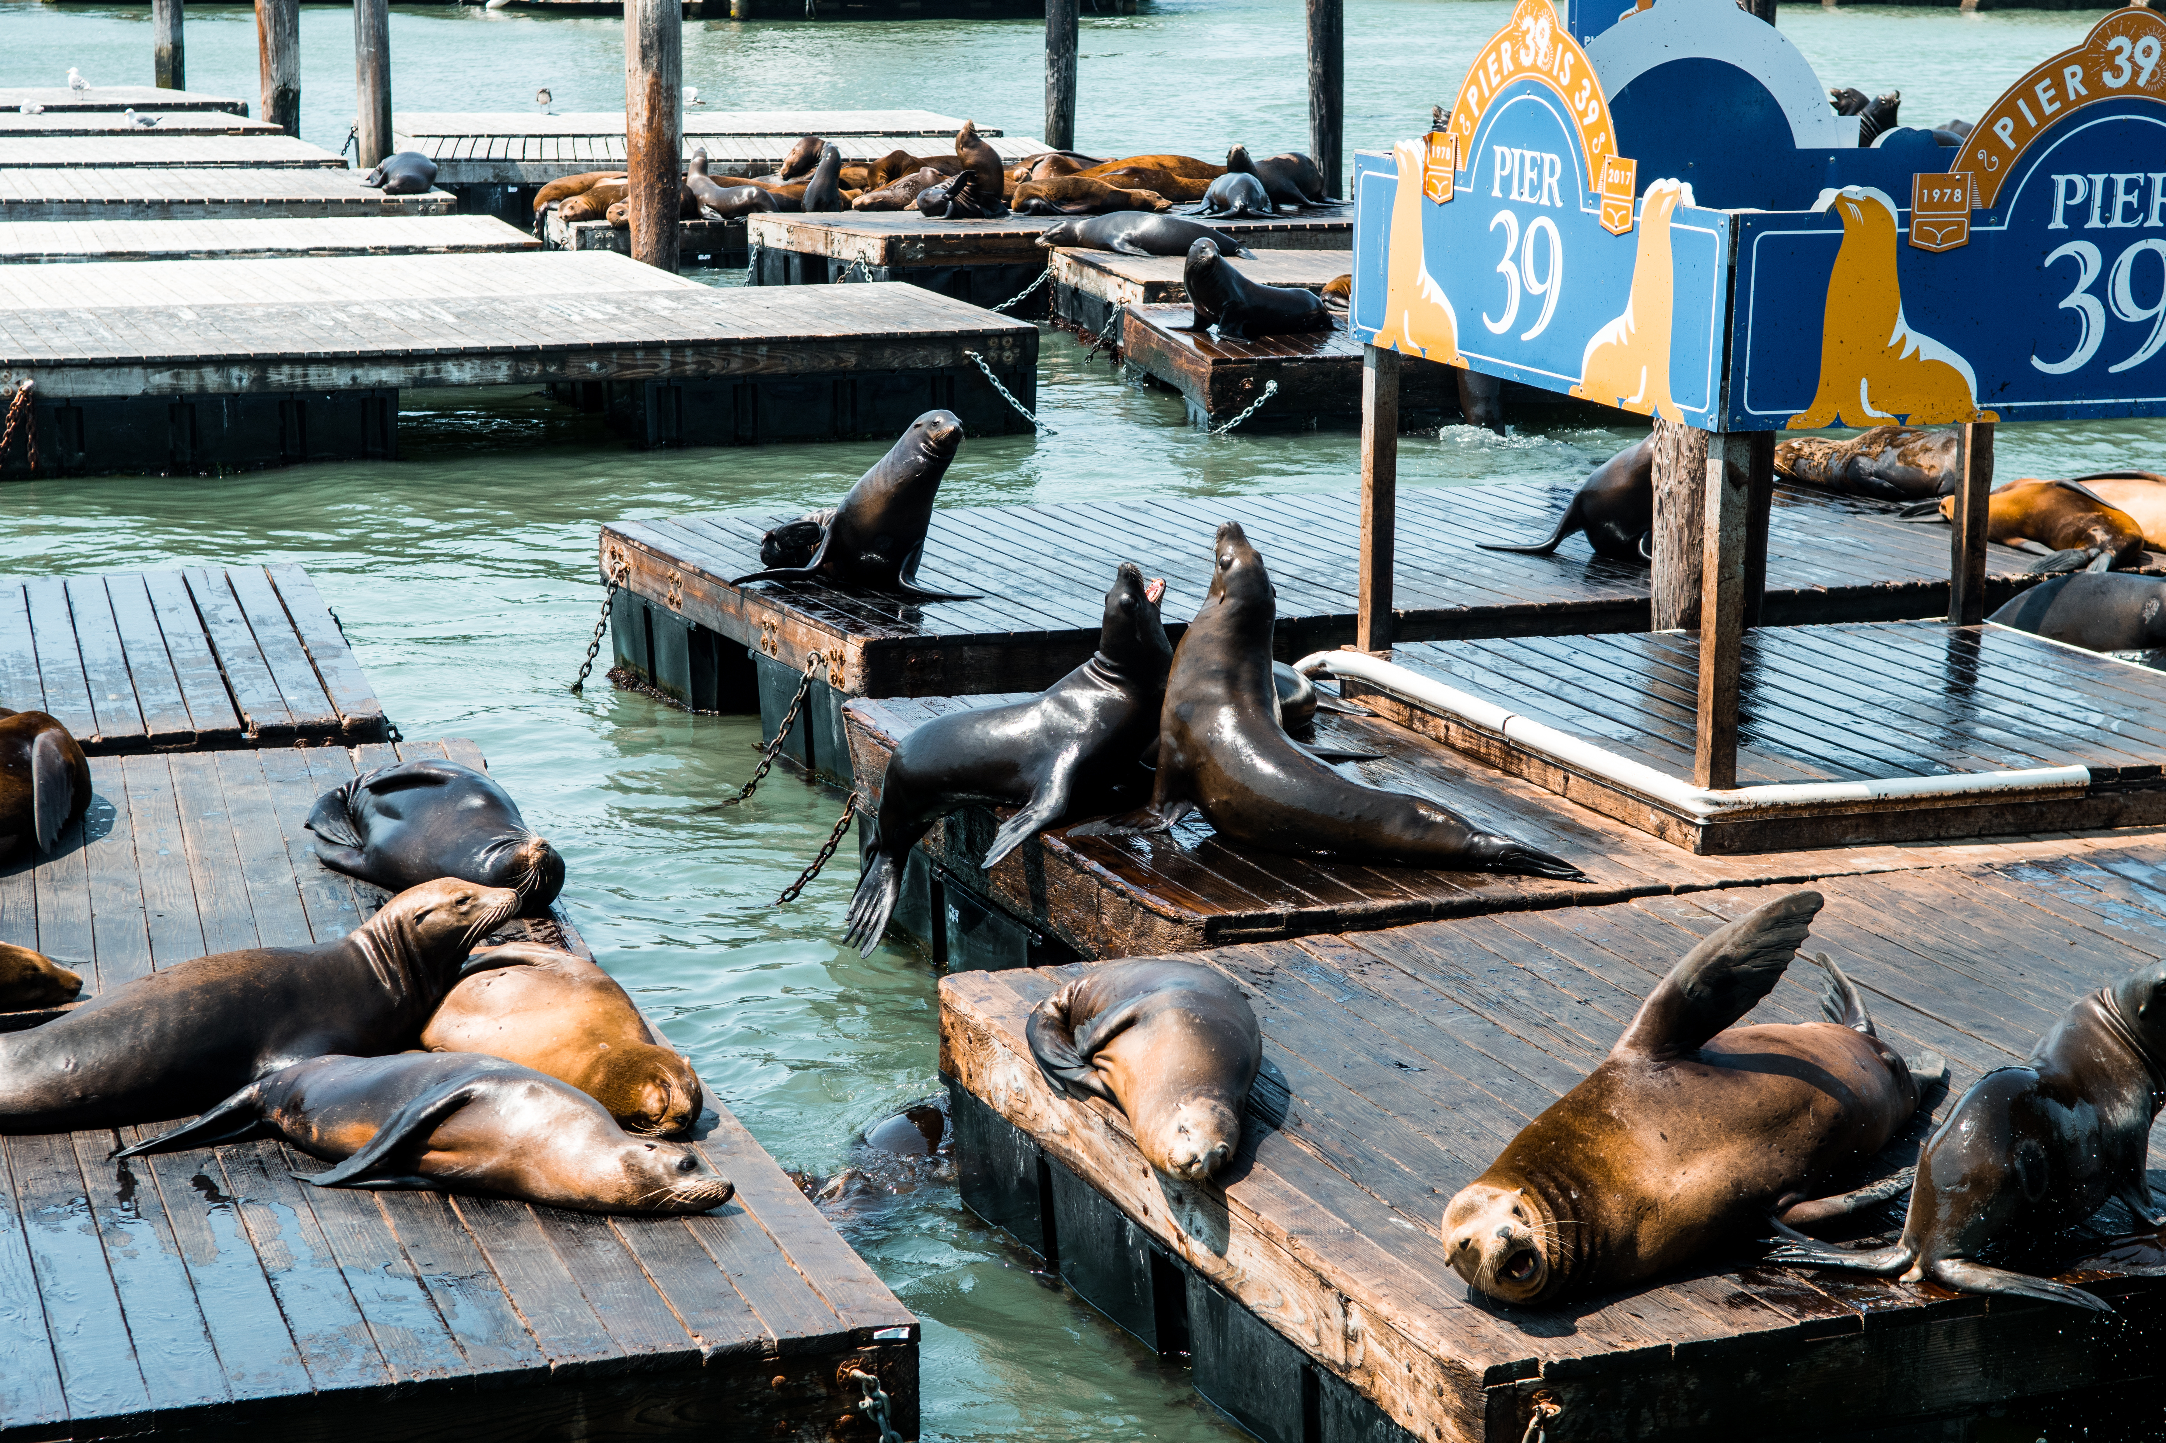

California sea lions (Zalophus californianus)
https://www.pier39.com/sealions/

Slide 18
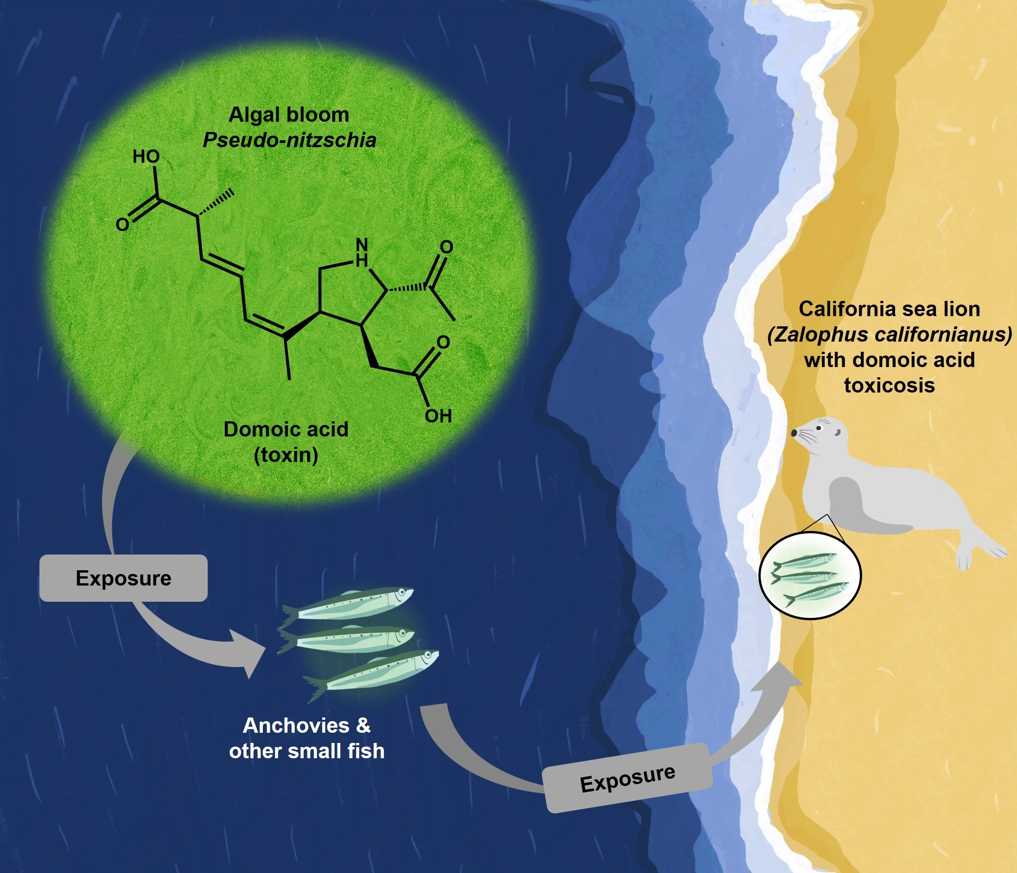
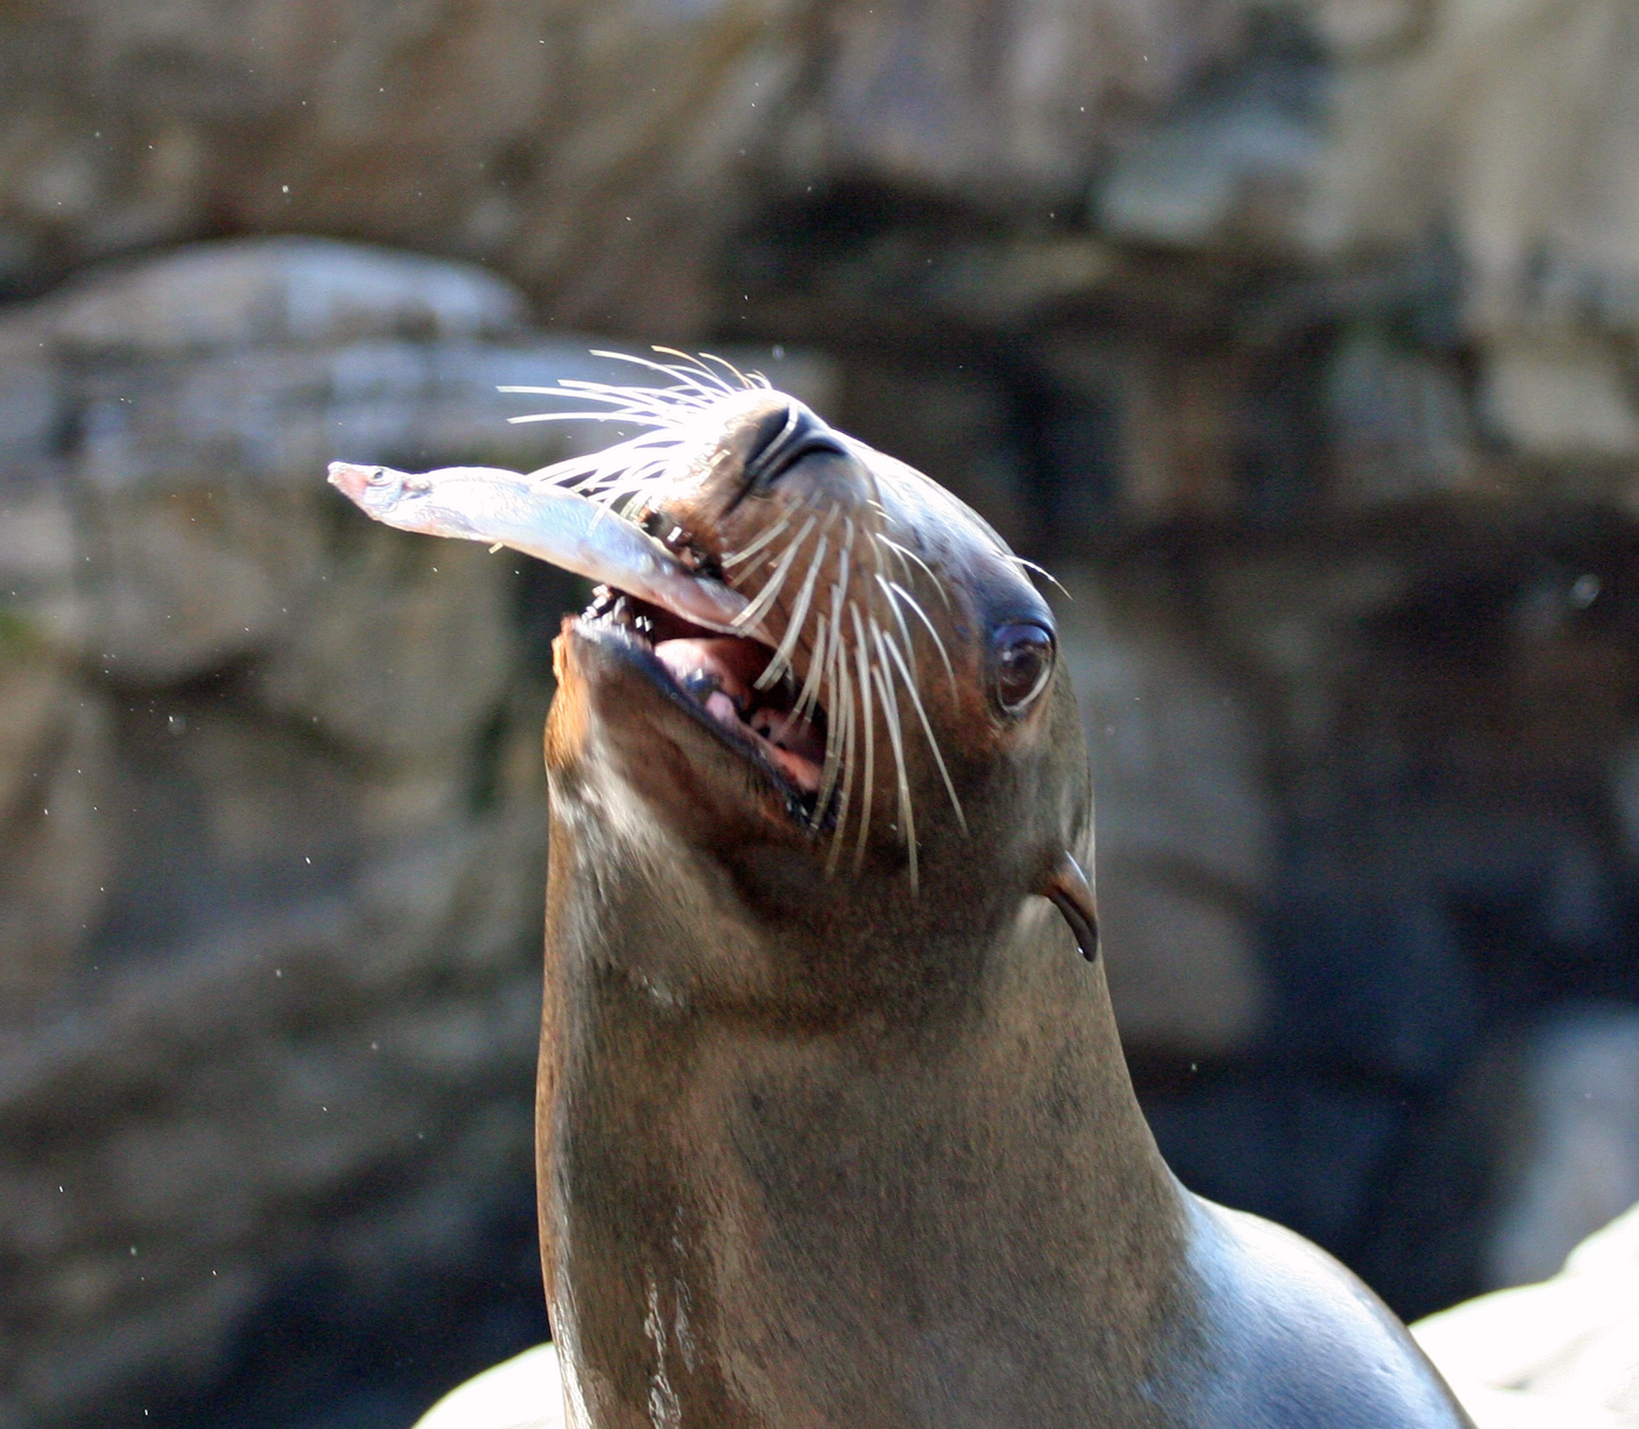
DAT & Sea lions (Zalophus Californianus)
Symptoms:
Seizures
Heart issues
Fatal
Challenges:
No diagnostic tools
Half-life of domoic acid is < 48 hours
McClain, A. M et al. Front. Vet. Sci. 2023, 10. DOI: 10.3389/fvets.2023.1245864.

Slide 19
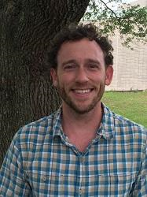
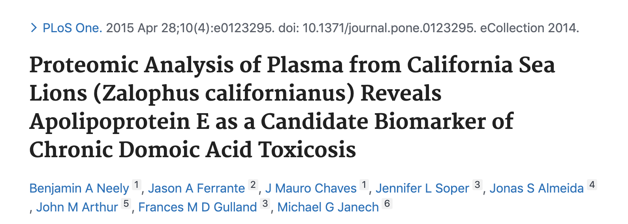
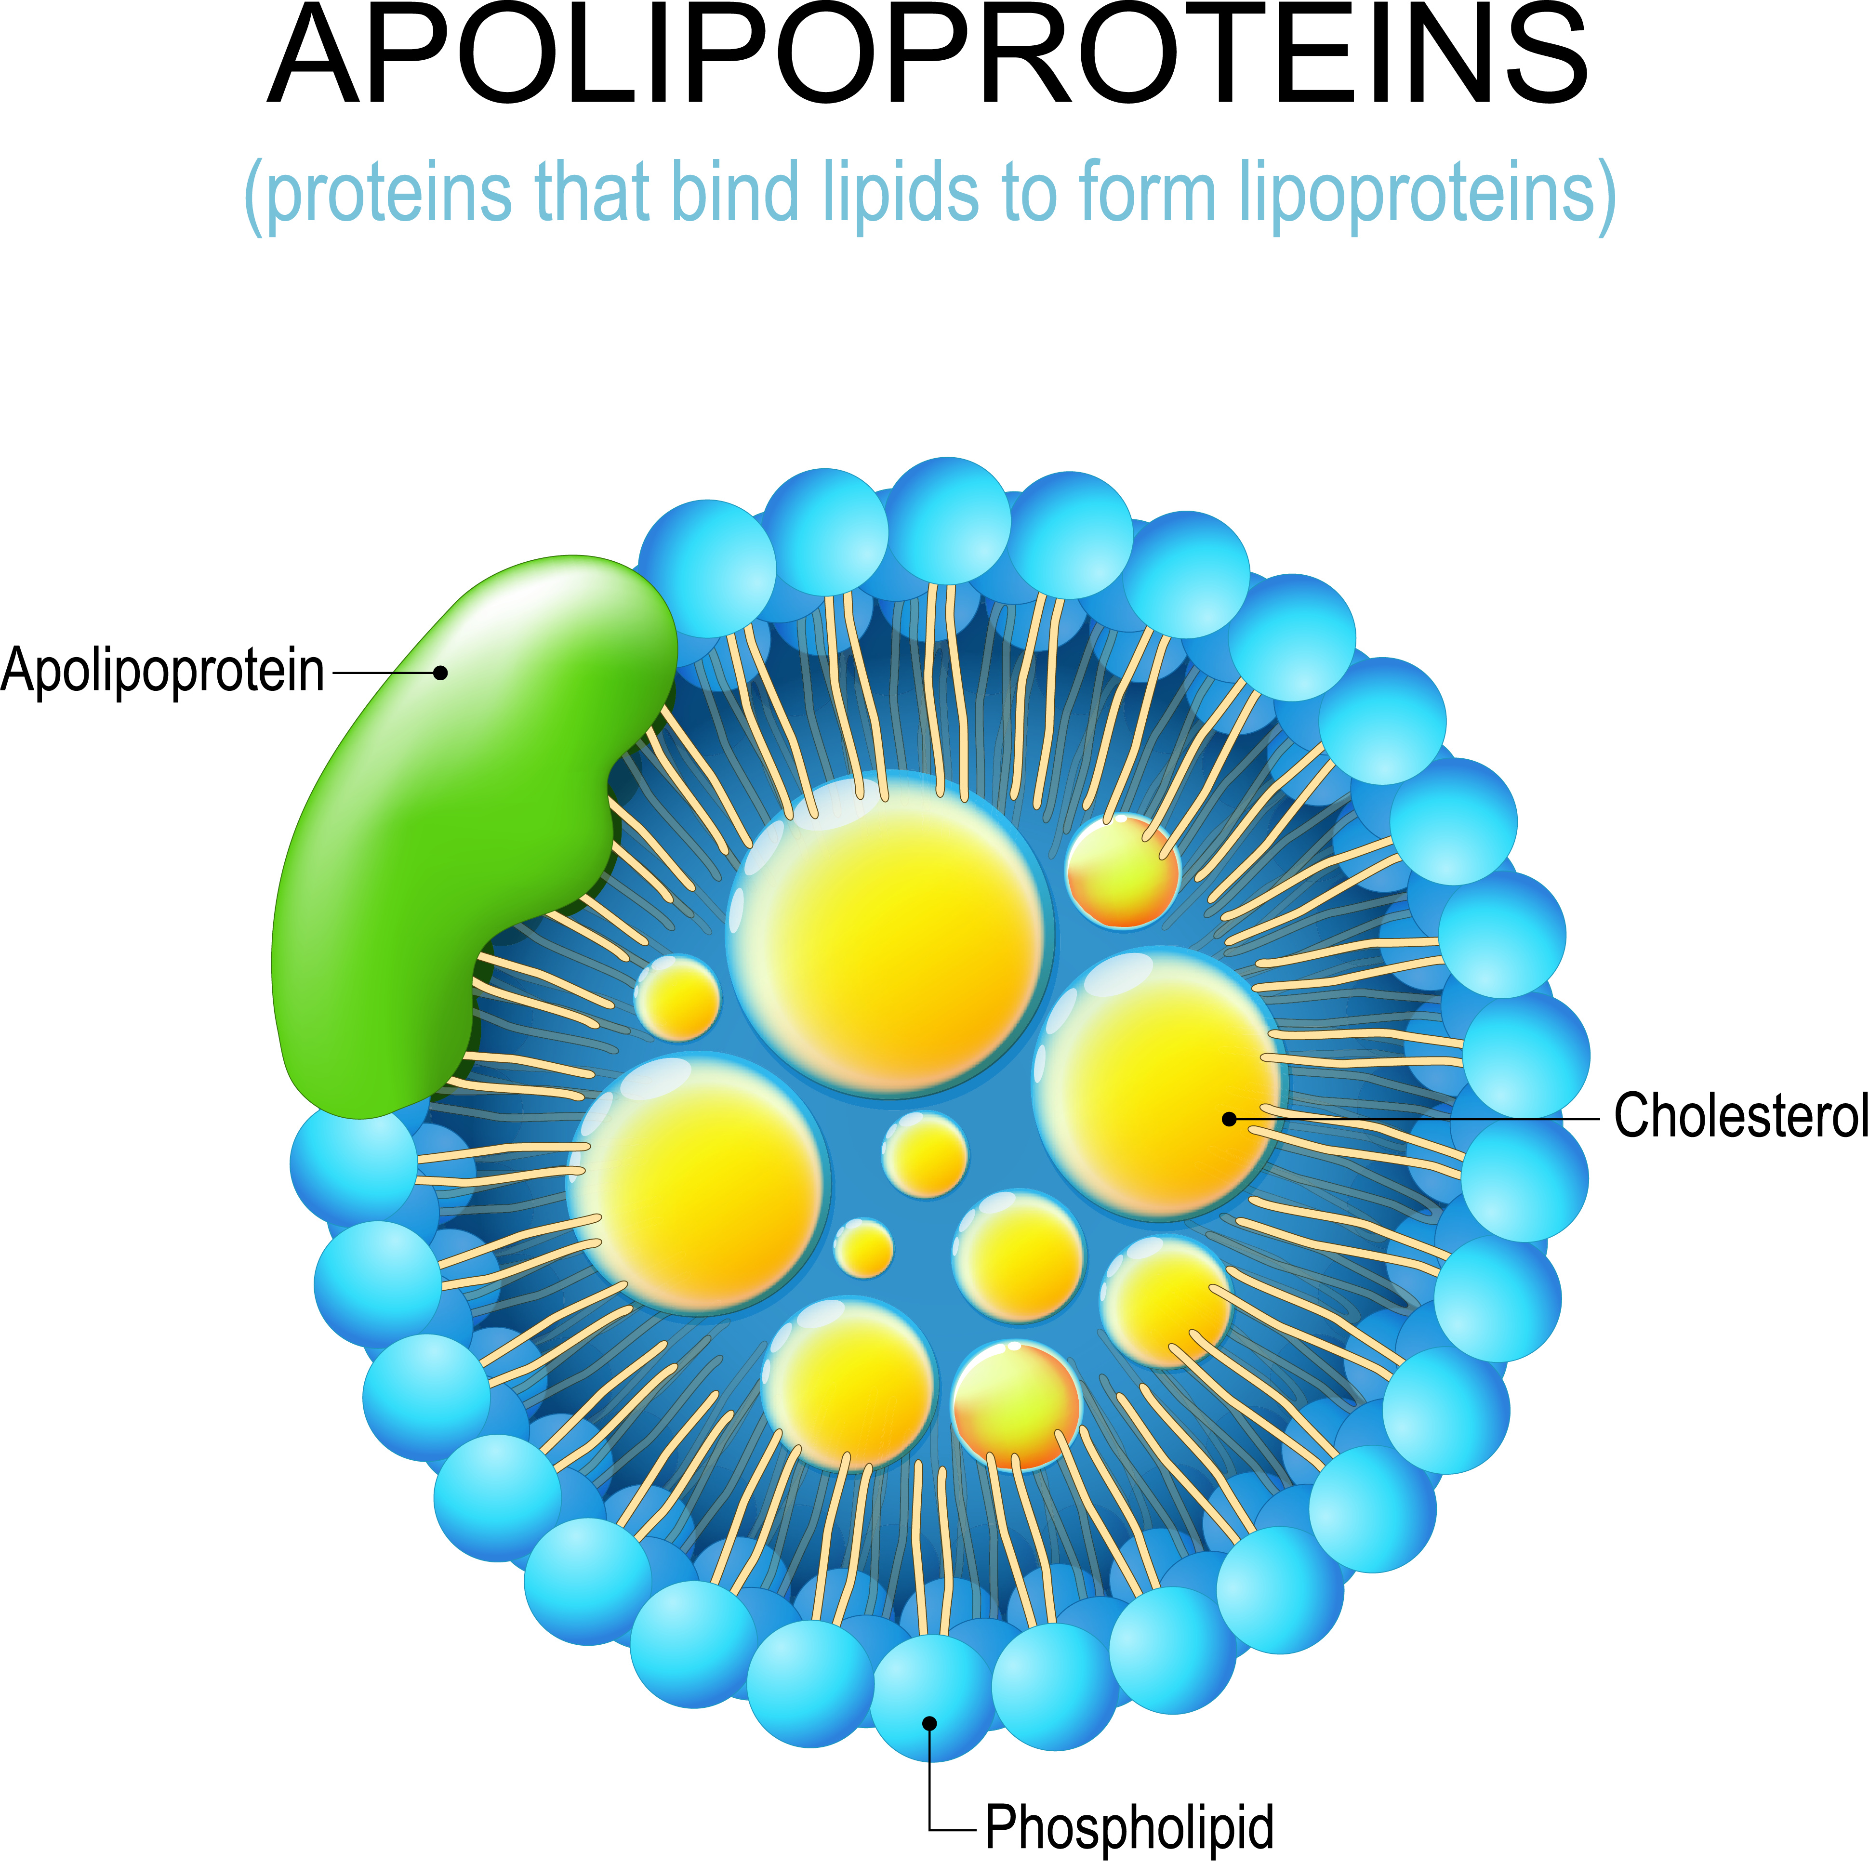
Previous proteomic study
Dr. Ben Neely,
NIST
Hypothesis: Apolipoprotein dysregulation indicates that lipids are informative of DAT

Slide 20
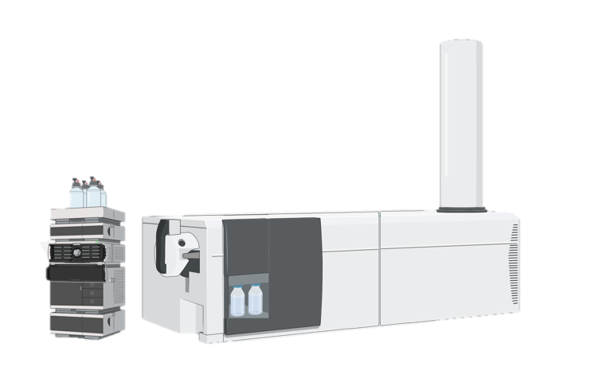




Experimental design (lipidomics)
Rescued Sea Lion Samples
14 DAT*
17 non-DAT
13 males, 18 females
All ages
Lipidomic Workflow
Experimental
Data Analysis
sea lion plasma
Modified-Folch lipid extraction
37 min LC-Drift Tube IMS-CID-MS
m/z 50 to 1700
Suspect Screening
Statistics
Data visualization
*Diagnosed based on histological exam of brain tissues & clinical signs
Kirkwood, K. I. et al., Nat Protoc., 2022, 17 (11), 2415-2430.
Pang, Zhiqiang et al. Nucleic Acids Res. 2021, 49(W1), W388-W396.
Created with BioRender.com

Slide 21
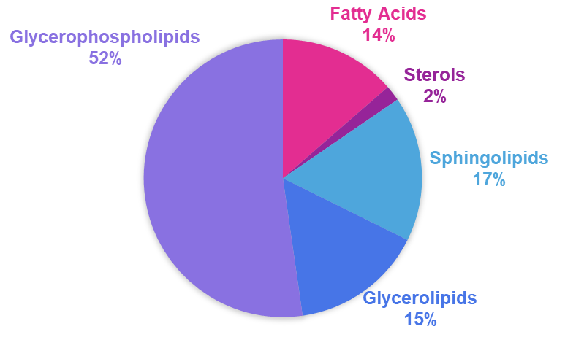
Lipid category trends
Detected Lipids: 331
Solosky, A.M. et al. bioRxiv, 2024.

Slide 22
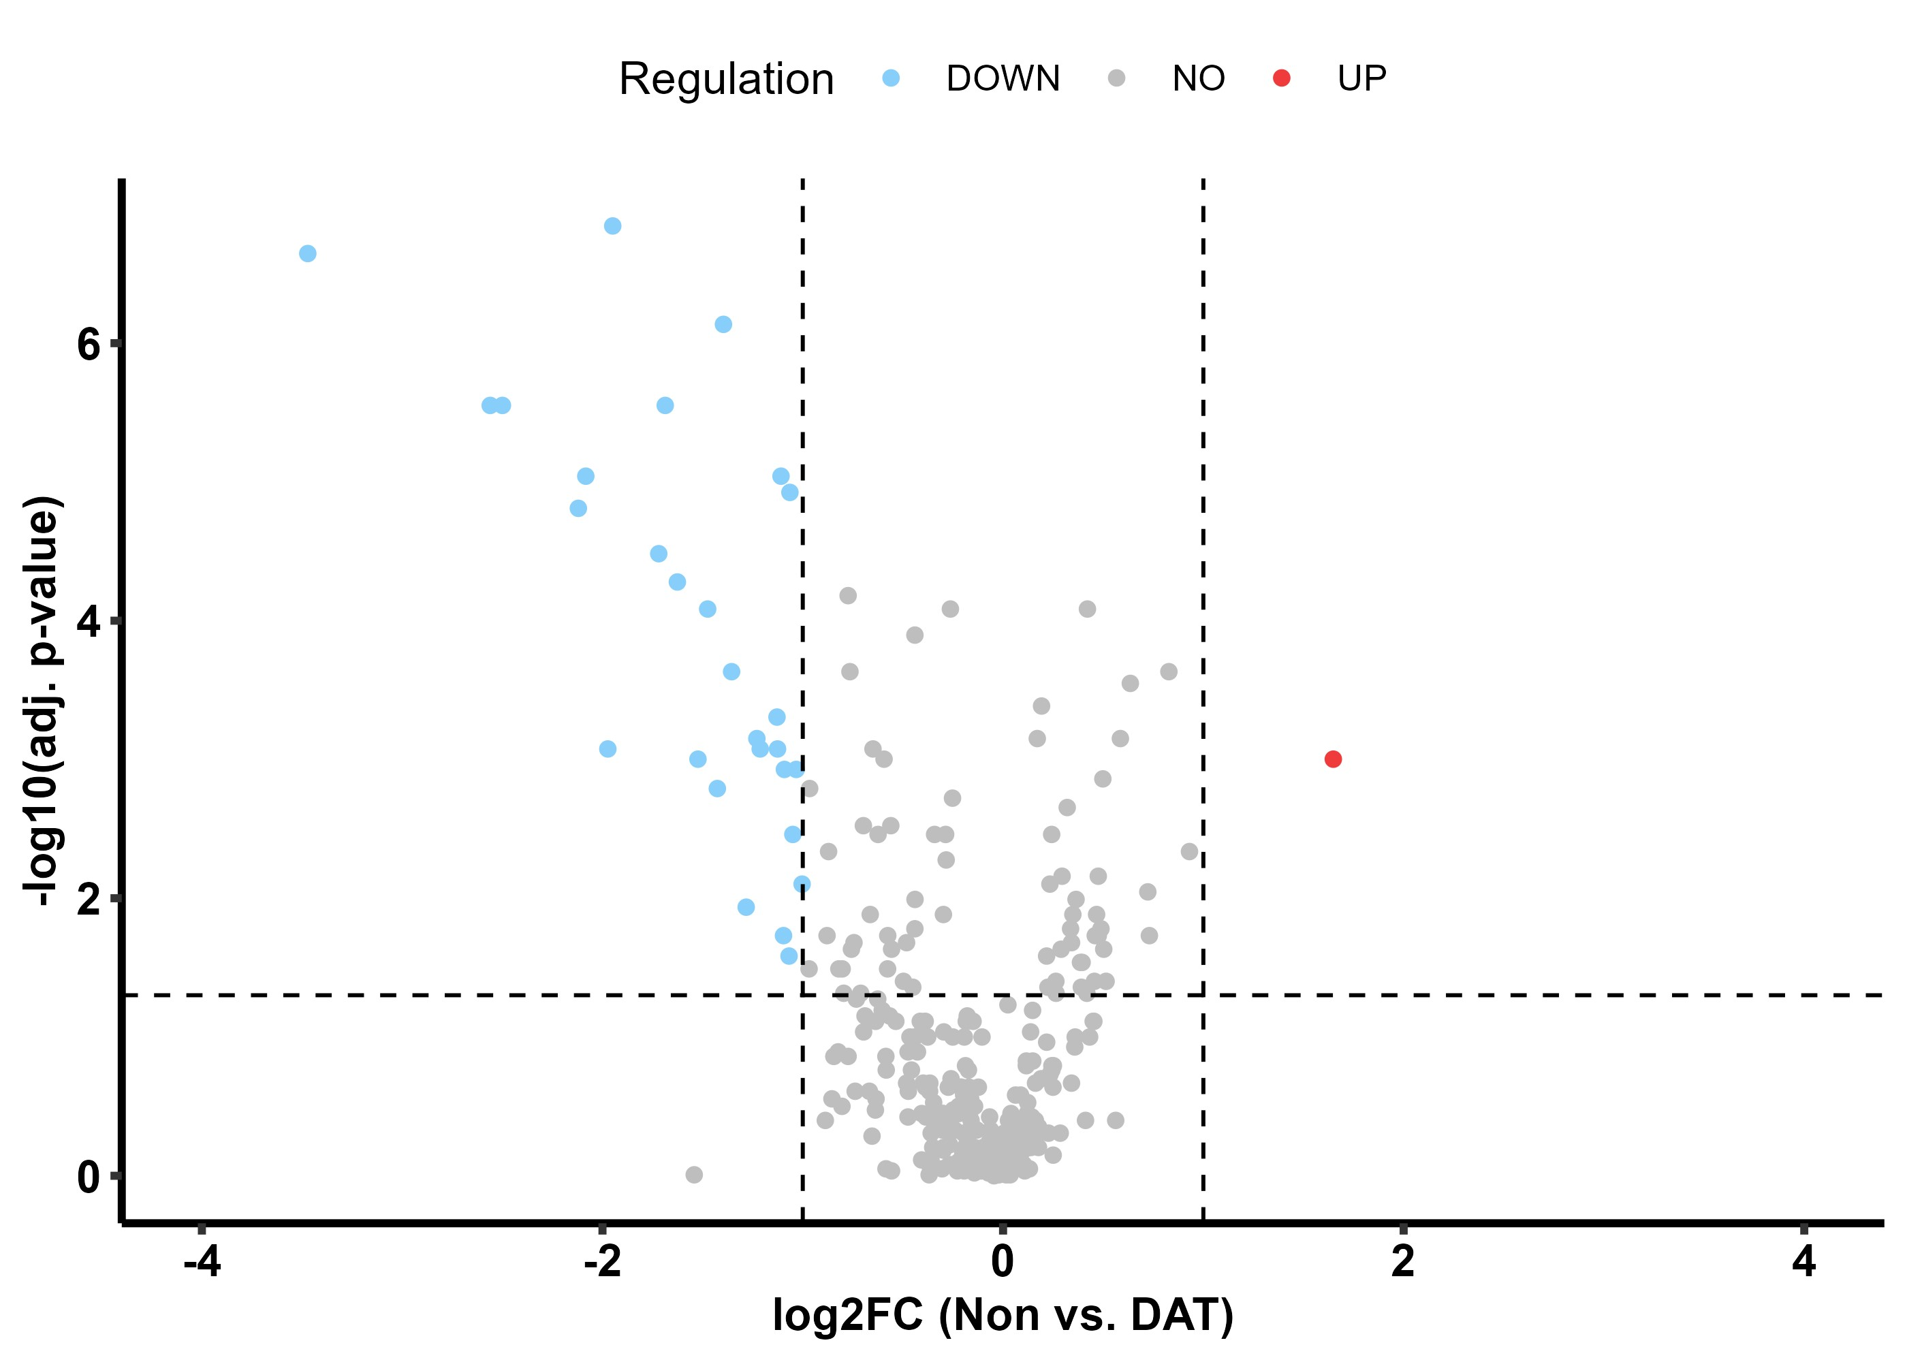
Significance testing
TG = Triglyceride
FA = Fatty acid
CE = Cholesteryl ester
PC = Phosphatidylcholine
PI = Phosphatidylinositol
Solosky, A.M. et al. bioRxiv, 2024.

Slide 23
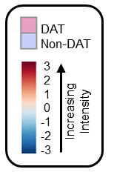
Hierarchical clustering results
DAT
Control
Peak Area
Correlation
Pang, Zhiqiang et al. Nucleic Acids Res. 2021, 49 (W1), W388-W396
Solosky, A.M. et al. bioRxiv, 2024.

Slide 24
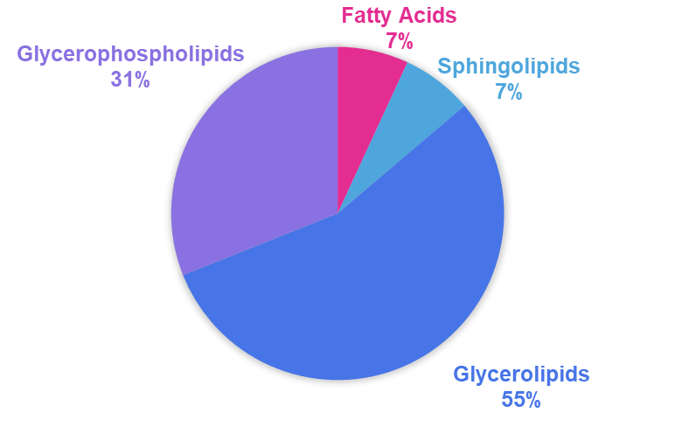
Lipid category trends
Detected Lipids: 331
Significant Lipids: 29
Solosky, A.M. et al. bioRxiv, 2024.

Slide 25
Summary
Conclusions:
29 significant lipids & 50% are TGs
Triglycerides are dysregulated in DAT sea lions
This is a trend unique to DAT sea lions!
Skyline was essential to these findings
Future Directions:
Develop a triglyceride blood panel to aid in diagnosis of DAT
Test more samples to validate results
Solosky, A.M. et al. bioRxiv, 2024.

Slide 26
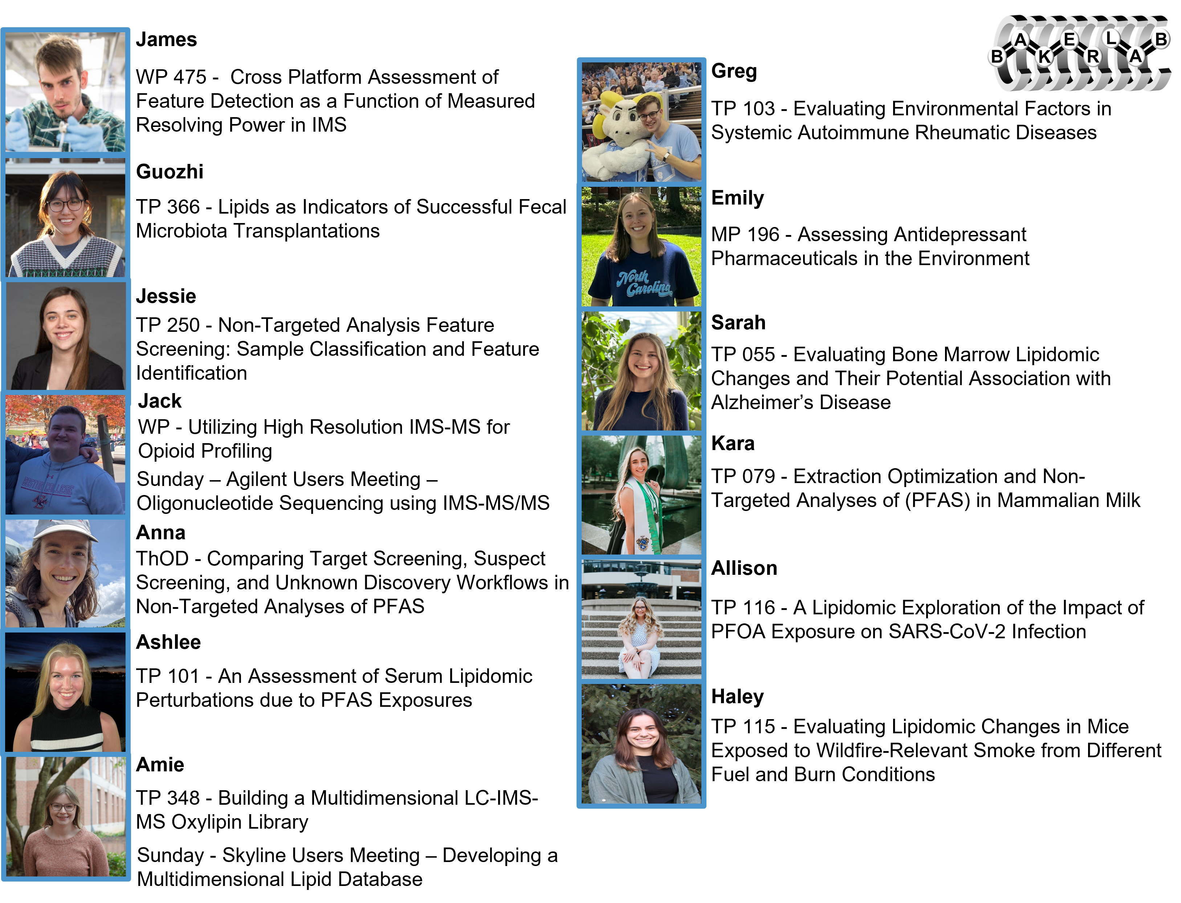
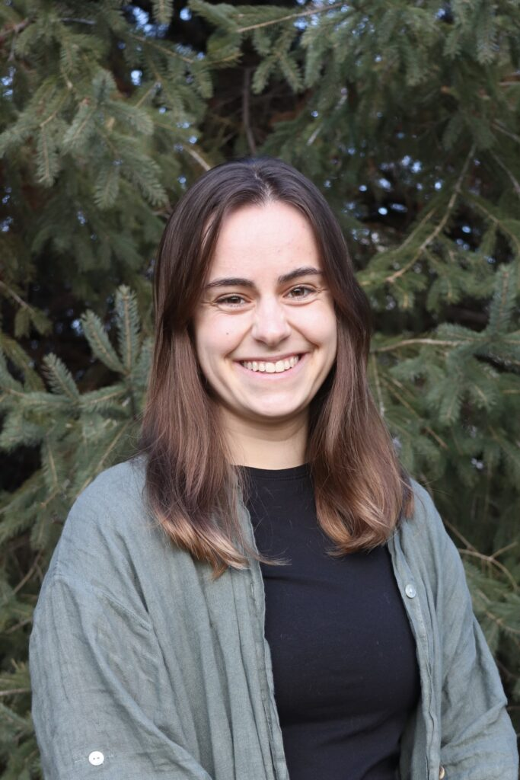













Check out the Baker Lab at ASMS!
Skyline used in the project

Slide 27
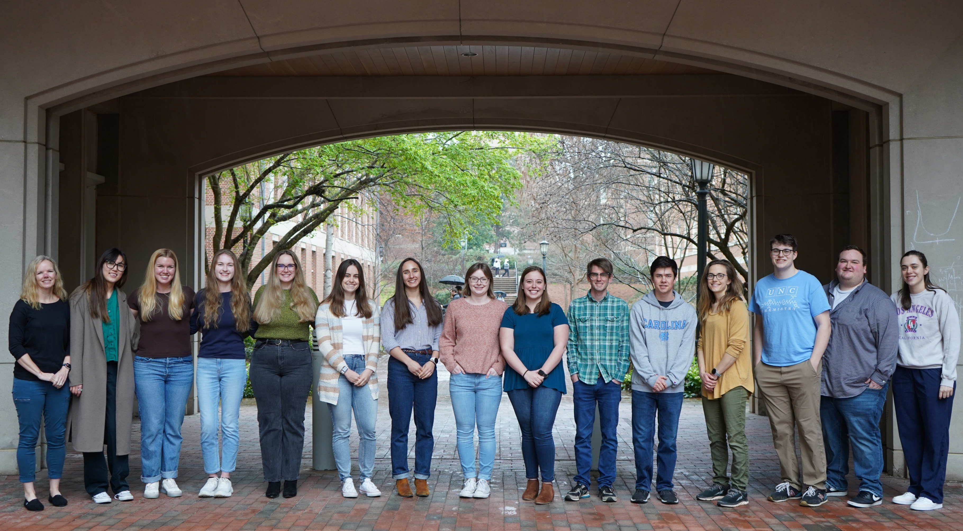




Acknowledgements
Baker Lab Members
Principal Investigator
Dr. Erin S. Baker
Research Assistant Professor
Prof. James Dodds
Postdoctoral Researchers
Dr. Guozhi Zhang
Dr. Jessie Chappel
Graduate Students
@BakerLabMS
@AmieSolosky
Jack Ryan
Past Graduates with Significant Contributions
Collaborators
Anna Boatman
Dr. Karen Butler
Ashlee Falls
Dr. Melanie Odenkirk
U Washington
University of California Davis
Greg Kudzin
Dr. Kaylie Kirkwood Donelson
Mike MacCoss
Frances M.D. Gulland
Dr. Nancy Lee Alexander
Brendan MacLean
Allison Fry
Emily Crawford
NIST
Haley Jostes
Contributing Undergraduate Students
Ben Neely
Kara Joseph
Iliana Claudio (alum)
Sarah Clark
Quentin DuVal
College of Charleston
Sources of Funding
Alison Bland
Michael Janech
NIEHS P42 ES027704 & P42 ES031009
NIGMS RM1 GM145416 & R01 GM141277
US EPA

