Slide 1

Tutorial Webinar #21
Welcome to the next in the series of tutorial webinars designed to help you get the most out of Skyline mass spectrometry software.
We’ll begin shortly …
Webinar Audio: Make sure you have audio during the webinar.
  Click Audio Settings in the lower left-hand corner of the screen :
  Computer audio (preferred) – through your computer’s speakers or a headset
  Phone call (US and International numbers available) By phone, use conference ID: 970 6344 1107
  **Note: we currently have music playing which you should be able to hear.**
Submit Skyline Questions: the Q&A form in Zoom to submit Skyline questions to the presenters
Have logistic issues? Use the Chat applet in Zoom for report webinar software (Zoom) issues or other problems.

Slide 2

Analysis of diaPASEF Data With Skyline
Tutorial Webinar #21
With
Brendan MacLean (Principal Developer, Skyline)
Ben Collins (DIA/SWATH researcher)
Nat Brace (Project Manager, Skyline)

Slide 3
Agenda
Welcome 200+ registered, from the Skyline team!
Analysis of diaPASEF Data With Skyline
  Introduction and Overview with Ben Collins
  Tutorial with Brendan MacLean
Audience Q&A – submit questions to Google Form:
https://skyline.ms/QA4Skyline.url

Slide 4
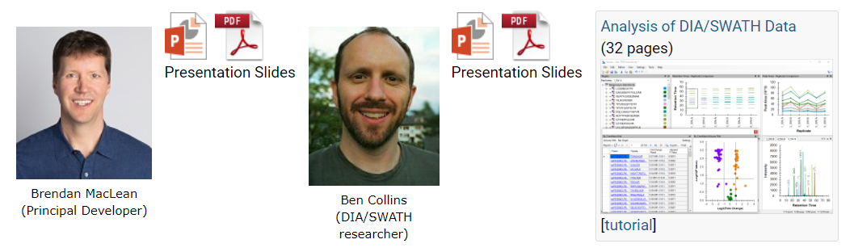
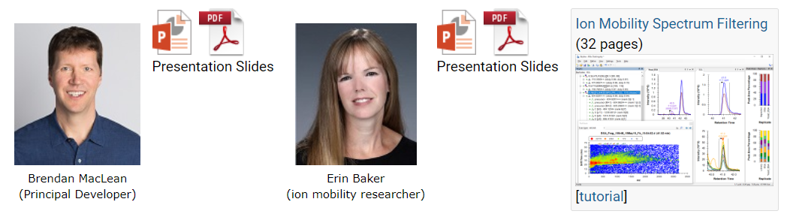
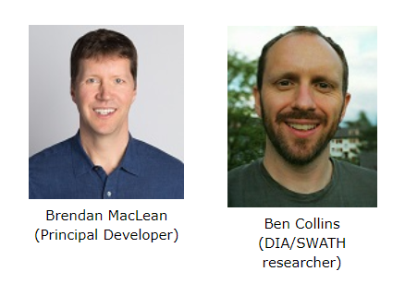
19 Tutorial Webinars – and Growing…
Webinar #18:
DIA/SWATH Data Analysis
Webinar #19:
Ion Mobility Spectrum Filtering
Webinar #20:
diaPASEF Data Analysis
See also – 2020 May Institute at Northeastern - https://computationalproteomics.khoury.northeastern.edu/

Slide 5
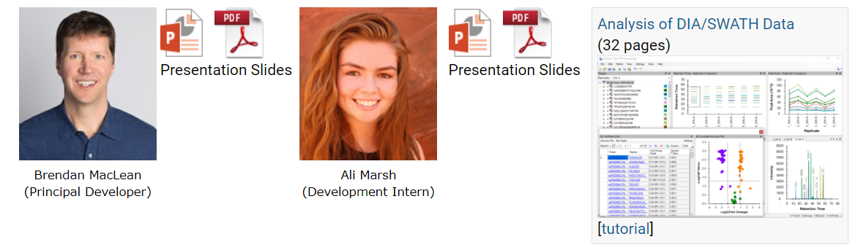
20 Tutorial Webinars – and Growing…
Webinar #20:
Skyline Batch for Large-Scale DIA
160 attended
Webinar #21 (in December):
diaPASEF Data Analysis
https://skyline.ms/tutorial_dia_pasef.url
https://skyline.ms/dia-pasef-2020.url
See also – 2021 May Institute at Northeastern - https://computationalproteomics.khoury.northeastern.edu/

Slide 6
Learn More in 2022
Skyline Online – February
May Institute Online? – May
Weeklong Courses ?
  University of Washington, Seattle – July?
  PRBB, Barcelona – November?
Workshops and Conferences ?
  Case Studies in Quantitative Proteomics – ASMS – June
  Skyline User Group Meeting at ASMS – June
  Listings updated in Join Us section of Skyline homepage:
  https://skyline.ms/Skyline.url

Slide 7
Questions?
Ask any questions at the Q&A form in Zoom:
Take the post-webinar survey:
https://skyline.ms/survey4webinar.url

Slide 8
Tutorial Webinar #21
This ends this Skyline Tutorial Webinar.
Please give us feedback on the webinar at the following survey:
https://skyline.ms/survey4webinar.url
A recording of today’s meeting will be available shortly at the Skyline website.
We look forward to seeing you at a future Skyline Tutorial Webinar.

