Slide 1



diaPASEF – concepts and data analysis
Skyline Webinar #21: Analysis of diaPASEF Data With Skyline
Ben Collins
Queen’s University Belfast | School of Biological Sciences
collinslab.net

Slide 2
Outline
Primer on trapped ion mobility separations (TIMS)
diaPASEF concept
Data set for the tutorial – 3 species mixture
For background see:
Webinar #18
DIA Data Analysis revisited
Webinar #19
Ion Mobility Spectrum Filtering

Slide 3
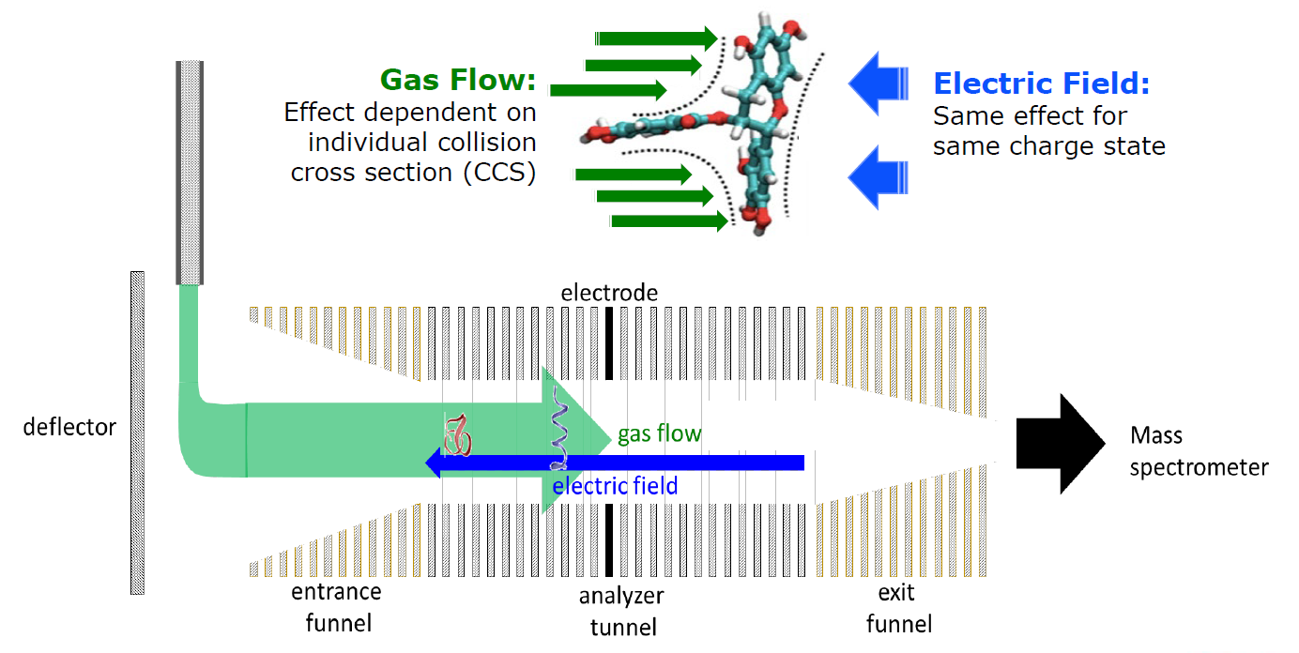
Trapped ion mobility spectrometry (TIMS)
electric field
Fernandez-Lima, Francisco, Desmond A. Kaplan, J. Suetering, and Melvin A. Park. “Gas-Phase Separation Using a Trapped Ion Mobility Spectrometer.” International Journal for Ion Mobility Spectrometry : Official Publication of the International Society for Ion Mobility Spectrometry (2011)

Slide 4
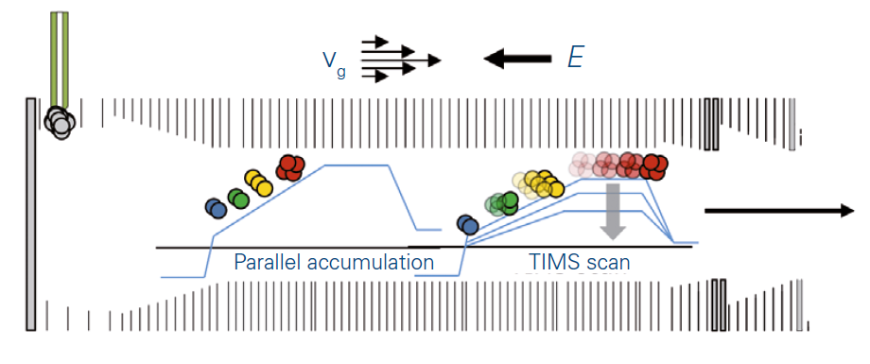
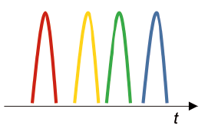
TIMS separates but also focuses ions
100ms
Accumulation
(from ESI)
5ms
5ms
5ms
5ms
100ms Separation

Slide 5
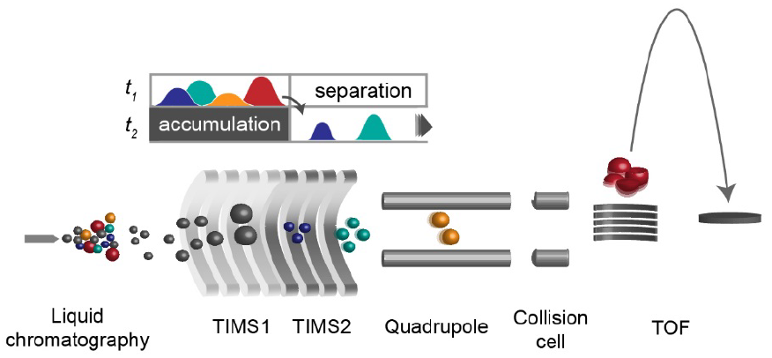
timsTOF Pro instrument
ddaPASEF
Meier, F, et al. Journal of Proteome Research (2015)
Meier, F., et al. Molecular & Cellular Proteomics (2018)

Slide 6
Outline
Primer on trapped ion mobility separations (TIMS)
diaPASEF concept
Data set for the tutorial – 3 species mixture
Notes:
Here’s a quick outline of what I talk about
There are basically 3 topics I’d like to touch on

Slide 7
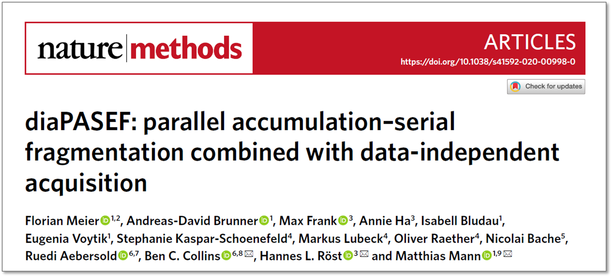
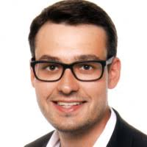
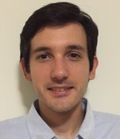
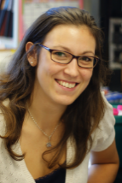
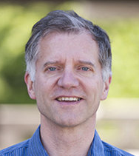
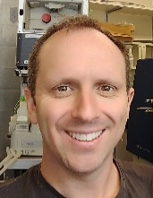
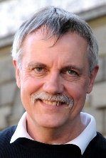
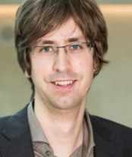
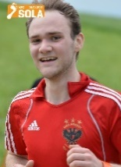
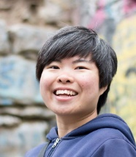


diaPASEF collaboration
Goal: Combine efficiency and sensitivity/selectivity of PASEF with
the deterministic quantification capability of DIA
Florian Meier, Andreas-David Brunner,
Isabell Bludau, Eugenia Voytik, Matthias Mann
Max Planck Institute of Biochemistry
Ben Collins, Ruedi Aebersold
Queen’s University Belfast and ETH Zurich
Hannes Röst, Max Frank, Annie Ha
Donnelly Centre for Cellular and Biomolecular Research
University of Toronto
Stephanie Kaspar-Schönefeld, Markus Lubeck,
Heiner Koch, Scarlet Koch, Oliver Räther
Bruker Daltonics
Nicolai Bache
Evosep

Slide 8
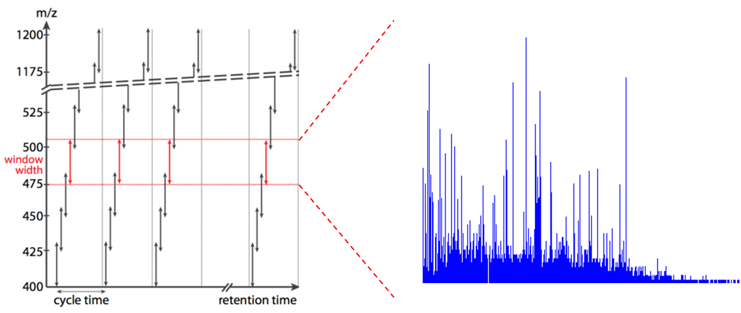
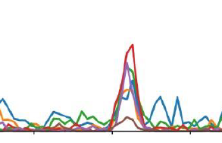
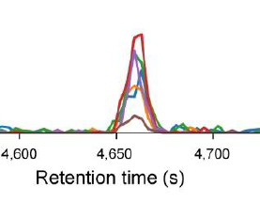
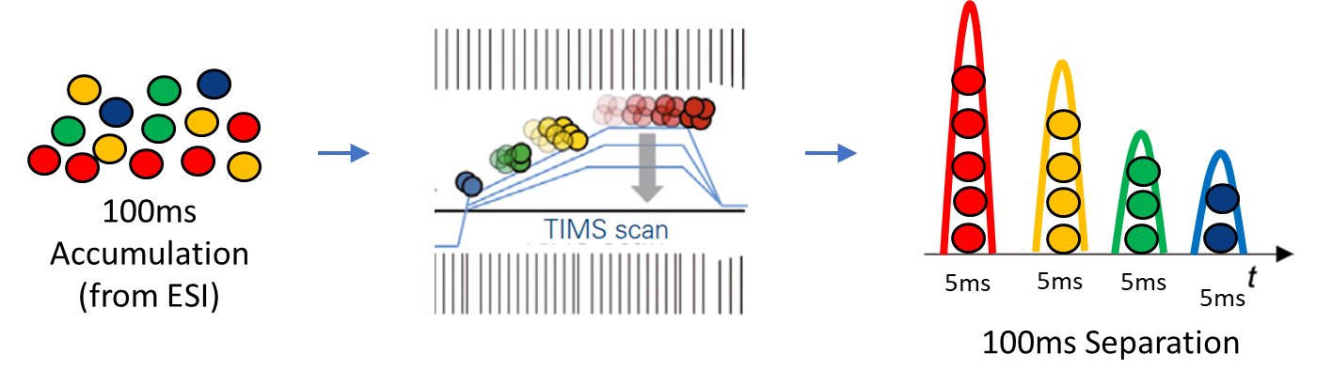
Problem statement(s)
?
Global efficiency of DIA/SWATH at the mass selective quadrupole is low
  1 / # precursor windows
  ~1-3% for commonly used schemes
In DIA/SWATH selectivity is (sometimes) limiting
  Mobility separation should help
Ion stacking benefit of PASEF not yet implemented in DIA mode
?
Notes:
benefit from the ion stacking effect implemented in the PASEF approach and so we wanted to also have this benefit

Slide 9
120 min HeLa run
Summed MS1 signal
~1,000 TOF pushes (MS1) in one ion mobility cycle 100ms
Charge +1
Ion mobility
+2 and +3
m/z

Slide 10
120 min HeLa run
Overlay
~1,000 TOF pushes (MS2) in one ion mobility cycle 100ms
Ion mobility
m/z
Notes:
And so now if we go to DIA mode where we’re talking about MS2 spectra
We use the correlation of the m/z and mobility to position the quadruple where we know there should be bigger ions at the start of the mobility scan
Then as the IM scan proceeds we can shift this over to capture progressively small ions
Each blue line is 1 of 1000 ion mobility resolved MS2 scans with one of several quadrupole positions
The idea here is that by using the correlation between m/z and IM we should be able to increase global ion utilization at the mass selective quadrupole
So, this is the basic concept that we had toward the start of the project

Slide 11
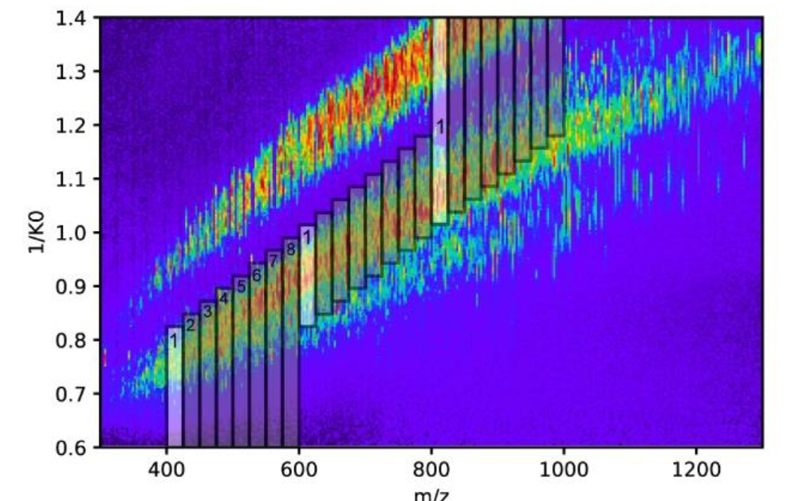
Balance between ion utilization efficiency, selectivity, and precursor coverage
high speed diaPASEF
- 24 x 25 m/z windows
- 3 IM windows / 100 ms IM cycle
- 8 IM cycles to cover precursors ~0.8 sec

Slide 12
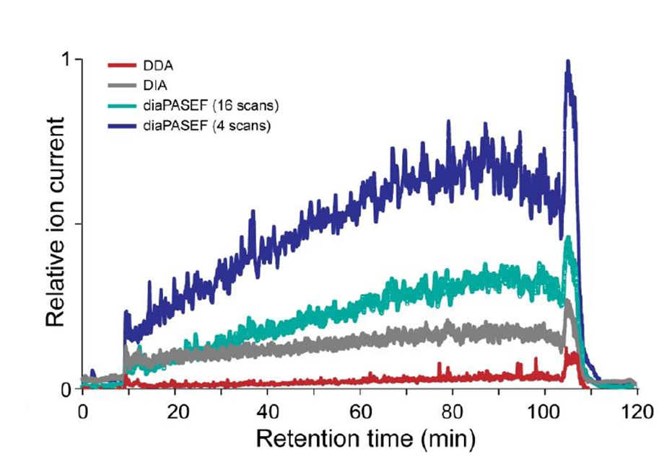
Increased ion utilization efficiency compared to standard DIA (or DDA)

Slide 13


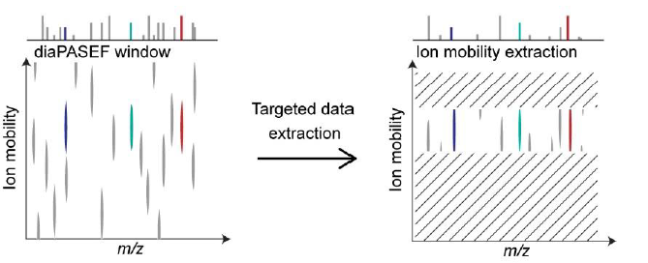


Data analysis strategy adapted for diaPASEF
Now also:
Selective extraction in the ion mobility domain
And several others…

Slide 14
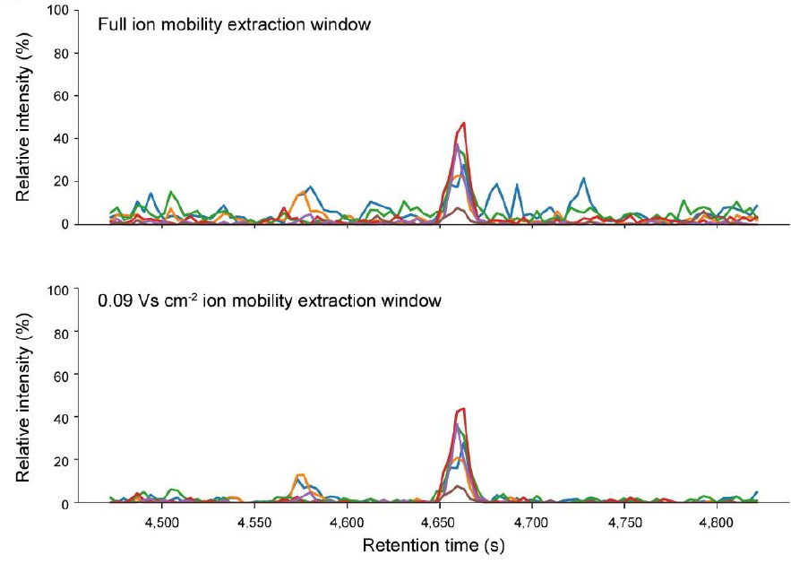
Does selective extraction in ion mobility dimension make a difference?

Slide 15
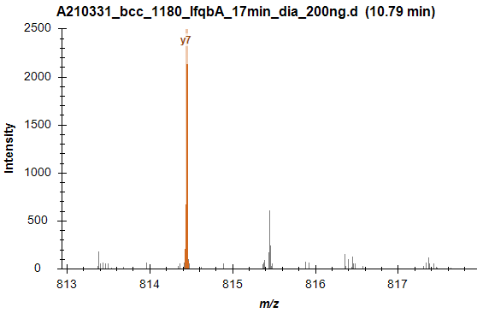
Skyline – ion mobility resolved visualization

Slide 16
Outline
Primer on trapped ion mobility separations (TIMS)
diaPASEF concept
Data set for the tutorial – 3 species mixture

Slide 17
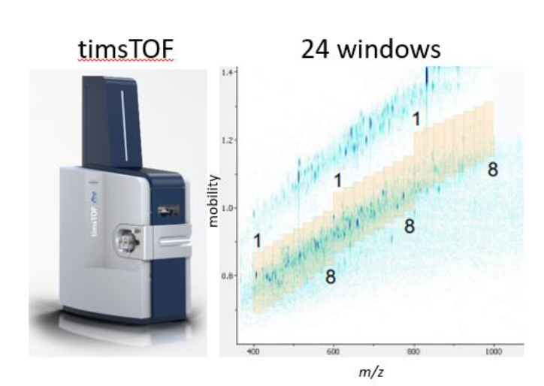
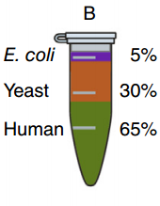
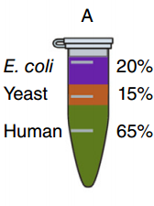
Data set for the webinar demo and tutorial
A
B
Expected ratio
1:4
2:1
1:1
3 x diaPASEF technical replicates
17 Minute gradient
200ng injected (5x less than Navarro et al)
2 ddaPASEF files (1 of each condition)
(A/B labelling is opposite from Navarro et al)
Navarro, P. et al. ‘A Multicenter Study Benchmarks Software Tools for Label-Free Proteome Quantification’. Nature Biotechnology (2016)
Meier, F., et al. ‘DiaPASEF: Parallel Accumulation–Serial Fragmentation Combined with Data-Independent Acquisition’. Nature Methods (2020)

Slide 18
Backup

Slide 19
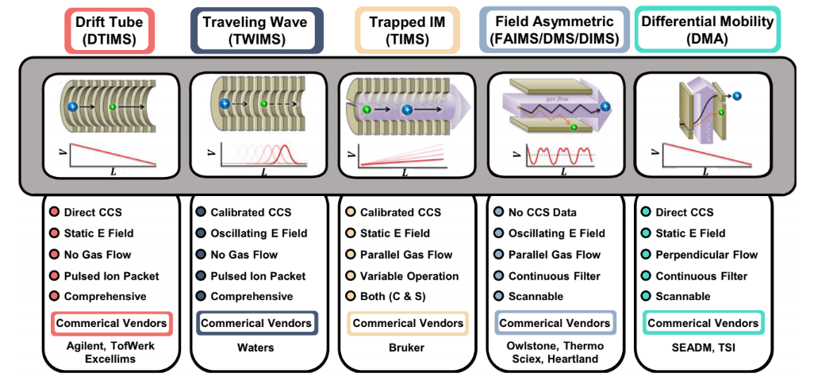
Many flavours of ion mobility separations
Dodds, James N., and Erin S. Baker. “Ion Mobility Spectrometry: Fundamental Concepts, Instrumentation, Applications, and the Road Ahead.” Journal of The American Society for Mass Spectrometry (2019)

Slide 20
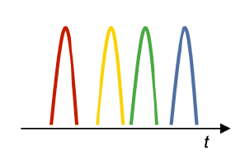
Dual TIMS design on timsTOF Pro improves duty cycle

Slide 21
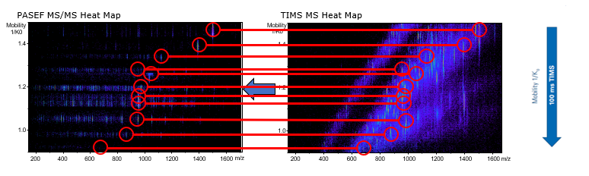
Parallel Accumulation – Serial Fragmentation
Meier, F, et al. Journal of Proteome Research (2015)
Meier, F., et al. Molecular & Cellular Proteomics (2018)

Slide 22
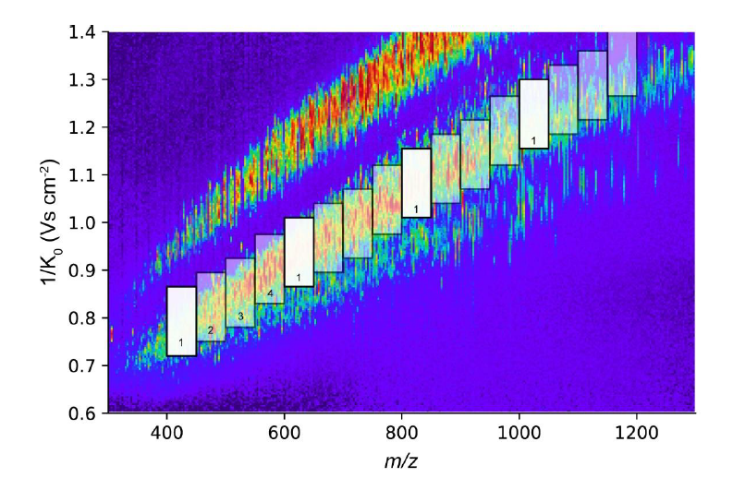
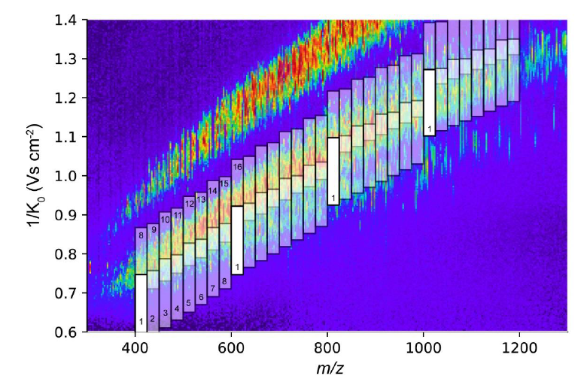
Balance between ion utilization efficiency, selectivity, and precursor coverage
high sensitivity diaPASEF
- 16 x 50 m/z windows
- 4 IM windows / 100 ms IM cycle
- 4 IM cycles to cover precursors ~0.4 sec
- Repeat 4x for ~1.7 sec duty cycle
Standard diaPASEF
- 32 x 25 m/z windows
- with IM overlap 64 windows
- 4 IM windows / 100 ms IM cycle
- 16 (8 x 2) IM cycles / ~1.7 sec duty cycle

