Slide 1


Skyline Batch
A user-friendly tool to run a simple Skyline workflow on many files at a time.
Great for:
  Overnight processing
  Easily reprocessing data
  Sharing workflows across computers
  Quickly getting from a Skyline template to a report file
Ali Marsh
Skyline Batch developer
Skyline Batch Instructions - Bruderer Skyline Batch Instructions.pdf - Google Drive

Slide 2
Skyline Batch Workflow
Download Files
Copy Template and Import Data
Create a New Refined File
Export Reports
Run R Scripts
Skyline Batch

Slide 3





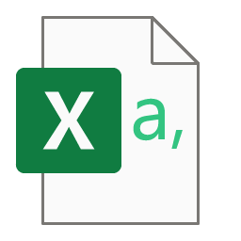
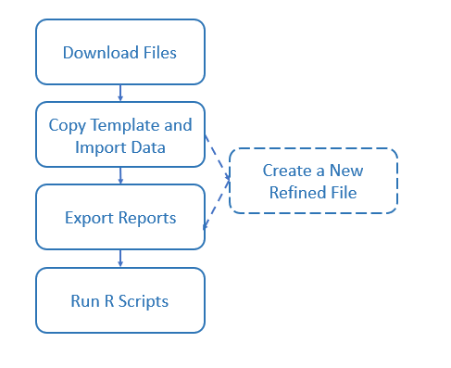

Reprocessing Data With Skyline Batch
Download Skyline Batch Configuration file from PanoramaWeb
View the outputted Skyline file, CSV files, and PDFs
Process data in Skyline Batch

Slide 4
Next Steps
Reprocess the Bruderer data using a downloaded Skyline Batch Configuration (.bcfg) file
Walk through creating the sharable Bruderer Skyline Batch configuration file ourselves

