Slide 1
Using Skyline Batch for
Large-Scale DIA
Tutorial Webinar #20
With
Brendan MacLean (Principal Developer)
Ali Marsh (Development Intern)
Nat Brace (Project Manager)

Slide 2
Agenda
Welcome from the Skyline team!
Introduction and overview with Brendan MacLean
Introduction to Skyline Batch with Ali Marsh
Tutorial on using Skyline Batch from Ali Marsh
Tutorial on creating a template file with Brendan MacLean
Audience Q&A – submit questions to Google Form:
https://skyline.ms/QA4Skyline.url

Slide 3
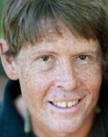
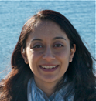

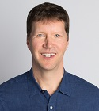
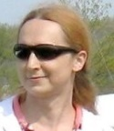
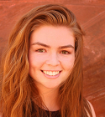
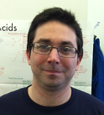
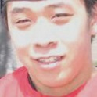

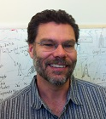
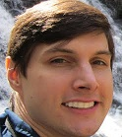
Skyline Team
Nat Brace
Vagisha Sharma
Brian Connolly
Brendan MacLean
Rita Chupalov
Ali Marsh
Nick Shulman
Kaipo Tamura
Brian Pratt
Matt Chambers

Slide 4
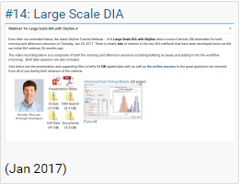
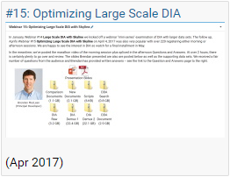
Windows Batch Scripts for Running Skyline
Created for Navarro, Nature Biotech. 2016
First presented in Skyline Tutorial Webinar 14 – https://skyline.ms/webinar14.url
Used again in Skyline Tutorial Webinar 15 –
https://skyline.ms/webinar15.url
Used to teach May Institute 2018-2020
Used in Searle, Nature Comm. 2018
Used in Vaca Jacome, Nature Methods, 2020
Used in MacLean oral (Prosit) and poster (diaPASEF) at ASMS 2020

Slide 5
Q: Do Skyline users use these scripts?
Require a user to slightly but expertly edit the scripts
AutoQC Loader increasingly popular
  Runs Skyline command-line based on GUI configuration
  Nice UI for monitoring processing logs

Slide 6
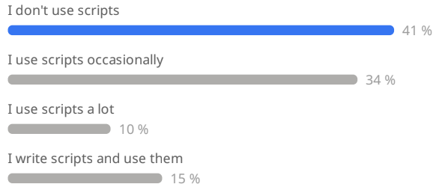
Replacing Scripts with Skyline Batch GUI
Intern Ali Marsh of MIT CS joined Skyline Team for 1 year
Goal: Replace the scripts with a GUI
Proof of concept 1: Replace the scripts in webinars 14 and 15
Proof of concept 2: Replace the scripts and teach in May Institute
  https://computationalproteomics.khoury.northeastern.edu/
  What is your scripting expertise?
https://skyline.ms/batch.url

Slide 7
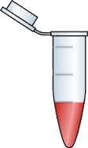
Two Phase Experiment
N * Quantitative Samples
1 * Detection Samples
pool
DDA
DDA
DDA
DIA
DDA
DDA
DDA
N *
Quantify Peptides
Detect Peptides
with Search Engine
Build Library
Bruderer, et al. & Reiter, MCP, 2015

Slide 8
Prior Knowledge Workflow
DIA Acquisition
Spectral Library
with iRT
Relative Ion Abundance
Normalized RT
Product Ion
Targeting
Chromatogram Extraction
mProphet
Peak Picking
Quantitative
Analysis
Reiter, Rinner, et al.
Nature Methods, 2011

Slide 9
Learn More
Webinar #21? Trapped Ion Mobility diaPASEF
  With Ben Collins (data collected, tutorial drafted)
Weeklong Courses 2022 ?
  University of Washington – July
  Buck Institute – April
  Northeastern May Institute – May 9 – 22
  PRBB, Barcelona – November
Workshops and Conferences 2020 ?
  Skyline User Group Meeting “at ASMS” – October (webinar)
  Pre-ASMS course – October 30 & 31
  Listings updated in Join Us section of Skyline homepage:
  https://skyline.ms/Skyline.url

Slide 10

Questions?
Ask any questions at the Q&A form in Zoom:
Take the post-webinar survey:
https://skyline.ms/survey4webinar.url

Slide 11
Tutorial Webinar #20
This ends this Skyline Tutorial Webinar.
Please give us feedback on the webinar at the following survey:
https://skyline.ms/survey4webinar.url
A recording of today’s meeting will be available shortly at the Skyline website.
We look forward to seeing you at a future Skyline Tutorial Webinar.

