Slide 1
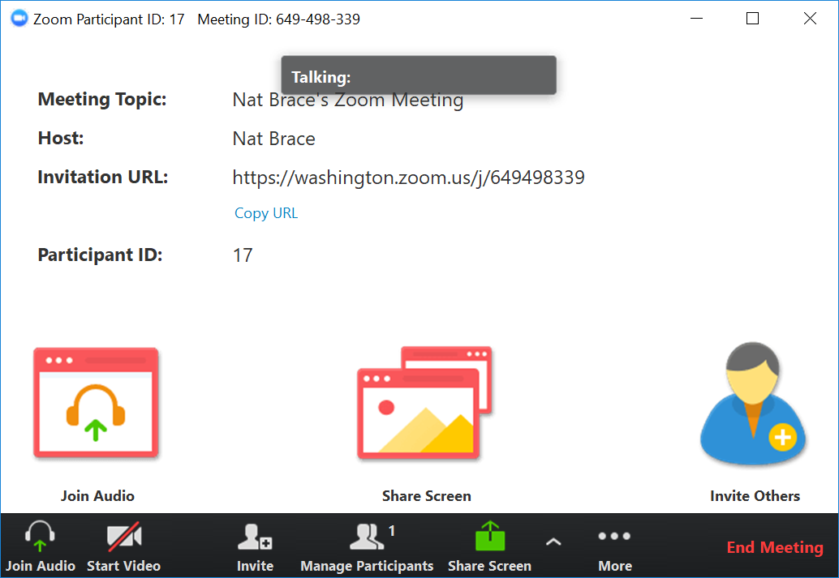
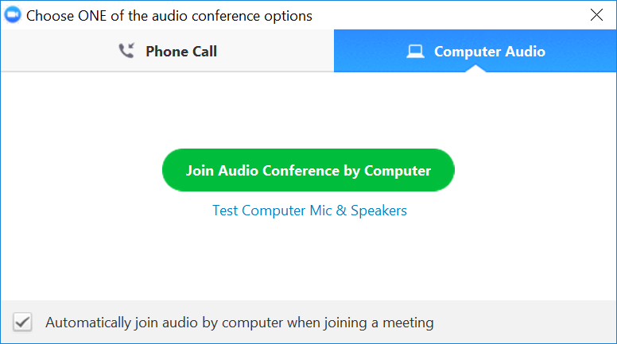
Tutorial Webinar #19
Welcome to the next in the series of tutorial webinars designed to help you get the most out of Skyline mass spectrometry software.
We’ll begin shortly …
Webinar Audio: Make sure you have audio during the webinar.
  Click the headphone icons in the lower left corner of Zoom app shown here You then have to click your choice to either:
  Computer audio (preferred) – through your computer’s speakers or a headset
  Phone call (US and International numbers available) By phone, use conference ID 246-102-609
  **Note: we currently have music playing which you should be able to hear.**
Submit Skyline Questions: Use this form to submit Skyline questions to the team – we will try to answer as many as possible:
https://skyline.ms/QA4Skyline.url
The QA link will also be available in the chat window – to open your chat window click the icon – circled on the Zoom app toobar below.

Slide 2
Ion Mobility Spectrum Filtering in Skyline
Tutorial Webinar #19
With
Brendan MacLean (Principal Developer, Skyline)
Erin Baker (Ion Mobility Researcher)
Nat Brace (Project Manager, Skyline)

Slide 3
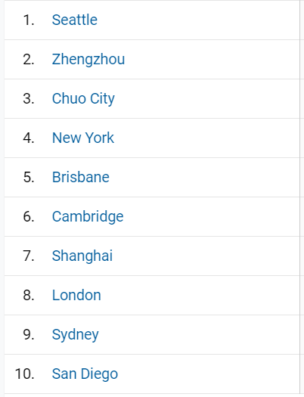
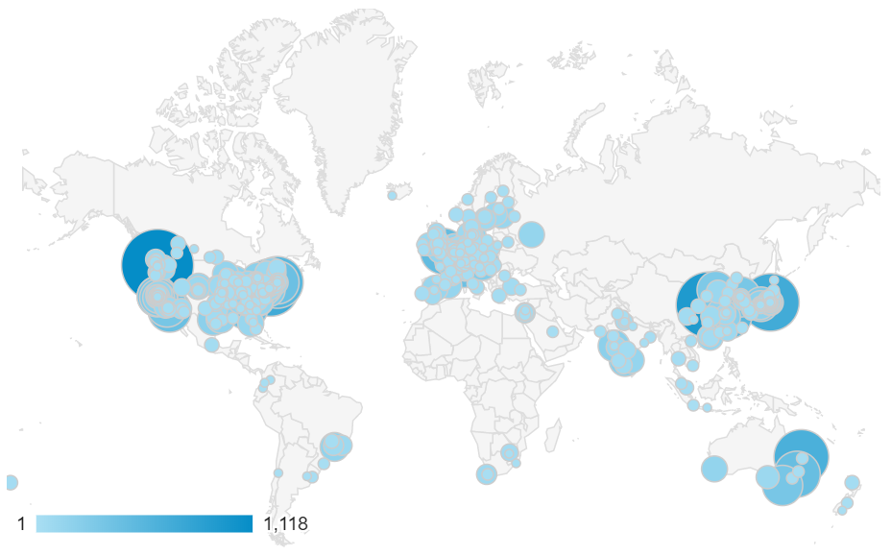
Is Skyline a Pandemic?

Slide 4
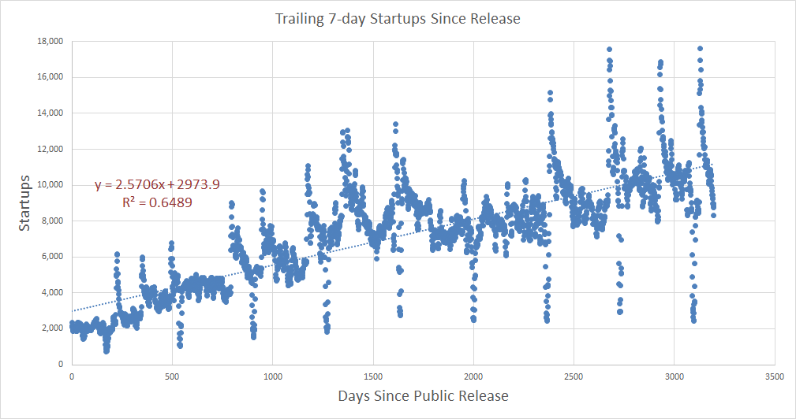
Viral Growth?
Plateau of
Productivity
Peak of Inflated
Expectations
Slope of
Enlightenment
Trough of Disillusionment

Slide 5
Agenda
Welcome from the Skyline team!
Ion Mobility Spectrum Filtering with Skyline
  Introduction and Overview with Erin Baker
  Tutorial with Brendan MacLean
Audience Q&A – submit questions to Google Form:
https://skyline.ms/QA4Skyline.url

Slide 6
Learn More
Webinar #20? Trapped Ion Mobility diaPASEF
  With Ben Collins (need new data)
Weeklong Courses 2020 ?
  University of Washington, Seattle – July 20-24
  Duke University, Durham – October 5-9
  PRBB, Barcelona – November
Workshops and Conferences 2020 ?
  Skyline User Group Meeting “at ASMS” – June (webinar)
  HUPO, Stockholm – October 17 & 18
  Listings updated in Join Us section of Skyline homepage:
  https://skyline.ms/Skyline.url

Slide 7
Questions?
Ask any questions at the following form:
  https://skyline.ms/QA4Skyline.url
Take the post-webinar survey:
https://skyline.ms/survey4webinar.url

Slide 8
Tutorial Webinar #18
This ends this Skyline Tutorial Webinar.
Please give us feedback on the webinar at the following survey:
https://skyline.ms/survey4webinar.url
A recording of today’s meeting will be available shortly at the Skyline website.
We look forward to seeing you at a future Skyline Tutorial Webinar.

