Slide 1


Ion Mobility Spectrometry: The Good, The Bad and The Ugly
Erin S. Baker
Department of Chemistry, NC State University

Slide 2
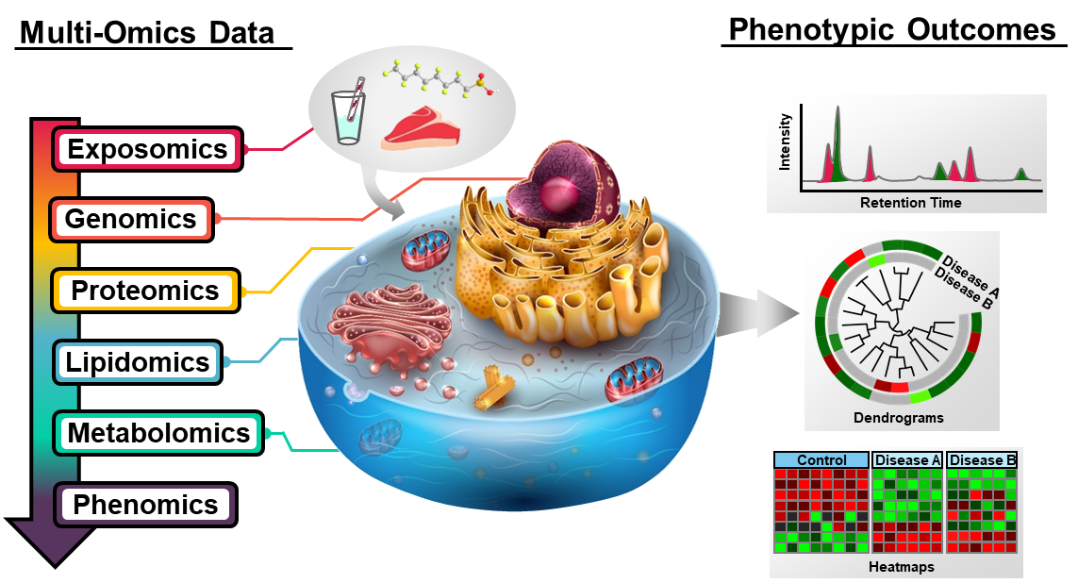
Multi-Omic Analyses
  Only ~16% of deaths can be attributed solely to genetics
1) Rappaport, SM “Genetic Factors Are Not the Major Causes of Chronic Diseases” PLoS One 2016.

Slide 3
Ion Mobility Concept
Defines how an ion drifts through a gas under the influence of an electric field
Separation based on the mass, charge, size & shape
Variables in diverse IMS methods
  Electric field
  Pressure
  Gas composition
  Gas flow
  Temperature
E
F_{friction}
F_{el}
Ion
p (Drift Gas)
Drift Cell

Slide 4


Ion Mobility Concept
E
in
out
Drift Time
Pulse of 2 ions with
same m/z but different
shape
Different conformers separate
in time with peak heights representing the amount of each
Drift Cell
velocity is constant
v = K E
K = ion mobility

Slide 5
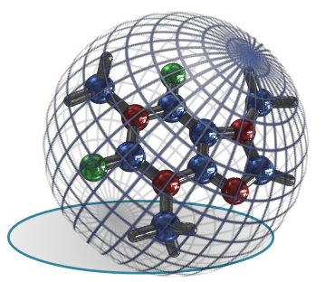
Ion-Neutral Collision Cross Section
Area related to the size and shape of an ion
Robust physicochemical property
Can easily be compared between labs
Varies depending on drift gas
Slide courtesy of Professor Kevin Pagel and Waters

Slide 6
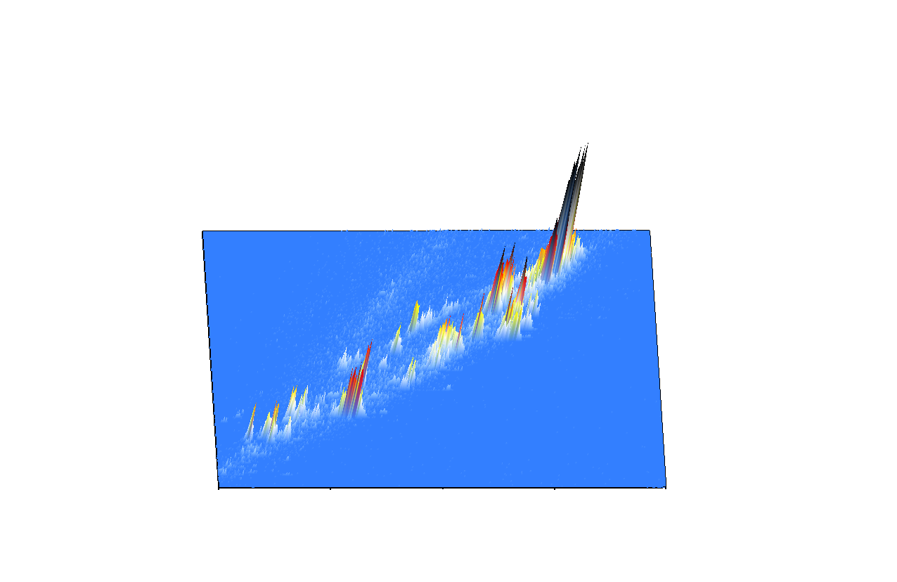
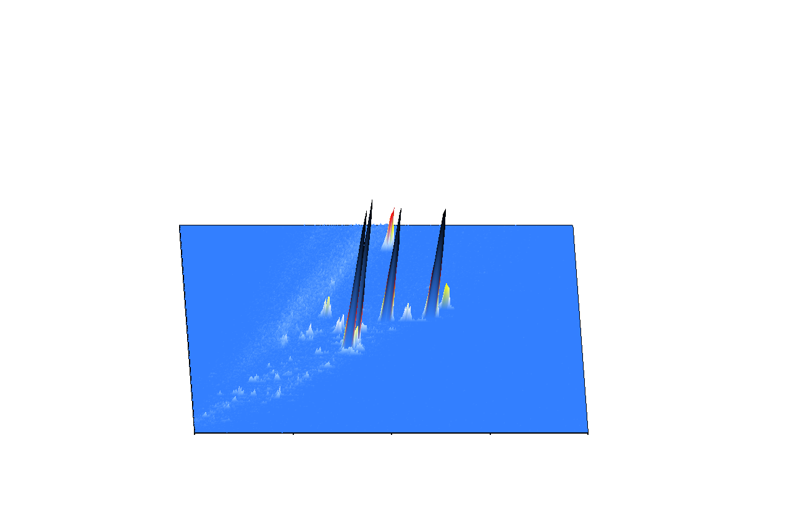
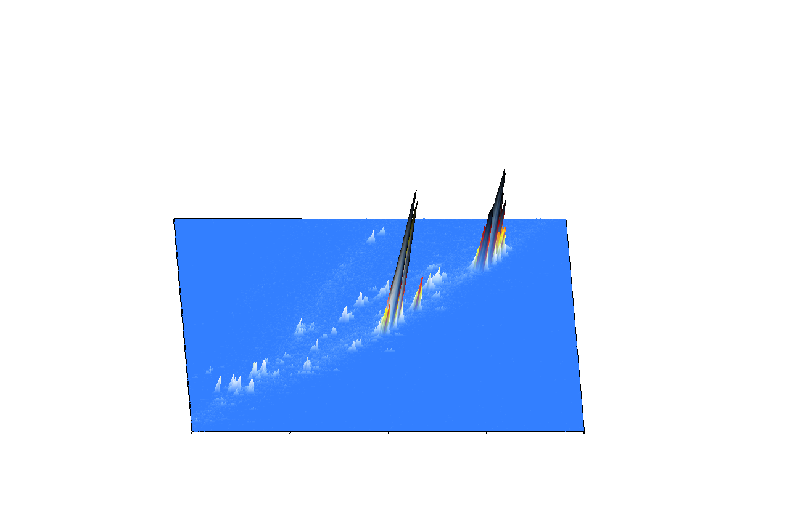
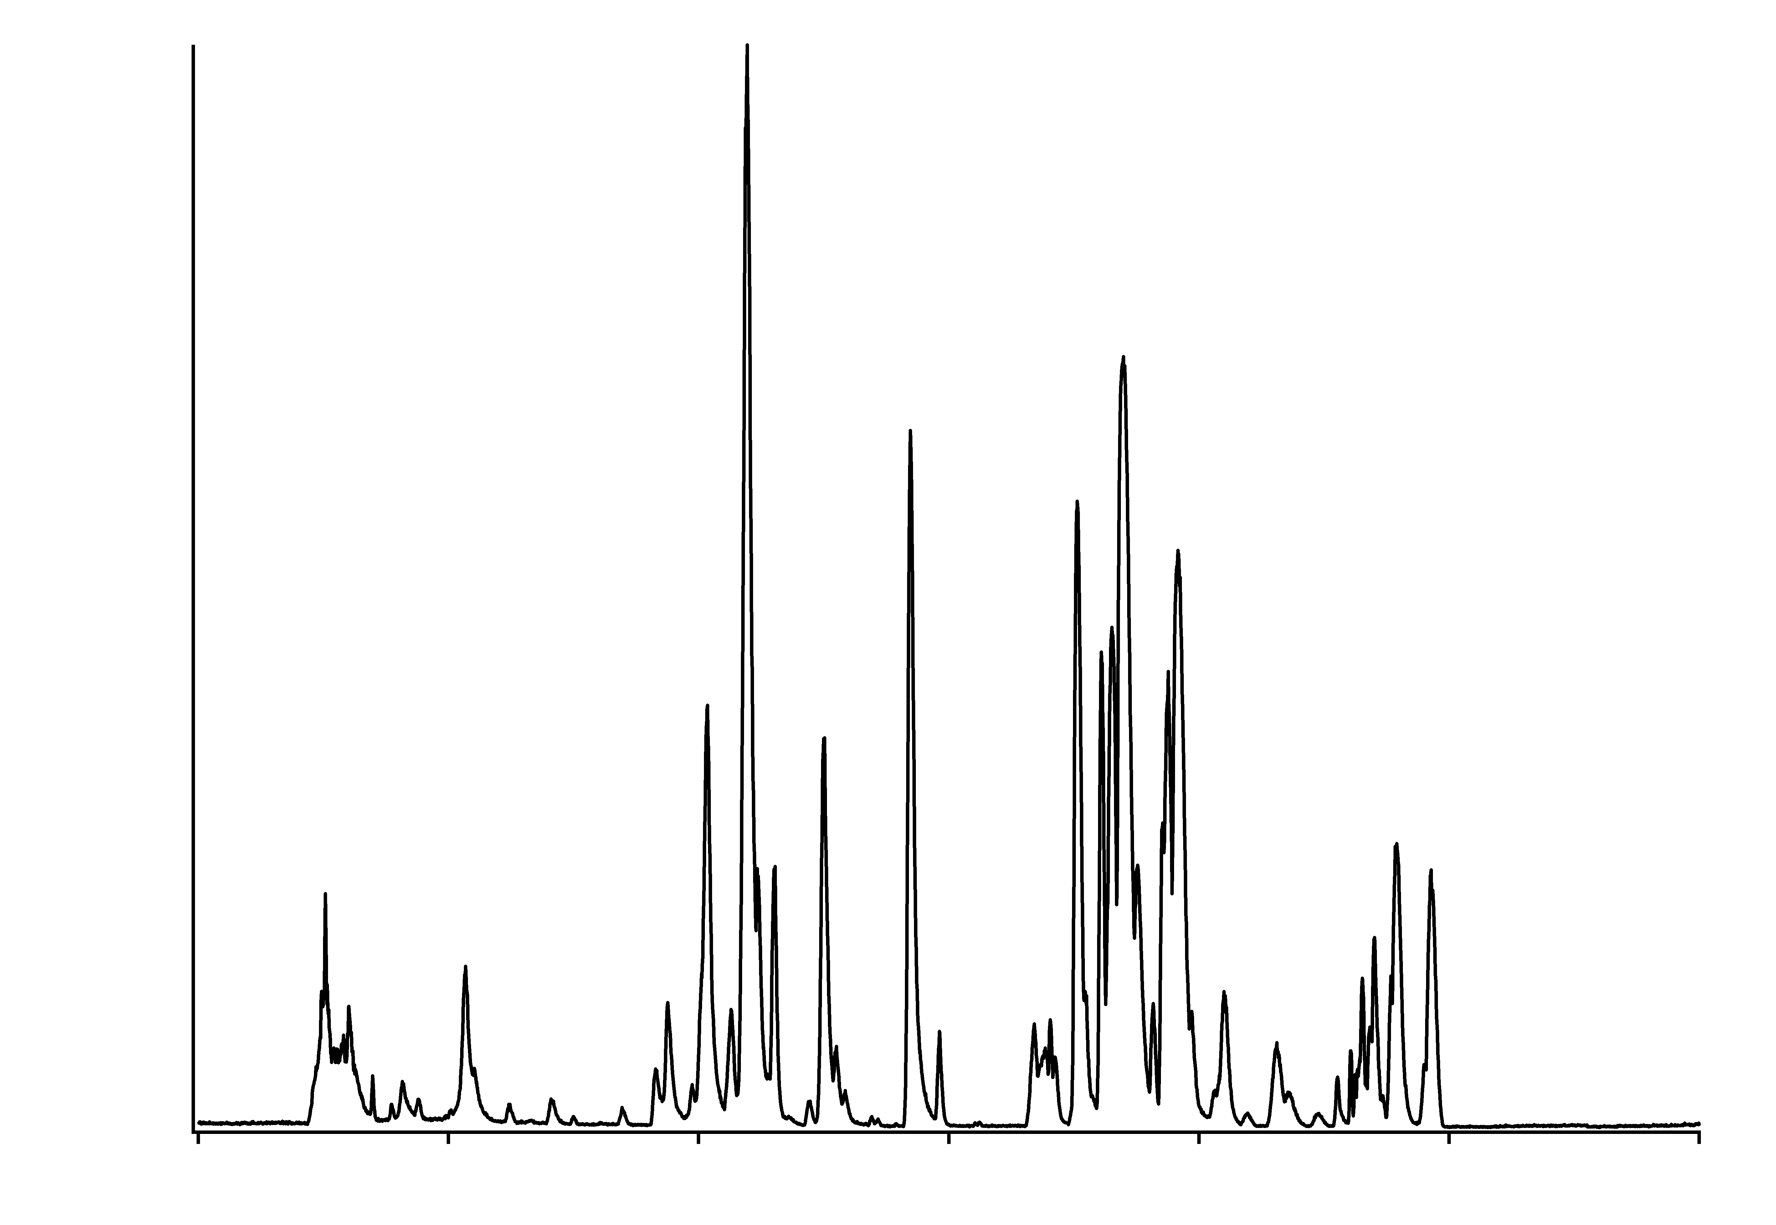
Multi-dimensional Analyses
LC (minutes)
IMS (~60 ms)
MS (~100 µs)
IMS
MS
Elution Time
Drift Time
m/z
1100
1100
1100
m/z
m/z
m/z
100
20
30
40
50
60
100
Drift Time (ms)
100
20
30
40
50
60
20
30
40
50
60
Drift Time (ms)
Drift Time (ms)
Intensity
0
10
20
30
40
50
60
Elution Time (minutes)

Slide 7
The Good: How Can IMS Help Multi-Omic Studies?
  1. IMS is fast (ms time scale) and easily coupled with front-end separations & MS
  2. Allows evaluation of structural biomarker presence
  3. Multi-dimensional analyses (such as LC-IMS-MS) provide more confident identifications
  4. CCS values reduce potential molecular candidates in untargeted studies
  5. Heavy labeled molecules have the same drift time as their endogenous versions,
  allowing pair analysis for absolute quantitation

Slide 8
The Bad & The Ugly: Analyzing LC-IMS-(CID)-MS Data
  The Bad: LC-IMS-(CID)-MS data is large in complexity and file size
  The Ugly: Manual assignment is extremely time consuming, can only be done for a few targets and limits our ability to understand IMS benefits
  Need to address 2 questions:
    Does IMS aid in identifications in DIA studies?
    Can Skyline be used as a rapid analysis tool to study the effect of the IMS dimension?

Slide 9
IMS-(CID)-MS Data Acquisition
Collision Cell
Fragmentation takes place
after the drift cell

Slide 10
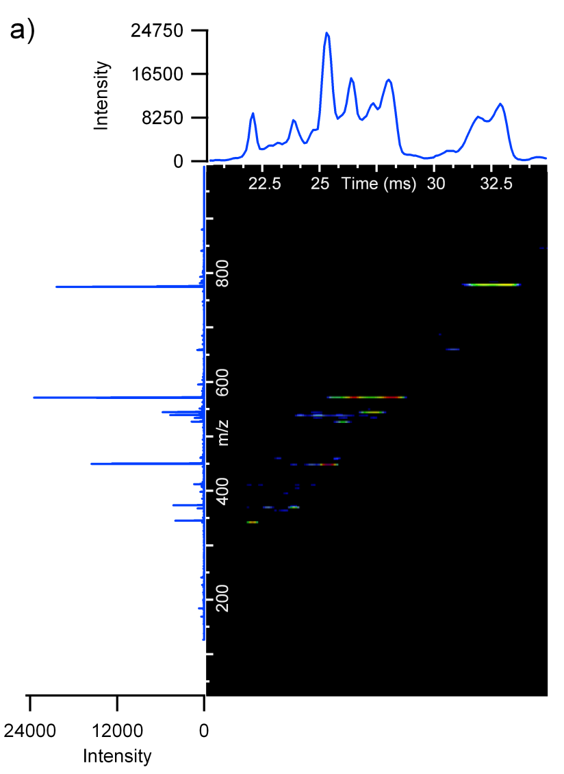

Drift Time Alignment for Precursors & Fragments
Precursor Spectrum
Fragment Spectrum

Slide 11
LC-IMS-(CID)-MS Experiment
  Spiked 8 different concentrations of tryptic BSA digest (from 100 pM to 1 µM) into 0.1 µg/µL yeast digest
  Analyzed the effect of IMS on MS quantitation & all ions CID quantitation for the DIA data
 | BSA Concentration in Yeast
 | 100 pM | 1 nM | 5 nM | 10 nM | 50 nM | 100 nM | 500 nM | 1 µM
LC-MS
LC-IMS-MS
All ions fragmentation LC-(CID)-MS
All ions fragmentation LC-IMS-(CID)-MS

Slide 12
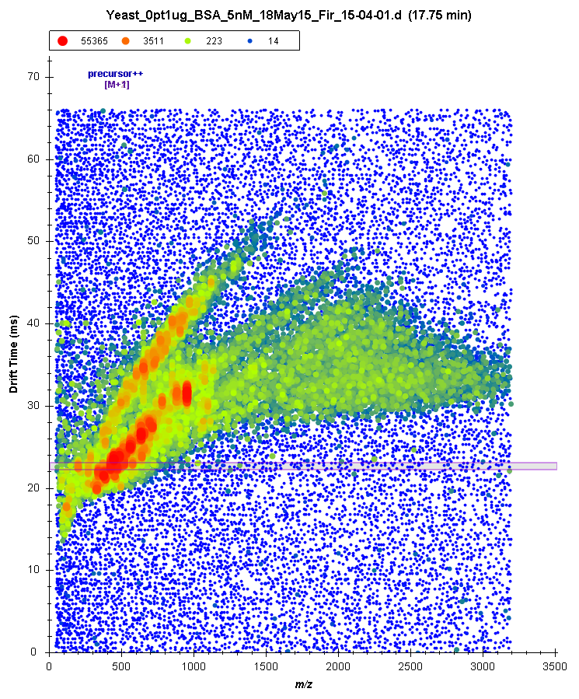
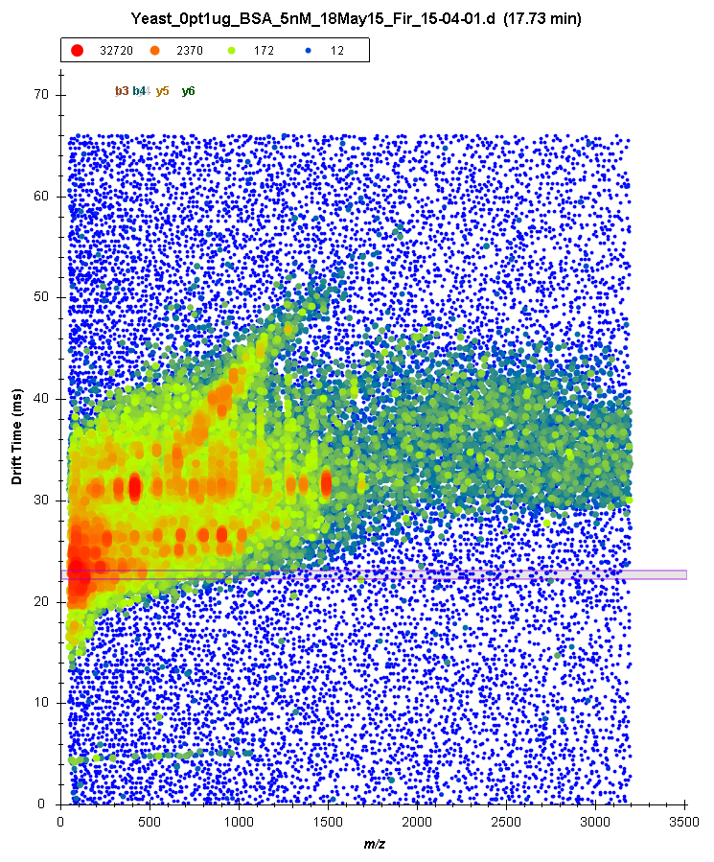
Alternating Precursor/Fragment Scans
IMS-MS
IMS-(CID)-MS (CE=29V)
CE of 29 V was chosen since it fragmented 2+ ions well

Slide 13
Drift Time Filtering Effect on MS Quantitation
LC-MS Quantitation
LC-IMS-MS Quantitation
Good quantitation from 100 pM to 1 µM for all peptides when drift time filtering was used
Without drift time filtering, lower concentration peptide quantitation was not as linear

Slide 14
Drift Time Filtering Effect on MS Quantitation
LC-MS Quantitation
LC-IMS-MS Quantitation

Slide 15
Peak Interferences Without Drift Time Filtering
LC-MS Quantitation
LC-IMS-MS Quantitation

Slide 16
Peak Interferences Without Drift Time Filtering
LC-MS Quantitation
LC-IMS-MS Quantitation

Slide 17
Drift Time Filtering Effect on Fragment Quantitation
LC-(CID)-MS Quantitation
LC-IMS-(CID)-MS Quantitation
Good quantitation from 1 nM to 1 µM for 8 of 10 peptides with drift time filtering
and 10 for 10 from 10 nM to 1 µM
When drift time filtering was not used, many interferences caused bad quantitation at low concentration levels

Slide 18
Drift Time Filtering Removes Fragment Interferences
LC-(CID)-MS Quantitation
LC-IMS-(CID)-MS Quantitation

Slide 19
Drift Time Filtering Removes Fragment Interferences
LC-(CID)-MS Quantitation
LC-IMS-(CID)-MS Quantitation

Slide 20
Drift Time Filtering Removes Fragment Interferences
LC-(CID)-MS Quantitation
LC-IMS-(CID)-MS Quantitation

Slide 21
Summary
  Skyline:
  Quickly analyzed the LC-IMS-(CID)-MS data
  Showed that IMS removed interfering peaks in LC-MS and fragmentation data
  Enabling further studies to better understand the effect of IMS on numerous analysis types (e.g. other omics)

Slide 22
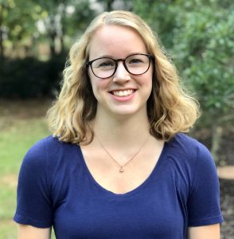

Skyline Lipidomics Workflow
NC STATE
@
Basic
Kaylie Kirkwood
Import Target List
Name, m/z, charge
Import Data Files
Vendor-neutral
Analyze & Visualize
View filtered data, confirm IDs, compare peak areas and retention times
Export Report
All target list information + retention times, peak areas, mass errors, etc.
Advanced
Import Target List
Basic + formulas, adducts, CCS, RT, fragments
Import Data FIles
Basic
Normalized RT Calculator
Predict RTs based on linear or Lowess regressions
Analyze & Visualize
Basic + compare to spectral library, calculate CCS
Quantify Lipids
Generate calibration curve from SIL standards
Export Report
Basic + concentrations, normalized retention times

Slide 23
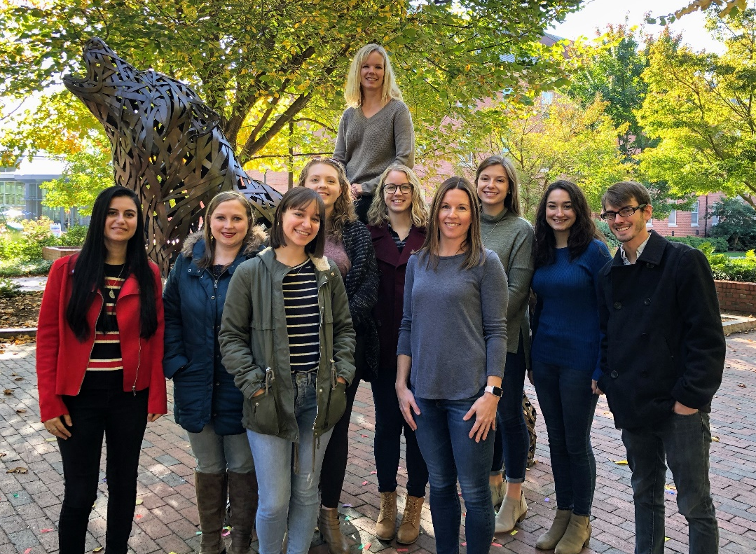

Acknowledgements
Baker Lab Members
James Dodds
Karen Butler
Melanie Odenkirk
Allison Stewart
Kaylie Kirkwood
MaKayla Foster
Caitlin Hodges
Nancy Abdelrahman
Collaborators
Sources of Funding
NCSU
PNNL
U Washington
NIEHS P42 ES027704
David Muddiman
Kristin Burnum-Johnson
Brendan MacLean
Denis Fourches
Kelly Stratton
Brian Pratt
NIH R56 AG063885
David Reif
Bobbie-Jo Webb-Robertson
Nick Shulman
National Academies of Sciences
Detlef Knappe
Marina Gritsenko
Kaipo Tamura
Agilent Technologies
Novartis
Emory
Nat Brace
NCSU Startup Funds
Stefan Thibodeaux
Blaine Roberts
Mike MacCoss
Amgen
Temple
Texas A&M U
Iain Campuzano
Brandie Taylor
Ivan Rusyn
AstraZeneca
Sonja Hess

