Slide 1
DIA/SWATH Data Analysis in Skyline Revisited
Tutorial Webinar #18
With
Brendan MacLean (Principal Developer, Skyline)
Ben Collins (DIA/SWATH researcher)
Nat Brace (Project Manager, Skyline)

Slide 2
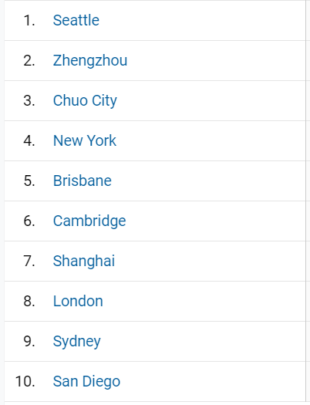
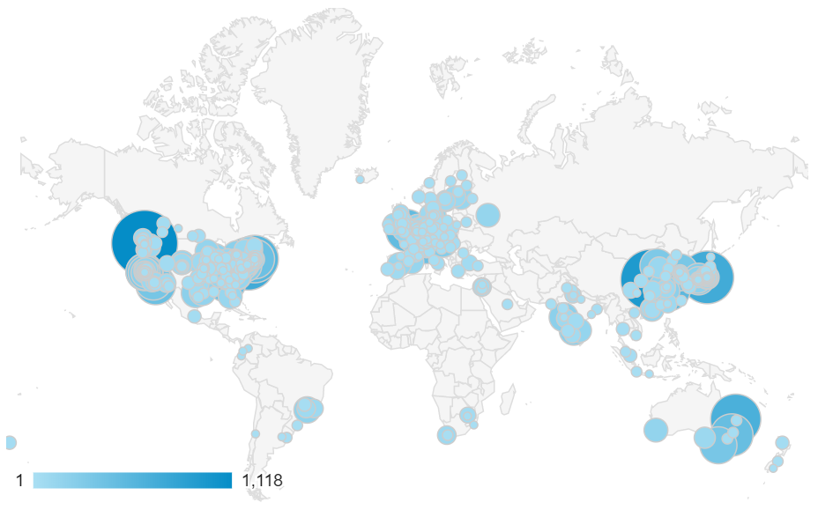
Skyline Use Worldwide

Slide 3
Agenda
Welcome 830+ registered, from the Skyline team!
DIA/SWATH Data Analysis in Skyline Revisited
  Introduction and Overview with Ben Collins
  Tutorial with Brendan MacLean
Audience Q&A – submit questions to Google Form:
https://skyline.ms/QA4Skyline.url

Slide 4
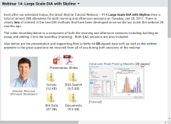
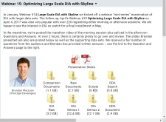
Learn More
Webinar 14: Large Scale DIA with Skyline
https://skyline.ms/webinar14.url
Webinar 15: Optimizing Large Scale DIA with Skyline
https://skyline.ms/webinar15.url

Slide 5
Learn More
Webinar #19: Ion Mobility Spectrum Filtering
  With Erin Baker
Weeklong Courses 2020 ?
  University of Washington, Seattle – July 20-24
  Duke University, Durham – October 5-9
  PRBB, Barcelona – November
Workshops and Conferences 2020 ?
  Skyline User Group Meeting “at ASMS” – June (webinar)
  HUPO, Stockholm – October 17 & 18
  Listings updated in Join Us section of Skyline homepage:
  https://skyline.ms/Skyline.url

Slide 6
Questions?
Ask any questions at the following form:
  https://skyline.ms/QA4Skyline.url
Take the post-webinar survey:
https://skyline.ms/survey4webinar.url

Slide 7
Tutorial Webinar #18
This ends this Skyline Tutorial Webinar.
Please give us feedback on the webinar at the following survey:
https://skyline.ms/survey4webinar.url
A recording of today’s meeting will be available shortly at the Skyline website.
We look forward to seeing you at a future Skyline Tutorial Webinar.

