Slide 1



DIA/SWATH -- primer and quantitative benchmarking
Skyline Webinar #18: DIA/SWATH Data Analysis in Skyline Revisited
Ben Collins
Queen’s University Belfast | School of Biological Sciences

Slide 2
Outline
Primer on DIA/SWATH
Peptide centric or targeted data analysis
Data set for the tutorial -- and where it came from
  Inspired by LFQBench (Navarro et al. Nature Biotech 2016)

Slide 3
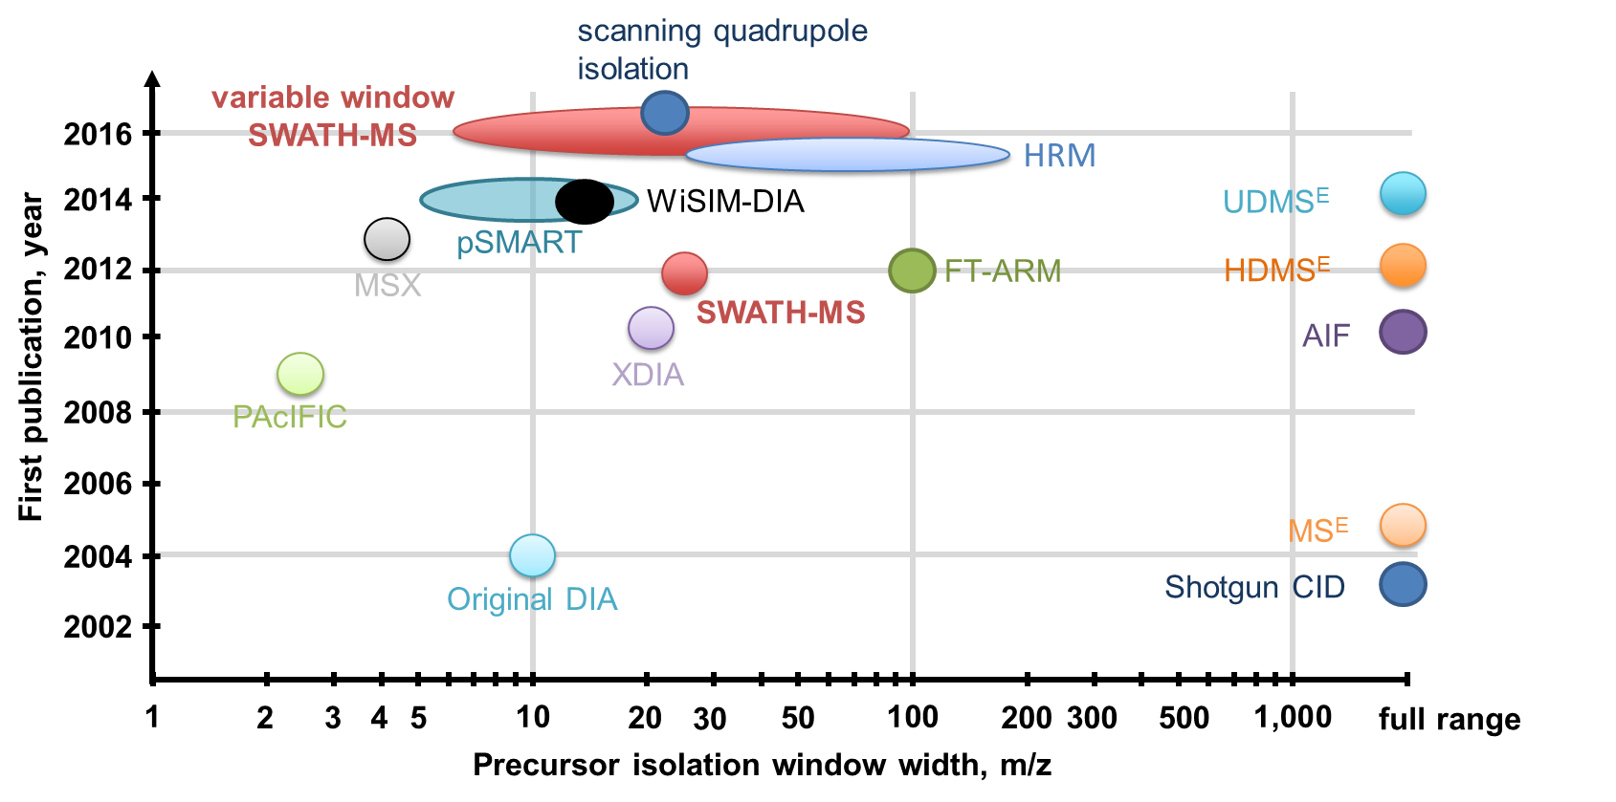
A brief history of data independent acquisition
Applications
Computational methods
Accessibility
Ludwig C. et al. DIA SWATH-MS tutorial Molecular Systems Biology (2018)

Slide 4
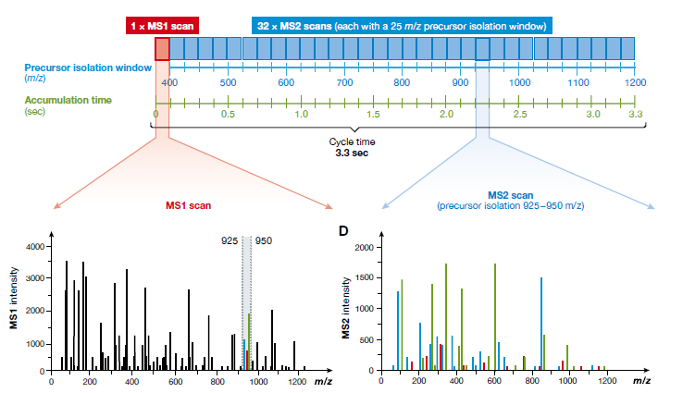
A typical DIA/SWATH acquisition method
Ludwig C. et al. DIA SWATH-MS tutorial Molecular Systems Biology (2018)

Slide 5
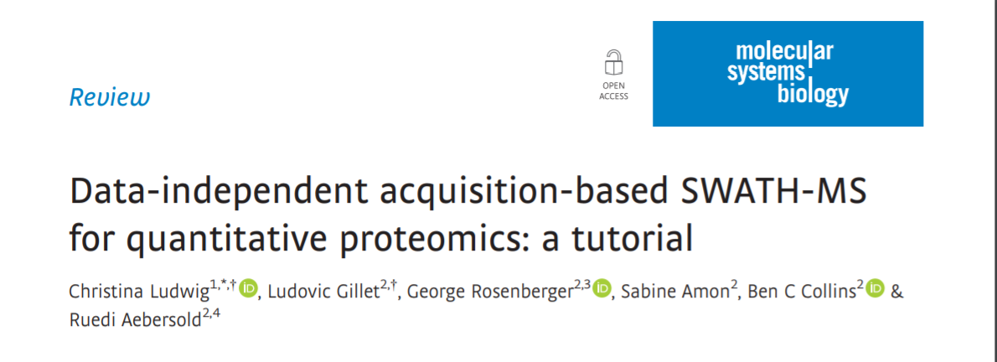
Tutorial paper – DIA/SWATH

Slide 6
Outline
Primer on DIA/SWATH
Peptide centric or targeted data analysis
Data set for the tutorial -- and where it came from
  Inspired by LFQBench (Navarro et al. Nature Biotech 2019)

Slide 7
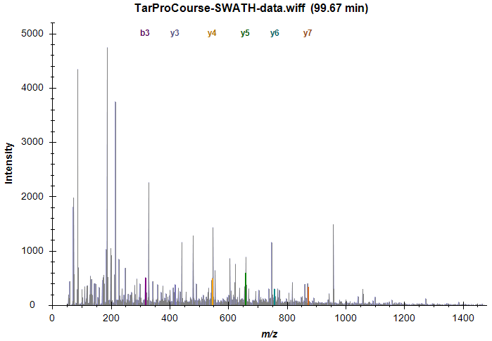
fragment ion spectrum 600-625 m/z
Why Targeted analysis?
AAHTEDINACTLTTSPR
Problem:
SWATH MS/MS spectrum contains fragment ions from any peptides in the precursor isolation range 600-625 m/z that are currently eluting

Slide 8
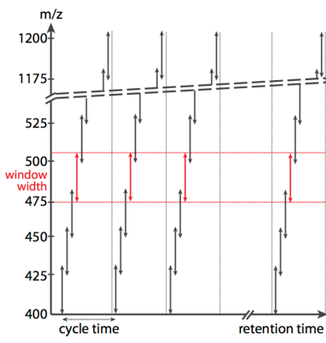
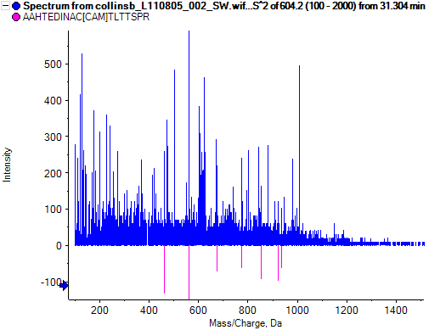
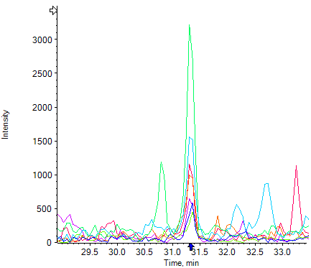
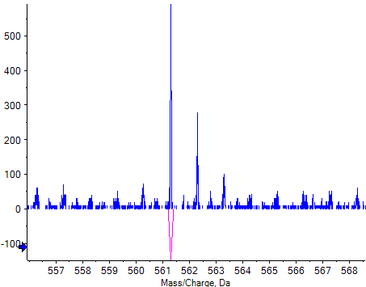
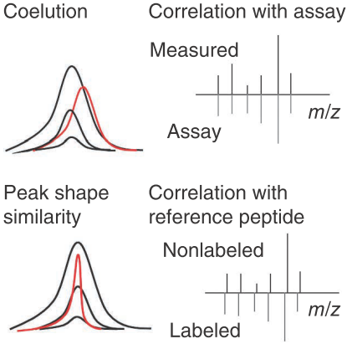
Peptide centric analysis (or targeted analysis)
Prior knowledge
AAHTEDINACTLTTSPR
y5
Reiter L. et al. (2011) Nature Methods
Gillet LC et al. (2012) Mol. Cell Proteomics

Slide 9
Outline
Primer on DIA/SWATH
Peptide centric or targeted data analysis
Data set for the tutorial -- and where it came from
  Inspired by LFQBench (Navarro et al. Nature Biotech 2019)

Slide 10

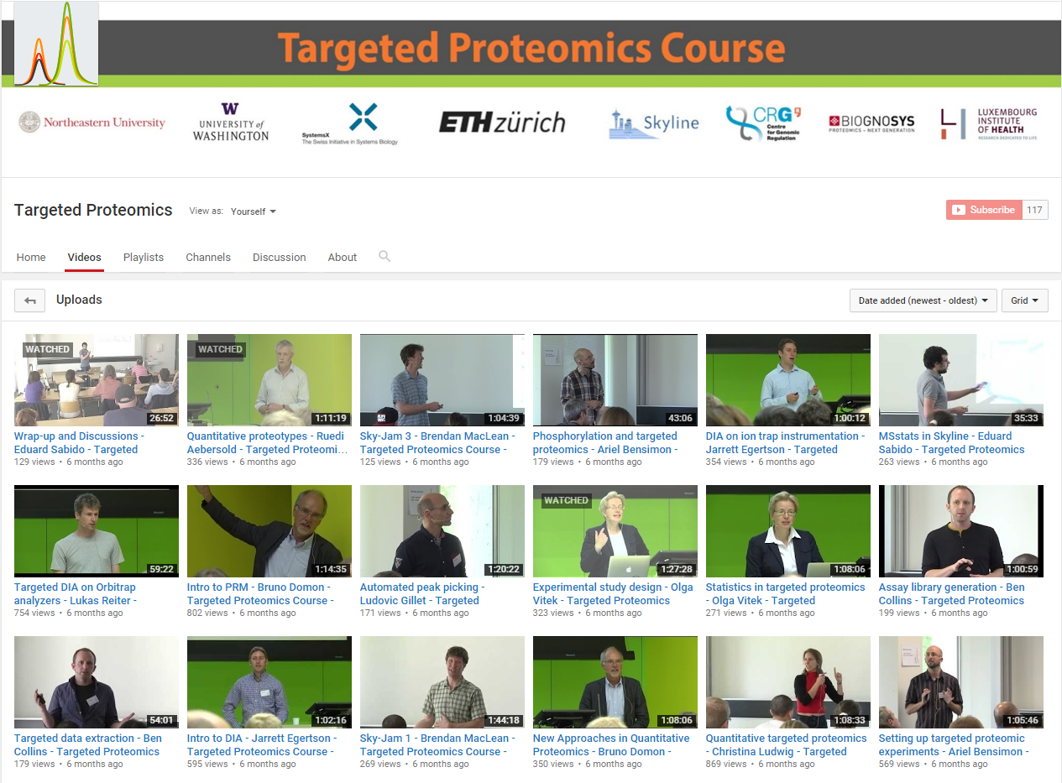
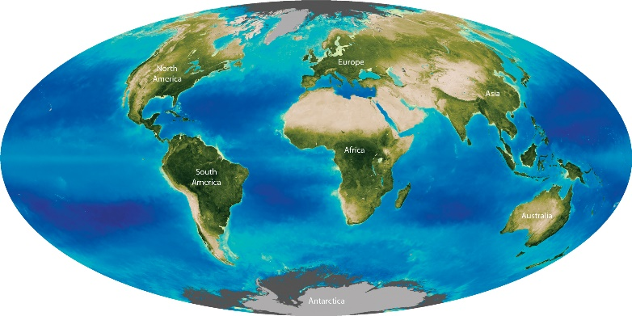
ETH Course Background
Data/Basis for today’s tutorial
Targeted Proteomics
(SRM, PRM, SWATH)
Targeted Proteomics
(SRM, PRM, SWATH)
DIA\SWATH
DIA\SWATH
SRM
SRM
?
2013
2014
2015
2016
2017
2018
Strong relationship with lots of courses worldwide
Youtube ‘Targeted Proteomics’ Channel
80,000+ views

Slide 11
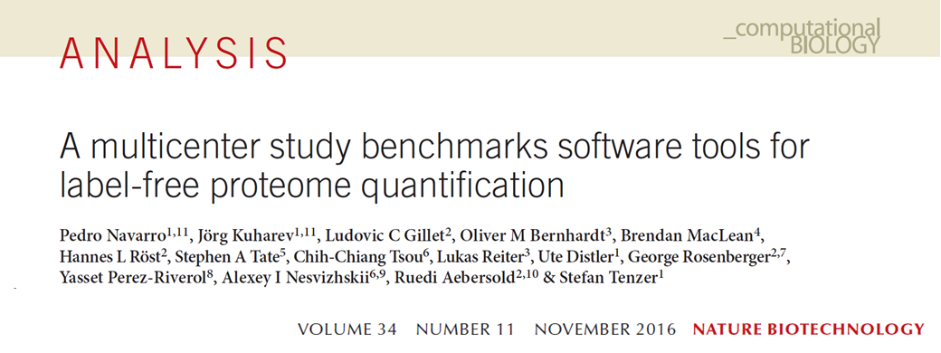
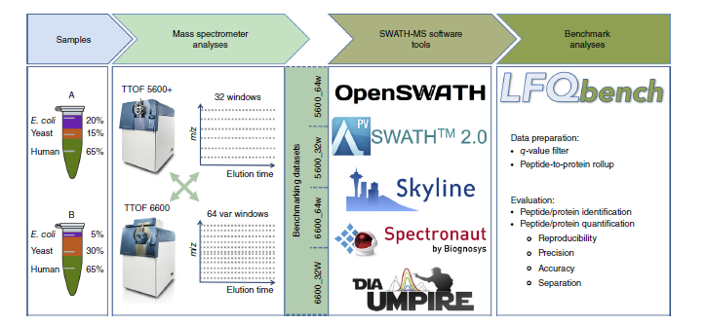
LFQBench study

Slide 12
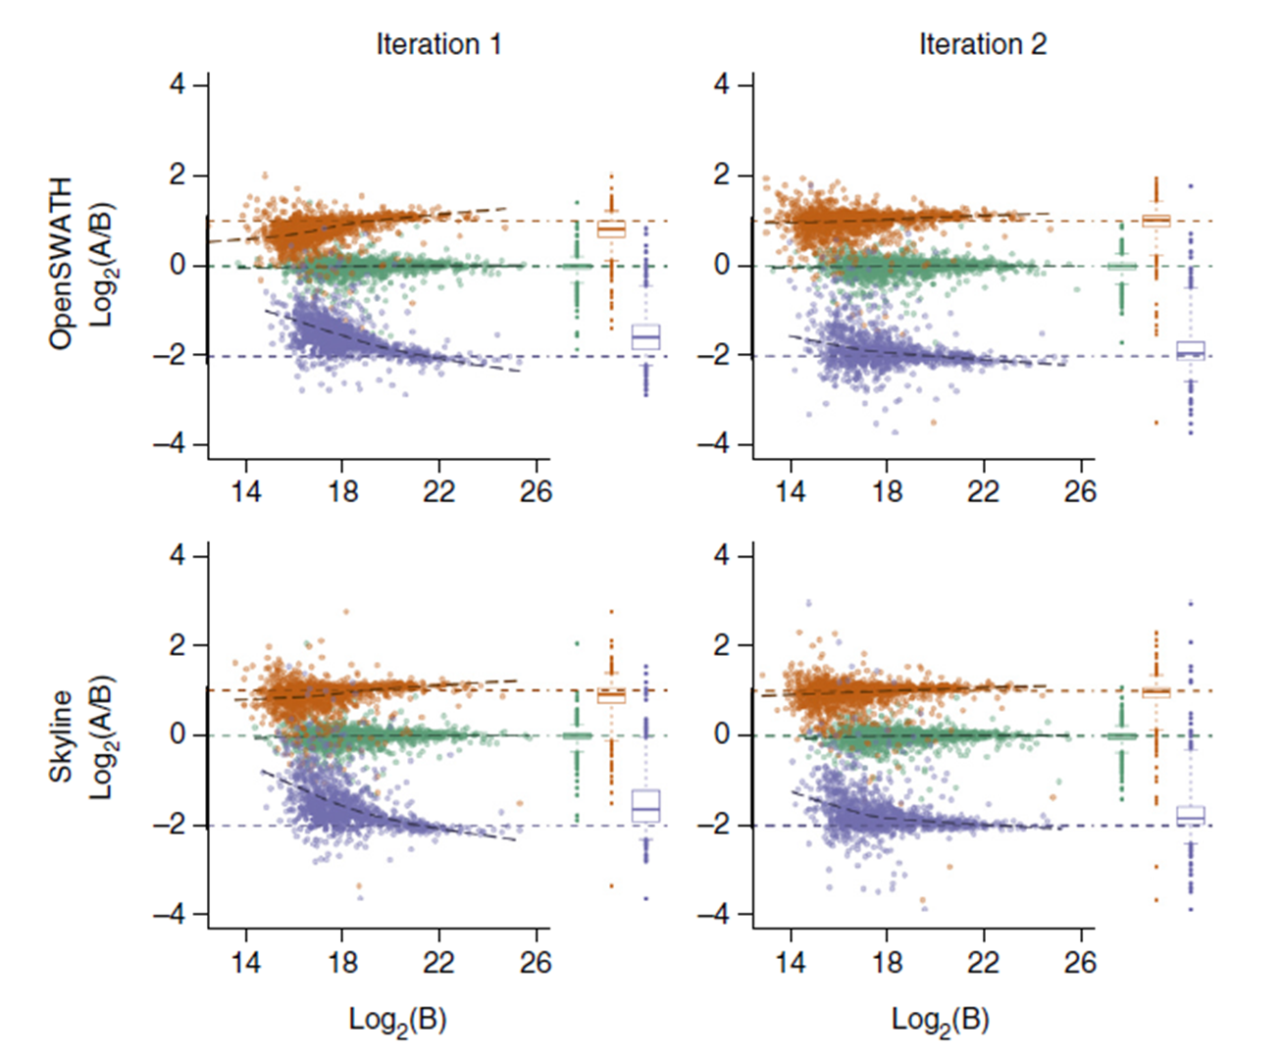
LFQBench study output
Some questions:
Are the quantitative ratios as expected?
Are there a lot of data points out of (species) position?

Slide 13
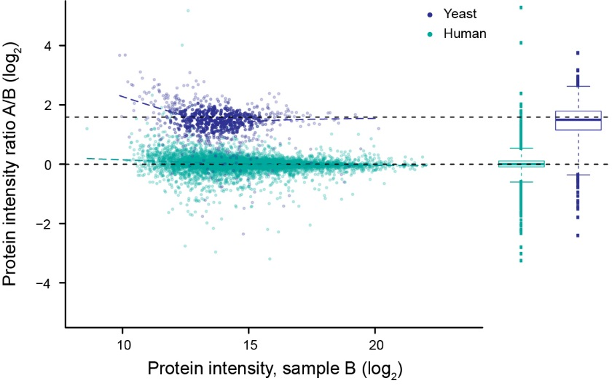
LFQBench style multispecies mixture proteome is now used
frequently for benchmarking of new methods
diaPASEF
Meier, F et al. BioRxiv (2020)

Slide 14
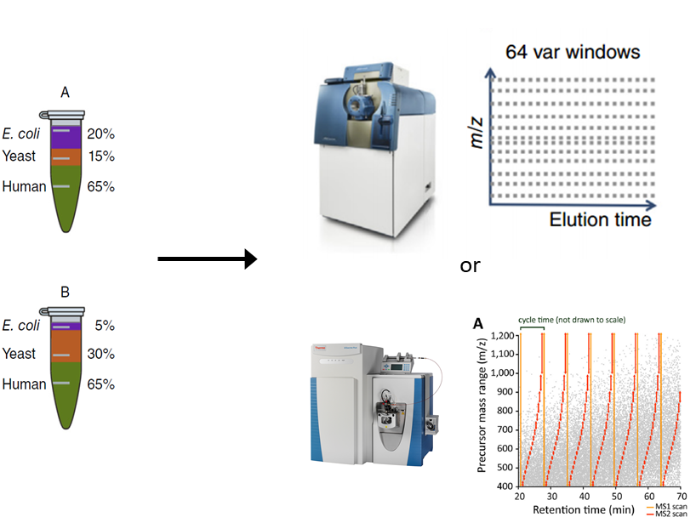
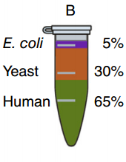
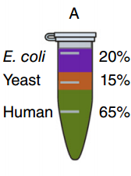
Data set for the webinar demo
6600 TripleTOF
A
B
Expected ratio
1:4
2:1
1:1
Q-Exactive Plus
3 x DIA technical replicates
1 hour gradient
+ 2 DDA files
(1 of each condition)
(A/B labelling is opposite from Navarro)

Slide 16
Backup

Slide 17
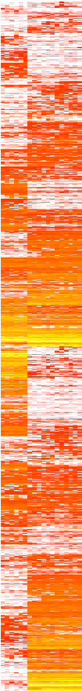
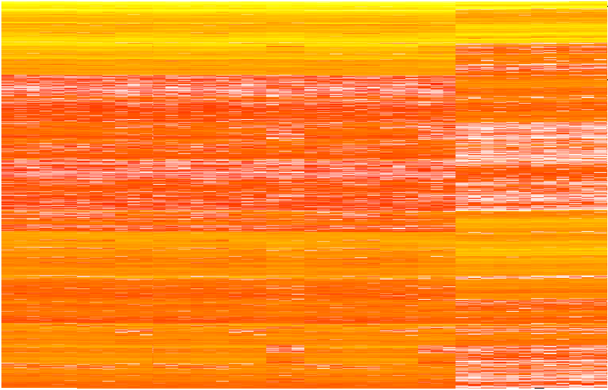
Motivation for DIA development
Targeted (acquisition) proteomics
DDA / Discovery proteomics
100s conditions
10s conditions
100 proteins
Data Independent Acquisition + "peptide-centric" Targeted Data Extraction
1’000s proteins
100s conditions
1’000s proteins
Notes:
I think its also good to mention what the motivation actually is for DIA methods
This is again somewhat historical and maybe a little bit contrived and doesn’t reflect the picture today
But the point to make here is that around 10-15 years ago we had DDA based proteomics as the standard method but may people were realizing that while it was very good for qualitative characterization, it was less good at quantification because of the missing data problem
The targeted proteomics came a long and it was great at reproducible quantification but the bandwidth was somewhat limited and you had to pre-specify targets
And really for many of us I think DIA or SWATH type methods were a way to make an effort to try and get the data quality associated with targeted methods but for more proteins and without having to pre-specify targets

Slide 18
What is data independent acquisition?
DIA term introduced by Venables J, et al. Nat Methods (2004)
Explicitly not data dependent (no stochastic precursor selection)
Features of DIA:
  Fixed duty cycle - deterministic (like SRM/PRM but unlike DDA)
  Untargeted/unbiased data acquisition (like DDA but unlike SRM/PRM)
  Comprehensive sampling of the precursor space with MS2 spectra
  (Usually) Wide precursor isolation windows
  (Usually) complex mixture MS2 spectra
Notes:
So, I think its helpful to say what we mean when we say DIA
I like to mention a few of the features that are common to DIA methods
The term was introduced by John Yates in this 2004 paper. I think at the the time it was intended to be a more specific descriptor for his method but subsequently its grown into an umbrella term to capture any method that fits the description
.....

Slide 19
Problem statement: DIA/SWATH produces highly complex mixture MS2 spectra
MS1
MS2
Precursor isolation
intensity
Fragmentation
intensity
m/z
m/z
Isolation window
e.g. 25 m/z
(or 6-90 m/z)
Not directly interpretable by standard
database searching approaches!
Notes:
Okay, so we’ve said a couple of slides back that the situation we’re in is that we have very complex spectra with fragment ions from lots of different precursors.
And the question is are these spectra interpretable by standard DDA search engines like Mascot or whatever
The answer is no. Or at least not directly without apply some kind of deconvolution
So, how should we proceed

Slide 20
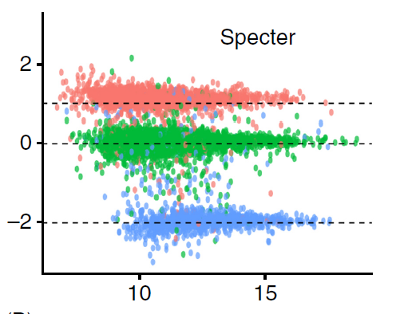
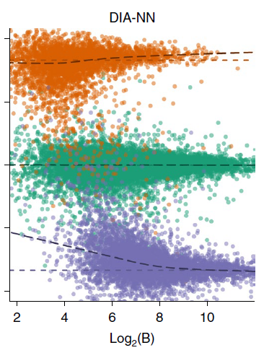
LFQBench style multispecies mixture proteome is now used
frequently for benchmarking of new methods
Specter
Peckner, R et al. Nature Methods (2018)
diaPASEF
Meier, F et al. BioRxiv (2020)
DIA-NN
Demichev, V et al. Nature Methods (2020)
Notes:
In the last few years this approach has become a popular way to do benchmarking of new methods and papers usually like to include something like this to convince people their method is working
Here I show a few examples
On the left is Specter, a software tool from Jake Jaffe’s lab that uses linear algebra to model mixture spectra
In the middle is DIA-NN which from Markus Ralser’s lab using neural nets to improve the DIA scoring
So, these are both software tools but of course you can also do this for new acquisition modes and on the right I show a figure from our preprint on diaPASEF where we used a similar approach

