Slide 1
Optimizing Large Scale DIA with Skyline
Tutorial Webinar #15
With
Brendan MacLean (Principal Developer, Skyline)

Slide 2
Agenda
Welcome from the Skyline team!
Optimizing Large Scale DIA with Skyline
  Introduction and overview with Brendan MacLean
  Tutorial with Brendan MacLean
Audience Q&A – submit questions to Google Form:
https://skyline.ms/QA4Skyline.url

Slide 3
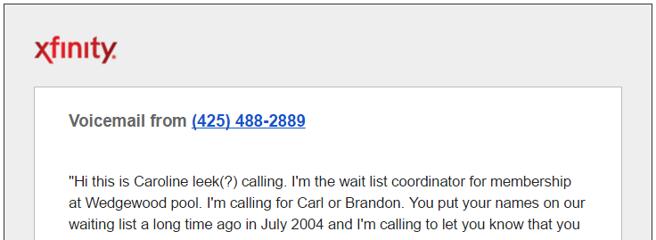
On Machine Learning
Voice recognition (Xfinity and Verizon/Apple)
  Brendan to Brandon
  Collette to
  Carl, Colin, Colleen
  Alair to Larry
Statistical analyses
  Name popularity?
  Messages left for men v. women?

Slide 4

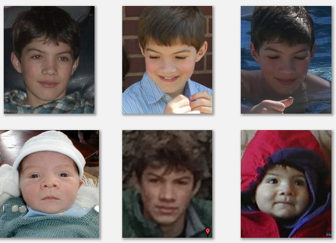
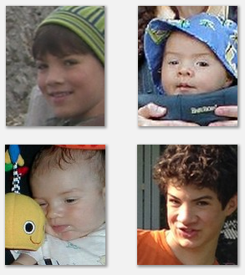
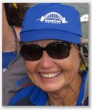
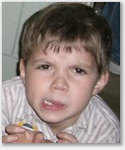
On Machine Learning
Face Recognition (Google)

Slide 5

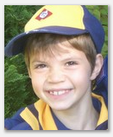
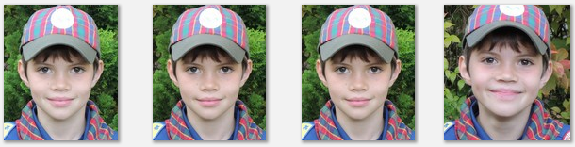
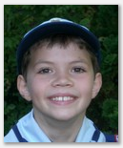
On Machine Learning
Face Recognition (Google)
p value = 0.3

Slide 6
Statistical Analysis of Noisy Data
Face identification raw data
2000
A | A | A | A | A | A | A | A | A | A | A | A | A | A | A | A | A | A | A | A | A
A | A | A | A | A | A | A | A | A | A | A | A | A | A | A | A | A | A | A | S | A | A | A | A | A
A | A | A | A | S | A | A | A | A | A
A | A | A | A | A | A | A | A | A | S | S | S | S | A | S | S | S | S | A | S | A | S | A | S | S | S | S | S | S | S | A | S | S | S | S | S | S | S | S | S
S | A | A | A | A | A | A | S | S | S | S | A | S | A | S | S | A | S | A | S | A | S | A | S | S
S | A | A | A | A | A | A | S | S | S | S | A | S | A | S | S | A | S | A | S | A | S | A | S | S | S | S | S | S | S | S | S | A | S | S | S | S | S | S | S
S | A | A | A | A | A | S | S | S | S | A | S | S | S | S | A | S | A | S | A | A | A | A | A | A | A | A | A | S | A | S | A | S | A | S | S | A | S | S | S
S | S | S | S | S | S | S | S | S | A | A | A | A | S | S | S | S | A | S | A | A | A | A | A | S | A | S | A | S | A | A | S | S | S | S | S | S | A | A | A
2001
2002
2003
2004
2005
2006

Slide 7
Statistical Analysis of Noisy Data
iPhones
Film Camera
Retired
Simon Born
Alex Born

Slide 8
Webinar 8: DDA to Targeted
ABRF iPRG 2014
 | Fake Accession | Name | Origin | Molecular Weight
A | P44015 | Ovalbumin | Chicken Egg White | 45KD
B | P55752 | Myoglobin | Equine Heart | 17KD
C | P44374 | Phosphorylase b | Rabbit Muscle | 97KD
D | P44983 | Beta-Galactosidase | Escherichia Coli | 116KD
E | P44683 | Bovine Serum Albumin | Bovine Serum | 66KD
F | P55249 | Carbonic Anhydrase | Bovine Erythrocytes | 29KD

Slide 9
Sample Preparation
ABRF iPRG 2014
A B C D E F (fmol)
65 | 55 | 15 | 2
55 | 15 | 2 | 65
15 | 2 | 65 | 55
11 | 10
0.6 | 500
10 | 11
Sample 1
+ 200 ng yeast digest
Sample 2
+ 200 ng yeast digest
Sample 3
+ 200 ng yeast digest

Slide 10
Peptide Differences (q value < 0.05)
29 Proteins (5 > 1 peptide)
63 Peptides (39 in proteins > 1 peptide)
24 Peptides in proteins with one significant peptide
MSstats protein comparison does better
(see Choi M, J. Proteome Res. 2017)

Slide 11
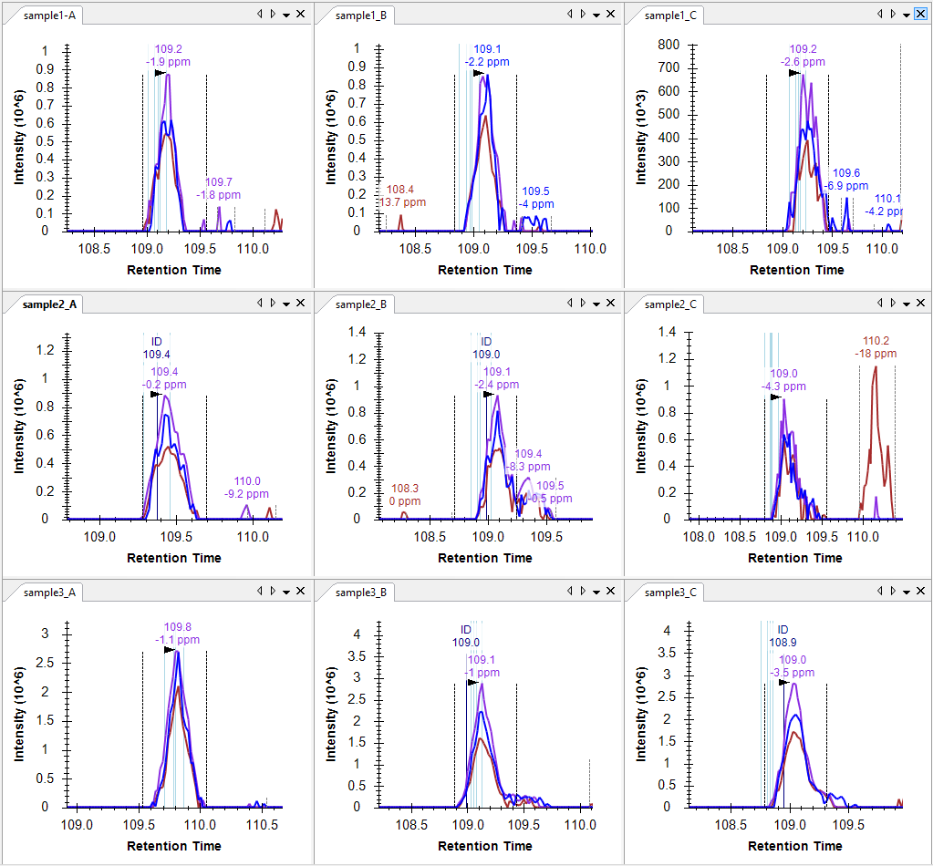
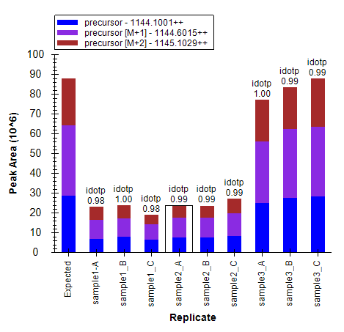
sp|P00330|ADH1_YEAST
K.SANLMAGHWVAISGAAGGLGSLAVQYAK.A [164, 191]

Slide 12
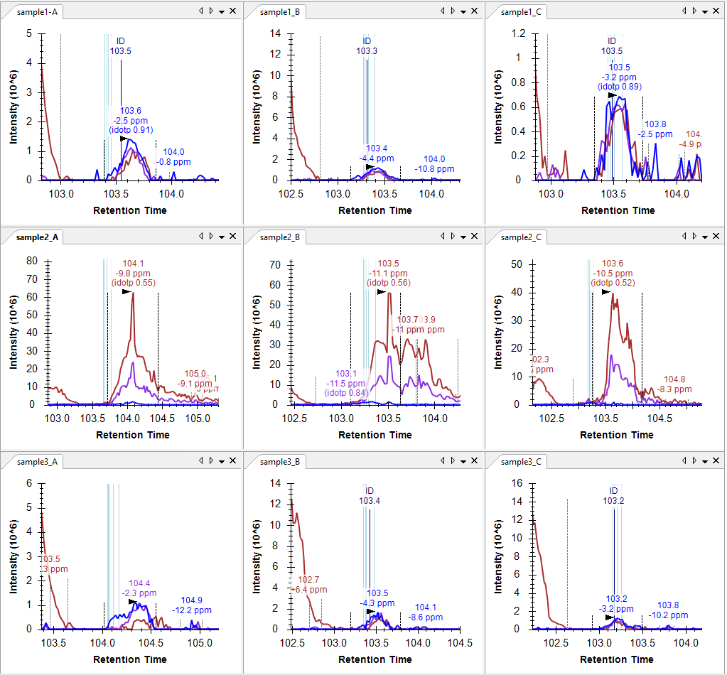
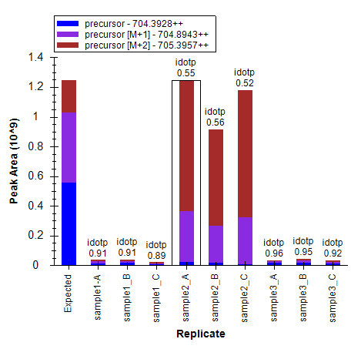
sp|O13525|COQ4_YEAST
R.LYNIYLPWAVR.T [260, 270]

Slide 13
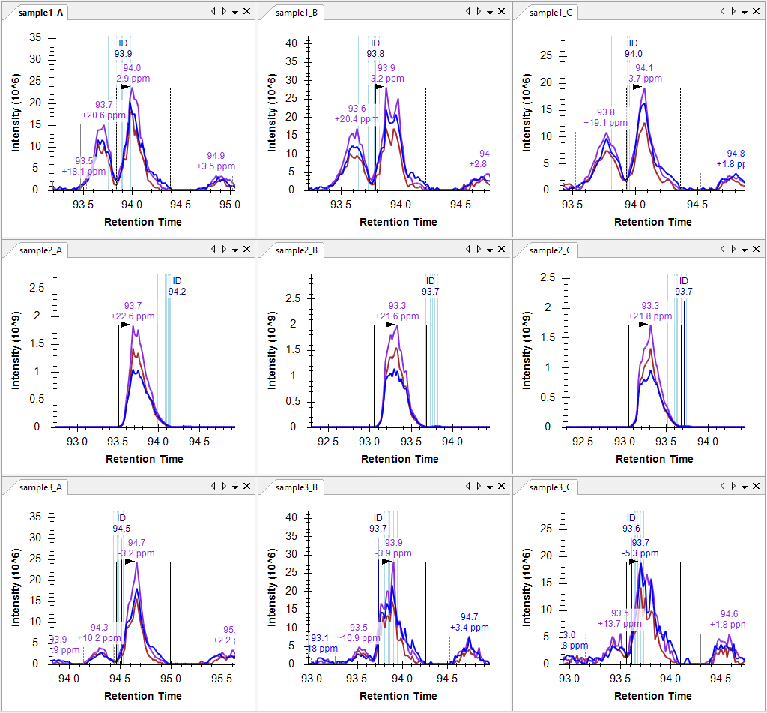
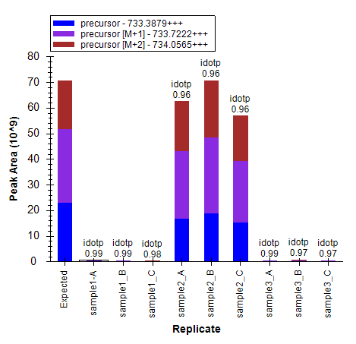
sp|P33734|HIS5_YEAST
K.IPVIASSGAGVPEHFEEAFLK.T [493, 513]

Slide 14
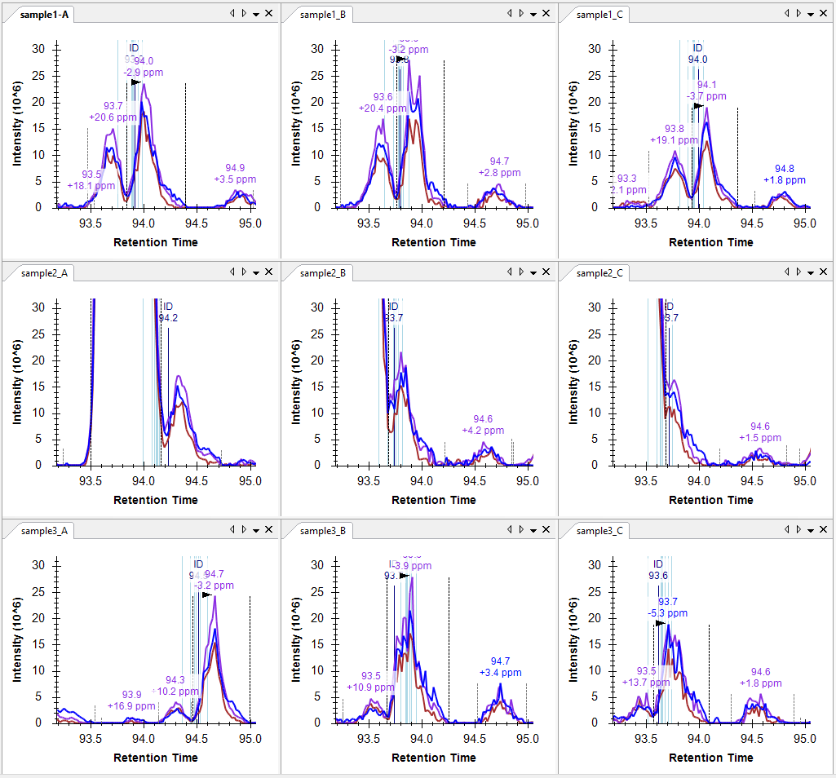
sp|P33734|HIS5_YEAST
K.IPVIASSGAGVPEHFEEAFLK.T [493, 513]

Slide 15
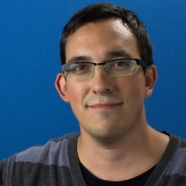
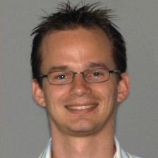
Skyline Compared (Statistically)
Webinar 14: Large Scale DIA with Skyline
http://skyline.ms/webinar14.url
Navarro, et al. & Tenzer
A multicenter study, Nature Biotech. 2016

Slide 16
Before (May 2015)
Spectronaut 42,439 peptides identified (56% more!)
OpenSWATH 40,387 peptides identified (49% more!)
DIA Umpire 31,256 peptides identified
PeakView 28,424 peptides identified
Skyline 27,121 peptides identified

Slide 17
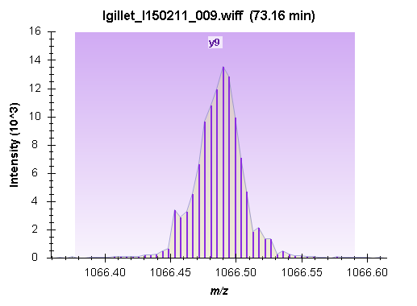
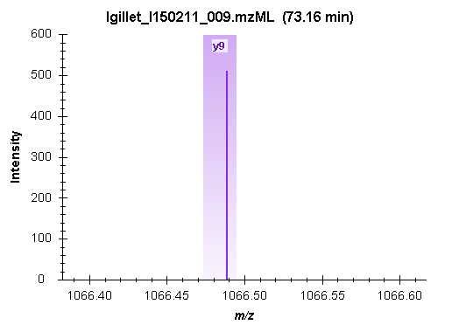
Extraction Width
10,000 rp (default) ±10 ppm (centroided)

Slide 18
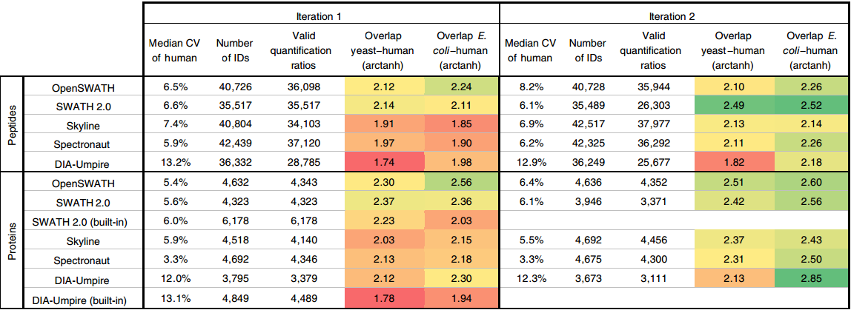
After (October 2016)
Skyline 42,517 peptides identified (16,500 human, 13,500 yeast, 12,000 E. coli)
Spectronaut 42,325 peptides identified
OpenSWATH 40,728 peptides identified
DIA Umpire 36,249 peptides identified
SWATH 2.0 35,489 peptides identified

Slide 19
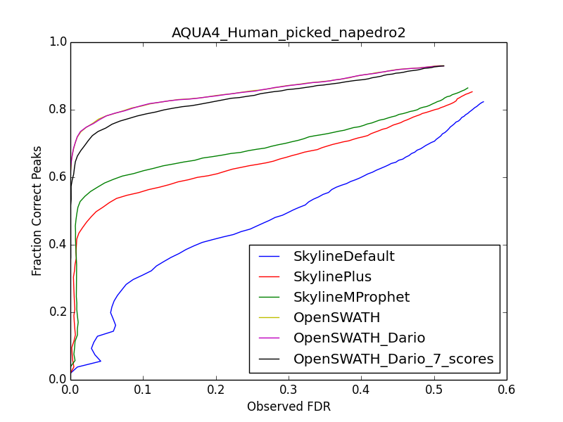
Long Before (January 2014)
Dario Amodei
(Mallick Lab, Stanford)

Slide 20
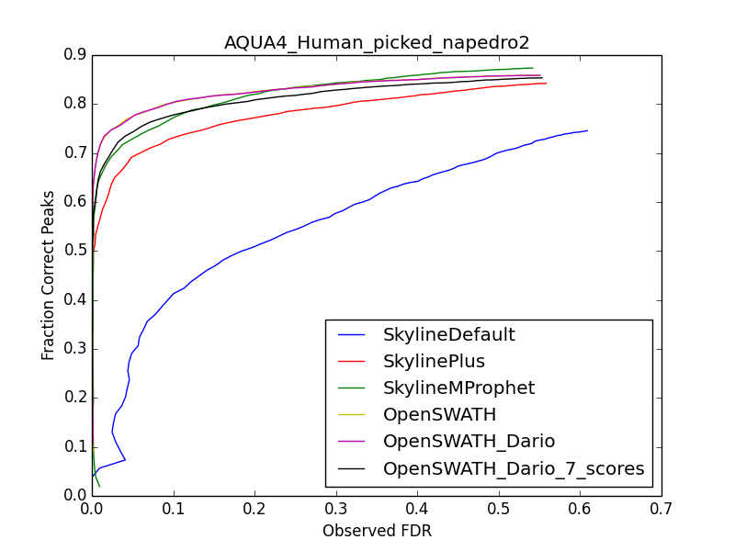
Shortly After (January 2014)
Incompatibility between
  New SCIEX wiff reader
  DIA isolation scheme

Slide 21
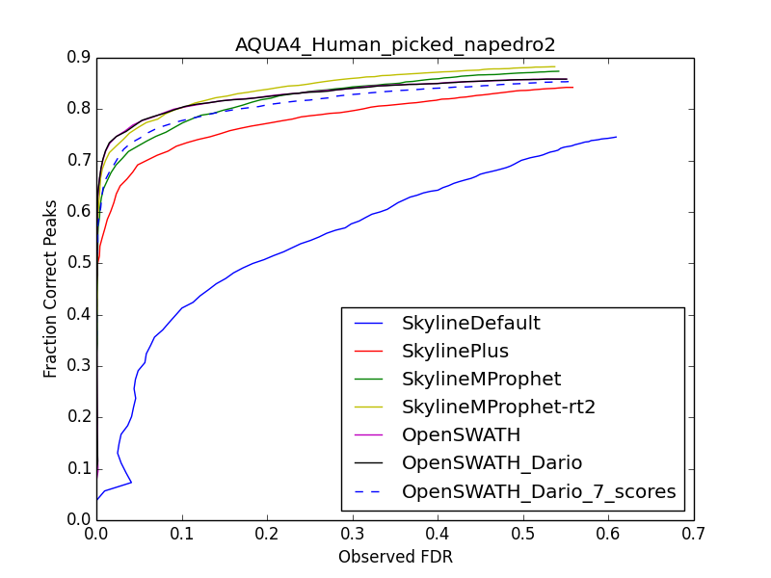
The Next Day
Adding (RT delta)²

Slide 22
More Recently (June 2016)
Bruker reports much higher detections with Spectronaut
  MaxQuant DDA library with 19,500 peptide precursors
Dataset 1
  Spectronaut 10,500 peptide precursors detected
Dataset 2
  Spectronaut 17,500 peptide precursors detected
  Skyline 14,000 peptide precursors detected
25% more!

Slide 23
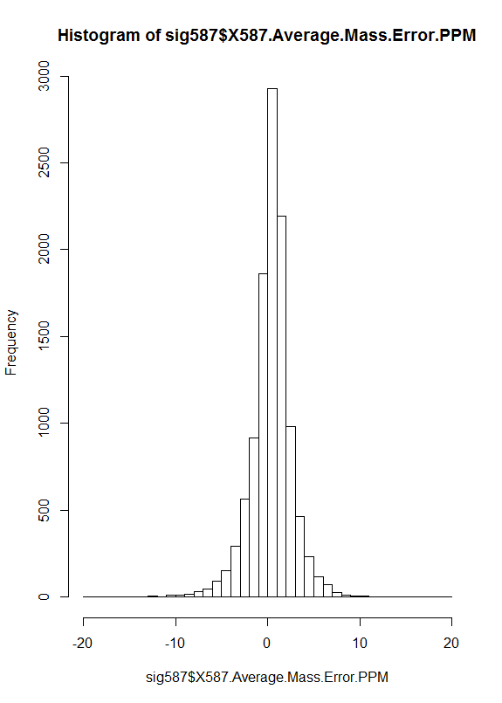
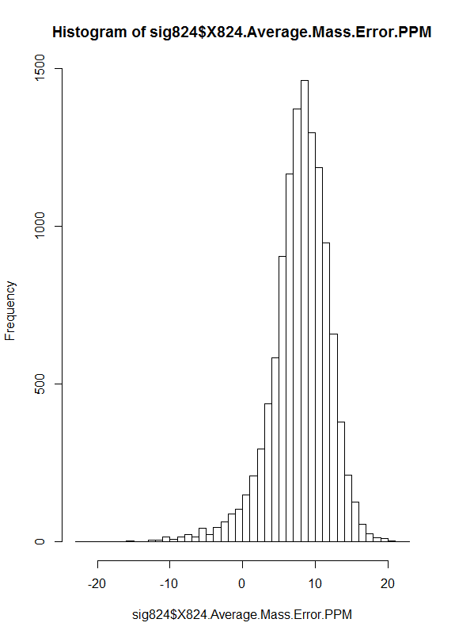
Mass Error Issue
Dataset 1
Dataset 2
First clue histograms
Frequency
Frequency
Mass Error (PPM)
Mass Error (PPM)
Mean = 0.47
Mean = 8.0
SD = 2.3
SD = 4.1

Slide 24
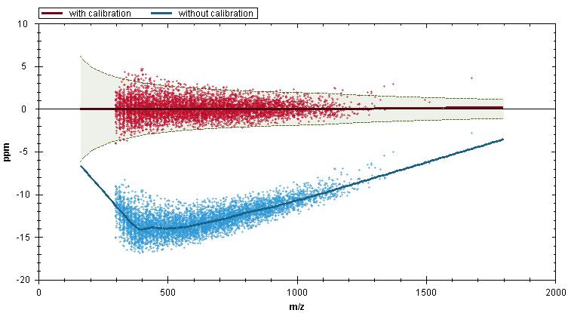
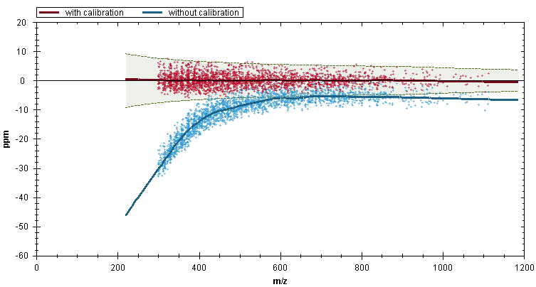
Spectronaut Mass Error Correction
Dataset 1
Dataset 2

Slide 25
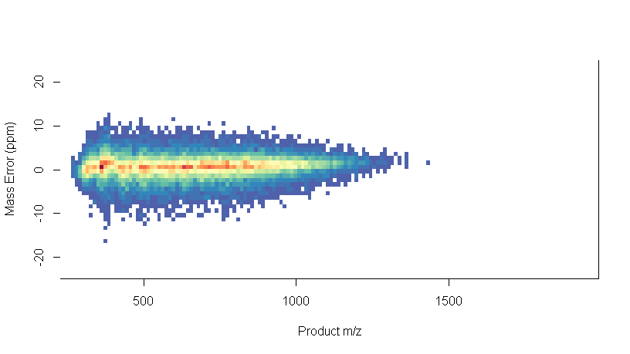
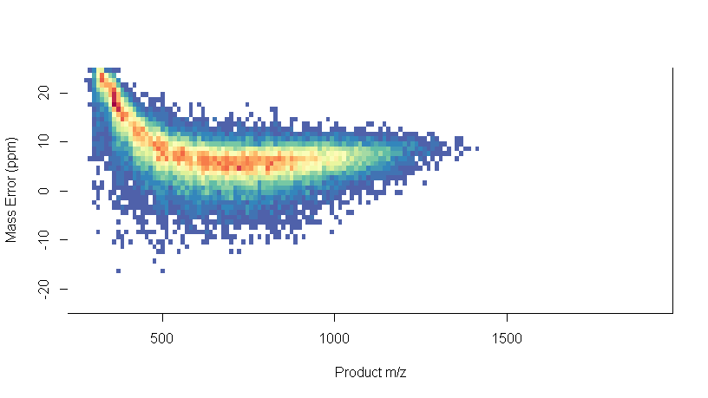
Mass Errors from Skyline Reports (R plots)
Dataset 1
Dataset 2

Slide 26
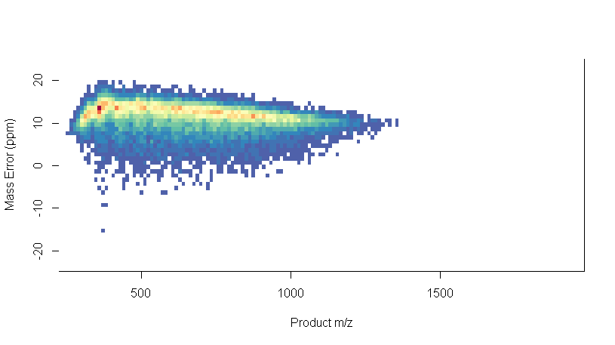
Mass Errors from Skyline Reports (R plots)
Dataset 1
Dataset 2
Read-Time Calibration Off

Slide 27
After Bruker Calibrated Dataset 2 (July 2016)
Dataset 1
  Skyline 13,800 peptide precursors detected
  Spectronaut 10,500 peptide precursors detected
Dataset 2
  Skyline 16,700 peptide precursors detected
  Spectronaut 17,500 peptide precursors detected (correction? 16,400)

Slide 28
Bruker Dataset 1 and 2 Review in Skyline
New mass error plots (thanks to Alex)

Slide 29
Dataset 3: MacCoss Lab Specified
Optimized window placement (no SWATH 0.5 m/z overlap)
2-cycle overlapping isolation scheme for demultiplexing
400-1000 m/z (oops 400-964 m/z) by 24 m/z windows
Library from 12 DDA runs (6 Top20, 6 fIE)
  32,860 peptide precursors
  28,153 peptides
Measurable in 400-964 m/z
  27,135 peptide precursors
  25,023 peptides

Slide 30
Overlapping Isolation Scheme
400 M/Z
1000 M/Z
Precursor Scan
Fragment Scan
Fragment Scan
Fragment Scan
Fragment Scan
Precursor Scan
Fragment Scan
Fragment Scan
Fragment Scan
Fragment Scan
Fragment Scan
Precursor Scan
Fragment Scan
Fragment Scan
Fragment Scan
Fragment Scan
Precursor Scan

Slide 31
24 m/z
Time = T₀
24 m/z
24 m/z
24 m/z
24 m/z
24 m/z
24 m/z
Intensity
Time = T₀
Fragment M/Z
(600-624 M/Z Precursor )

Slide 32
Time = T₋₁
24 m/z
Time = T₀
24 m/z
24 m/z
24 m/z
24 m/z
24 m/z
24 m/z
Time = T₊₁
Intensity
Intensity
Time = T₋₁
Fragment M/Z
(588-612 M/Z Precursor )
Fragment M/Z
(612-636 M/Z Precursor )
Intensity
Time = T₀
Fragment M/Z
(600-624 M/Z Precursor )
Intensity
Intensity
Time = T₊₁
Fragment M/Z
(588-612 M/Z Precursor )
Fragment M/Z
(612-636 M/Z Precursor )

Slide 33
Time = T₋₁
24 m/z
Time = T₀
24 m/z
24 m/z
24 m/z
24 m/z
24 m/z
24 m/z
Time = T₊₁
Intensity
Intensity
Time = T₋₁
Fragment M/Z
(588-612 M/Z Precursor )
Fragment M/Z
(612-636 M/Z Precursor )
Intensity
Time = T₀
Fragment M/Z
(600-624 M/Z Precursor )
Intensity
Intensity
Time = T₊₁
Fragment M/Z
(588-612 M/Z Precursor )
Fragment M/Z
(612-636 M/Z Precursor )

Slide 34
Time = T₋₁
24 m/z
Time = T₀
24 m/z
24 m/z
24 m/z
24 m/z
24 m/z
24 m/z
Time = T₊₁
Intensity
Intensity
Time = T₋₁
Fragment M/Z
(588-612 M/Z Precursor )
Fragment M/Z
(612-636 M/Z Precursor )
Intensity
Time = T₀
Fragment M/Z
(600-624 M/Z Precursor )
Intensity
Intensity
Time = T₊₁
Fragment M/Z
(588-612 M/Z Precursor )
Fragment M/Z
(612-636 M/Z Precursor )

Slide 35
Time = T₋₁
24 m/z
Time = T₀
24 m/z
24 m/z
24 m/z
24 m/z
24 m/z
24 m/z
Time = T₊₁
Intensity
Intensity
Time = T₋₁
Fragment M/Z
(588-612 M/Z Precursor )
Fragment M/Z
(612-636 M/Z Precursor )
Intensity
Time = T₀
Fragment M/Z
(600-624 M/Z Precursor )
Intensity
Intensity
Time = T₊₁
Fragment M/Z
(588-612 M/Z Precursor )
Fragment M/Z
(612-636 M/Z Precursor )

Slide 36
Time = T₋₁
24 m/z
Time = T₀
24 m/z
24 m/z
24 m/z
24 m/z
24 m/z
24 m/z
Time = T₊₁
Intensity
Intensity
Time = T₋₁
Fragment M/Z
(588-612 M/Z Precursor )
Fragment M/Z
(612-636 M/Z Precursor )
Intensity
Intensity
Intensity
Time = T₀
Fragment M/Z
(600-612 M/Z Precursor )
Fragment M/Z
(600-624 M/Z Precursor )
Fragment M/Z
(612-624 M/Z Precursor )
Intensity
Intensity
Time = T₊₁
Fragment M/Z
(588-612 M/Z Precursor )
Fragment M/Z
(612-636 M/Z Precursor )

Slide 37
Processing Bruker Data Set 3 in Skyline

Slide 38
Learn More
Webinar #16: Pan Human DIA with Skyline
  1 billion peaks
Weeklong Courses 2017
  Northeastern University, Boston – May 1-3 – Full
  ETH, Zurich, June 26 – 30 – Full
  University of Washington, Seattle – July 24-28 – Register now!
Workshops and Conferences 2017
  Short Course #21: Case Studies in Quantitative Proteomics at ASMS, Indianapolis – June 3-4 – Register now!
  Skyline User Group Meeting at ASMS, Indianapolis –
  June 4 – Register now!
  Listings updated in Join Us section of Skyline homepage:
  https://skyline.ms/Skyline.url

Slide 39
Questions?
Ask any questions at the following form:
  https://skyline.ms/QA4Skyline.url
Take the post-webinar survey:
https://skyline.ms/survey4webinar.url

Slide 40
Tutorial Webinar #15
This ends this Skyline Tutorial Webinar.
Please give us feedback on the webinar at the following survey:
https://skyline.ms/survey4webinar.url
A recording of today’s meeting will be available shortly at the Skyline website.
We look forward to seeing you at a future Skyline Tutorial Webinar.

