Slide 1
Large Scale DIA
With Skyline
Tutorial Webinar #14
With
Brendan MacLean (Principal Developer, Skyline)

Slide 2
Agenda
Welcome from the Skyline team!
Large Scale DIA with Skyline
  Introduction and overview with Brendan MacLean
  Tutorial with Brendan MacLean
Audience Q&A – submit questions to Google Form:
https://skyline.ms/QA4Skyline.url

Slide 3
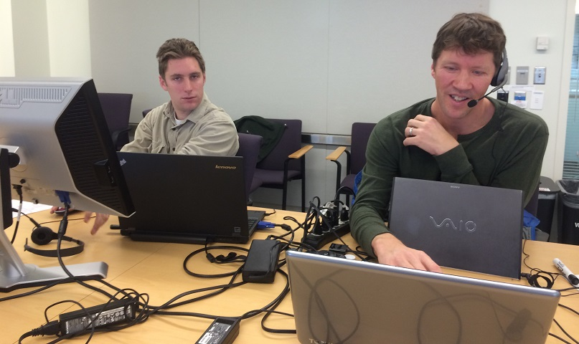
Webinar 2: Jump start DIA… November, 2014

Slide 4
Chromatography-based Quantification
Hypothesis testing (Verification)
SRM
MS1 chromatogram extraction
Targeted MS/MS (PRM)
Data independent acquisition (DIA/SWATH)
Acquisition | Targeted | Survey
More Selective | PRM | DIA
Less Selective | SRM | MS1
Exploratory vs. Confirmatory
Got HYPOTHESIS??

Slide 5
Prior Knowledge and Consistency
Relative product ion abundance
  Spectral libraries
Retention time
  iRT libraries
Powerful enough to be used cross-lab / cross experiment
  Measure, store, re-use
More powerful run-to-run
Notes:
Confidence in what is being measured

Slide 6
Relative Product Ion Abundance

Slide 7
Webinar 7: iRT time prediction… May 2015
Escher, Reiter, et al. Proteomics, 2012

Slide 8
Defining an iRT Scale
Points on a line (score = time * slope + intercept)

Slide 9
Building an iRT Library
*
*
*
*
*
*
*
*
*
*
*

Slide 10
Prior Knowledge Workflow
DIA Acquisition
Spectral Library
Relative Ion Abundance
iRT Library
Normalized RT
Product Ion
Targeting
Chromatogram Extraction
mProphet
Peak Picking
Quantitative
Analysis
Reiter, Rinner, et al.
Nature Methods, 2011

Slide 11



Prior Knowledge Workflow
DIA Acquisition
Assay Library
Relative Ion Abundance
Normalized RT
Product Ion
Targeting
Spectronaut
Chromatogram Extraction
PeakView
mProphet
Peak Picking
Quantitative
Analysis

Slide 12

Prior Knowledge Workflow
DIA Acquisition
Chromatogram Library
Relative Ion Abundance
Normalized RT
Product Ion
Targeting
Chromatogram Extraction
mProphet
Peak Picking
Quantitative
Analysis

Slide 13
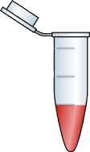
Two Phase Experiment
N * Quantitative Samples
1 * Detection Samples
pool
DDA
DDA
DDA
DIA
DDA
DDA
DDA
N *
Quantify Peptides
Detect Peptides
with Search Engine
Build Library
Bruderer, et al. & Reiter, MCP, 2015

Slide 14
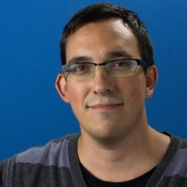
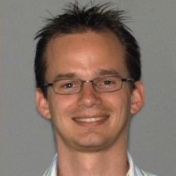
DIA/SWATH Software Comparison
Driving lots of performance improvement
  MaxQuant tutorial MS1 data imports 3x faster
  Comparison pipeline tasks 20x to 200x faster
    Single file import 5 hours on SSD with 3.1
    6 files import in 50 minutes on spinning drive with 3.5
    Adjusting peaks took 2 hours with 3.1
    Adjusting peaks takes 10 seconds with 3.5
Looked bad for Skyline DIA quant
  Turned out to be serious issues with settings
Navarro, et al. & Tenzer
A multicenter study, Nature Biotech. 2016

Slide 15
SkylineRunner Command-Line Interface
Great for long batch runs
Ready to be adapted to a compute cluster

Slide 16
Before
Spectronaut 42,439 peptides identified
OpenSWATH 40,387 peptides identified
DIA Umpire 31,256 peptides identified
PeakView 28,424 peptides identified
Skyline 27,121 peptides identified

Slide 17
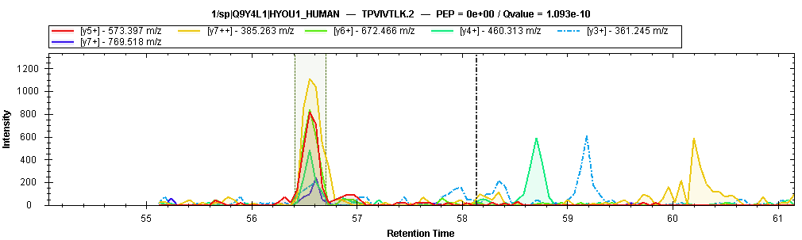
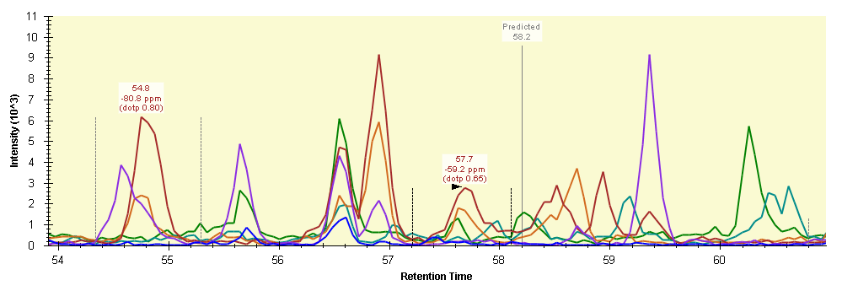
Finding the Problem
TPVIVTLK
Spectronaut
Wrong!!
Skyline

Slide 18
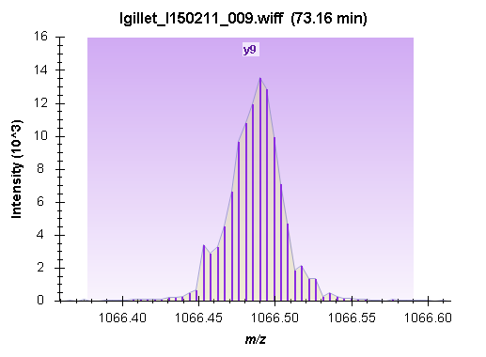
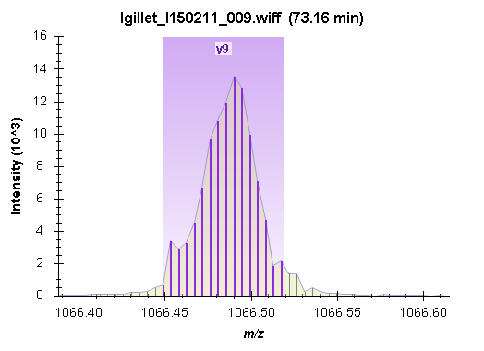
Extraction Width
10,000 rp (default) 30,000 rp

Slide 19
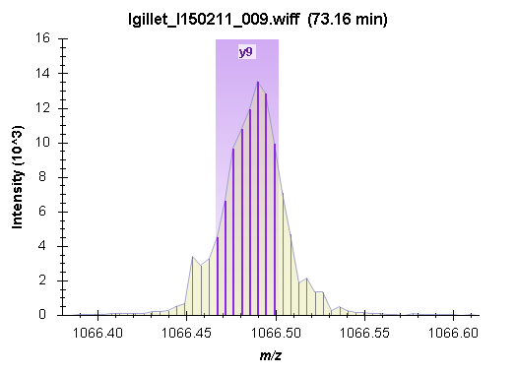
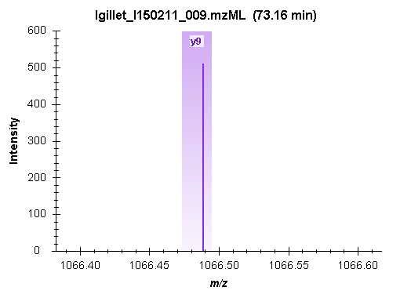
Extraction Width
60,000 rp ±10 ppm (centroided)

Slide 20
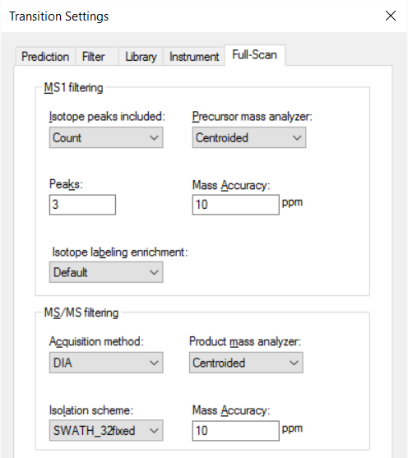
Extraction from Centroided Spectra

Slide 21
Extending SkylineRunner
--reintegrate-model-name=<name> | The name of a scoring model to use for the reintegrate operation. The model can either be pre-defined (e.g. using the Edit > Refine > Reintegrate form) or created automatically during this operation by using --reintegrate-create-model.
--reintegrate-create-model | This option will cause a new model to be created, using the mProphet algorithm with all available scores for the results found in the document. (requires --reintegrate-model-name)
--reintegrate-annotate-scoring | Peaks will be annotated with q value and score annotations. (requires --reintegrate-model-name)
--reintegrate-overwrite-peaks | Existing manually integrated peaks will be overwritten with peaks chosen by the reintegration model. (requires --reintegrate-model-name)

Slide 22
Extending SkylineRunner
--full-scan-precursor-res=<resolving power> | Resolving power of the precursor mass analyzer.
--full-scan-precursor-res-mz=<m/z value> | The m/z value at which the precursor mass analyzer resolving power is specified. (applies only to orbitrap and ft_icr mass analyzers)
--full-scan-product_res=<resolving power> | Resolving power of the product mass analyzer.
--full-scan-precursor-res-mz=<m/z value> | The m/z value at which the product mass analyzer resolving power is specified. (applies only to orbitrap and ft_icr mass analyzers)
--full-scan-rt-filter-tolerance=<minutes> | The number of minutes on either side of the predicted time or MS/MS IDs, i.e. ± minutes. Defaults to.

Slide 23
Optimal Settings Analysis (RP)

Slide 24
Optimal Settings Analysis (RT)

Slide 25
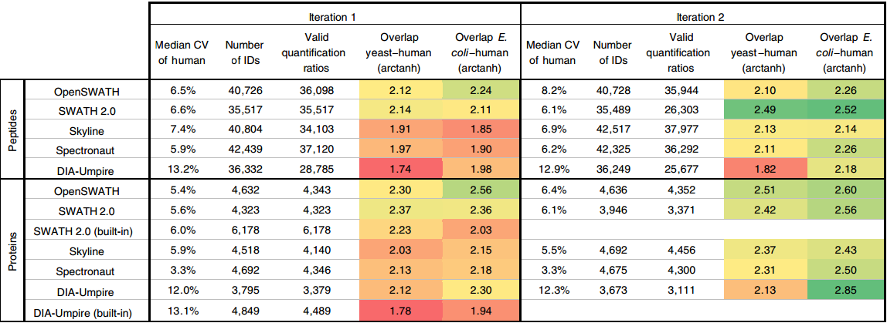
After
Skyline 42,517 peptides identified
Spectronaut 42,325 peptides identified
OpenSWATH 40,728 peptides identified
DIA Umpire 36,249 peptides identified
SWATH 2.0 35,489 peptides identified

Slide 26
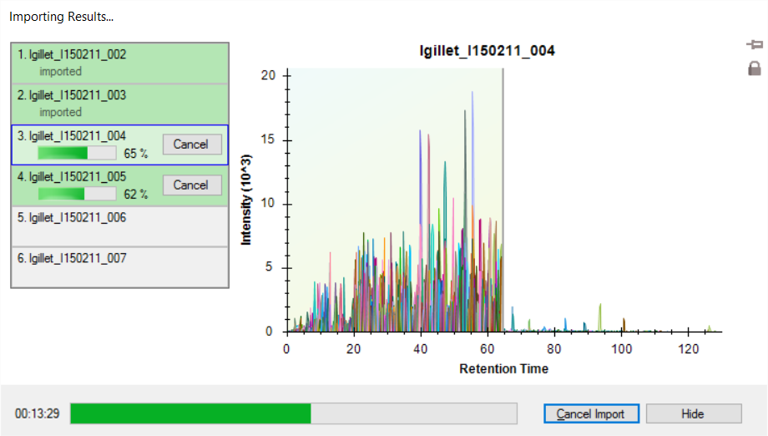
Multi-File Parallel Loading

Slide 27
Multi-File Loading Performance

Slide 28
Analyzing Data From Navarro Paper
Acquired by L. Gillet

Slide 29
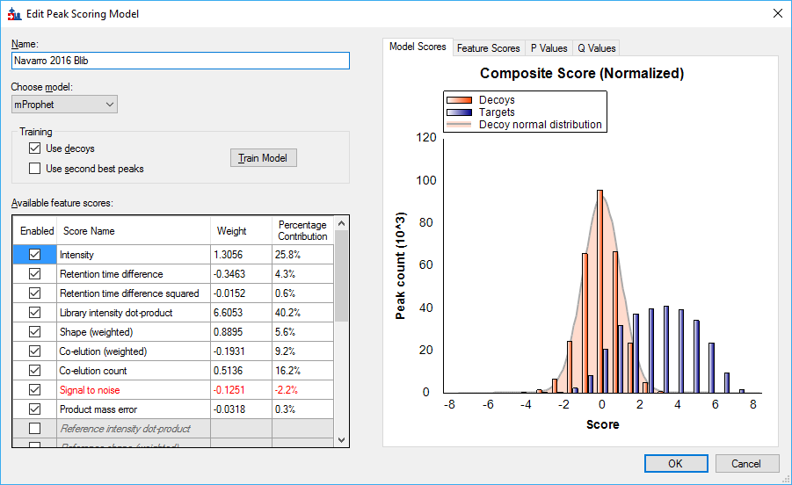
Blib Document mProphet Model

Slide 30
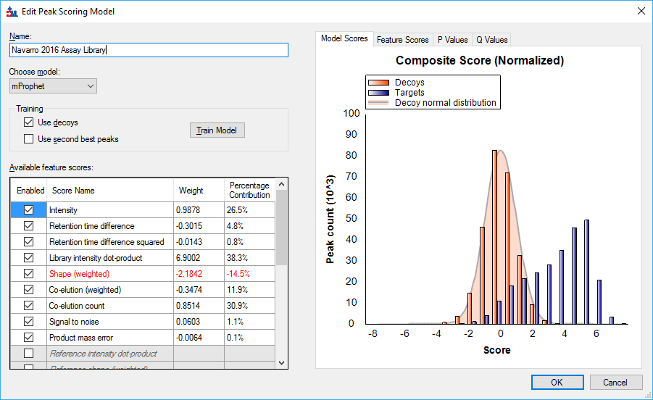
Assay Library Document mProphet Model

Slide 31
Learn More
Webinar #15: TBD (14 recorded webinars)
Weeklong Courses 2017
  Buck Institute, Feb 27 – Mar 3 - Full
  Northeastern University, Boston – May 1-3 – Register now!
  ETH, Zurich, June 26 – 30 – Register now!
  University of Washington, Seattle – July 24-28
Workshops and Conferences 2017
  Skyline User Group Meeting at ASMS, Indianapolis – June 4
  Listings updated in Join Us section of Skyline homepage:
  https://skyline.ms/Skyline.url

Slide 32
Questions?
Ask any questions at the following form:
  https://skyline.ms/QA4Skyline.url
Take the post-webinar survey:
https://skyline.ms/survey4webinar.url

Slide 33
Tutorial Webinar #14
This ends this Skyline Tutorial Webinar.
Please give us feedback on the webinar at the following survey:
https://skyline.ms/survey4webinar.url
A recording of today’s meeting will be available shortly at the Skyline website.
We look forward to seeing you at a future Skyline Tutorial Webinar.

