Slide 1
“Research-grade” Targeted Proteomics Assay Development:
PRMs for PTM Studies with Skyline or,
“How I learned to ditch the triple quad and love the QE”
Jacob D. Jaffe
Skyline Webinar July 2015

Slide 2
Outline
Definitions
When do PRM assays make sense?
Considerations for PRM method development
Live Demo

Slide 3
Definition of PRM
PRM = MRM-HR = HR-MRM = Targeted Full Scan MS/MS
Closest spiritual cousin is triple-quad based MRM/SRM, but:
SRM
PRM
Q3 mass analyzer
mass analyzer
P-H₃PO₄
y₅-H₂O
b₁
y₄
b₆
y₅
y₁
y₈
m/z₁
m/z₂
m/z₃
m/z range
Discrete transitions, hardware selected
Full scan

Slide 4
Definition, continued
Assay is completely deterministic
Precursor m/z (list) is specified
  Possibly scheduled
  Quadrupole or ion trap selection/isolation
Fragmentation is performed
  Any kind is OK
Full MS/MS spectrum is recorded
  Any analyzer: Orbitrap, TOF, scanning quad, ion trap, etc.
Usually a full scan MS spectrum is also periodically recorded
  Two chances to verify and quantify!

Slide 5
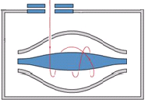
Common configuration: high resolution mass analyzer
Orbitrap or TOF
Precursor cycle vs. Acquisition loop cycle
  Precursor cycle: time it takes to loop through precursor list
    May vary during method
    Governs points across peak
  Acquisition loop cycle: Time from full scan to full scan with intervening # of MS/MS
    May affect instrument performance, full scan points across peak
MS1
MS2₁
MS2₂
MS2…
MS2_{n}

Slide 6
When do PRMs make sense?
Exquisite selectivity required
  Unit (quadrupole) vs. ppm (hi-res)
Post-translational modification localization is required
  GVDQ(pS)PLTPAGGK vs. GVDQSPL(pT)PAGGK
Rapidly convert discovery data to targeted assay
  Stay within platform
You don’t have a triple quad!
  But still want the benefits of targeted proteomics

Slide 7



High resolution adds value to selectivity
K_{me3}SAPATGGVK_{pr}K_{pr}PHR₁₀
m/z 551.9940 z=3
K_{ac}SAPATGGVK_{pr}K_{pr}PHR₁₀
m/z 551.9819 z=3
ABI 5500 triple quad
ABI 5500 triple quad
20x
20x
QE
QE
20x
20x

Slide 8
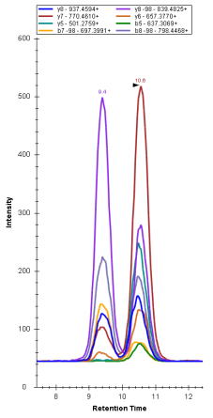
PTM Localization – shared ions, differential ions
Differentially Phosphorylated Peptides
With Same Base Sequence

Slide 9
Discovery Proteomics to PRM – Short version / Label Free
Shotgun MS/MS*
Database Search
Target Selection
Spectral Library
Skyline Doc
Method/Precursor List Export
Acquire Data
Skyline Quant
* iRT peptides recommended

Slide 10
Discovery Proteomics to PRM – Long version
External Data
Shotgun w/ iRT
Database Search
Target Selection
Make Labeled Peptides
QC / Spectral Library
Skyline Doc
iRT Model
Transition, Scheduling and Gradient Optimization in Background
Acquire Data
Skyline Quant

Slide 11
Planning ahead for success
Strongly consider including iRT peptides in every single sample you run in your lab
  Diverse retention times, well spaced
  High enough levels to trigger MS/MS
    Or, include targeted scans
    Or, determine RTs with precursor quant in Skyline
  This can also be very beneficial for scheduling tight windows
Use a search engine supported by Skyline spectral library import
Set up your funky PTMs in advance in your document
Learn about Skyline’s secret PTM notation for import

Slide 12
Document refinement
Keep a lot of transitions around initially
  You can always get rid of them later
  You can take them from the spectral libraries
  In theory: the more transitions, the more signal-to-noise
    Also in theory more sensitive than MRM, but generally not in practice
Take advantage of the raw data spectrum viewer functionalities
  Helpful for both MS and MS/MS inspection
Use that high res!
  Narrow your import m/z tolerances
  Inspect the ppm errors

Slide 13
The all important dotp
dotp = dot product
  Metric of observed transition relative intensities in comparison with spectral library example
Better than a search engine score!
  Expect > 0.9 under most circumstances
Extremely useful in differentiating among similar analytes
Spectral library quality important
  Garbage in, garbage out

Slide 14
Standardization Considerations
Label free
  Requires high degree of system reproducibility
  Hard to compare samples longitudinally
Synthetic peptides
  Highest degree of rigor
  Highest cost in time, $
  More optimization required
SILAC
  Increases complexity, chance for interference
  Standard is “prenormalized”
  Consider growing up a vat of standard for longitudinal performance
Chemical labels? (+ standards?)

Slide 15
Data analysis considerations
Be patient, use all metrics at your disposal
Consider time window import limits
  But relies on RT or other indicators in spectral library / RT models
Consider further minimizing your document when happy with data
  Hi-res data, skyd files get big

Slide 16
“Research Grade” PRM Concept
A quantitative, targeted proteomics assay suitable for “everyday” use
Ideally standardized with synthetic peptides (or SILAC)
Rapid design cycle using discovery data/platform
Enables longitudinal comparisons across days, months, years
Output useful for rapidly guiding biology
NOT:
  Obsessed with LOD/LOQ
  Suitable for clinical deployment

Slide 17
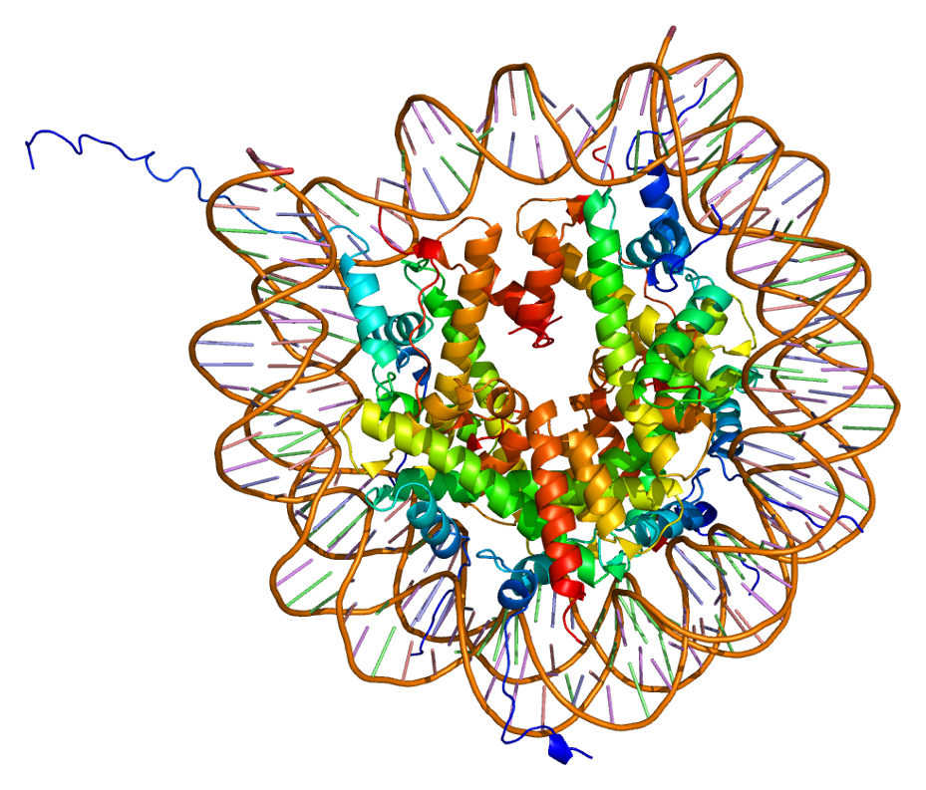
Histones and their post-translational modifications
S T G G K A P R K Q…
ph
ac
NH₂-A R T K Q T A R K
me
me
me
me
Associated with transcriptional regulatory states of genomic loci
Source: PDB 1AOI, Luger et al. Nature (1997)

Slide 18
Sample preparation process and standardization
Day 1
Day 2
Day 3
Agilent Bravo LH – fully automated
96-well SPE – semi-automated

